Slide 1

A Rounder Sense of Purpose
Framing essential competences in education for sustainable development
Dr Paul Vare
University of Gloucestershire
BAICE 20th Anniversary Symposium: Sustainability, Peace and Education – Exploring Promise and Practice

Slide 2
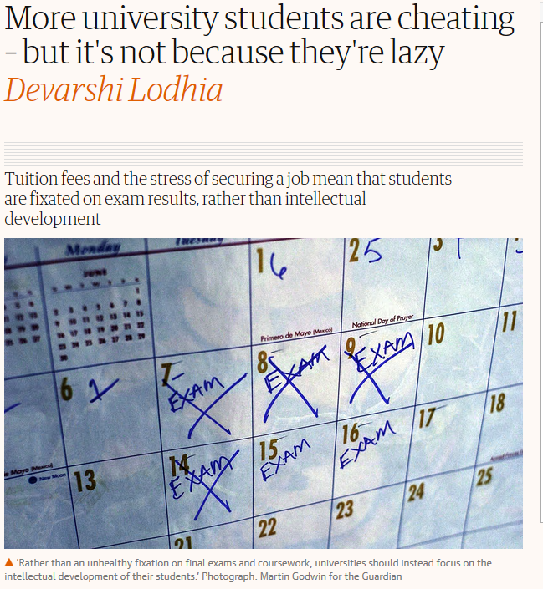
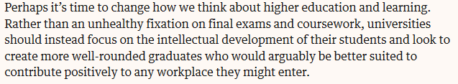

Slide 3






Six partner institutions aiming to:
…develop a practical accreditation model that teacher educators can use in any European context so that pre- and in-service educators can demonstrate their competence in ESD through a widely-recognised qualification.

Slide 4
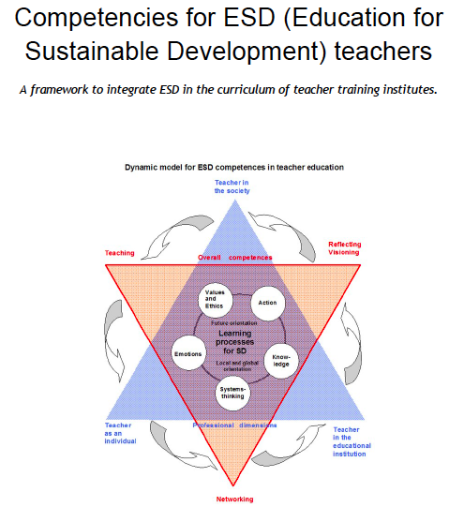
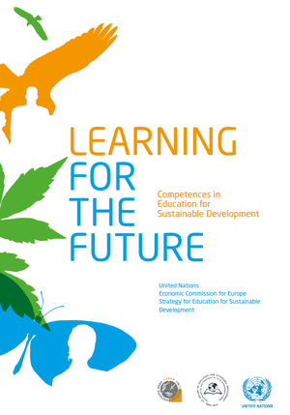
The United Nations Economic Commission for Europe (UNECE 2012)
Defined 39 ‘competences’.
(Sleurs 2008)
We ‘distilled’ the 39 UNECE competences
Refining, filtering, extracting the essential elements to define 12 competences
(Also using Wiek et al 2011 & Roorda 2012)

Slide 5
Thinking Holistically | Envisioning Change | Achieving Transformation
Integration:
Systems Competence The educator helps learners to develop an understanding of the world as an interconnected whole and look for connections across human and natural worlds and consider the consequences of our actions. | Futures Competence The educator uses a range of techniques to help learners explore alternative possibilities for the future and to use these to consider how our behaviours might need to change. | Participation Competence The educator contributes towards changes in education that will help sustainable development and encourages their learners to do the same.
Involvement:
Attentiveness Competence The educator alerts learners to fundamentally unsustainable aspects of our society and the way it is developing and conveys the urgent need for change. | Empathy Competence The educator is considerate of the emotional impact of the learning process on their learners and develops their self-awareness. | Engagement Competence The educator works flexibly and responsively with others, remaining aware of their personal beliefs and values, and encourages their learners to do the same.
Practice:
Transdisciplinarity Competence The educator acts collaboratively both within and outside of their own discipline, role, perspectives and values and encourages their learners to do the same. | Innovation Competence The educator takes an innovative and creative approach using real world contexts wherever possible. | Action Competence The educator focuses on the development of learners’ critical thinking skills and helps them to take considered actions in their own context
Reflection:
Evaluation Competence The educator helps learners to critically evaluate the relevance and reliability of assertions, sources, models and theories. | Responsibility Competence The educator acts transparently and accepts personal responsibility for their work and encourages their learners to do the same. | Decisiveness Competence The educator acts in a cautious and timely manner even in situations of uncertainty and encourages their learners to do the same.

Slide 6
Example: Futures Competence
The educator uses a range of techniques to help learners explore alternative possibilities for the future and to use these to consider how our behaviours might need to change.
Learning objectives The educator helps learners to…
5.1 Envision creatively and critically a range of possible or thinkable futures and their sustainability aspects, sharing and debating ideas, worldviews and possible evolutions; focusing near and far, moving flexibly between short and long term goals and perspectives
5.2 Recognise relations and possible evolutions between past, present, near future and far future worldviews, developments and actions
5.3 Anticipate how sustainability problems might evolve or occur over time, considering inertia, path dependencies and triggering events, critically assessing processes of change in society

Slide 9
At any academic ‘Level’ we suggest three stages of achievement

Slide 10
How do/would you approach educating tomorrow’s educators?
Thoughts?

Slide 11
Thank you!
pvare@glos.ac.uk

Slide 12
References
Roorda N (2012) Fundamentals of Sustainable Development. London: Earthscan
Sleurs W (ed.) (2008) Competencies for ESD teachers. A framework to integrate ESD in the curriculum of teacher training institutes, Brussels Online at: http://platform.ue4sd.eu/downloads/CSCT_Handbook_11_01_08.pdf
Wiek A, Withycombe L, and Redman C L (2011) Key Competencies in Sustainability: A Reference Framework for Academic Program Development in Sustainability Science 6(2): 203–18.
UNECE (2012) Learning for the future: Competences in Education for Sustainable Development. Geneva: United Nations Economic Commission for Europe

