Slide 1
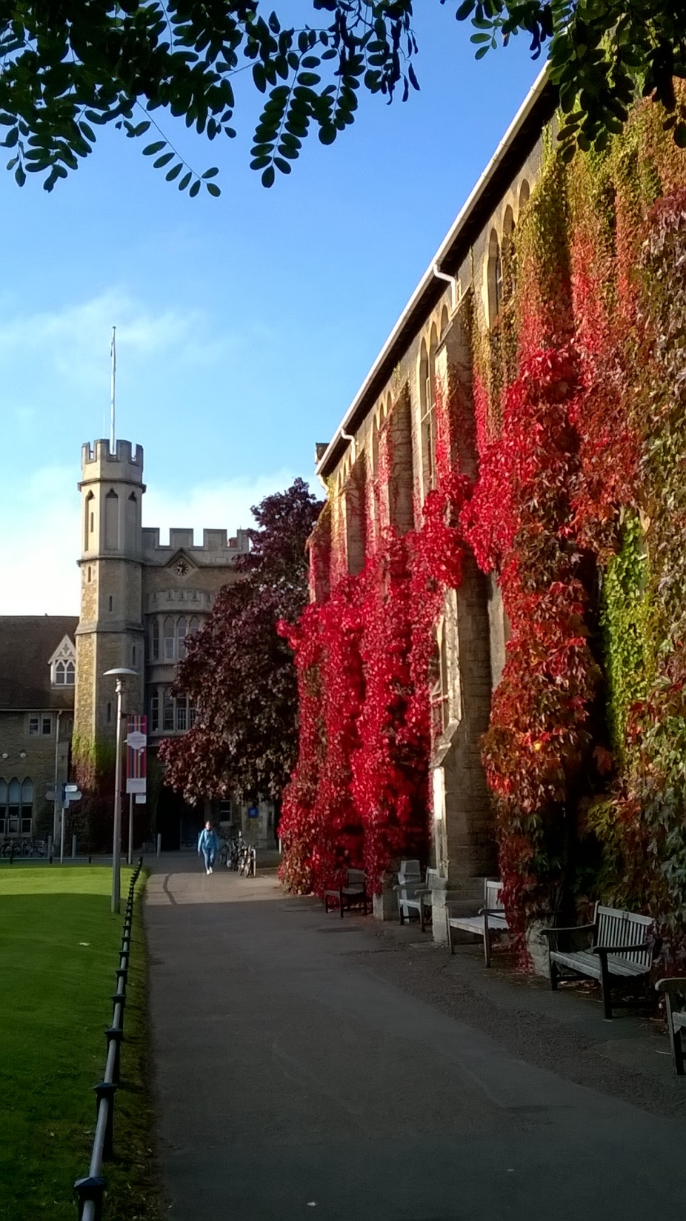
Are competences appropriate for educators of sustainability?
Dr Paul Vare
University of Gloucestershire, UK
Competence 2016, Wageningen, NL
October 2016

Slide 2
Overview
Context - UNECE
- A Rounder Sense of Purpose
Competences and sustainable development
Some research with schools and complexity
Concluding thoughts

Slide 3
To conclude…
Competences are vital for sustainability – but:
It is the unforeseen contexts and combinations in which competences are applied that makes them sustainable – or not
Educators for ESD need above all to recognise the limitations of ‘everyday’ competence discourse which is positivist in nature.

Slide 4
UNECE in one minute:
United Nations Economic Commission for Europe (55 Member States including Europe, all the countries of the former Soviet Union plus the USA and Canada)
2005: Strategy on Education for Sustainable Development.
2006/7: Developed indicators to measure progress on ESD Strategy
2007: Reporting suggests ‘bottleneck’ of low level of competence among teachers and other educators
2012: Published competences for educators of ESD.

Slide 5
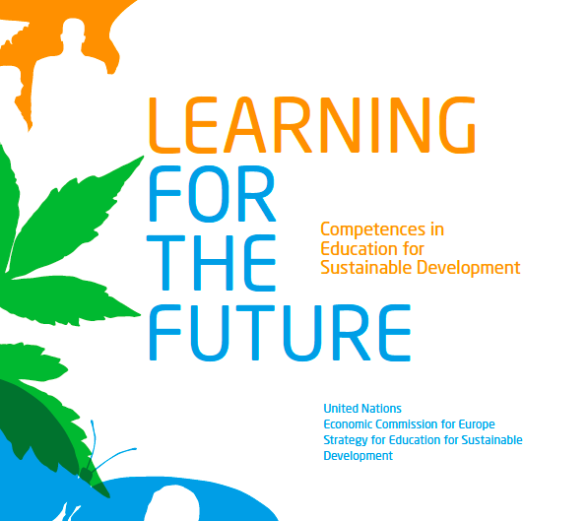
Includes:
General recommendations for policy makers
A set of core competences in ESD for educators

Slide 6
A Rounder Sense of Purpose
Erasmus+ funded project
Six partners
Aims to develop:
A qualification based on the UNECE competences
A tools and guidelines document
Tested training courses for teacher educators

Slide 7
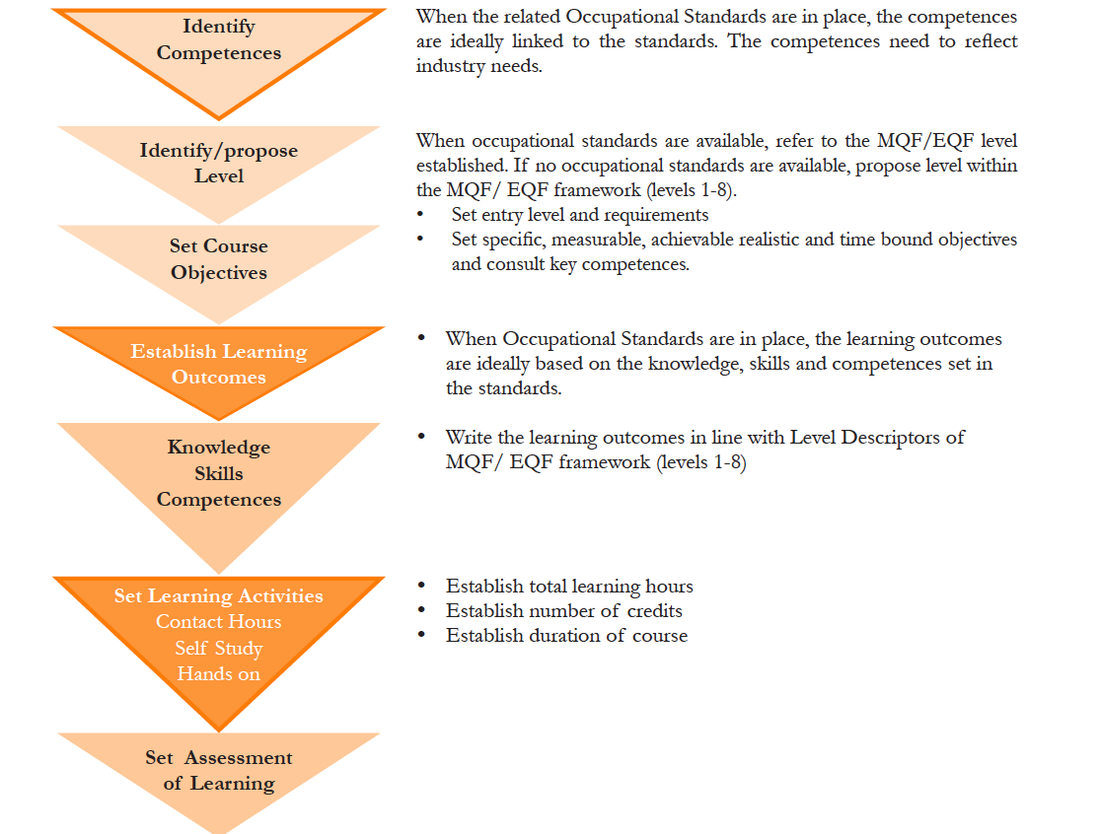
This is
Curriculum as content
i.e. a predetermined linear path
http://eupa.org.mt/wp-content/uploads/2015/07/ECVET-Conversion-Manual.pdf

Slide 8
Four ‘curriculum as product’ questions
What are the educational purposes?
What experiences can attain those purposes?
How can those experiences be organised?
How can we determine whether those purposes are being attained?
(Based on Ralph Tyler, 1949 cited in Lawton, 1996:19)

Slide 9
“Aims limit intelligence (because) given ready-made, they must be imposed by some authority external to intelligence, leaving to the latter nothing but a mechanical choice of means.” (Dewey 1916:138)
An objective-based curriculum is positivist, founded on an absolutist epistemology, a view advocated as far back as Plato, which provides a sense of certainty but offers little hope for those who wish to challenge the status quo.

Slide 10
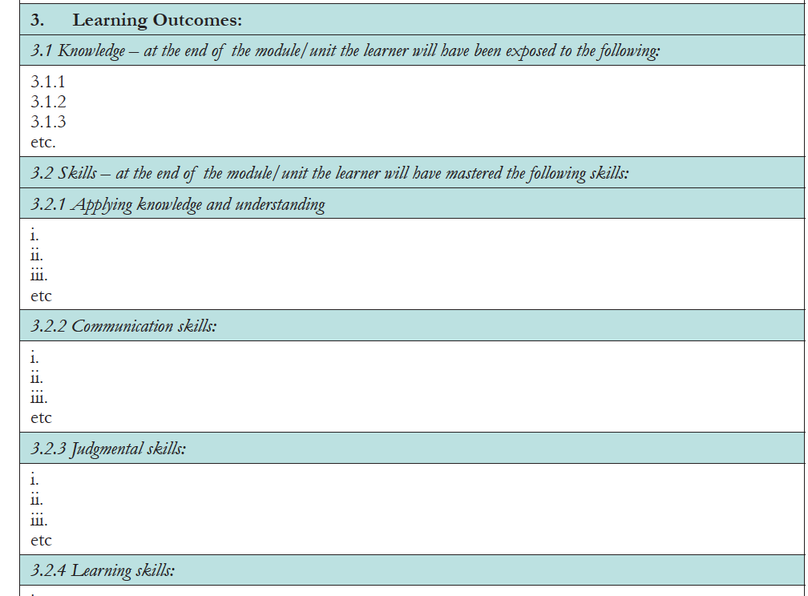
Atomisation of learning

Slide 11
But…
Sustainable development is characterised by ‘wicked problems’
These are complex, non-linear problems with no single solution
It may be that at best they are not solved - only resolved.

Slide 12
‘Wicked’ problems are multi-faceted…

Slide 13
…they draw on multiple disciplines…
Reductionist thinking remains vital as there is a need for discipline-based expertise (Meadows 2008)

Slide 14
…which demands inter-disciplinary working…
Competence for interdisciplinary cooperation is central (Bath et al. 2007)

Slide 15
Inter-disciplinary communication needs support
e.g. By facilitating communities of practice (Wenger 2000)

Slide 16
Trans-disciplinary boundary crossing takes it further
Does everyone need all of these competences for us to be sustainable?

Slide 17
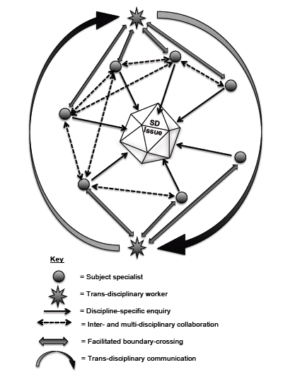
Vare (unpublished)

Slide 18
Yes, competences are essential but…
It’s not particular competences or even a specific combination that is crucial here, rather it is the context in which the competences are applied.
Meanwhile:
Is the language of competences forcing us into an approach to curriculum and assessment that runs counter to the ethos of sustainability?

Slide 19
Some research into ESD in Schools:
Twelve English schools (primary and secondary)
Framed using Cultural-historical activity theory
Semi-structured interviews with teachers/heads
Supplementary evidence (websites, reports, etc.)
Verified using dilemma analysis

Slide 20
The research asked:
To what extent do teachers recognise contradictions in attempting to implement education for sustainable development in their schools?
And:
How do they approach these contradictions?
(Vare, forthcoming)

Slide 21
Layers of contradiction emerged but…
…these are not identified as contradictions by the interviewees themselves.
Four explanations are given:
Unawareness
Powerlessness
‘Satisficing’ (Cuban 1992)
Expansive learning (Engeström 1987)

Slide 22
Expansive Learning – the competence of creating something new in the face of contradictions
e.g. the headteacher who reversed the situation where going outdoors was a punishment:
“…if anybody doesn’t stick to those rules they’re moved into the next zone down until they’re on Zone One, which is the tarmac area, which bores them to tears and they hate it, so they kind of earn the right to come out again.” (Heather)
Notes:
The headteacher avoiding a situation where time spent outdoors is seen as punishment (collecting litter) by zoning the landscaped school grounds so that children have access to zones of woodland and grass but:

Slide 23
Expansive Learning – the competence of thinking beyond what you are told
“We don’t have solar panels or a wind turbine – the bling – but you don’t need that because it’s an approach” (Ellen).
Notes:
The Eco Co-ordinator at a new primary school, focusing on sustainability as a learning process rather than a shopping list of technical installations:

Slide 24
These professionals are taking responsibility for the care of their own selves and their values in the face of the narrow performativity that currently governs their profession.
(Ball & Olmedo 2013)
Expansive Learning – the competence of
thinking beyond competences?
Participatory paradigm (Reason & Heron 1997); Critical teacher education (Huckle 1997); Transgressive, transformative, social learning (Lotz-Sisitka et al 2015) ESD 1 + ESD 2 = ESD 3? (Vare & Scott 2007 + Vare forthcoming)
Notes:
Louise’s flag of sustainability is ‘secret’
Ellen’s use of the term ‘bling’ dismisses an emphasis on green infrastructure over ethos
Heather’s approach reverses the practice observed in other schools.

Slide 25
The professionals in these examples demonstrate that the current social reality is not inevitable.
“…species do not adapt to environments; they construct them”
(Lewontin in Engeström 1987)

Slide 26
Autopoiesis = self-creation
These are demonstrations of autopoietic organisation that show that schools are simultaneously producers and products of their own system.
(Maturana & Varela 1994)
Notes:
By absorbing contradictions and weaving them into the tight fabric of their hectic professional lives, teachers are modelling what it is to be a resilient learner with a high degree of ‘adaptive capacity’ (Smith & Green 2011).

Slide 27
Which brings us to Complexity
Systems will self-organise
Emergent properties, which cannot be predicted from the sum of their parts, will arise
Systems that are between order and chaos are the most resilient.
(Pueyo 2014)

Slide 28
Another example…
When evaluating a recent project on teacher CPD in Modern Foreign Languages we learned that…

Slide 29
…allowing participating schools complete flexibility within certain parameters…
Needs analysis (i.e. competences in context)
Face-to-face CPD
Sharing resources on a VLE
…allowed resilient professional-to-professional networks to emerge.
(Burch & Vare, forthcoming)

Slide 30
Lead School
Partner School
Facilitator
University

Slide 31
Repeated contacts among many schools
Lead School
1st Contact
Partner School
2nd Contact
Facilitator
3rd Contact
Authority
4th Contact

Slide 32
http://www.vicologamba.it/?m=201112
https://www.healthtap.com/user_questions/1168476
Wikimedia Commons: Internet map 1024.jpg
Notes:
Systems self-organise creating fractal patters, whether it’s the internet, the cosmos or our own blood vessels echoing the veins in a leaf.

Slide 33
What about competences?
Provide order:
a limited framework within which to expand
opportunities for multi-directional dialogue in formal learning
Linear tracking of achievement
And ‘chaos’
Informal learning – linked to…
…exploratory forms of assessment that can identify emergent outcomes.

Slide 34
Competences for ESD Educators?
Criticality towards those who would identify your required competences
Criticality towards any competence framework you encounter
Competence to demonstrate your own adaptive capacity
Courage in the face of competence discourse to recognise education as participative, co-creative and world-making rather than ready made.

Slide 35
Can we expand beyond competences?
Do we have adequate tools for measuring dispositions and sensibilities?
Norden & Anderberg (2011) prefer the concept of knowledge capabilities as defined by Bowden (2004)
Will we one day attend ‘Capability 20xx’ or something else at Wageningen?

Slide 36
Last night’s e-mail…
“ESD is explicitly dealing with values and cannot claim to be objective and values free…
It is impossible to 'measure' competences (but also learning outcomes) even if all the assessment literature talks about 'measurements’…
What can be done is to 'evaluate', to 'give value', to competences when they are put in practice, observed, described.”
(‘Performance indicator’ seen as a problematic term)
(Prof. Michela Mayer)

Slide 37
To conclude…
Competences are vital for sustainability – but:
It is the unforeseen contexts and combinations in which competences are applied that makes them sustainable – or not
Educators for ESD need above all to recognise the limitations of ‘everyday’ competence discourse which is positivist in nature.

Slide 38
Thank you
pvare@glos.ac.uk

Slide 39
References
Ball S J & Olmedo A (2013) Care of the self, resistance and subjectivity under neoliberal governmentalities in Critical Studies in Education, 54:1, 85-96
Barth, M., J. Godemann, M. Rieckmann & U. Stoltenberg (2007). Developing key competencies for sustainable development in higher education. International Journal of Sustainability in Higher Education, 8(4), 416–430
Cuban L (1992) Managing Dilemmas while Building Professional Communities, in Educational Researcher, 21:1, 4-11
Dewey J (1916) Democracy and Education. Project Gutenberg EBook. Accessed at: www.gutenburg.org
Engeström Y (1987) Learning by Expanding: An Activity - Theoretical Approach to Developmental Research. Helsinki: The Laboratory of Comparative Human Cognition
Accessed March 2016 at: http://lchc.ucsd.edu/mca/Paper/Engestrom/expanding
Maturana H R & Varela F J (1994) The tree of knowledge: the biological roots of human understanding. Boston MA: Shambhala
Meadows D (2008) (Edited by Diana Wright) Thinking in Systems: A Primer. London: Earthscan
Pueyo S (2014) Ecological Econophysics for Degrowth. Sustainability 2014, 6, 3431-3483; DOI:10.3390/su6063431
UNECE (2012) Learning for the Future: Competences in Education for Sustainable Development. Geneva: UNECE
Vare P & Scott WAH (2007) Learning for a Change: exploring the relationship between education and sustainable development; Journal of Education for Sustainable Development 1:2, 191–198
Wenger, E. (2000). Communities of Practice and Social Learning Systems. Organization, 7(2), 225-246.

Slide 40
ESD 1
ESD 2
Promoting/ facilitating changes in what we do
Promoting informed behaviours and ways of thinking, where the need is identified and agreed
learning for sustainable development
Building capacity to think critically beyond what experts say - testing sustainability ideas
exploring the contradictions inherent in sustainable living
learning as sustainable development
Vare & Scott (2007)

