Slide 1
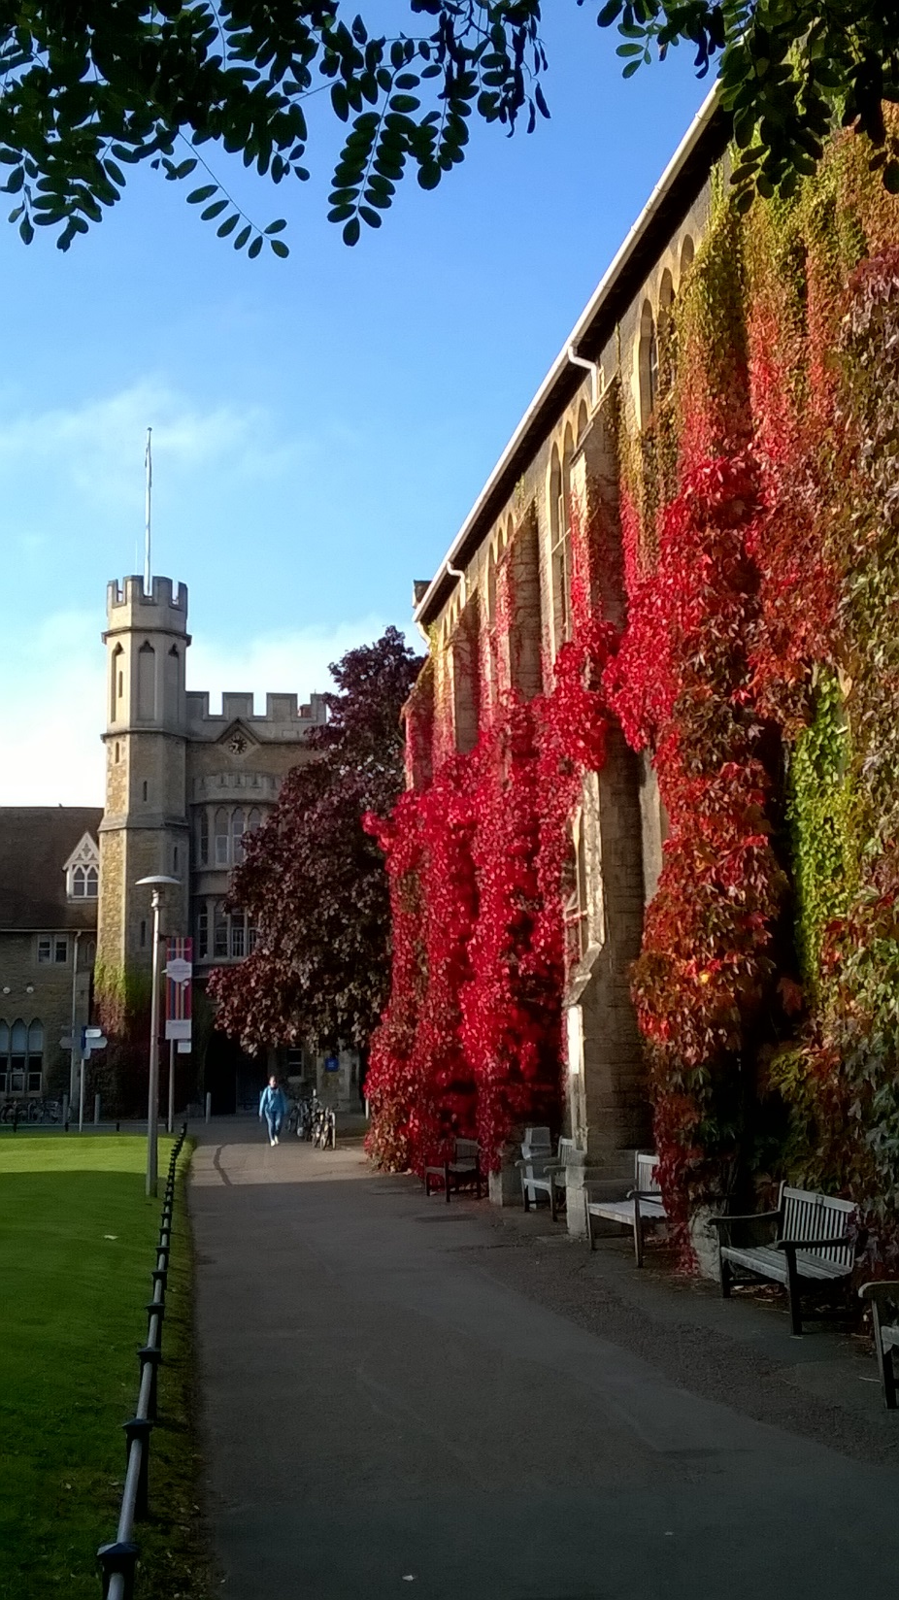

Teacher Education as Sustainable Development: what are the chances?
Dr Paul Vare
University of Gloucestershire
International Symposium: Research on Teacher Education for Sustainable Development – Insights, Perspective and Future Directions
University of Vechta
21st March 2019

Slide 2
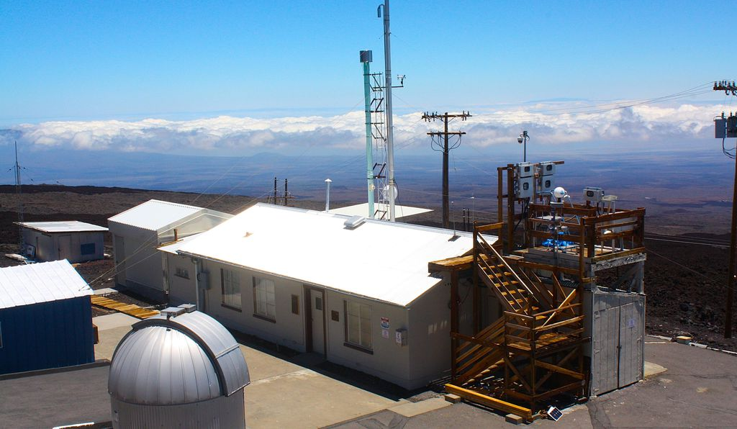
Teacher Education as Sustainable Development: what are the chances?
Dr Paul Vare
University of Gloucestershire
International Symposium: Research on Teacher Education for Sustainable Development – Insights, Perspective and Future Directions
University of Vechta
21st March 2019

Slide 3
Plan
University of Gloucestershire; my background
Research in ESD and teacher education
Some thoughts on ESD – and educator competences
The bigger picture
Closing thoughts
Questions

Slide 4
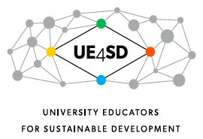







The Environmental Association for Universities and Colleges

Slide 5
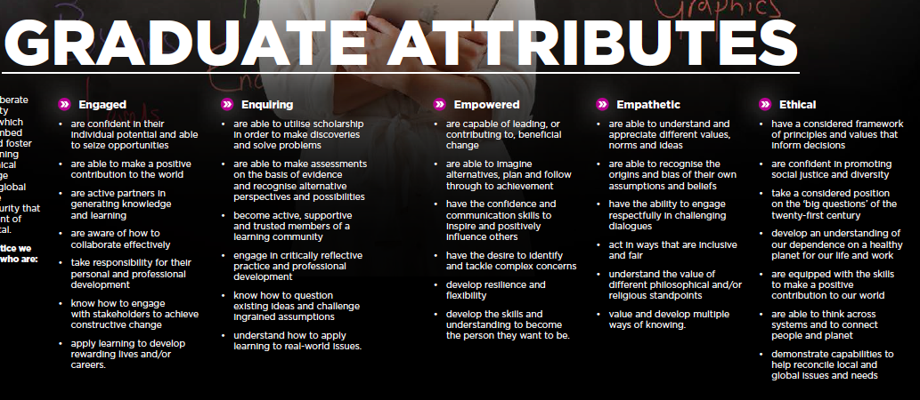

Slide 6
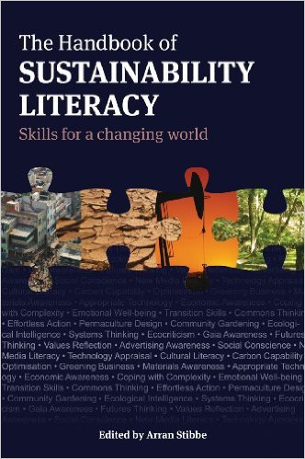
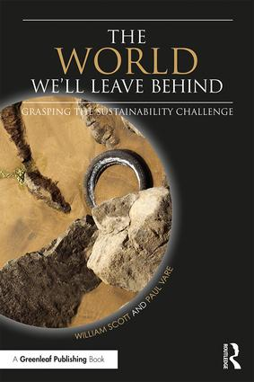

Slide 7
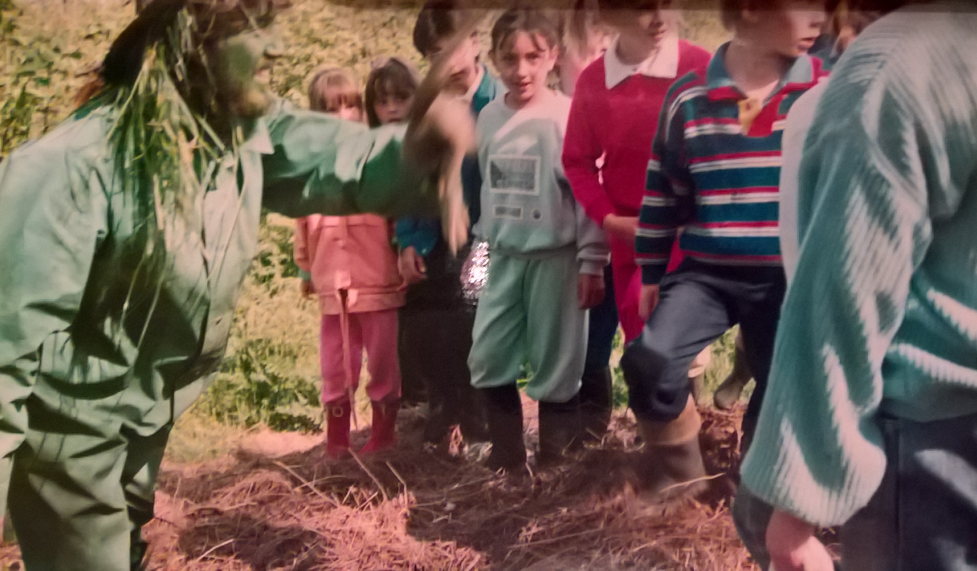

Slide 8
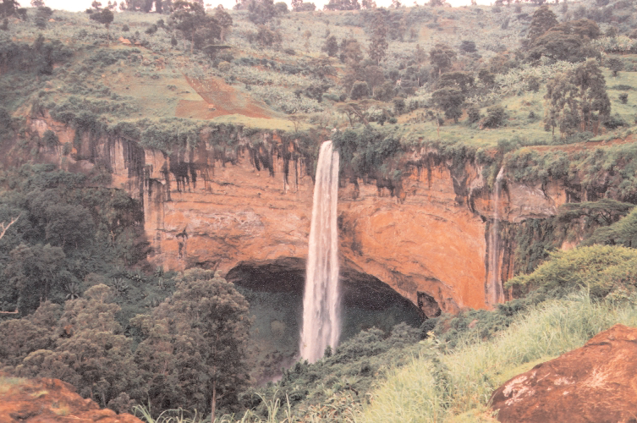

Slide 9
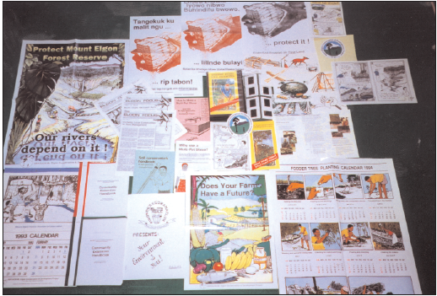
From this…

Slide 10
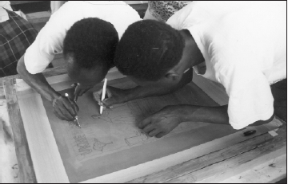
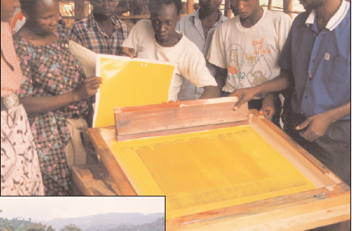
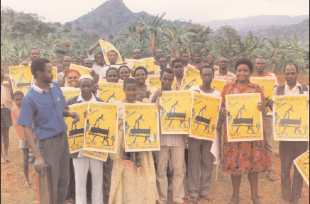
To this…

Slide 12
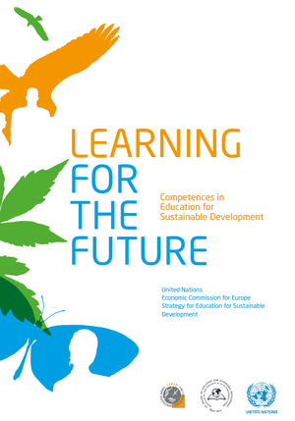

Slide 13
Research priorities – Put these under the three headings
Bald spots – done to death
Blank spots – what we know enough to question but not enough to answer
Blind spots – what we don’t know well enough to ask about or even care about
Conceptual issues –
- what is ESD?
- ESD: process or outcome?
- wht is ESD for?
Doing ESD – practical considerations; what works and why.
Developing the field of ESD research itself – what is it; what does it mean (or take) to do well? What are its underlying assumptions?
To what extent can any education/pedagogy be good ESD because f its impact or the way it makes us re-think things?

Slide 14
Teacher education research
ITE/CPD; materials; programmes (curriculum) and pedagogy; reform; action research; assessment/evaluation; cultures; histories; technology; other domains of learning (informal/non-formal); learners’ learning, conceptual development; philosophy; motivation…

Slide 15
Connecting Biophilia with videophilia
AI – greatest achievemnet - and possibly our last! (According to Stephen Hawking)
Implications and challenges of AI
Hybrid learning spaces/voices/perspectives – cllaborate internationally to decentre our own knowledge traditions
(If there’s one thing Brexit teaches us, it’s that taken-for-granted assumptions about what binds us and what divides us are not as stable as we might think.)
‘Authentic’ research: Citizen science, action research, LeARN – be accepting of the ‘mistakes’ that novice researchers make – they can reveal blindspots!
Our time as come – everyone who educates is an educator of/for sustainable development these days
Started out wandering dreamily into a city to bring nature closer to the children there – even though we talked of ozone holes and biodiversity loss, I never imagined that our work would become so important in my lifetime. Ten years from now, if I’m still around I’ll be doing this work as an unpaid retired academic; most of you will still be co-creating the future with your colleagues and others – good luck

Slide 16
Thinking holistically…
Systems – helping learners to see that everything is connected and how this impacts our lives
Attentiveness – researching issues to discover their importance, impact and possibilities for change
Transdisciplinarity – working together with people from different backgrounds
Criticality – asking why things are as they are, checking sources, recognising perspectives

Slide 17
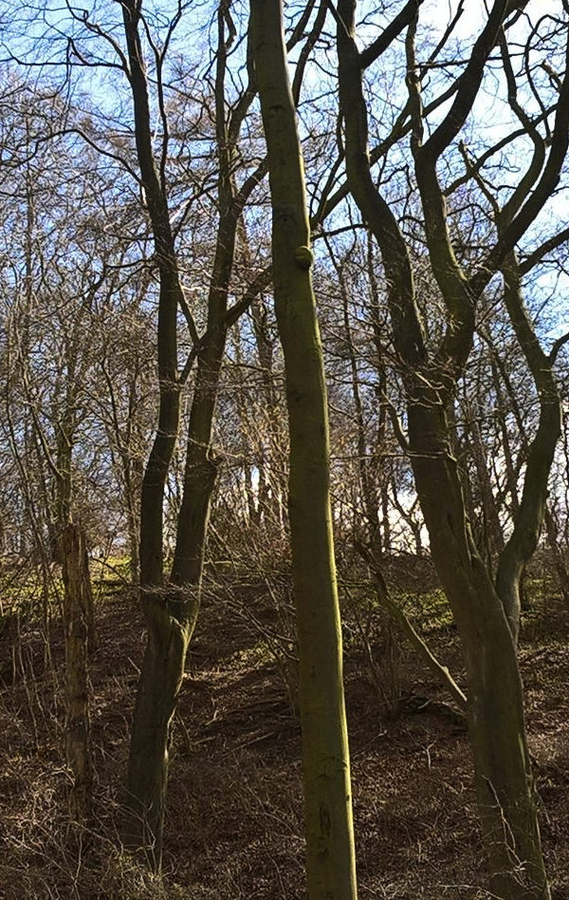
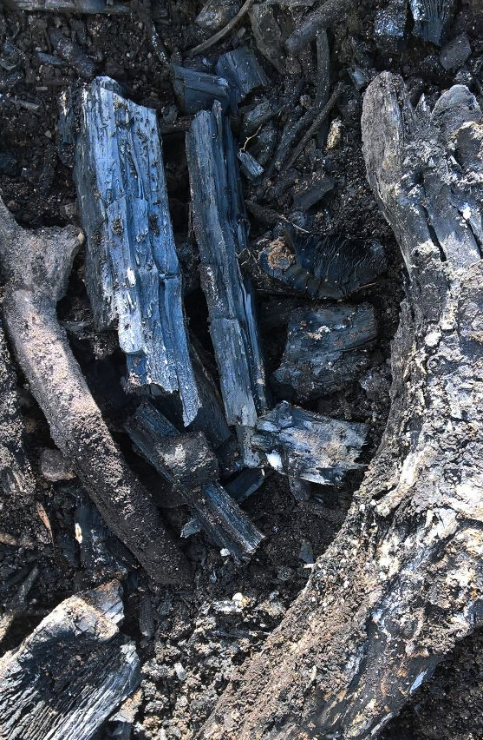

Slide 18

London-Lima: 6,316 miles x 300gms CO₂ per passenger mile = 1,894,800, i.e. 2 tonnes of CO₂ + return trip =
4 tonnes CO₂

Slide 19
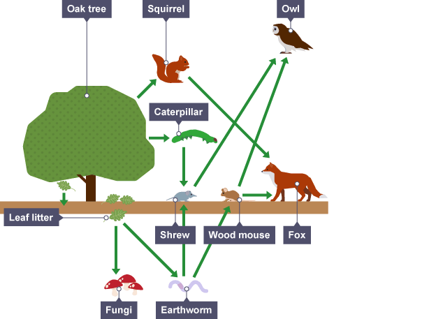
http://www.bbc.co.uk/education/guides/z2m39j6/revision/2

Slide 20
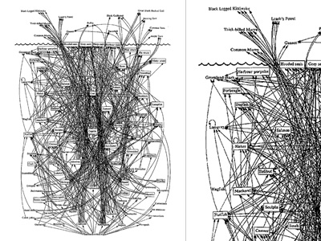
http://www.visualcomplexity.com/vc/project.cfm?id=47

Slide 21
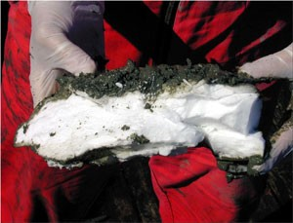
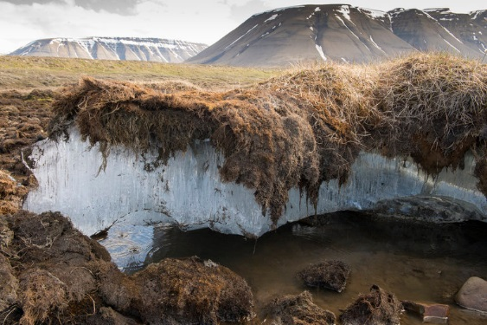
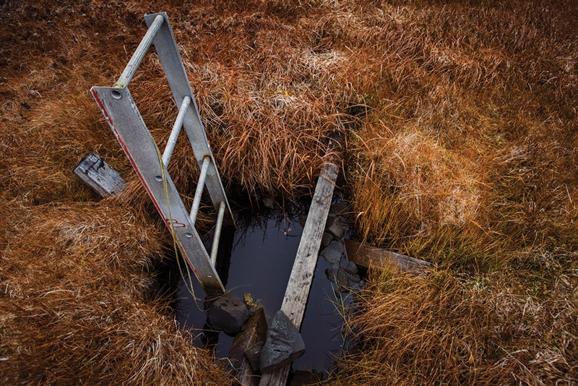
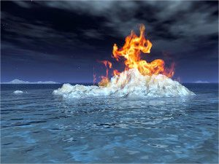
Clathrate release
Permafrost thawing

Slide 22
Thoughts
Ecosophy
Ecofeminism
New economics
Not objective researchers but working from a position of what Maria Mies calls ‘Conscious partiality’
Based on critical theory – having both pedagogical and emancipatory ends.
I hesitate to use the term ‘transformative’ – everything we learn, regardless of the intention on the part of the educator or learner, has the potential to transform.
Mies M & Shiva V (1993) Ecofeminism. London: Zed Books
Bronwyn Davies talks of research not being about objectification but “positive incomprehension, not regulation and control but openness to the not-yet-known, and finally, not prediction but generation.” (Davies 2009: 485)
Davies B (20029) A Feminist Poststructural Approach to Environmental Education Research in Stevenson R B, Brody M, Dillon J & Wals A E J (Eds.) International Handbook of Research on Environmental Education. New York: AERA/Routledge

Slide 23
i) a critical awareness of connections – personal, professional, environmental – and how to nurture these
ii) a positive vision of one’s future – developing one’s sense of agency in achieving this
iii) the importance of doing something, in concert with others as far as possible (even if it seems futile!)

Slide 24
This title will allow me to refer to our precarious position globally (i.e. we need to take the risk of societal collapse seriously) as well as discussing the extent to which teacher education itself is or isn’t currently a form of ESD before discussing possibilities for greater alignment with ESD – here I’ll report on our attempts to get UCET (UK HEIs) to include values explicitly in their next five-year plan. Then I’d like to introduce the RSP competences. On reflection, the core of RSP’s contribution to sustainability and wellbeing could be reduced to three key points (I can feel a diagram coming on to show the links):
(i) a critical awareness of connections – personal, professional, environmental – and how to nurture these
(ii) a positive vision (or focus of our affection) for the future – and thus developing one’s sense of agency towards achieving this
(iii) the importance of taking action (whether large or small or a decision not to do something), in concert with others as far as possible, even if it seems futile.
Points (i) and (iii) are connected of course because each action has an impact in a world of which we are a component. Perhaps this could be reduced further with (i) and (iii) relating to our external presence in the world while point (ii) is about our internal/mental selves. Then again, points (i) and (iii) are deliberately framed as useful suggestions for mental wellbeing. Maybe I’ll end the talk so tied up in knots that somebody will have to help me to my seat.

Slide 25
The extent to which economics is overlooked by ESD in schools is a serious concern.
“If education actually did set out to explore the inter-relatedness of social justice and ecological integrity through economics, then we might be getting somewhere”
(Scott cited in Webster & Vare 2012: 408)

Slide 26
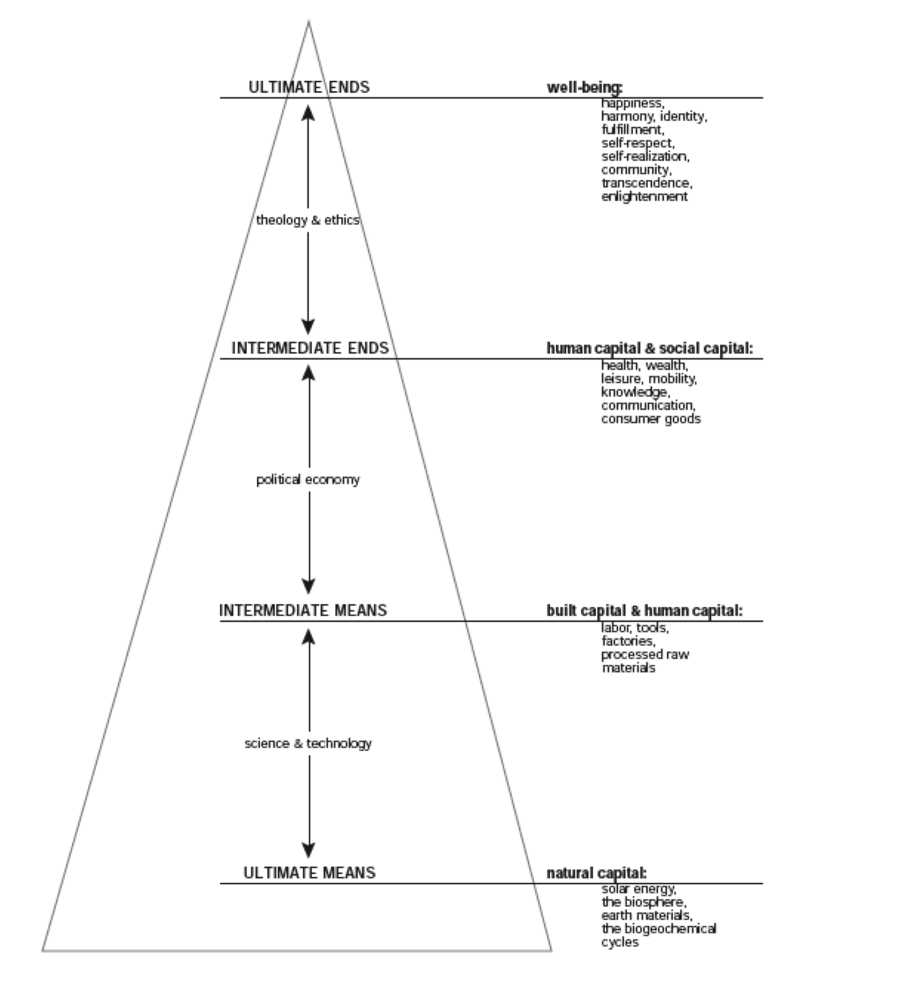
Framing Sustainable Development
Ultimate Ends
Intermediate Ends
Intermediate Means
Ultimate Means
Source: Meadows, 1998

Slide 28
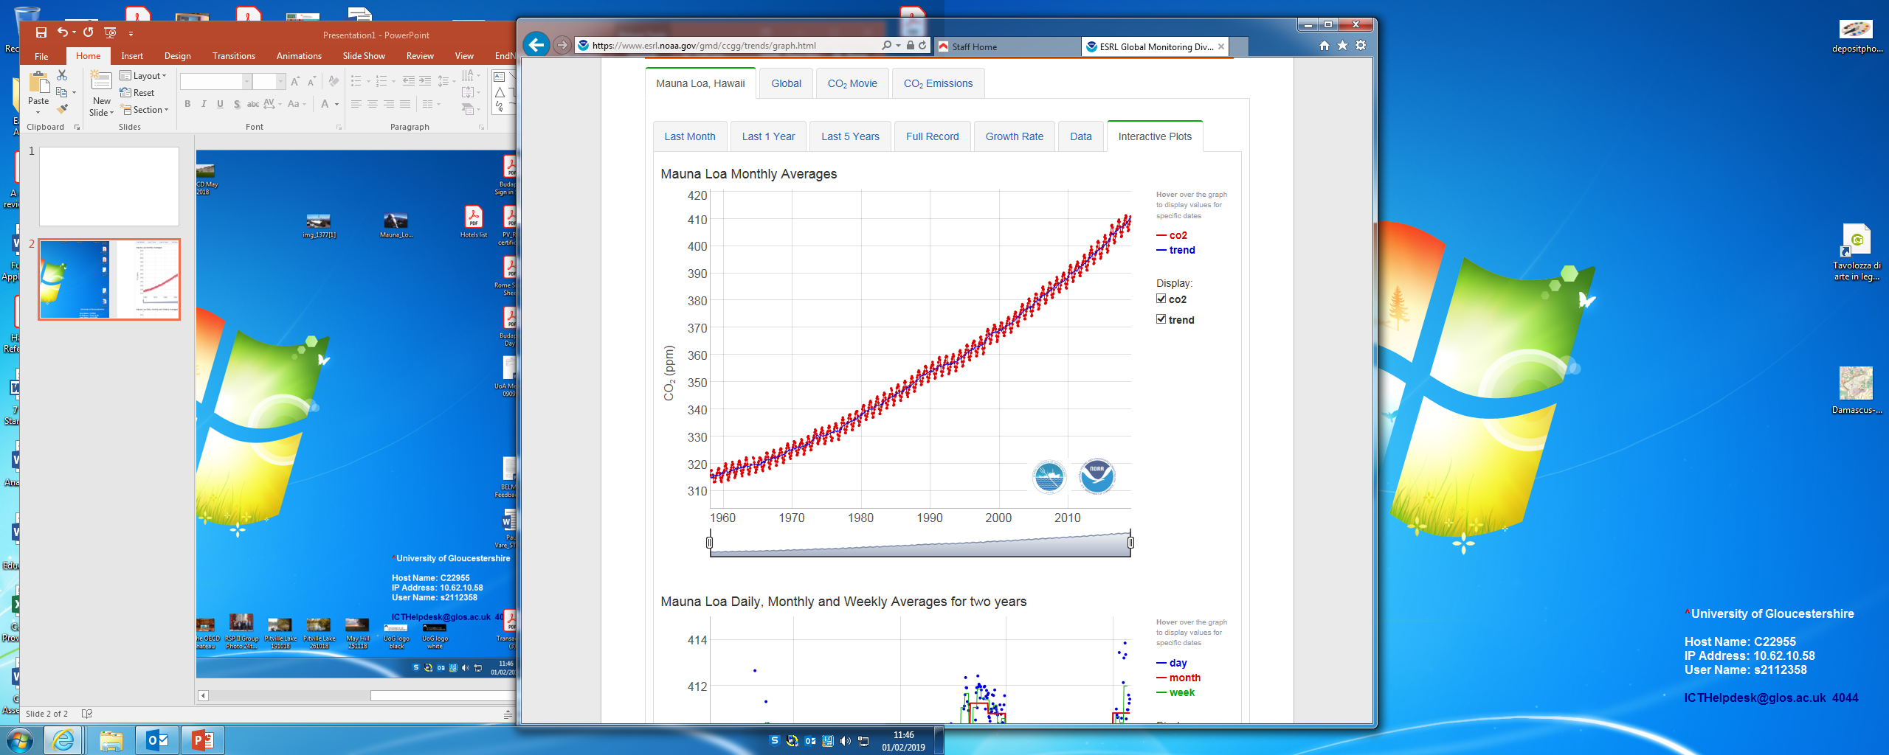
350 ppm – safe level

Slide 29
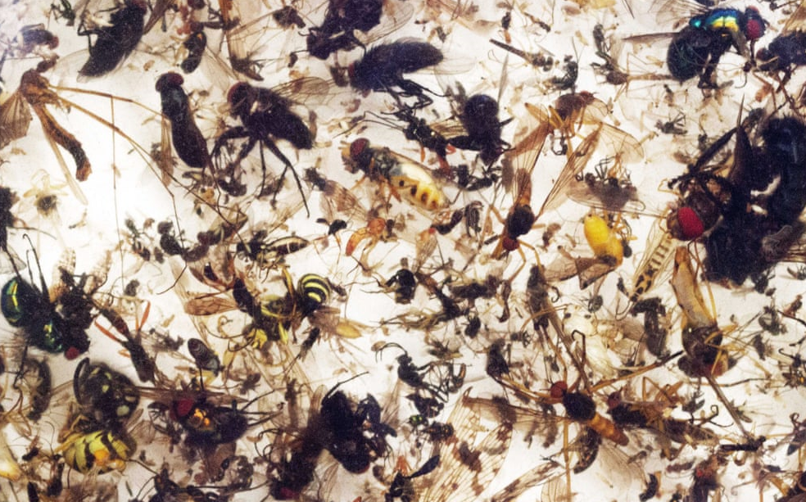

Slide 30
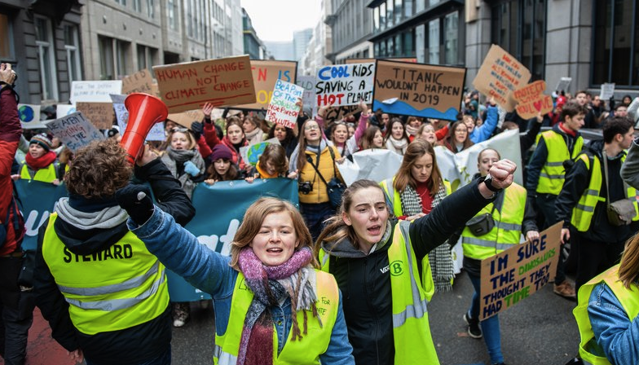
https://www.rte.ie/news/newslens/2019/0124/1025366-brussels-protests/

Slide 31
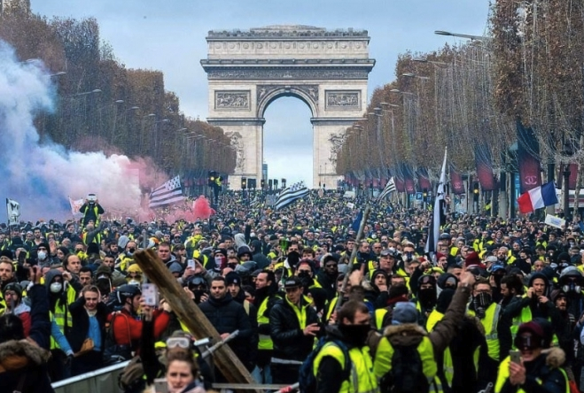
https://www.connexionfrance.com/French-news/Gilets-jaunes-More-protests-set-for-Acte-9-weekend-in-Paris-and-Bourges

Slide 32
Systems – helping learners to see that everything is connected and how this impacts our lives
Attentiveness – researching issues to discover their importance, impact and possibilities for change
Transdisciplinarity – working together with people from different backgrounds
Criticality – asking why things are as they are, checking sources, recognising perspectives

Slide 33
Envisioning change…
Futures – imagining different possibilities for the future and describing their consequences
Empathy – understanding the centrality of emotions to learning; seeing situations as others do
Innovation – considering new ideas while learning from the past
Responsibility – being personally responsible and transparent in how we work

Slide 34
Don’t lose sight of hope!
Martin Luther King did NOT say…
“I have a nightmare…”

Slide 35
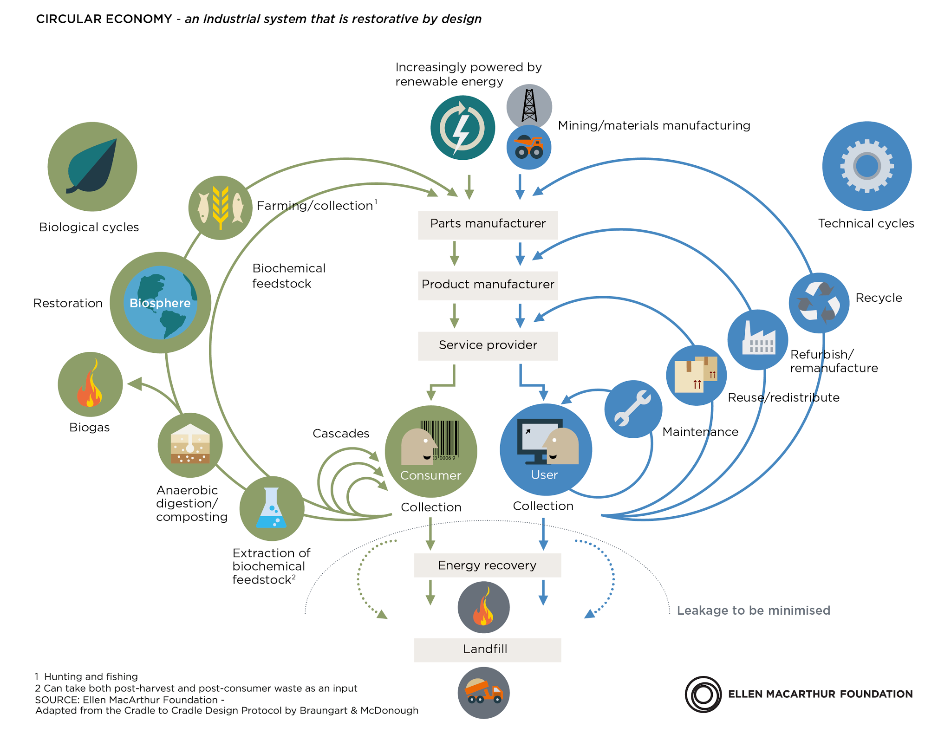

Slide 36
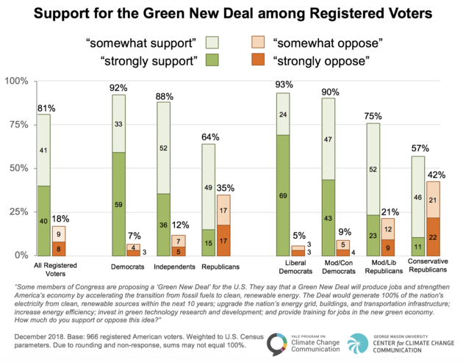
https://www.huffingtonpost.co.uk/entry/green-new-deal-poll_us_5c169f2ae4b05d7e5d8332a5

Slide 37
GND?
It’s a question of framing…

Slide 38
Is this really the purpose of education?
…perhaps most important of all, we must ensure that more people have the knowledge and skills they need to succeed in a demanding economy.
Nick Gibb MP
UK Schools Minister, England
2015
https://www.gov.uk/government/speeches/the-purpose-of-education

Slide 39
If you can’t beat them, join them:
…perhaps most important of all, we must ensure that more people have the knowledge and skills they need to succeed in a demanding green economy.
???? ????MP
UK Schools Minister, England
2022

Slide 40
https://www.greentechmedia.com/articles/read/five-predictions-for-the-global-energy-storage-market-in-2019#gs.UCPbYuhS

Slide 41
Futures – imagining different possibilities for the future and describing their consequences
Empathy – understanding the centrality of emotions to learning; seeing situations as others do
Innovation – considering new ideas while learning from the past
Responsibility – being personally responsible and transparent in how we work

Slide 42
Achieving transformation
Participation – collaborating with others to improve the places where we live and work
Engagement – working from ‘who I am’ recognising my values and those held by others
Action – developing agency through involvement in meaningful, community-based change projects
Decisiveness – acting in good time, even when faced with dilemmas or situations of uncertainty.

Slide 43
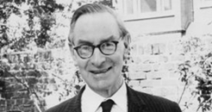

Dr Chad Varah

Slide 44
There is only love, and then oblivion.
“The building was on fire and there was no way down the stairs. She was calling to say goodbye. There was really only one thing for her to say, those three words that all the terrible art, the worst pop songs and movies, the most seductive lies, can somehow never cheapen. I love you.
She said it over and again before the line went dead. And that is what they were all saying down their phones, from the hijacked planes and the burning towers. There is only love, and then oblivion. Love was all they had to set against the hatred of their murderers.”
https://www.theguardian.com/world/2001/sep/15/september11.politicsphilosophyandsociety2

Slide 45


And trust

Slide 46
A Rounder Sense of Purpose
Educator competences for a sustainable world

Slide 47
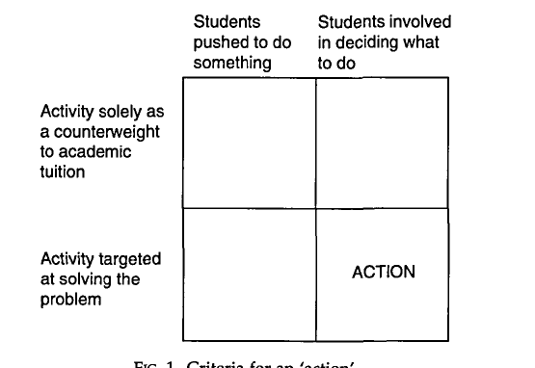
Criteria for ‘action’
’
Jensen & Schnack 1997

Slide 48
Participation – collaborating with others to improve the places where we live and work
Engagement – working from ‘who I am’ recognising my values and those held by others
Action – developing agency through involvement in meaningful, community-based change projects
Decisiveness – acting in good time, even when faced with dilemmas or situations of uncertainty.

Slide 49
Thinking Holistically | Envisioning Change | Achieving Transformation
Integration:
Systems The educator helps learners to develop an understanding of the world as an interconnected whole and to look for connections across our social and natural worlds and consider the consequences of actions. | Futures The educator helps learners to explore alternative possibilities for the future and to use these to consider how behaviours might need to change.. | Participation The educator helps learners to contribute towards changes that will support sustainable development.
Involvement:
Attentiveness The educator helps learners to understand fundamentally unsustainable aspects of our society and the way it is developing and increases their awareness of the urgent need for change. | Empathy The educator helps learners to develop their self-awareness and their awareness of others. | Engagement The educator helps learners to work responsively and inclusively with others, remaining aware of their personal beliefs and values.
Practice:
Transdisciplinarity The educator helps learners to act collaboratively both within and outside of their own discipline, role, perspectives and values. | Innovation The educator encourages creativity and flexibility within their learners. | Action The educator helps the learners to take action in a proactive and considered manner.
Reflection:
Criticality The educator helps learners to critically evaluate the relevance and reliability of assertions, sources, models and theories. | Responsibility The educator helps the learners to act transparently and to accept personal responsibility for their work. | Decisiveness The educator helps the learners to act in a cautious and timely manner even in situations of uncertainty.

Slide 50
“As soon as you start to teach one of the competences, you inevitably touch on the other eleven.”
(Teacher in The Netherlands)

Slide 51
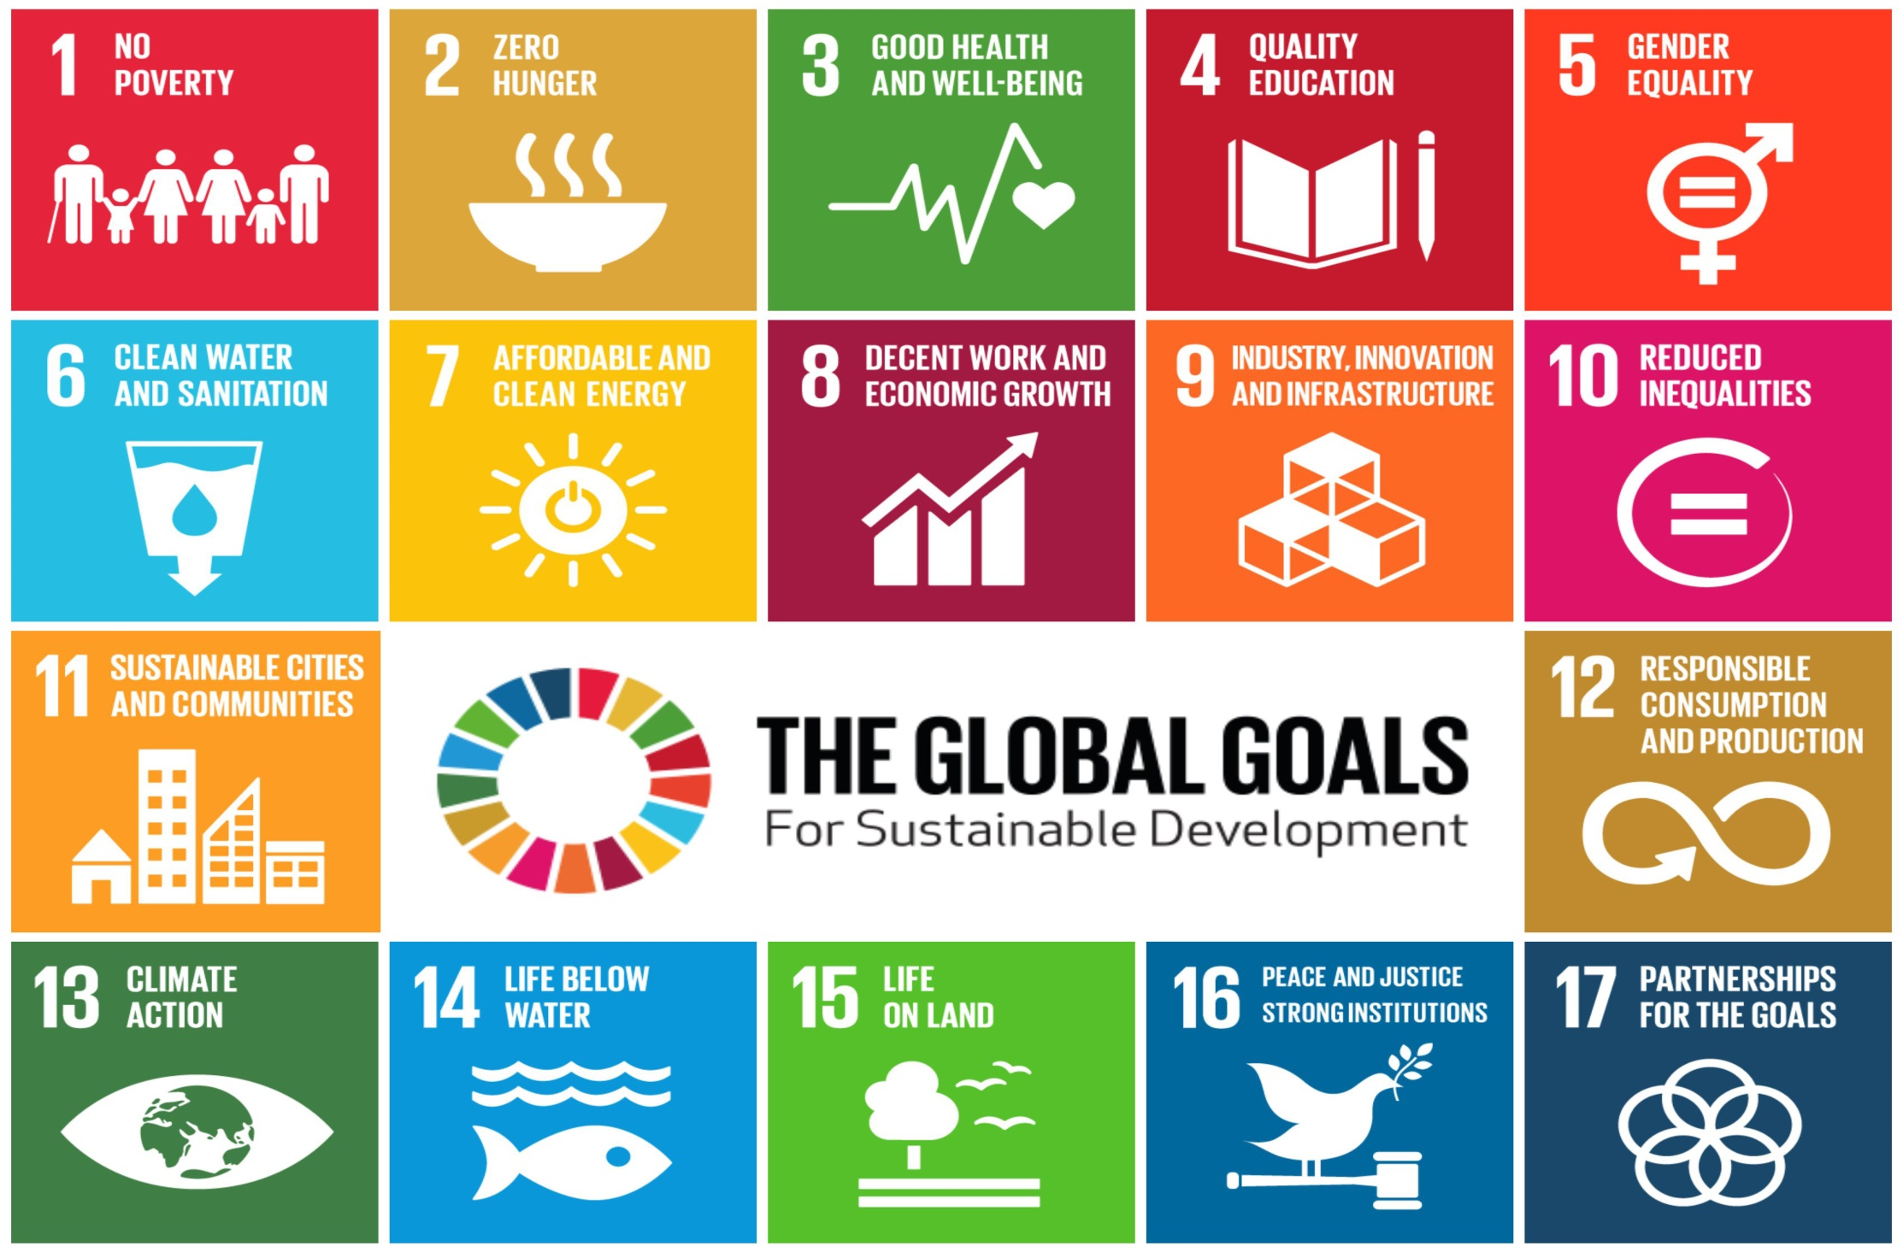

Slide 52
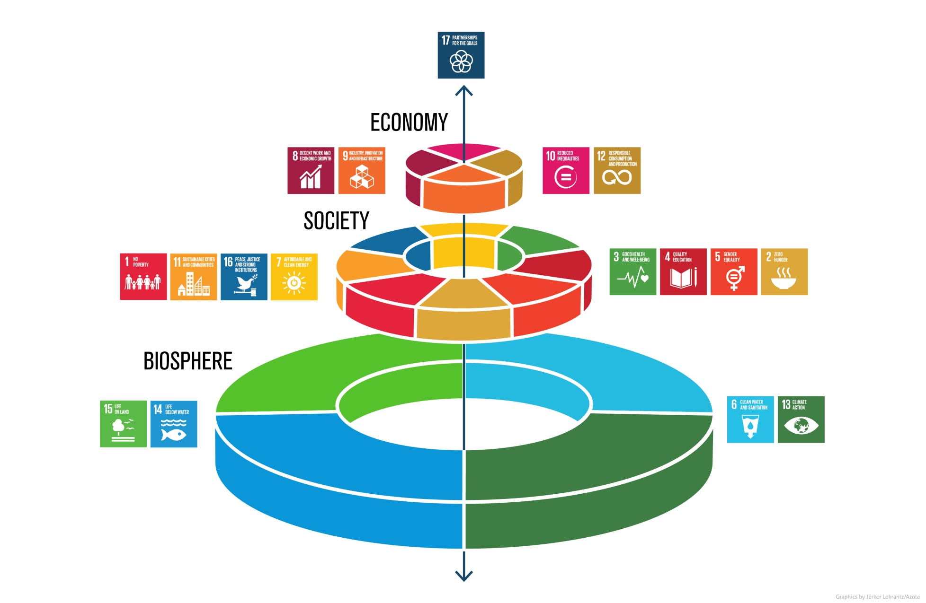
http://www.stockholmresilience.org/images/18.36c25848153d54bdba33ec9b/1465905797608/sdgs-food-azote.jpg

Slide 53
Environment
Society
Economy

Slide 54


Slide 55
Goal 4: Quality Education
Target 4.7:
By 2030, ensure that all learners acquire the knowledge and skills needed to promote sustainable development, including, among others, through education for sustainable development and sustainable lifestyles, human rights, gender equality, promotion of a culture of peace and non-violence, global citizenship and appreciation of cultural diversity and of culture’s contribution to sustainable development
(NB There are 10 targets under Goal 4 – a measure or indicator for Target 4.7 has yet to be defined)

Slide 56
Possibly, the most valuable lesson that educational professionals can share with young people is not what they teach or how they teach it – but who they are.

Slide 57
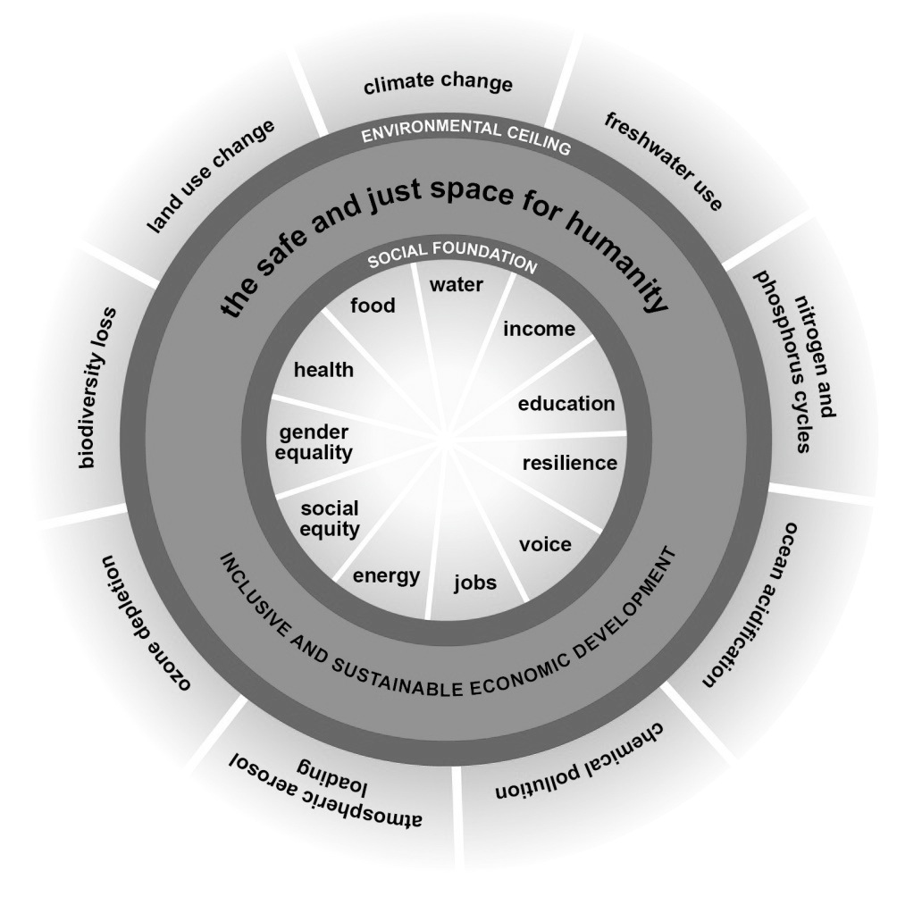
(Raworth 2013)
Notes:
We are overshooting the planet’s limits to sustain a safe, humanly habitable environment while still failing to address key social concerns adequately.
Sustainable development might be ‘covered’ by Geography teachers but it is tackled (or not) by everyone.
It’s our choice. We either choose to ignore these issues as irrelevant, and thus we remain part of the problem, or we engage in whatever capacity we find ourselves, seeing the connections between our own work and wider concerns.
For teacher educators this distinction is magnified immensely.

Slide 58


Slide 59
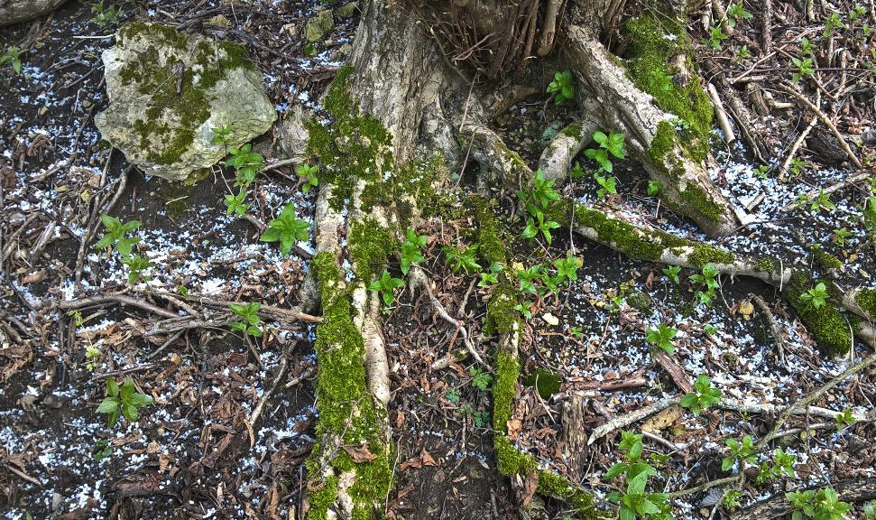

Slide 60
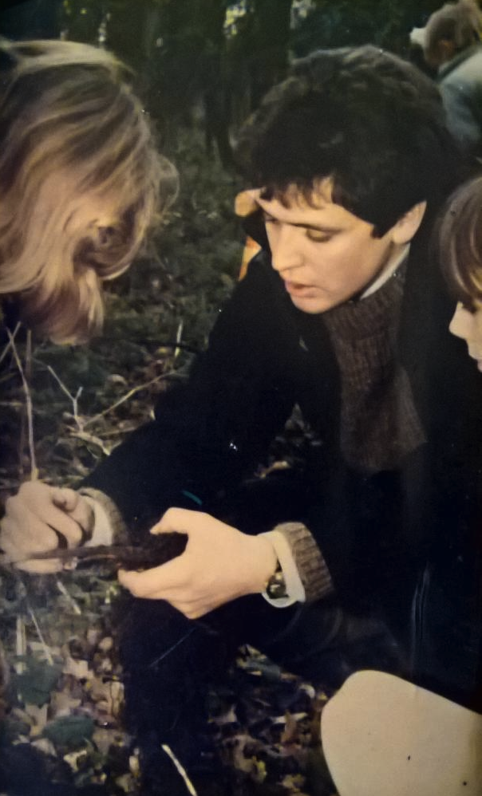

Slide 61
One of the most harmful habits in contemporary, in modern thought.. (is) ..the analysis of the present as being precisely, in history, a present of rupture, or of high point, or of completion or of a returning dawn... The solemnity with which everyone who engages in philosophical discourse reflects on his own time strikes me as a flaw.. It is a time like any other, or rather, a time which is never quite like any other. (Foucault 1984)
The suggestion is that we look for lines of fragility in the present:
to grasp how and why that-which-is might no longer be that-which-is... (for) ...these kinds of virtual fracture... open up the space of freedom., of possible transformation. (Foucault 1984)
“In abandoning hope that one way of life will continue, we open up a space for alternative hopes.” Tommy Lynch (2017).

Slide 62
Deep Adaptation
Resilience – “the capacity to adapt to changing circumstances so as to survive with valued norms and behaviours”
Relinquishment

Slide 63

Thank you
Questions?
If you have any further comments or questions, please come and talk or contact me at:
pvare@glos.ac.uk

Slide 64
References
A Rounder Sense of Purpose website: www.aroundersenseofpurpose.eu
  Jensen B B & Schnack K (1997) The Action Competence Approach in Environmental Education, Environmental Education Research, 3:2, 163-178
Leicht A, Heiss J & Byun W J (Eds.) (2018) Issues and trends in Education for Sustainable Development. Paris: UNESCO
Orr D (2004) Earth in Mind. Washington: First Island Press
Raworth K (2012) A Safe and Just Space for Humanity: Oxfam Discussion Paper Oxford: Oxfam
Rychen D S (2003) ‘Key competencies: meeting important challenges in life’ in Rychen DS & Salganik JH (eds) Key Competencies for a Successful Life and Well-functioning Society. Cambridge, MA: Hogrefe and Huber, pp63-107
Stockholm Resilience Centre: http://www.stockholmresilience.org/images/18.36c25848153d54bdba33ec9b/1465905797608/sdgs-food-azote.jpg
Wiek, Arnim, Lauren Withycombe, and Charles L. Redman. 2011. Key Competencies in Sustainability: A Reference Framework for Academic Program Development. Sustainability Science 6(2): 203–18.
UNECE (2011) Learning for the future: Competences in Education for Sustainable Development. Geneva: UNECE

Slide 65
