Slide 1
A Rounder Sense of Purpose Developing and measuring educator competence in Education for Sustainable Development
Dr Paul Vare
University of Gloucestershire
UKFIET Conference, University of Oxford
5-7 September, 2017

Slide 2
Six partner institutions aiming to:
…develop a practical accreditation model that teacher educators can use in any European context so that pre- and in-service educators can demonstrate their competence in ESD through a widely-recognised qualification.

Slide 3
ESD 1
ESD 2
Promoting (informed, skilled) behaviours and ways of thinking, where the need for this is clearly identified and agreed
learning for sustainable development
Building capacity to think critically about [and beyond] what experts say and to test sustainable development ideas
learning as sustainable development

Slide 4
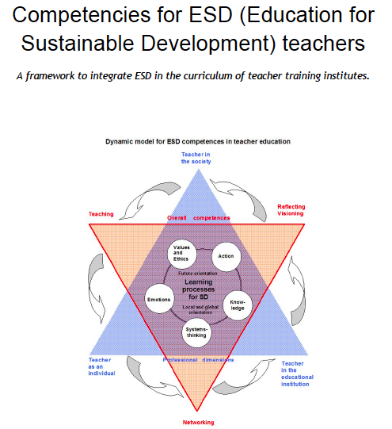
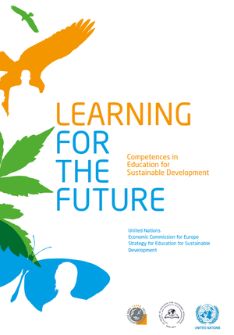
The United Nations Economic Commission for Europe (UNECE 2012)
Defined 39 ‘competences’.
(Sleurs 2008)
We ‘distilled’ the 39 UNECE competences
Refining, filtering, extracting the essential elements to define 12 competences
(Also using Wiek et al 2011 & Roorda 2012)

Slide 5
Thinking Holistically | Envisioning Change | Achieving Transformation
Integration:
Systems Competence The educator helps learners to develop an understanding of the world as an interconnected whole and look for connections across human and natural worlds and consider the consequences of our actions. | Futures Competence The educator uses a range of techniques to help learners explore alternative possibilities for the future and to use these to consider how our behaviours might need to change. | Participation Competence The educator contributes towards changes in education that will help sustainable development and encourages their learners to do the same.
Involvement:
Attentiveness Competence The educator alerts learners to fundamentally unsustainable aspects of our society and the way it is developing and conveys the urgent need for change. | Empathy Competence The educator is considerate of the emotional impact of the learning process on their learners and develops their self-awareness. | Engagement Competence The educator works flexibly and responsively with others, remaining aware of their personal beliefs and values, and encourages their learners to do the same.
Practice:
Transdisciplinarity Competence The educator acts collaboratively both within and outside of their own discipline, role, perspectives and values and encourages their learners to do the same. | Innovation Competence The educator takes an innovative and creative approach using real world contexts wherever possible. | Action Competence The educator focuses on the development of learners’ critical thinking skills and helps them to take considered actions in their own context
Reflection:
Evaluation Competence The educator helps learners to critically evaluate the relevance and reliability of assertions, sources, models and theories. | Responsibility Competence The educator acts transparently and accepts personal responsibility for their work and encourages their learners to do the same. | Decisiveness Competence The educator acts in a cautious and timely manner even in situations of uncertainty and encourages their learners to do the same.

Slide 6
Example: Futures Competence
The educator uses a range of techniques to help learners explore alternative possibilities for the future and to use these to consider how our behaviours might need to change.
Learning objectives The educator helps learners to…
5.1 Envision creatively and critically a range of possible or thinkable futures and their sustainability aspects, sharing and debating ideas, worldviews and possible evolutions; focusing near and far, moving flexibly between short and long term goals and perspectives
5.2 Recognise relations and possible evolutions between past, present, near future and far future worldviews, developments and actions
5.3 Anticipate how sustainability problems might evolve or occur over time, considering inertia, path dependencies and triggering events, critically assessing processes of change in society

Slide 9
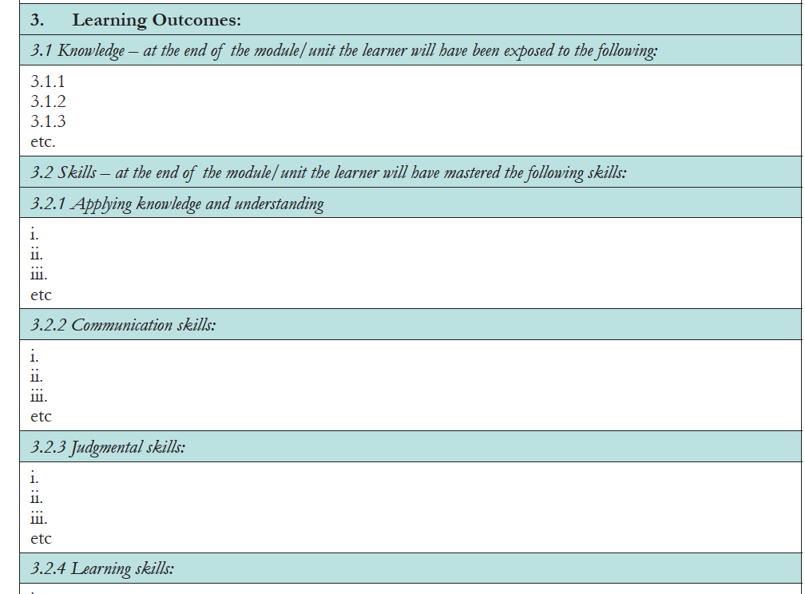
But how to assess the learning?
This is one approach
The atomisation of learning

Slide 10
At any academic ‘Level’ we suggest three stages of achievement

Slide 11
Vertical and horizontal:
dialogue; thinking; learning (After Wegerif 2011)
Horizontal: learning more e.g. about SDGs; learning the laguage of sustainability; doing the ‘right’ thing; ESD 1
Vertical: reflecting on and responding to new events, across contexts, challenging existing practices, e.g. critical thinking; consideration of underpinning ethical dimensions and values; ESD 2.

Slide 12
Assessment tools
Presentation and discussion including a question and answer session
Engagement in the question and answer session of one’s peers
(In 1 and 2 the assessor pays attention to the dialogic dimensions in play)
3. Portfolio – possibly multimedia
Under development…
Assessor’s guidelines on how to identify vertical and horizontal learning through learner dialogue in the context of ESD.

Slide 13
Thank you
References
Roorda N (2012) Fundamentals of Sustainable Development. London: Earthscan
Sleurs W (ed.) (2008) Competencies for ESD teachers. A framework to integrate ESD in the curriculum of teacher training institutes, Brussels Online at: http://platform.ue4sd.eu/downloads/CSCT_Handbook_11_01_08.pdf
Wegerif R (2011) Towards a dialogic theory of how children learn to think in Thinking Skills and Creativity 6 (2011) 179–190
Wiek A, Withycombe L, and Redman C L (2011) Key Competencies in Sustainability: A Reference Framework for Academic Program Development in Sustainability Science 6(2): 203–18.
UNECE (2012) Learning for the future: Competences in Education for Sustainable Development. Geneva: United Nations Economic Commission for Europe
Vare P & Scott WAH (2007) Learning for a Change: exploring the relationship between education and sustainable development; Journal of Education for Sustainable Development 1:2, 191–198

