Slide 1

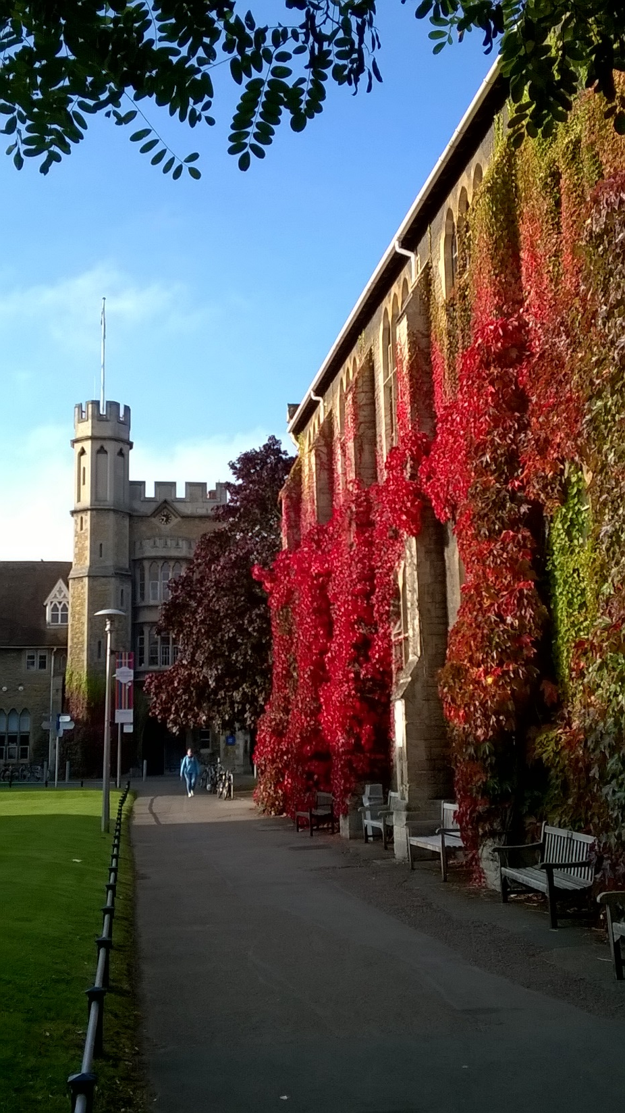
Reflections on education for sustainable development (ESD)
Dr Paul Vare
Postgraduate Research Lead, School of Education
UPCH, Lima
21st September 2018

Slide 2

London-Lima: 6,316 miles x 300gms CO₂ per passenger mile = 1,894,800, i.e. 2 tonnes of CO₂ + return trip =
4 tonnes CO₂

Slide 3
To Conclude…
Institutions also ‘teach’ their students simply by the way they operate.
The important thing is not how sustainable the institution is today but how seriously it tries to meet the challenges of tomorrow.

Slide 4
Plan
University of Gloucestershire; my background
A rationale for Education for Sustainable development (ESD)
Two sides of ESD
ESD competences
Managing contradictions in ESD
Questions

Slide 5
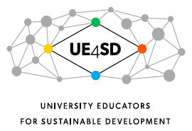







Campus
Curriculum
Community
Culture
The Environmental Association for Universities and Colleges

Slide 6
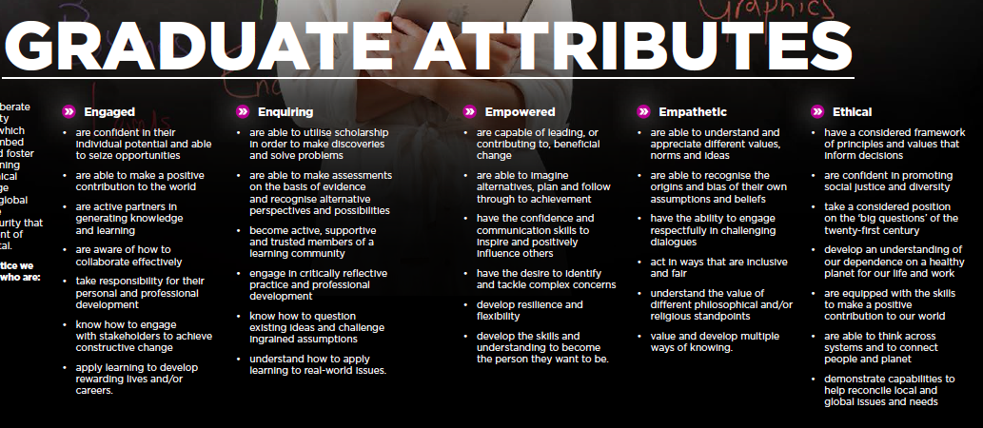

Slide 7
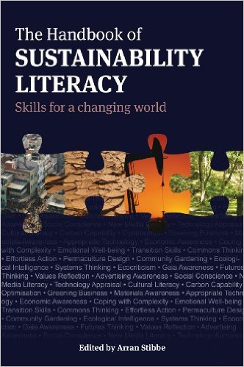


Slide 8
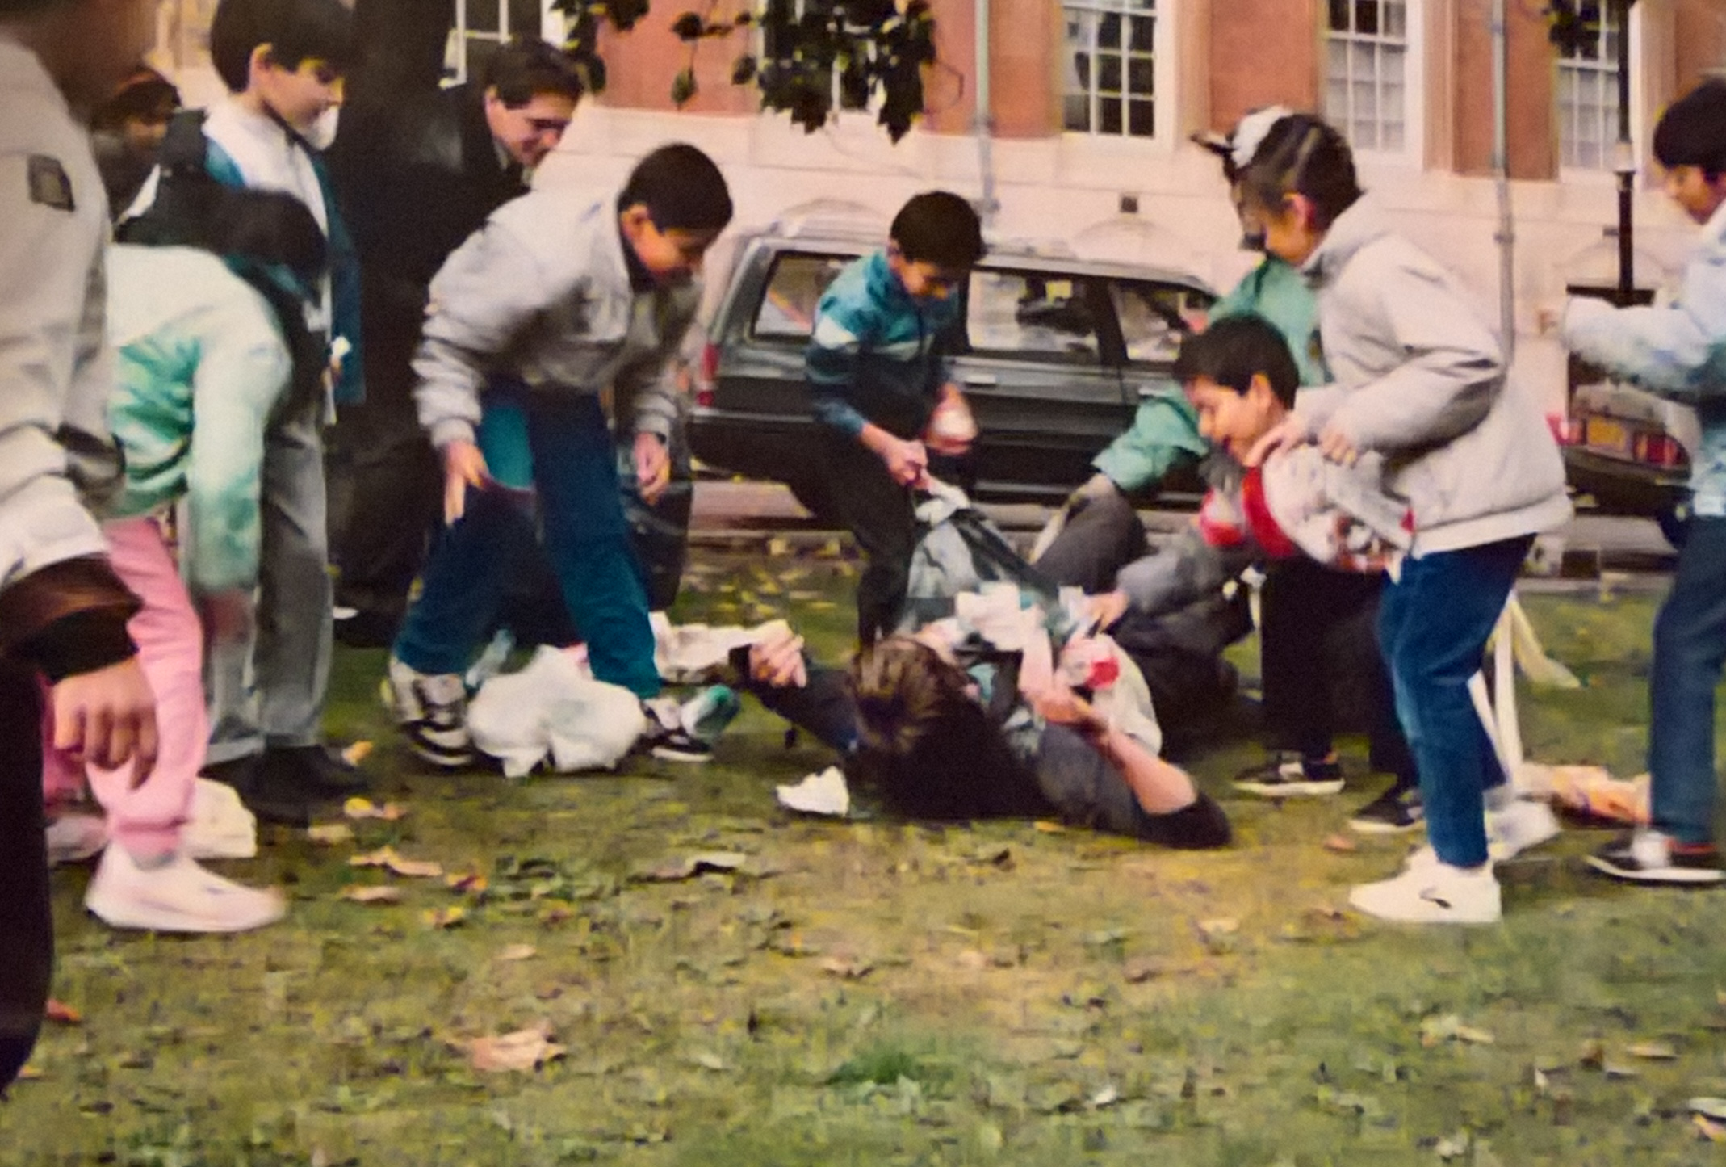
1987

Slide 9
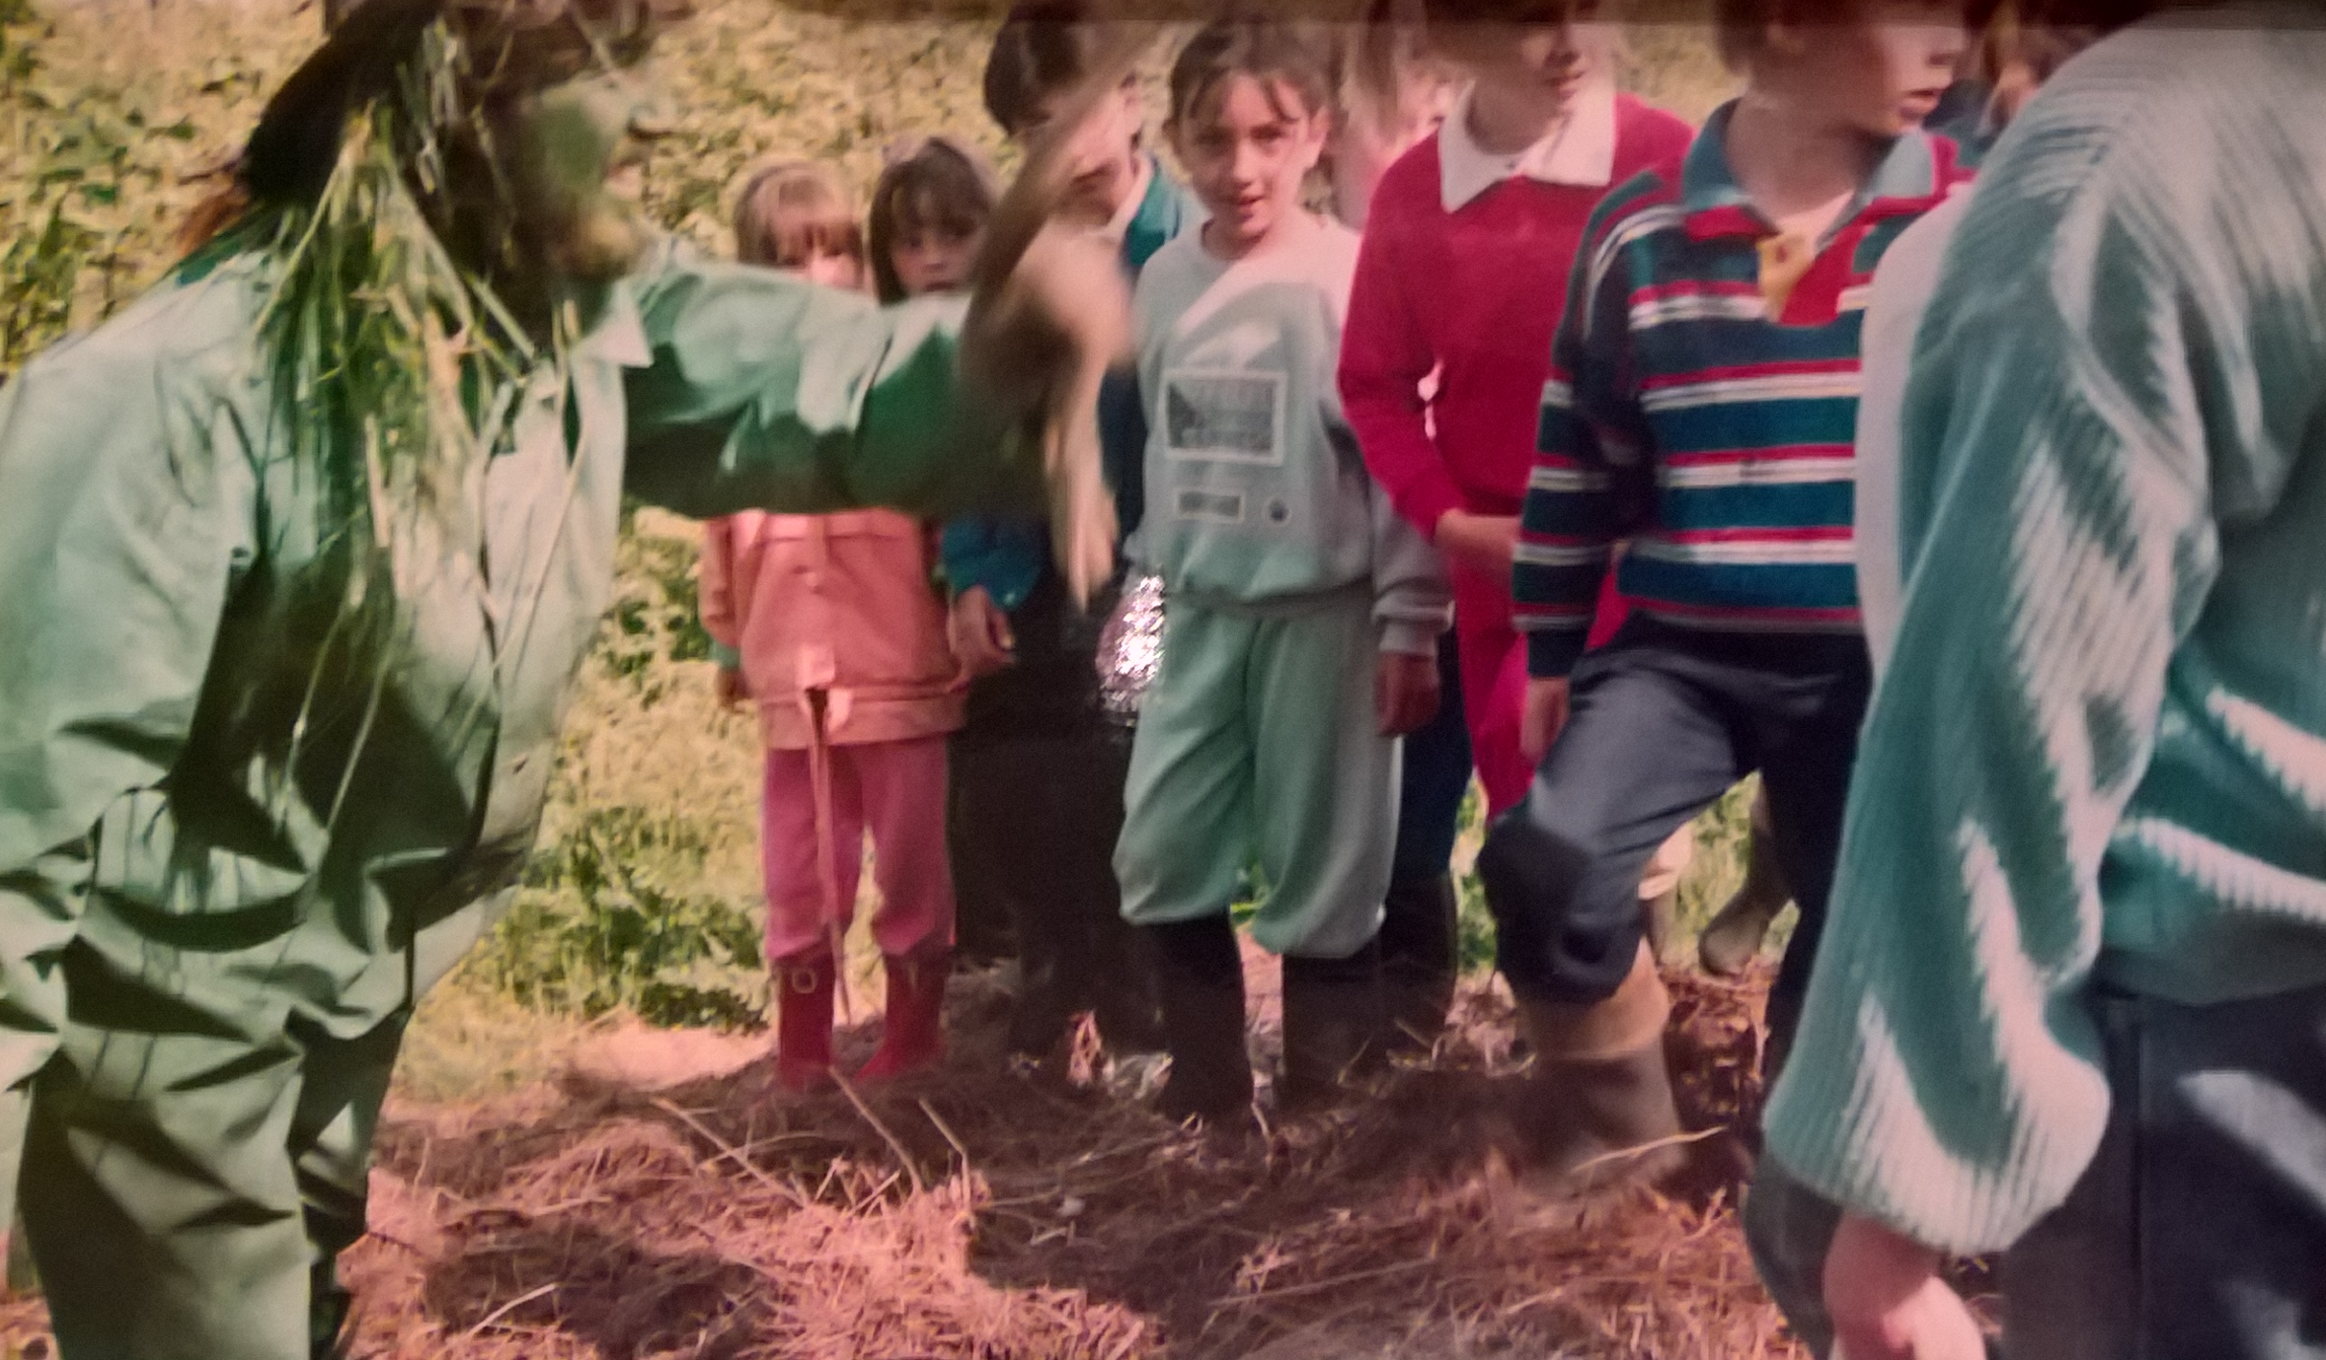

Slide 10
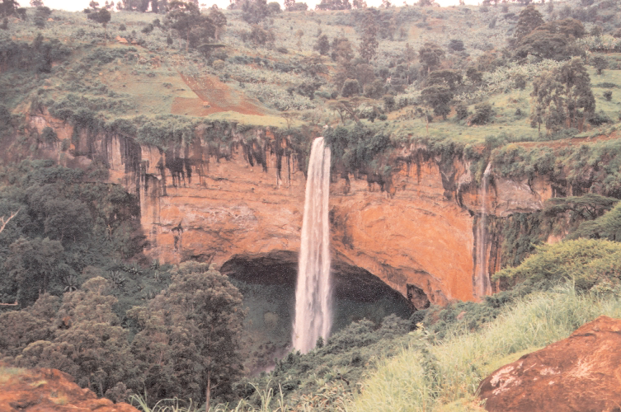

Slide 11
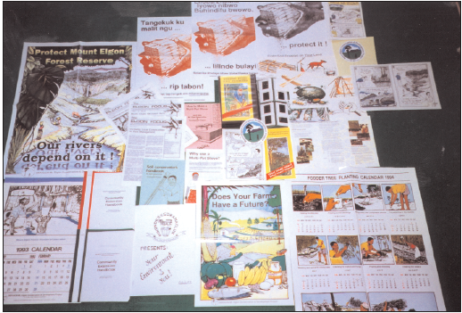
From this…

Slide 12
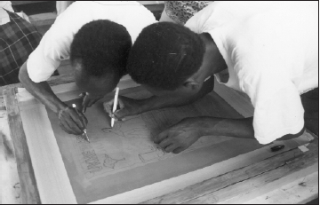
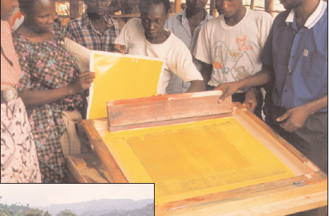
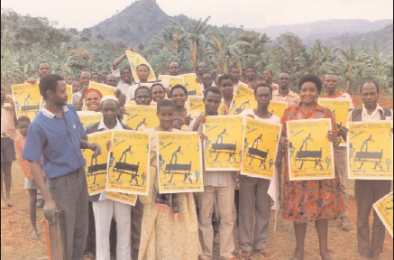
To this…

Slide 14


Slide 15


Slide 16
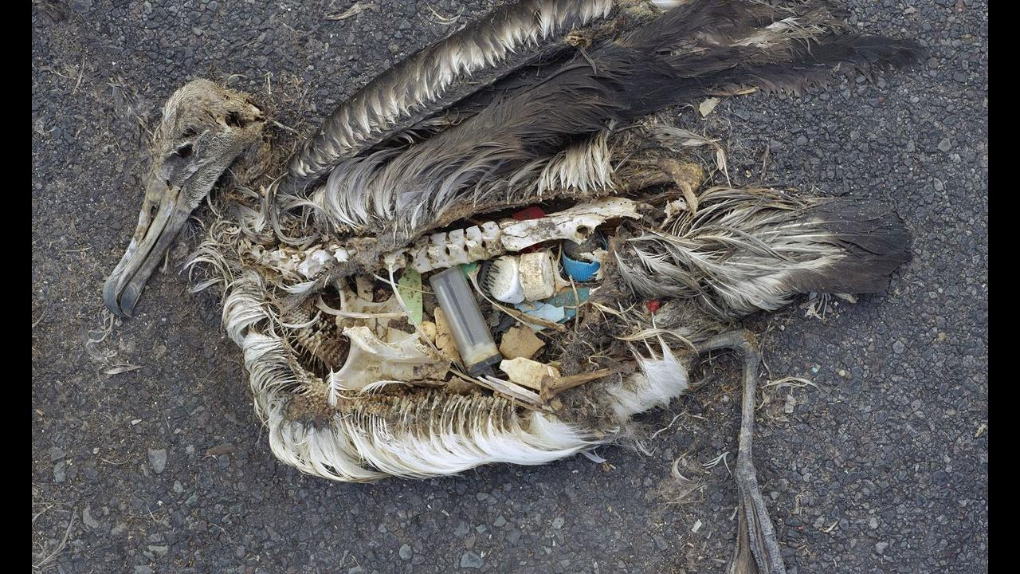

Slide 17
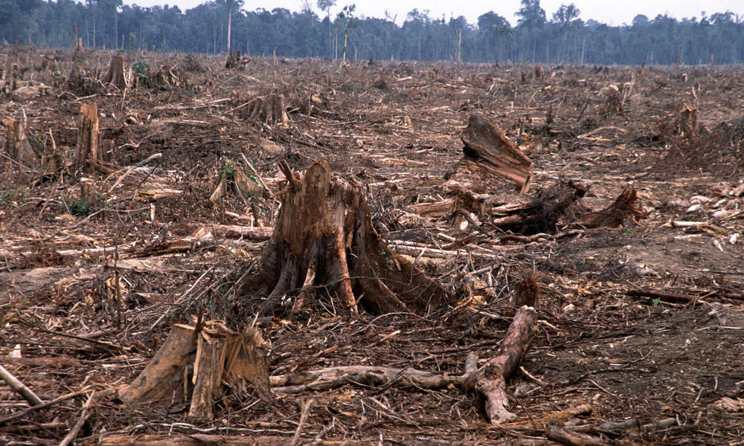

Slide 18
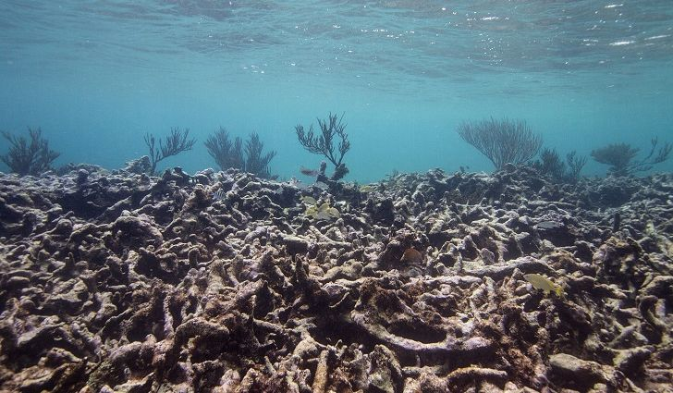

Slide 19


Slide 20
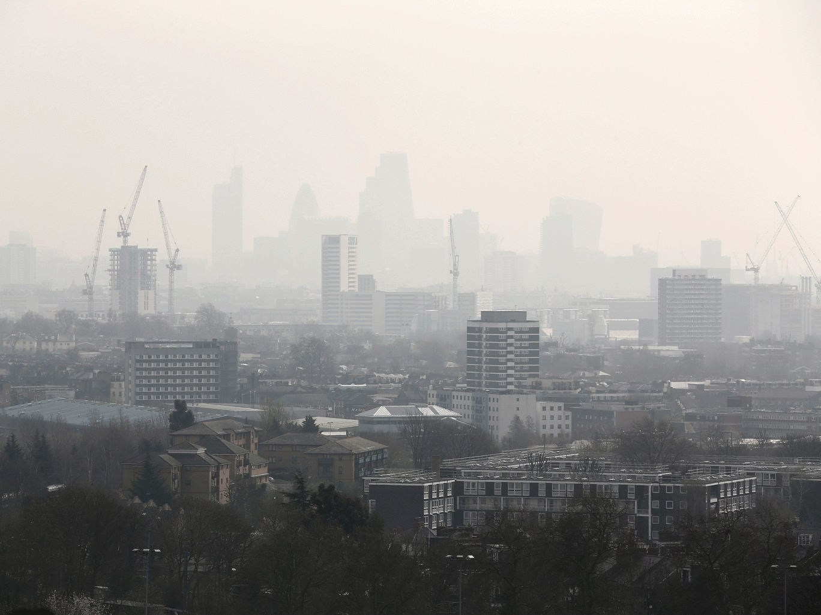

Slide 21
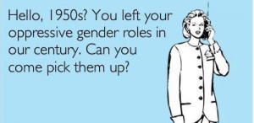

Slide 22


Slide 23
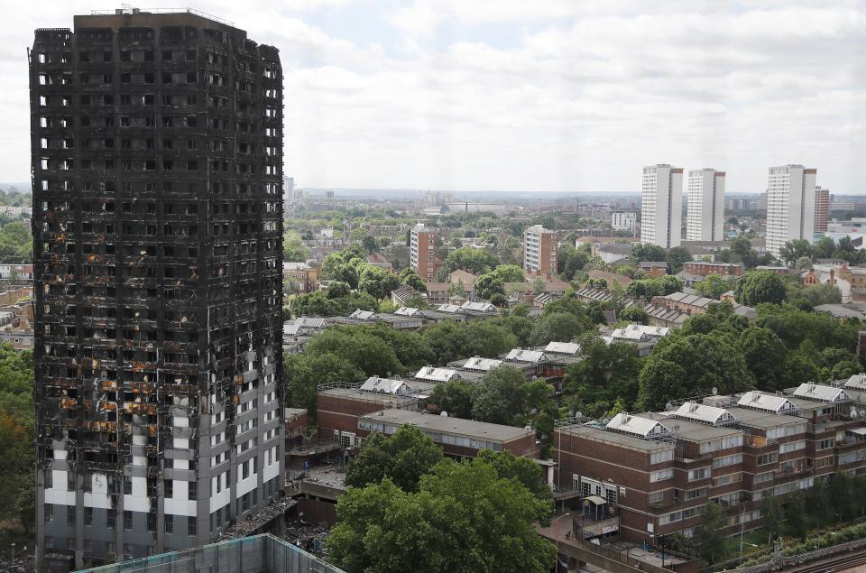

Slide 24
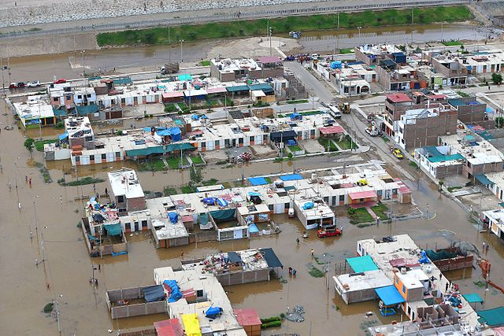

Slide 25
Don’t lose sight of hope!
Martin Luther King did NOT say…
“I have a nightmare…”

Slide 26
Economy
Society
Environment

Slide 27

Environment
Society
Economy

Slide 28
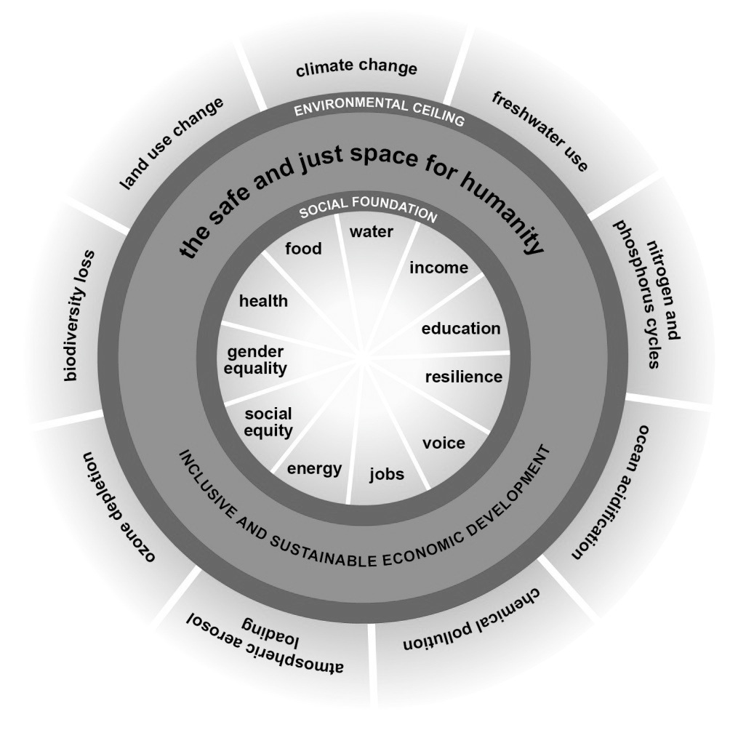
(Raworth 2013)
Notes:
We are overshooting the planet’s limits to sustain a safe, humanly habitable environment while still failing to address key social concerns adequately.
Sustainable development might be ‘covered’ by Geography teachers but it is tackled (or not) by everyone.
It’s our choice. We either choose to ignore these issues as irrelevant, and thus we remain part of the problem, or we engage in whatever capacity we find ourselves, seeing the connections between our own work and wider concerns.
For teacher educators this distinction is magnified immensely.

Slide 29


Slide 30


Slide 44
Is this really the purpose of education?
…perhaps most important of all, we must ensure that more people have the knowledge and skills they need to succeed in a demanding economy.
Nick Gibb MP
UK Schools Minister, England
2015
https://www.gov.uk/government/speeches/the-purpose-of-education

Slide 45
Is more education the answer?
“… many things on which our future health and prosperity depend are in dire jeopardy: climate stability, the resilience and productivity of natural systems, the beauty of the natural world, and biological diversity.
It is worth noting that this is not the work of ignorant people. Rather, it is largely the results of work by people with BAs, BScs, LLBs, MBAs and PhDs.”
(David Orr 2004)

Slide 46
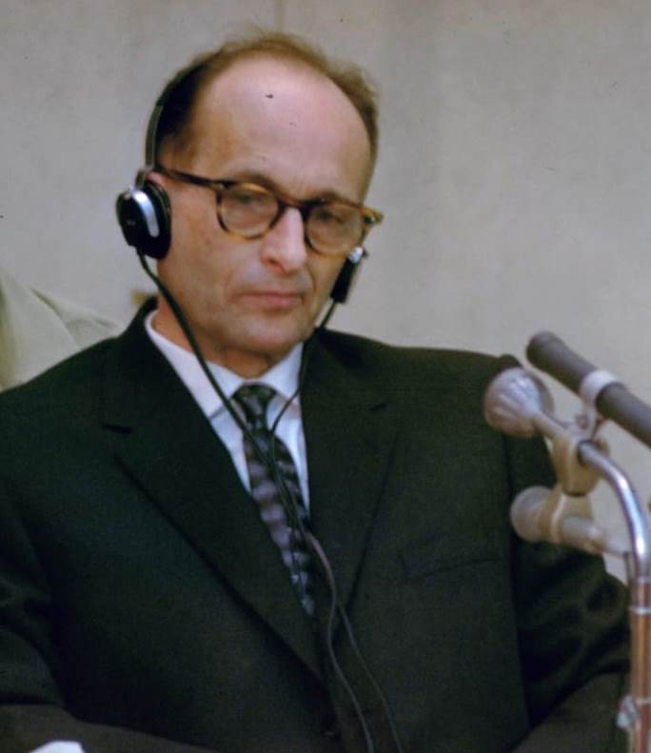
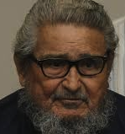
The persuasive professor
The effective manager

Slide 47
“If still more education is to save us, it would have to be education of a different kind…”
E F Schumacher

Slide 48
Diamond Ranking
Preferred
statement
Favoured
statement
Favoured
statement
Ambivalent
Ambivalent
Ambivalent
Less preferred statement
Less preferred
Statement
Least favoured statement

Slide 49
1
6
2
7
3
8
4
9
5

Slide 50

ESD 1
ESD 2
Promoting/
facilitating changes
in what we do
promoting (informed, skilled) behaviours and ways of thinking, where the need for this is clearly identified and agreed
learning for
sustainable
development
Building capacity to think critically about [and beyond] what experts say and to test SD ideas
exploring the contradictions inherent in sustainable living
learning as sustainable development
Vare & Scott (2007)

Slide 51
OECD’s Three Categories of Competency
Using tools interactively
Interacting in heterogeneous groups
Acting autonomously
(Rychen 2003)

Slide 52
Unesco’s Key competencies in ESD
Anticipatory competency
Normative competency
Strategic competency
Collaboration competency
Critical thinking competency
Self-awareness competency
Integrated problem-solving competency
Rieckmann in Leicht A, Heiss J & Byun W J (Eds.) (2018)

Slide 53
The UNECE Competences for Educators of ESD
Notes:
An unreadable slide. The UNECE framework – it’s unreadable in any language. It is not really workable in schools.

Slide 54






A Rounder Sense of Purpose
University of Gloucestershire
Frederick University (Cyprus)
Hungarian Research Teachers’ Association
Italian Association for Sustainability Science
Duurzame PABO (The Netherlands)
Tallinn University

Slide 55
X
X
We ‘distilled’ the 39 UNECE competences
Refining, filtering, extracting the essential elements to define 12 competences
(Also using Wiek et al 2011 & Roorda 2012)
X
X
Notes:
An unreadable slide. The UNECE framework – it’s unreadable in any language. It is not really workable in schools.

Slide 56
Systems – helping learners to see that everything is connected and how this impacts our lives
Attentiveness – researching issues to discover their importance, impact and possibilities for change
Transdisciplinarity – working together with people from different backgrounds
Criticality – asking why things are as they are, checking sources, recognising perspectives
Futures – imagining different possibilities for the future and describing their consequences
Empathy – understanding the centrality of emotions to learning; seeing situations as others do

Slide 57
Innovation – considering new ideas while learning from the past
Responsibility – being personally responsible and transparent in how we work
Participation – collaborating with others to improve the places where we live and work
Engagement – working from ‘who I am’ recognising my values and those held by others
Action – developing agency through involvement in meaningful, community-based change projects
Decisiveness – acting in good time, even when faced with dilemmas or situations of uncertainty.

Slide 58
Thinking Holistically | Envisioning Change | Achieving Transformation
Integration:
Systems The educator helps learners to develop an understanding of the world as an interconnected whole and to look for connections across our social and natural worlds and consider the consequences of our actions. | Futures The educator helps learners to explore alternative possibilities for the future and to use these to consider how our behaviours might need to change. | Participation The educator contributes towards system level changes that will support sustainable development and develops their learners’ ability to do the same.
Involvement:
Attentiveness The educator alerts learners to fundamentally unsustainable aspects of our society and the way it is developing and conveys the urgent need for change. | Empathy The educator is considerate of the emotional impact of the learning process on their learners and develops their self-awareness and their awareness of others. | Engagement The educator works responsively and inclusively with others, remaining aware of their personal beliefs and values and develops their learners’ ability to do the same.
Practice:
Transdisciplinarity The educator acts collaboratively both within and outside of their own discipline, role, perspectives and values and develops their learners’ ability to do the same. | Innovation The educator takes a flexible and creative approach using real world contexts wherever possible and encourages creativity within their learners. | Action The educator takes action in a proactive, considered and systematic manner action and develops their learners’ ability to do the same.
Reflection:
Criticality The educator critically evaluates the relevance and reliability of assertions, sources, models and theories and develops their learners’ ability to do the same. | Responsibility The educator acts transparently and accepts personal responsibility for their work and develops their learners’ ability to do the same. | Decisiveness The educator acts in a cautious and timely manner even in situations of uncertainty and develops their learners’ ability to do the same.

Slide 59
“As soon as you start to teach one of the competences, you inevitably touch on the other eleven.”
(Teacher in The Netherlands)

Slide 61
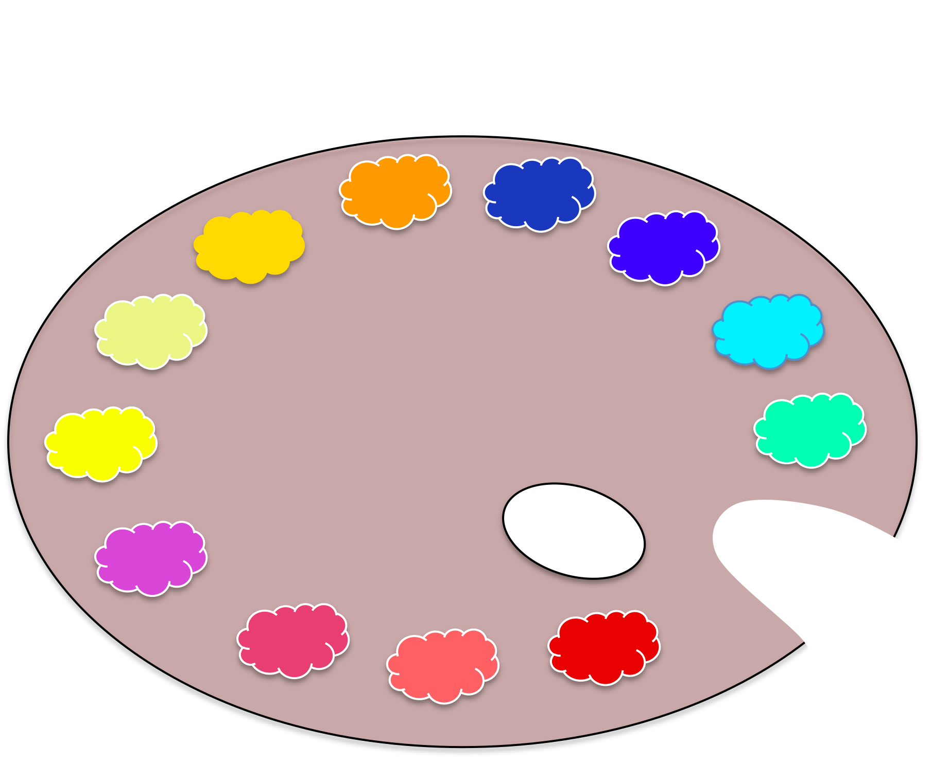
The RSP
Pallet

Slide 62
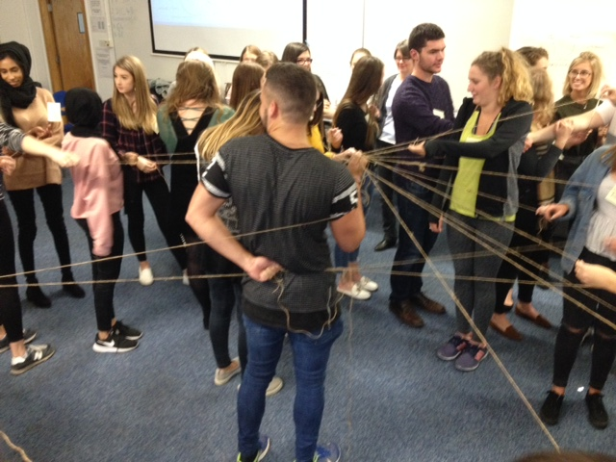
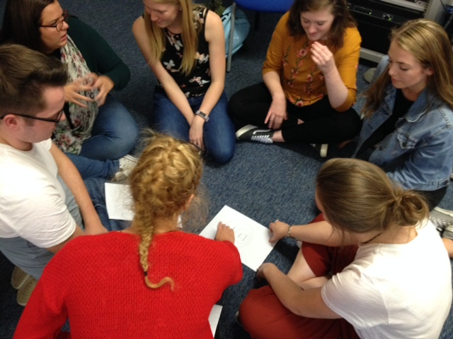
Systems

Slide 63
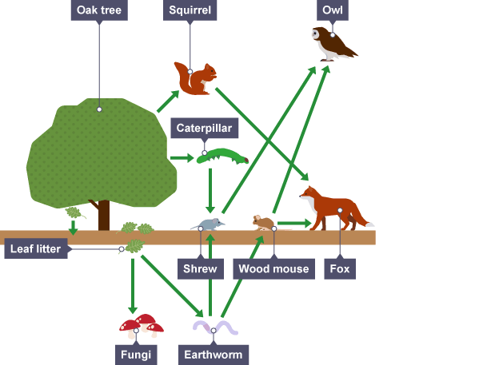
http://www.bbc.co.uk/education/guides/z2m39j6/revision/2

Slide 64
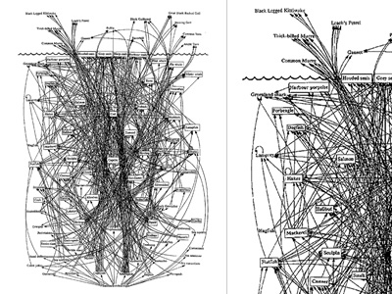
http://www.visualcomplexity.com/vc/project.cfm?id=47

Slide 65
Two words on complexity
Autopoiesis – self-creation
create possibilities to resolve issues
Emergence – unforeseen outcomes look beyond objectives to see what learners do with your inputs

Slide 66
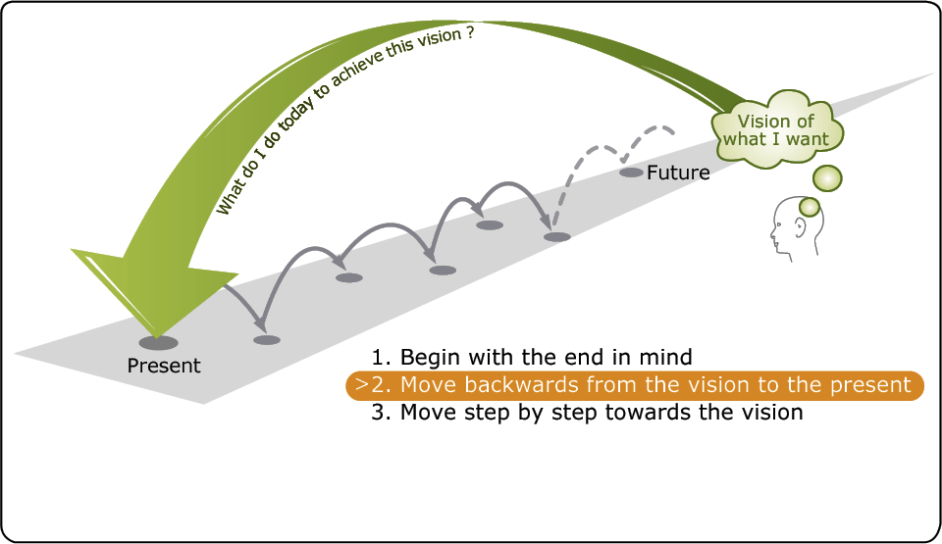
Futures

Slide 67
Transdisciplinarity
‘Wicked’ problems are multi-faceted…

Slide 68
…so they draw on multiple disciplines…
There will always be a need for discipline-based expertise

Slide 69
…which demands inter-disciplinary working…

Slide 70
Inter-disciplinary communication can still leave key people out of the picture

Slide 71
Trans-disciplinary boundary-crossing takes it further
Does everyone need all of these competences for us to be sustainable?

Slide 72
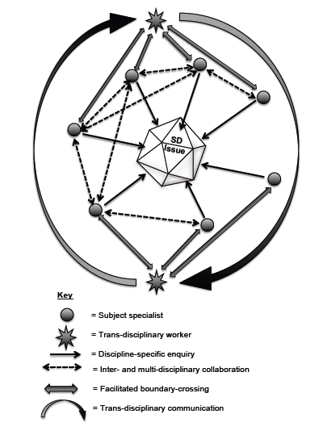

Slide 73


And trust

Slide 74
Example activity: discuss these three words
Empathy
Understanding: Is knowing without feeling.
Sympathy: Is feeling FOR people. It’s based on pity. It can drive disconnection.
Empathy: Is feeling WITH people. It’s based on support. It fuels connection.
Understanding:
Sympathy:
Empathy:
Notes:
Activity 2 – how are they feeling?

Slide 75
Action
What
Why
Knowledge about an issue
Where/ When
How

Slide 76
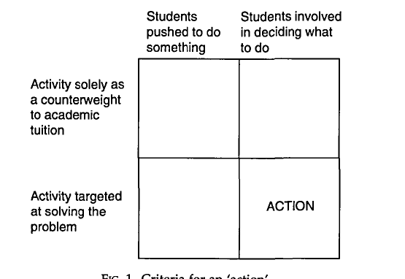
Criteria for ‘action’’
Jensen & Schnack 1997

Slide 77
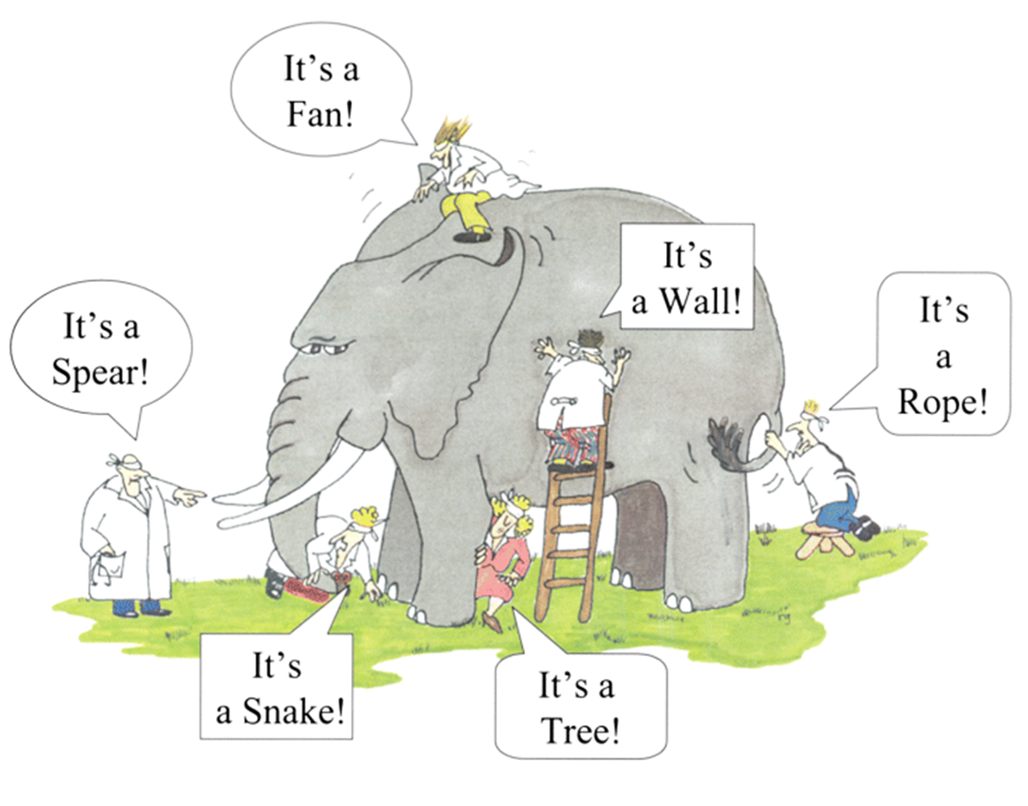
Criticality

Slide 78
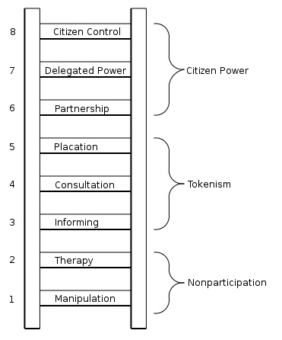
Participation
Arnstein’s
Ladder of Citizen
Participation

Slide 79
Example activity
Attentiveness
In pairs, investigate the question you are given
(NB These are: a global issue; a specific example; a positive action)
In groups, share findings from your pairs
Discuss the links that you see
Prepare a presentation using the findings of all three pairs, outline the main points found

Slide 80
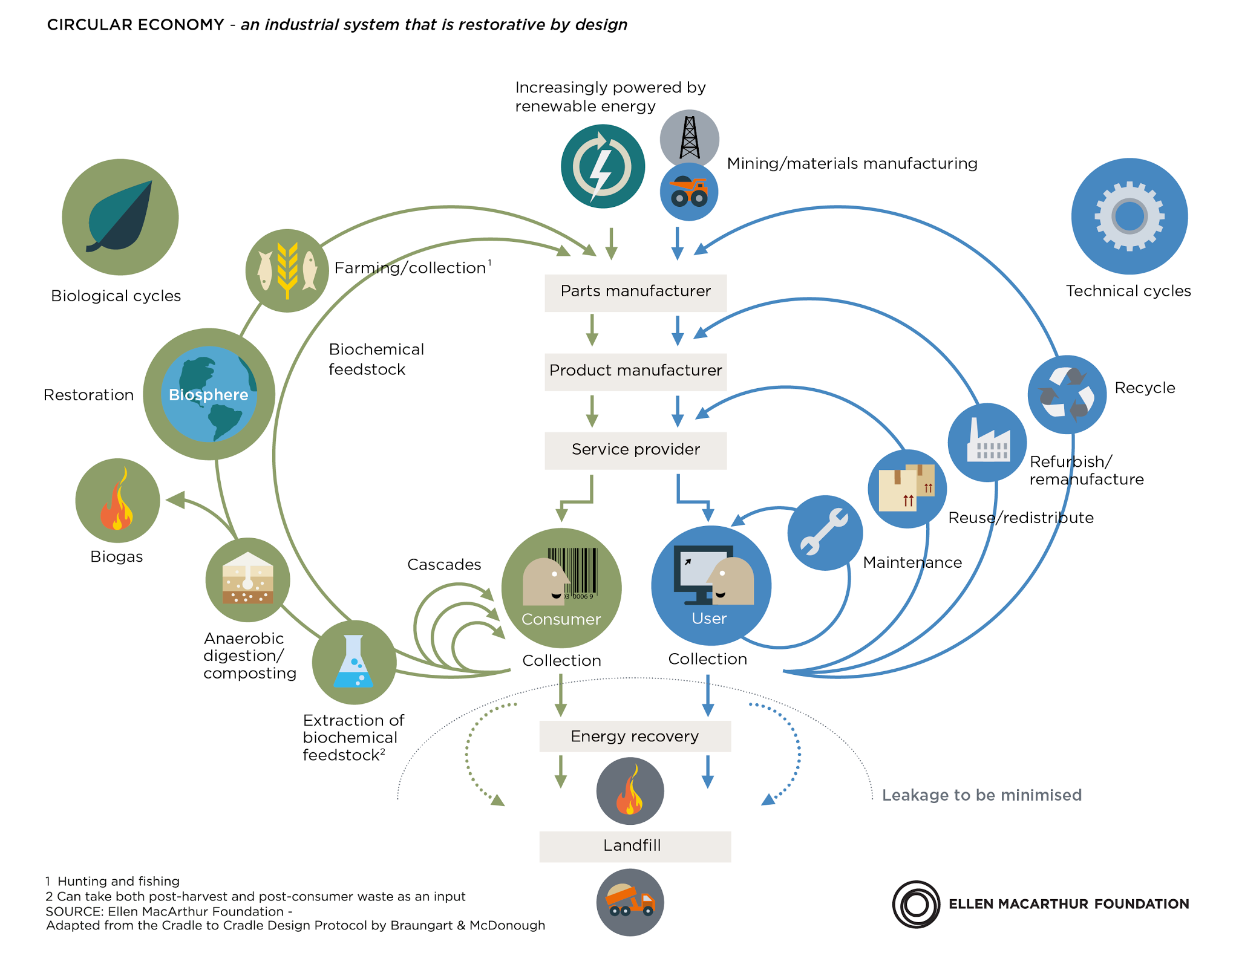
Innovation

Slide 81

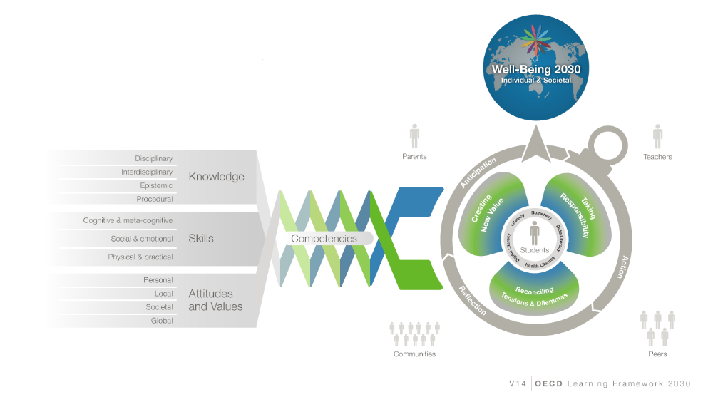
Next steps…
RSP2
Alignment with OECD’s
E2030 framework?

Slide 82
Contradictions in promoting ESD
A study that investigated the contradictions inherent in promoting ESD in schools identified five ways in which contradictions are recognised and rationalised:
(Vare, forthcoming)

Slide 83
Unawareness
Not recognising any contradiction.
Powerlessness
Where a teacher is frustrated, e.g. because they lack the authority to realise their own vision.
Denial
Larger forces, such as cultural trends or Government inspections may be resented but not resisted by the teacher; they simply hope it will be resolved over time.

Slide 84
‘Satisficing’
Teachers find ‘good enough’ compromises based on professional judgements.
These are intelligent survivors who ‘play the game’ and respond to competing priorities but do not lose sight of their own beliefs and values.

Slide 85
Expansive Learning
– ESD 3?
Contradictions are worked through by ‘expanding’ the problem to overcome the contradiction, e.g.:
A teacher linking sustainability and inclusion in order to overcome any contradiction with her role as special needs coordinator
A zoning system for play areas that reverses a situation where children were punished by being sent outside to tidy the grounds!

Slide 86
By taking opportunities to share creative solutions to issues, teachers can demonstrate the kind of learning that we need in a sustainable society.
By managing contradictions teachers can model what it means to be a resilient learner, i.e. someone with adaptive capacity.
In this way the teacher is is a critical resource for ESD.

Slide 87
Possibly, the most valuable lesson that educational professionals can share with young people is not what they teach or how they teach it – but who they are.

Slide 88
Institutions also ‘teach’ their students simply by the way they operate.
The important thing is not how sustainable the institution is today but how seriously it tries to meet the challenges of tomorrow.
Good luck UPCH and colleagues!

Slide 89
Thank you
Questions?
If you have any further comments or questions, please come and talk or contact me at:
pvare@glos.ac.uk

Slide 90
References
A Rounder Sense of Purpose website: www.aroundersenseofpurpose.eu
  Jensen B B & Schnack K (1997) The Action Competence Approach in Environmental Education, Environmental Education Research, 3:2, 163-178
Leicht A, Heiss J & Byun W J (Eds.) (2018) Issues and trends in Education for Sustainable Development. Paris: UNESCO
Orr D (2004) Earth in Mind. Washington: First Island Press
Raworth K (2012) A Safe and Just Space for Humanity: Oxfam Discussion Paper Oxford: Oxfam
Roorda N (2012) Fundamentals of Sustainable Development. London: Earthscan
Rychen D S (2003) ‘Key competencies: meeting important challenges in life’ in Rychen DS & Salganik JH (eds) Key Competencies for a Successful Life and Well-functioning Society. Cambridge, MA: Hogrefe and Huber, pp63-107
Vare P (2007) From practice to theory: participation as learning in the context of sustainable development projects in A.D. Reid, B.B. Jensen, J. Nikel & V. Simovska (eds), Participation and Learning: perspectives on education and the environment, health and sustainability. Dordrecht: Springer Press.
Vare P and Scott W (2007) Learning for a Change: Exploring the relationship between education and sustainable development, Journal for Education for Sustainable Development, Vol.1 (2) 191-198
Wiek, Arnim, Lauren Withycombe, and Charles L. Redman. 2011. Key Competencies in Sustainability: A Reference Framework for Academic Program Development. Sustainability Science 6(2): 203–18.
UNECE (2011) Learning for the future: Competences in Education for Sustainable Development. Geneva: UNECE

Slide 91
