Slide 1
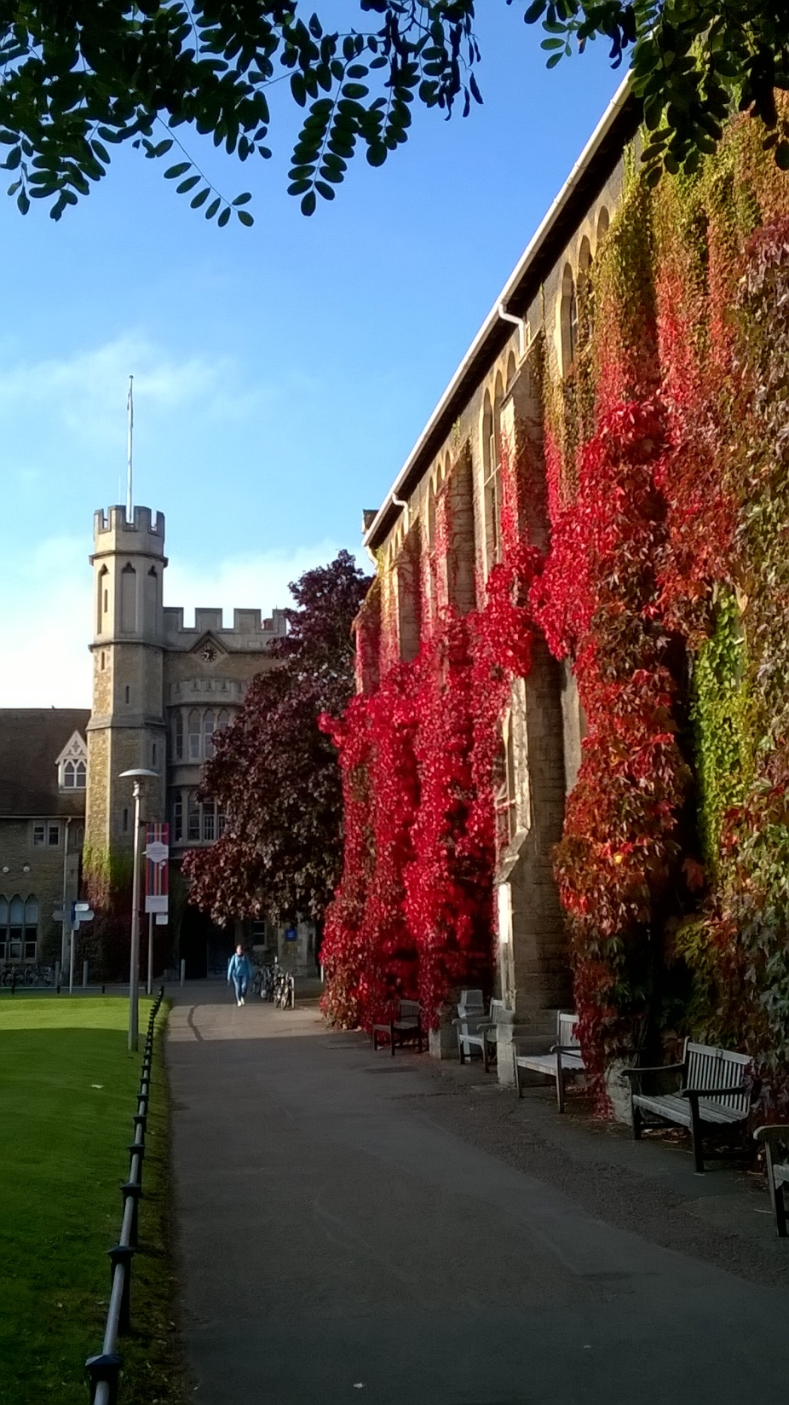
Be the change? You’ve no choice. Discovering autopoiesis in schools as a response to unsustainability
Dr Paul Vare
University of Gloucestershire, UK
Australian Association for Environmental Education Conference, October 2016

Slide 2
Overview
Context: me; global issues; EE/ESD; the research
Some of the research findings
Contradictions
Teachers’ responses
Implications
Assessment
Recognising complexity

Slide 3
To conclude…
Teaching EE/ESD demands both ESD 1 and ESD 2
We all face dilemmas and contradictions - teachers can self-create possibilities to resolve these (autopoiesis)
ESD 3 is the emergent property of good EE/ESD
The terms in red relate to complexity theory; this suggests that we change systems simply by being a part of them (we are never apart from them).

Slide 4
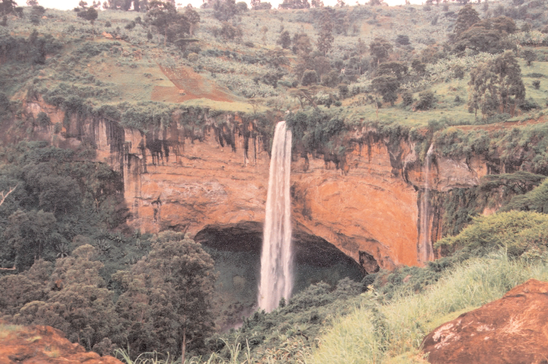

Slide 5
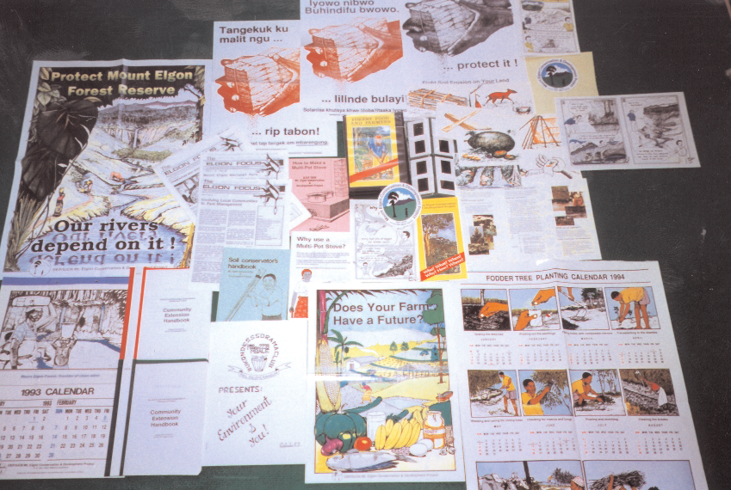

Slide 6
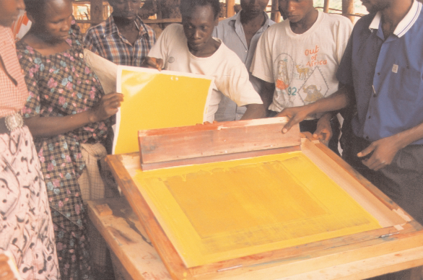

Slide 7
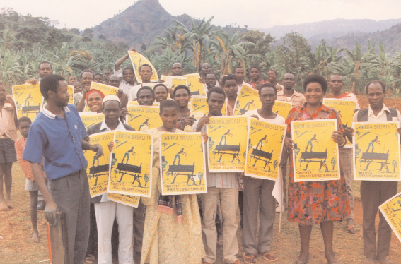

Slide 8
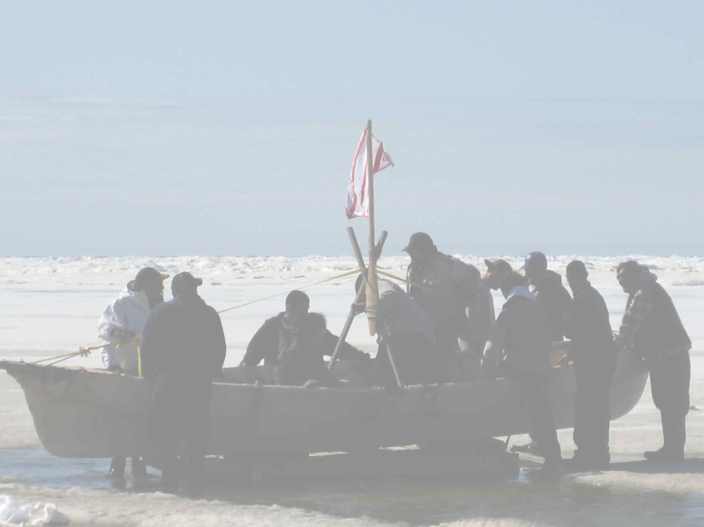

Slide 9
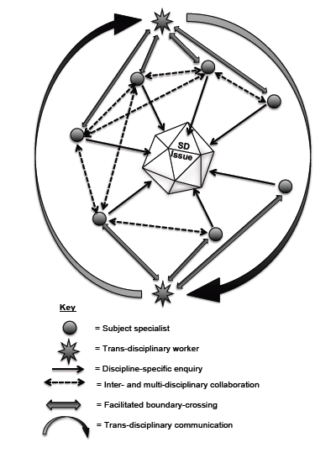
Vare (2014)

Slide 10
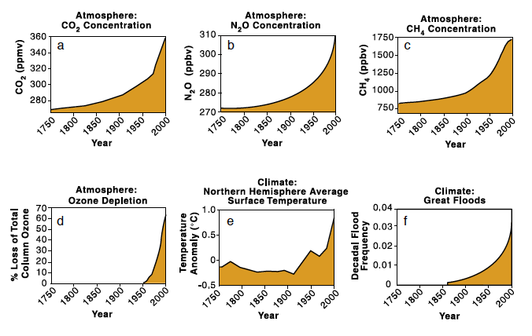
It’s not looking good…
Steffen et al, (2004)

Slide 11
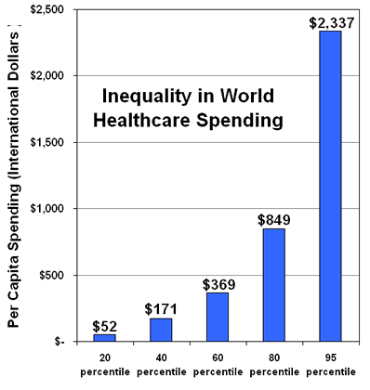
…or fair...
http://ucatlas.ucsc.edu/health

Slide 12
…or sensible.
Source: Ellen MacArthur Foundation

Slide 13
We have a tendency to commit terrible deeds thoughtlessly due to a failure to think critically.
But we don’t intend to do harm.
To paraphrase Hannah Arendt:
This highlights the role of education.

Slide 14
ESD 1
ESD 2
Promoting/ facilitating changes in what we do
Promoting informed behaviours and ways of thinking, where the need is identified and agreed
learning for sustainable development
Building capacity to think critically beyond what experts say - testing sustainability ideas
exploring the contradictions inherent in sustainable living
learning as sustainable development
Vare & Scott (2007)

Slide 15
And yet…
In EE/ESD there remains a persistent theory-practice gap.
(Stephenson 1987; 2007a&b)

Slide 16
Aspects of neoliberalism
Individualisation
Inequality
Insecurity
Depoliticization
Financialization
(Lazzarato 2009)

Slide 17
So the research asked:
To what extent do teachers recognise contradictions in attempting to implement education for sustainable development in their schools?
How do they approach these contradictions?

Slide 18
The theoretical framework: Cultural-historical Activity Theory
Unit of analysis = the activity system

Slide 19
Activity System:
Tools and signs
Object
Subject
Sense/meaning
Outcome
Transformation
Rules, Customs
(Culture)
Division
of Labour
Community
(See: Engeström 1987)

Slide 20
The research setting
Twelve English schools (primary and secondary)
Timing, 2011/12, just after Labour Government
Primary data gathered through semi-structured interviews (12 teachers/heads)
Supplementary evidence (websites, Ofsted reports, etc.) verified through additional interviews plus dilemma analysis

Slide 21
Some findings

Slide 22
Some Emerging themes
EE/ESD seen as saving money or marketing the school
Focus on improving grades
Atomised curriculum
Sustainability as means to reach community, not vice versa
Juggling multiple commitments
Government impact
Creeping managerialism

Slide 23
Fear and performativity?
“…if my reading, writing and maths results dip I know there’s going to be a knock at the door and I’m, you know, nights at Tesco’s here I come.”
(Primary Headteacher)

Slide 24
Four positions of sustainable schools
1. Discreet: Isolated projects
2. Dutiful: Adhering to a given framework
3. Dynamic: Looking beyond frameworks
4. Diffuse: Simply the way the school works

Slide 25
Layers of Contradiction
“Technology like photo-voltaic arrays … are important as demonstrations to our students.”
versus
“Sustainability is not about the ‘bling’ of technology, it’s about the school ethos…”

Slide 26
Creating a culture that encourages staff to take pupils outside
versus
Punishing pupils by sending them out to pick up litter around the school field

Slide 27
“Our goal has to be student achievement – Ofsted only benchmark us on whether children can read, write and count.”
versus
“Policies change every few years so one can work around them or simply wait them out.”

Slide 28
“…if [a classroom assistant] is saying, ‘…you can get those sort of bananas lots cheaper than that in Asda and they’re not Fairtrade, that’s so much the better.’ Those little things… can undermine...”
(Melanie)

Slide 29
But:
While several contradictions are revealed, perhaps the most significant finding is the extent to which these are not identified as contradictions by the interviewees themselves.

Slide 30
Four ways in which contradictions are recognised and rationalised:

Slide 31
1. Unawareness
Interviewer: The Sustainable Schools Strategy of the last Government, is that something you were aware off?
Cheryl: No, not really. No [laughing].
There is no prospect of overcoming a discourse-practice gap if practitioners are not exposed to the discourse.
Notes:
Uncritical, not seeing the contradiction between, for example, the desired outcome of ‘thinking activists’ and the most commonly adopted strategy of safely pre-determined activity.

Slide 32
2. Powerlessness
“I think I’ve got to the point where I’m thinking, we have to progress. And, until we do, I’m not willing, I want us to not have that Green Flag flying there until we do.” (Rebecca)
Schools it seems have their own rhetoric reality gaps.
Notes:
Where a teacher’s vision of the ‘object’ of their activity system is more advanced than that of their school leadership and possibly the rest of their school community.

Slide 33
3. Accommodation or ‘satisficing’ (Cuban 1992)
Impacts of neoliberal ideology such as narrow inspection regimes are resented but not resisted.
“…I have my performance management objective to reduce energy costs by 5% per year, which I think is probably quite unusual.” (Michael)
Notes:
Cognitive dissonance is avoided by finding ‘good enough’ compromises about what to sacrifice while acting in line with intrinsic values.
Individuals and systems are intelligent survivors who ‘play the game’ in response to competing priorities and values.

Slide 34
“I might get an email back saying, ‘Well, be careful, you’ve only been a teacher for a year, … so I very quietly feed it in, and let people think it’s their idea. It’s like living with a man!”
(Louise)

Slide 35
4. Expansive Learning
Two examples:
The headteacher:
Discussing her zoned playground with woodland, landscaped grass, flat grass and tarmac:
“…if anybody doesn’t stick to those rules they’re moved into the next zone down until they’re on Zone One, which is the tarmac area, which bores them to tears and they hate it, so they kind of earn the right to come out again.” (Heather)
Notes:
Contradictions are worked through by expanding the system, making an ‘invisible breakthrough’ (Engeström 1987) to overcome the contradiction.
Some examples: The special educational needs co-ordinator in a secondary school, overcoming contradictions by linking sustainability and inclusion as related and underpinning principles:

Slide 36
The special educational needs co-ordinator:
“There’s been a behaviour review, where I’ve been leading a secret flag of inclusion within that behaviour review and a secret flag of sustainability. So that when people are talking about things, I introduce the dialogue of inclusion, the dialogue of sustainability.”
(Louise)
Notes:
The headteacher avoiding a situation where time spent outdoors is seen as punishment (collecting litter) by zoning the landscaped school grounds so that children have access to zones of woodland and grass but:

Slide 37
The professionals in these examples demonstrate that the current social reality is not inevitable.
“…species do not adapt to environments; they construct them”
(Lewontin in Engeström 1987)

Slide 38
Autopoiesis = self-creation
These demonstrations of autopoietic organisation show that schools are simultaneously producers and products of their own system.
See: Maturana & Varela (1994)
Notes:
By absorbing contradictions and weaving them into the tight fabric of their hectic professional lives, teachers are modelling what it is to be a resilient learner with a high degree of ‘adaptive capacity’ (Smith & Green 2011).

Slide 39
In this way schools can demonstrate the kind of learning that makes a resilient society.
Teachers who survive the system are resilient individuals.
Notes:
Teachers who take opportunities to discover and share creative ways of addressing a wide range of concerns can offer children a model of learning that they may adopt and adapt for themselves.

Slide 40
Possibly the most valuable lesson that professionals working in a sustainable school can share with young people is not what they teach (ESD 1) nor how they teach it (ESD 2) – but who they are.
The emergent outcomes or expansive learning that results from this might be termed ESD 3.

Slide 41
Some ESD 3 (emergent) outcomes among pupils:
Making connections
Students who had grown a glut of tomatoes gave them to peers who made chutney that they sold to buy resources for their link school in Kenya.
As their teacher said: “That was a brief moment where I thought we made it.” (Bob)
Notes:
Growing food organically, entrepreneurship and global awareness all linked by student-initiated action.

Slide 42
2. Taking sustainability beyond the primary-secondary transition
“I know some of them have gone to (secondary school) staff and said ‘we want to do this’ and certain things have started up...” (David)

Slide 43
3. Improving attendance
“Our travelling community, who traditionally have every Friday off and every other day in between ... One little lad … did some planting and he said ‘hey miss, I’m coming back tomorrow to see whether that’s grown…’
And there he was in the morning, the first thing he said to me, ‘I’m here, I want to see if my plant’s OK’.”
(Heather)

Slide 44
Fulfilling who’s potential?
Focusing assessment only on pre-determined learning outcomes underplays the richness and value of these learning experiences
The phrase ‘fulfil their potential’ is extremely limiting in its ambition.

Slide 45
These outcomes were not foreseen
To ‘measure’ them teachers need research skills of their own plus the possibility of working with others in order to discover what happened and why
In this way, assessment becomes part of a teacher’s professional development.

Slide 46
Which brings us to Complexity Theory
Emergent properties, which cannot be predicted from the sum of their parts, will arise
Systems will self-organise
Systems that are between order and chaos are the most resilient.
(Pueyo 2014)

Slide 47
In a recent project on teacher CPD in foreign languages we learned that…
…allowing participating schools complete flexibility within certain parameters…
Needs analysis
Face-to-face CPD
Sharing resources on a VLE
…has allowed resilient professional-to-professional networks to emerge.
This is Complexity Theory at work!

Slide 48
Making connections
Lead School
Partner School
Facilitator
University

Slide 49
31 Secondary schools 237 Primary schools
Lead School
1st Contact
Partner School
2nd Contact
Facilitator
3rd Contact
University
4th Contact

Slide 50
http://www.vicologamba.it/?m=201112
https://www.healthtap.com/user_questions/1168476
Wikimedia Commons: Internet map 1024.jpg
Notes:
Systems self-organise creating fractal patters, whether it’s the internet, the cosmos or our own blood vessels echoing the veins in a leaf.

Slide 51
What does this tell us about supporting EE/ESD?
Provide a limited number of parameters within which frameworks operate.
ESD 1 (content)
ESD 2 (process)
The tools of analysis (teacher-led research)
To look for:
ESD 3 (emergent outcomes)…
… and share the learning.

Slide 52
As for neoliberalism…
Individualisation
Inequality
Insecurity
Depoliticization
Financialization
Collaborate (grasp that we are our relationships)
Share; broaden the value base
Network; build trust
Be political – recognise an ideology when it bites you on the bum
Critique your values; volunteer

Slide 53
To summarise…
Teaching EE/ESD demands both ESD 1 and ESD 2
We all face dilemmas and contradictions - teachers can self-create possibilities to resolve these (autopoiesis)
ESD 3 is the emergent property of good EE/ESD
The terms in red relate to complexity theory; this suggests that we change systems simply by being a part of them (we are never apart from them).

Slide 54
Thank you
pvare@glos.ac.uk

Slide 55
References
Arendt H (1994) Eichmann in Jerusalem: a report on the banality of evil (revised edition). London: Penguin
Ball S J & Olmedo A (2013) Care of the self, resistance and subjectivity under neoliberal governmentalities in Critical Studies in Education, 54:1, 85-96
Cuban L (1992) Managing Dilemmas while Building Professional Communities, in Educational Researcher, 21:1, 4-11
Engeström Y (1987) Learning by Expanding: An Activity - Theoretical Approach to Developmental Research. Helsinki: The Laboratory of Comparative Human Cognition
Accessed March 2016 at: http://lchc.ucsd.edu/mca/Paper/Engestrom/expanding
Lazzarato M (2009) Neoliberalism in Action Inequality, Insecurity and the Reconstitution of the Social, Theory, Culture & Society, 26:6, 109–133
Maturana H R & Varela F J (1994) The tree of knowledge: the biological roots of human understanding. Boston MA: Shambhala
Pueyo S (2014) Ecological Econophysics for Degrowth. Sustainability 2014, 6, 3431-3483; DOI:10.3390/su6063431
Steffen W, Sanderson A, Tyson P D, Jäger J, Matson P M, Moore III B, Oldfield F, Rich­ardson K, Schellnhuber H J, Turner B L, Wasson R J (2004) Global Change and the Earth System: A Planet Under Pressure. Heidelberg: Springer
Stevenson R (1987) Schooling and environmental education: contradictions in purpose and practice in: I Robottom (Ed.) Environmental education: practice and possibility, Victoria, Australia: Deakin University Press, 69–82
Stevenson R B (2007a): Schooling and environmental education: contradictions in purpose and practice, Environmental Education Research, 13:2, 139-153
Stevenson R B (2007b): Schooling and environmental/sustainability education: from discourses of policy and practice to discourses of professional learning, Environmental Education Research, 13:2, 265-285
Vare P & Scott WAH (2007) Learning for a Change: exploring the relationship between education and sustainable development; Journal of Education for Sustainable Development 1:2, 191–198

