Slide 1
Building an evidence base for BCRPs: Identifying best practice and examining challenges
Dr Andrew Stafford
Senior Lecturer in Criminology – University of Gloucestershire
astafford1@glos.ac.uk @andrewbstafford

Slide 2
Overview
Background
Findings from a multi-year examination of one BCRP
Next steps and contributing to the NBCC & National Standards

Slide 3
Background
Despite Business Crime Reduction Partnerships (BCRPs) being present in most town centres, there is limited available evidence on their impact, on the merits of particular BCRP designs or approaches, and generally on what works in reducing crime against the commercial sector.
Where evidence does exist, it can be difficult to determine whether outcomes are directly attributable to an intervention due to variation in design, scope and implementation.

Slide 4
Multi-year examination of the ‘Gloucester City Safe’ BCRP
Gloucester City Safe
Not for profit crime reduction partnership designed to help reduce crime, disorder and anti-social behaviour
150 Members – businesses, restaurants, bars, retail establishments and transport services
Members commit to using and enforcing an exclusion-based sanction system and have access to an information sharing network
Multi-year examination of the scheme
Incident data: 4523 incidents captured by the scheme (1st June 2014 – 31st May 2017)
Public surveys conducted in Gloucester City Centre in October 2014 (n=247), October 2015 (n=619) October 2016 (n=560) and October 2017 (n=743).
Semi-structured interviews with scheme members conducted in October 2014 (n=31), October 2015 (n=41), October 2016 (n=35), and October 2017 (n=42).

Slide 5
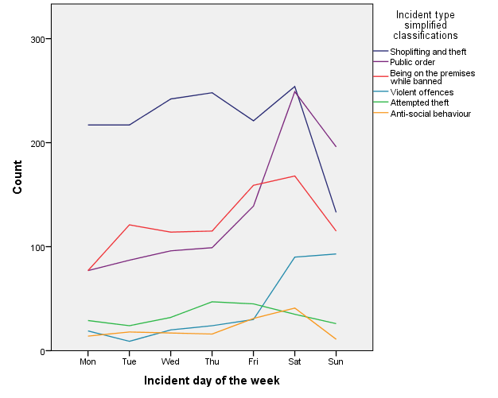
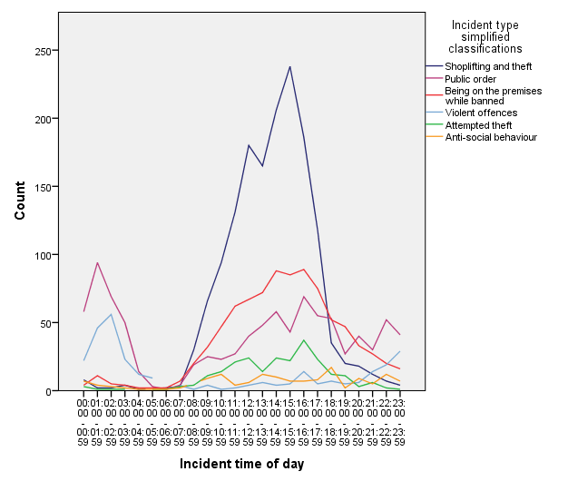
Understanding crime and disorder in the city centre
There were 1433 offenders in the data, but 70 (5%) offenders committed 1926 (43%) of the incidents.
34 individuals (2% of total offenders) had committed 20 or more offences, constituting 1411 (31%) of the total incidents reported.
The highest number of incidents committed by a single person was 118.
There were c.130 members reporting incidents to the scheme, but 10 members had together reported 2396 (53%) of all incidents.
Source: Stafford, A.B., and Hobson, J. (2018) A multi-year examination of the Business Crime Reduction Partnership ‘Gloucester City Safe’. Project Report. University of Gloucestershire. http://eprints.glos.ac.uk/5475/

Slide 6
The use and effectiveness of exclusions
1223 sanctions were issued to 954 individuals between June 2014 and May 2017. 796 individuals (83% of those who received sanctions) received only one sanction.
In 43 of the 107 interviews, a member noted that the warning/exclusion sanction system was a significant mechanism through which they could influence behaviour and control entry to their premises:
‘It does change people’s behaviour, certainly people who have yellow cards behave very differently and don’t want to be in a situation where they get red cards’. (2015)
158 individuals received a second sanction through the scheme and were then ‘excluded’.
59 (37%) of those who received a second sanction did not offend further after its receipt.
99 (63%) offended further after its receipt.
Source: Stafford, A.B., and Hobson, J. (2018) A multi-year examination of the Business Crime Reduction Partnership ‘Gloucester City Safe’. Project Report. University of Gloucestershire. http://eprints.glos.ac.uk/5475/

Slide 7
Offender behaviour and the value of the ‘Holistic’ BCRP model
Of those who committed more than one offence:
78% (476/608) of these offenders committed more than one type of offence (according to standard police crime recording categories).
21% (125/608) committed offences during both day time trading hours (6am – 6pm) and night time trading hours (6pm – 6am).
39% (237/608) committed an offence against more than one type of business (according to Standard Industrial Classifications).
Only 6% (34/608) committed offences in both licenced premises and retail establishments.
Source: Stafford, A.B., and Hobson, J. (2018) ‘Business crime reduction partnerships: examining a holistic approach’, Safer Communities Journal.

Slide 8
Value and benefit of approach according to members
Fosters collaboration, cohesion and increased feelings of safety.
62 of the 107 respondents said that membership of the scheme led to some form of increase in feelings of community or collective responsibility
‘We are part of a community’ (2014)
Quick and convenient information sharing via radios, email and secure web platform.
90 of the 107 respondents discussed how the scheme helped them to identify individuals who had previously committed offences at another member’s premises.
‘…you’re more aware of what’s going on around. You know about issues before they happen to you’ (2015)
Members value the ‘holistic’ membership model.
‘We know that the whole of the high street is dealing with this and the whole of the high street is sort of standing together’ (2017)
Source: Stafford, A.B., and Hobson, J. (2018) ‘Business crime reduction partnerships: examining a holistic approach’, Safer Communities Journal.

Slide 9
Conclusions from this work
The behaviour of individual offenders doesn’t conform to specific trading hours, can involve more than one kind of offence, and can take place at different kinds of business location.
There is value in BCRPs bringing together businesses from all commercial sectors and that operate during day time or night time trading hours, and focusing on a broad range of offending activity.
Collaboration and effective information sharing helps foster a sense of community and feelings of safety and security for members.

Slide 10
Next steps and contributing to the work of the NBCC & BCRP National Standards
Collaboration with the providers of the DISC platform:
160 crime-reduction partnerships, covering more than 400 towns, city-centres and rural areas use DISC throughout the UK.
Survey of BCRP managers to examine partnership design and activity, best practice, stakeholder engagement, incident recording, use of exclusions.
Build and analyse a dataset consisting of all incident data (anonymised) held by the 160 crime reduction partnerships.
Use this evidence to inform the work of the NBCC and future iterations of the National Standards.

