Slide 1
Andrew Bick

Slide 2
Conversation

Slide 3
Part 1: titles

Slide 4
OGVDS

Slide 5
ORIGINAL
GHOST
VARIETY
DOUBLE
SPIDER

Slide 8
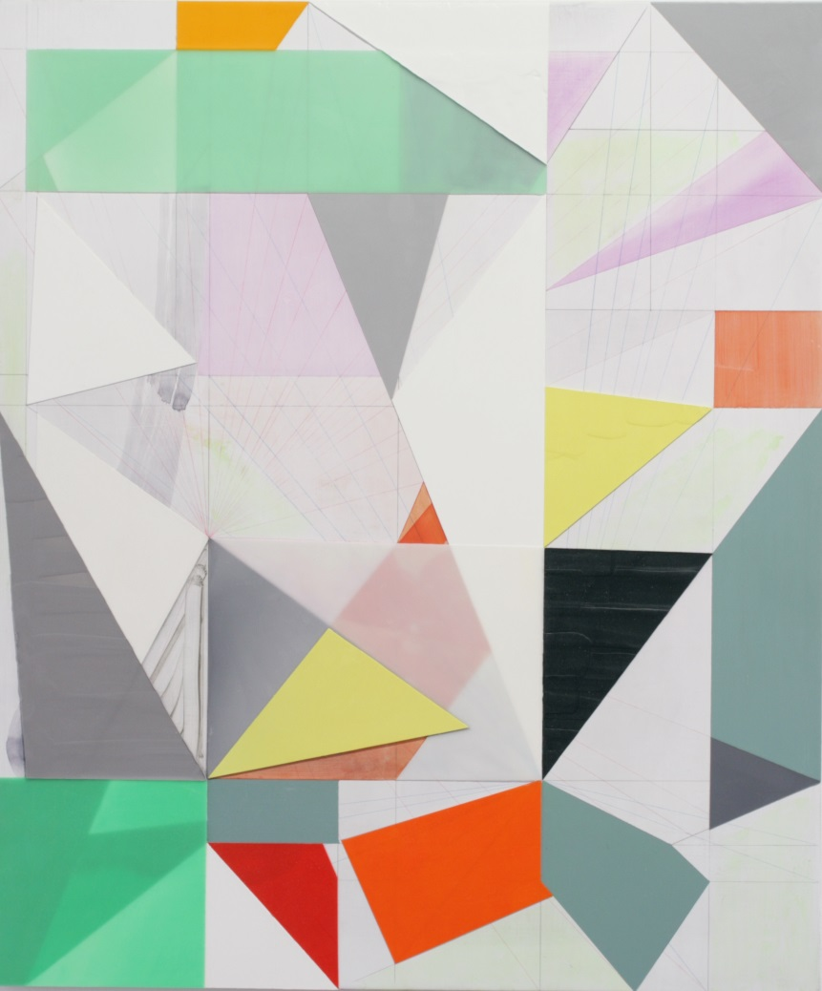

Slide 10
GW
= GILLIAN WISE

Slide 11
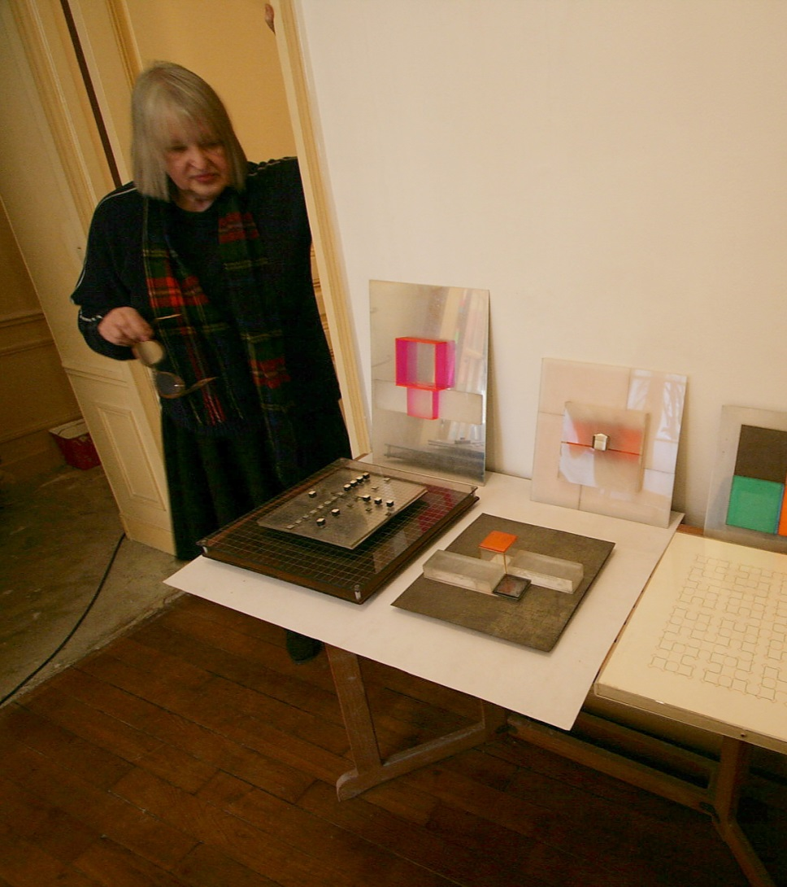

Slide 16
Part 2: anecdotes

Slide 23
Systems for hesitation

Slide 25
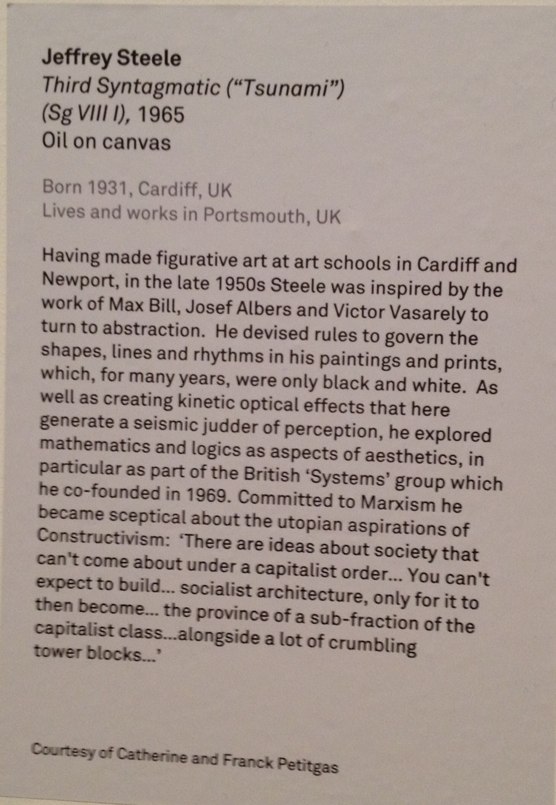

Slide 27
Part 3: concrete possibilities

Slide 30
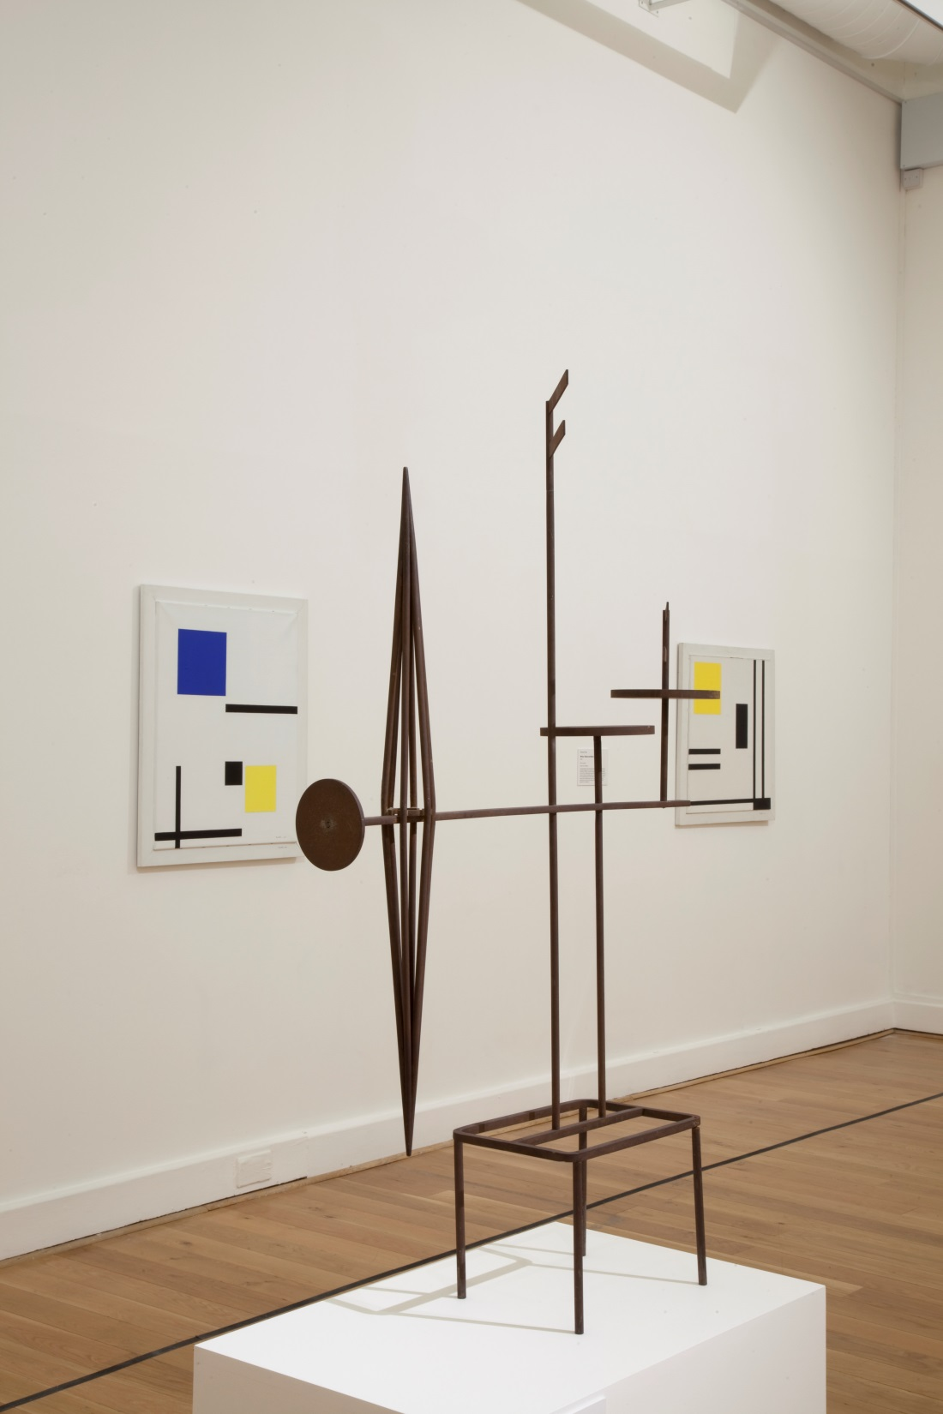

Slide 31
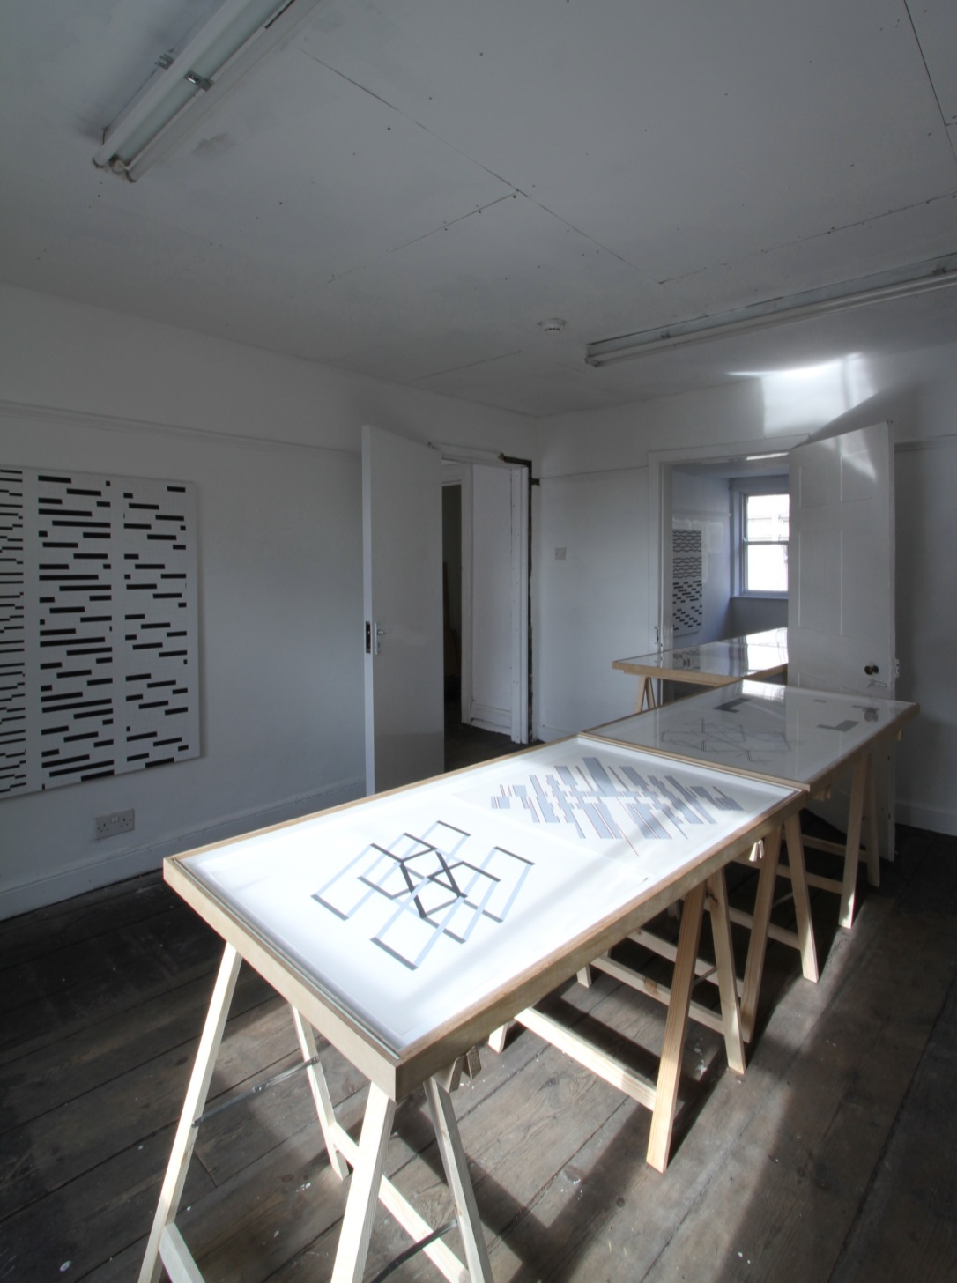

Slide 35
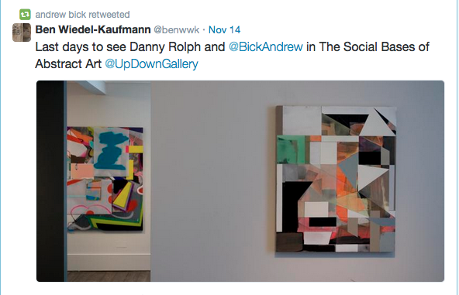

Slide 36
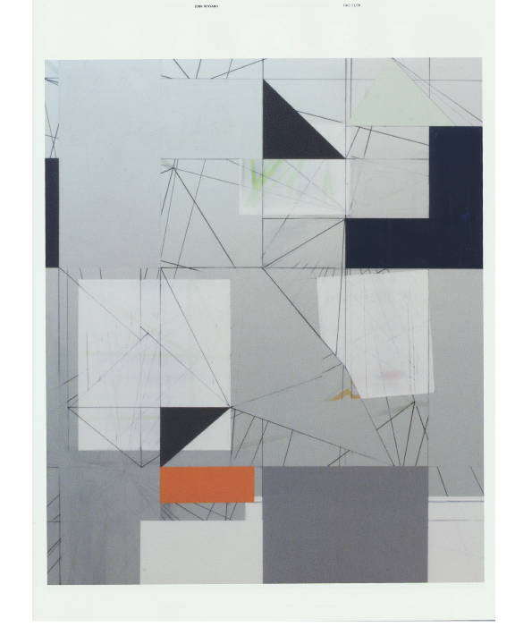

Slide 48
Part 4: grids

Slide 49
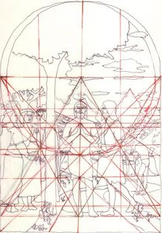

Slide 56
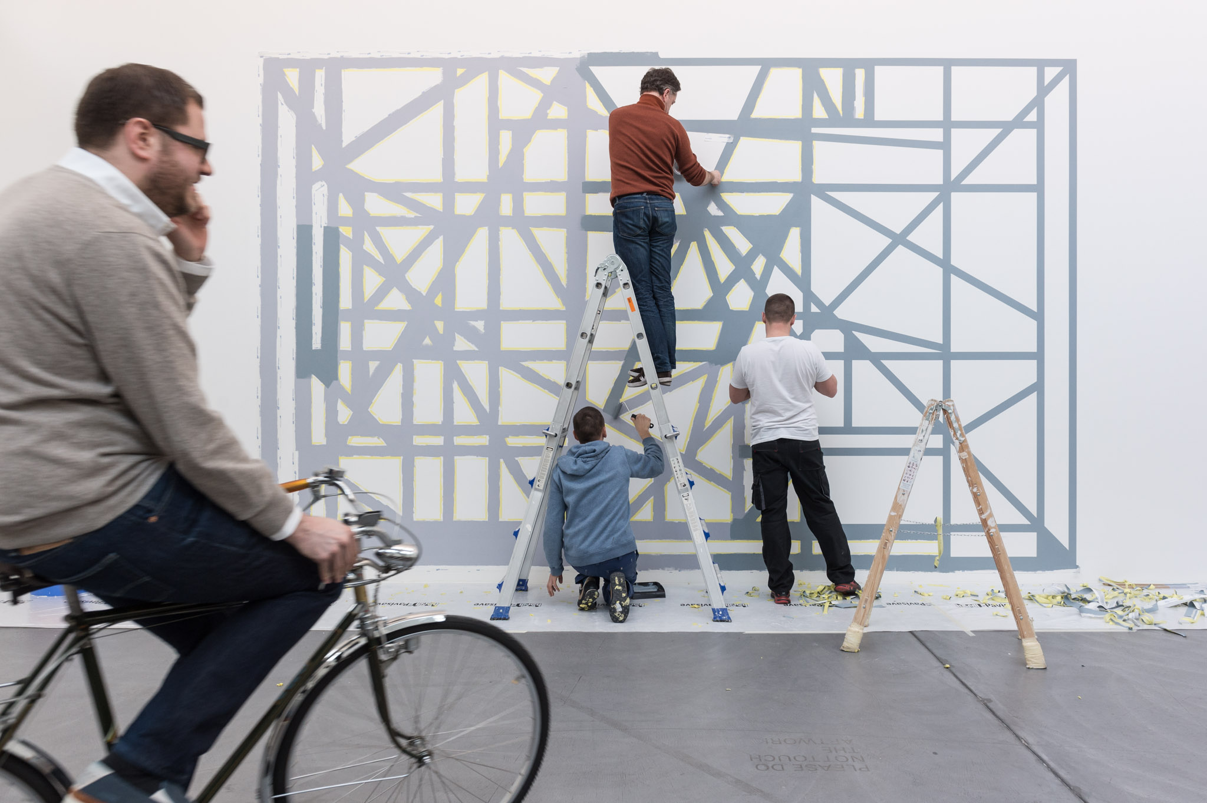

Slide 60
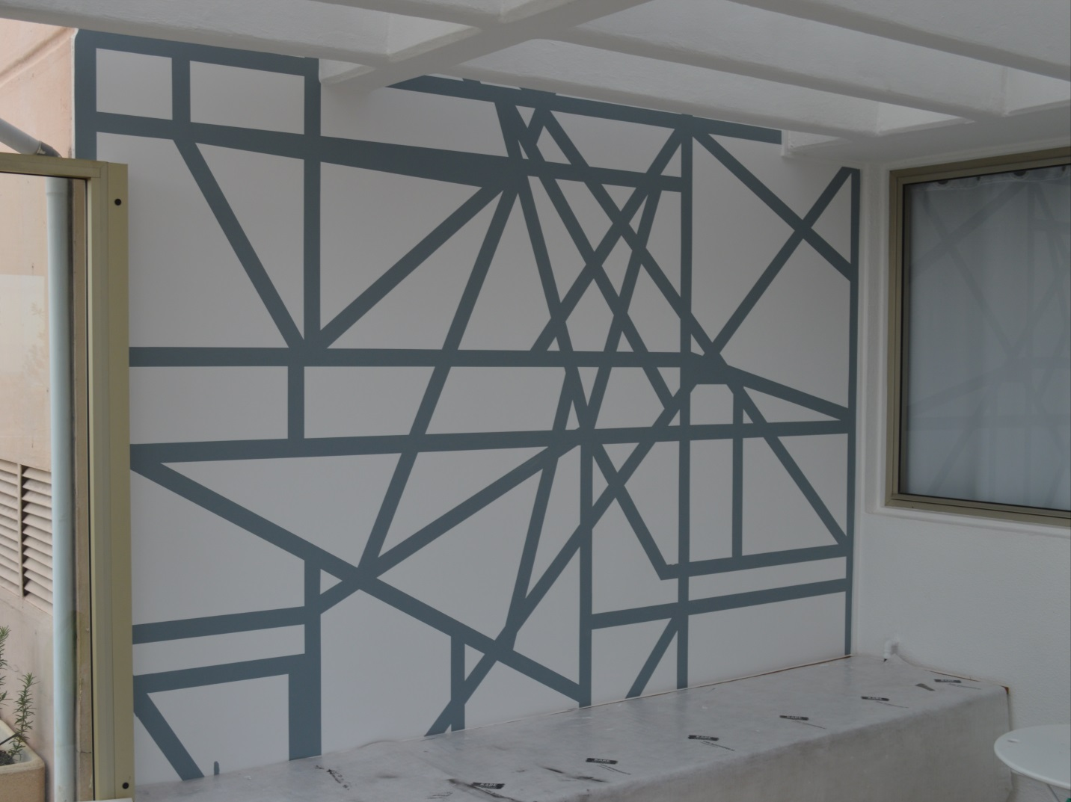

Slide 64
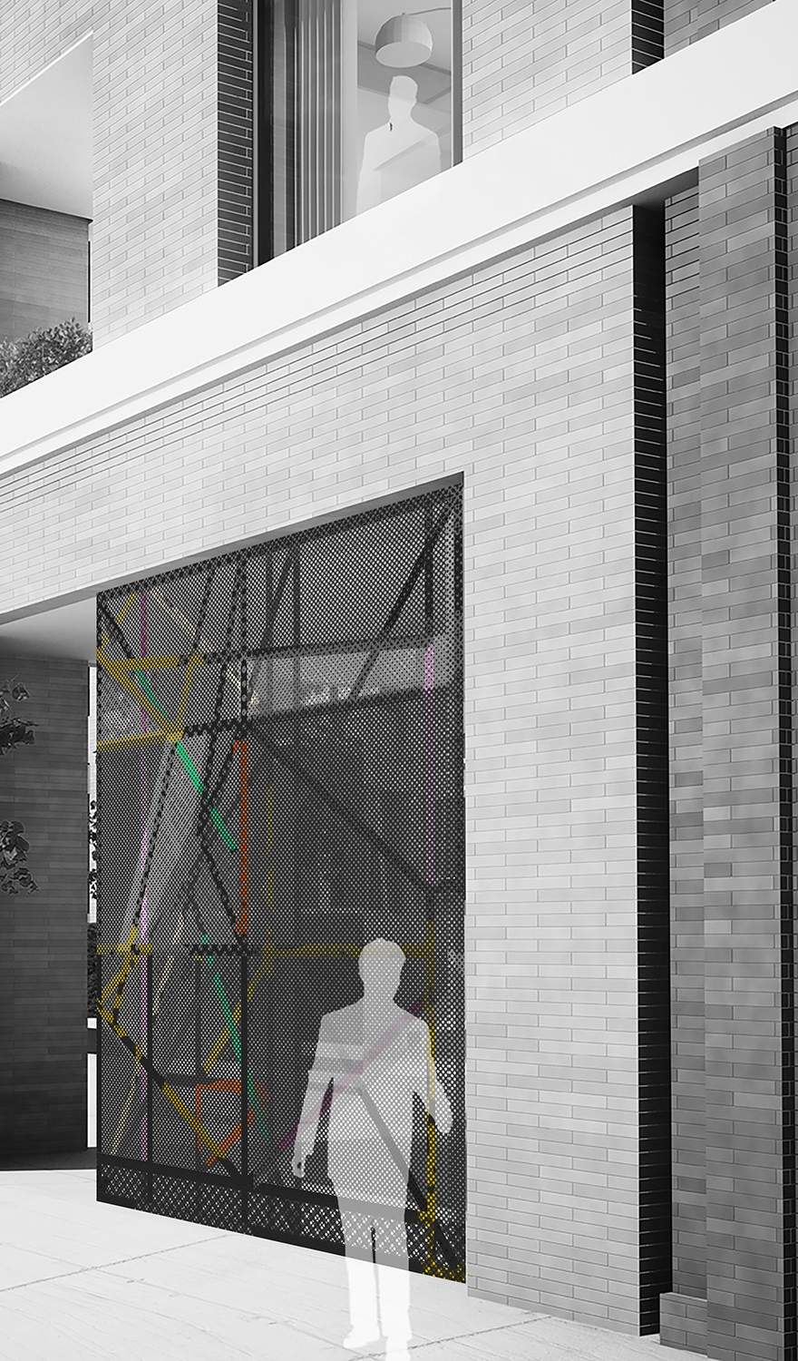

Slide 65
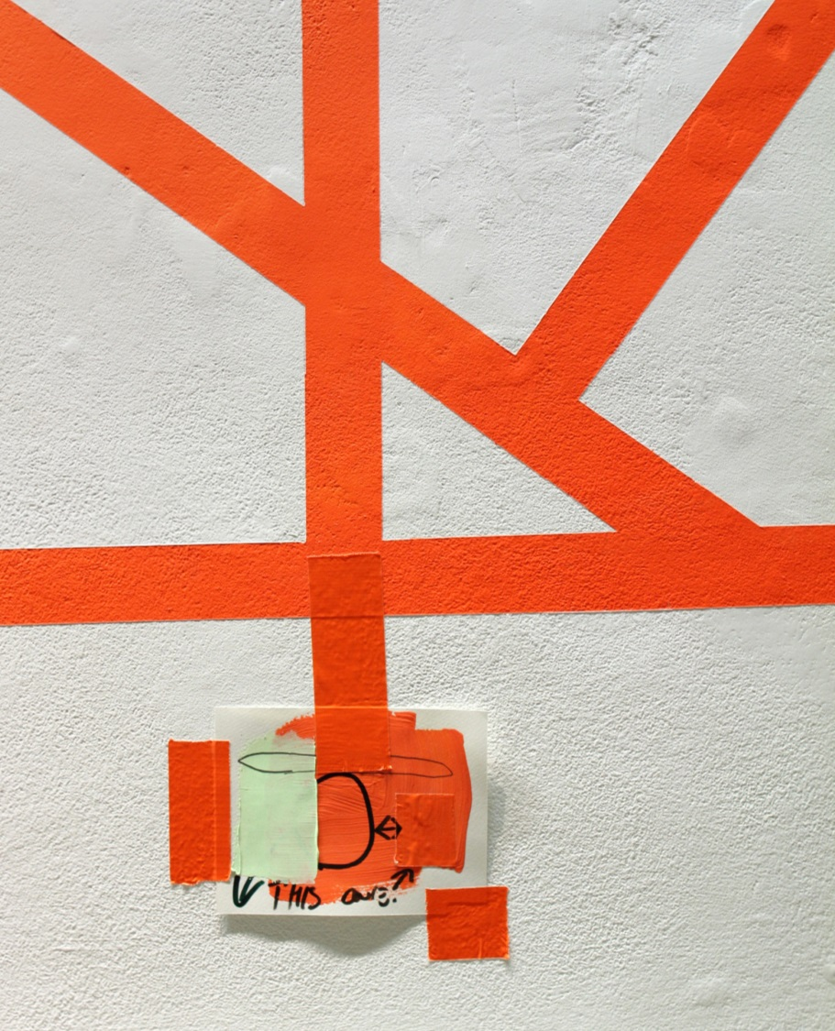

Slide 66
