Slide 1
RCA Sustainlab Falmouth University Presentation
Susie Olczak
@susieolczak
www.susieolczak.co.uk

Slide 2
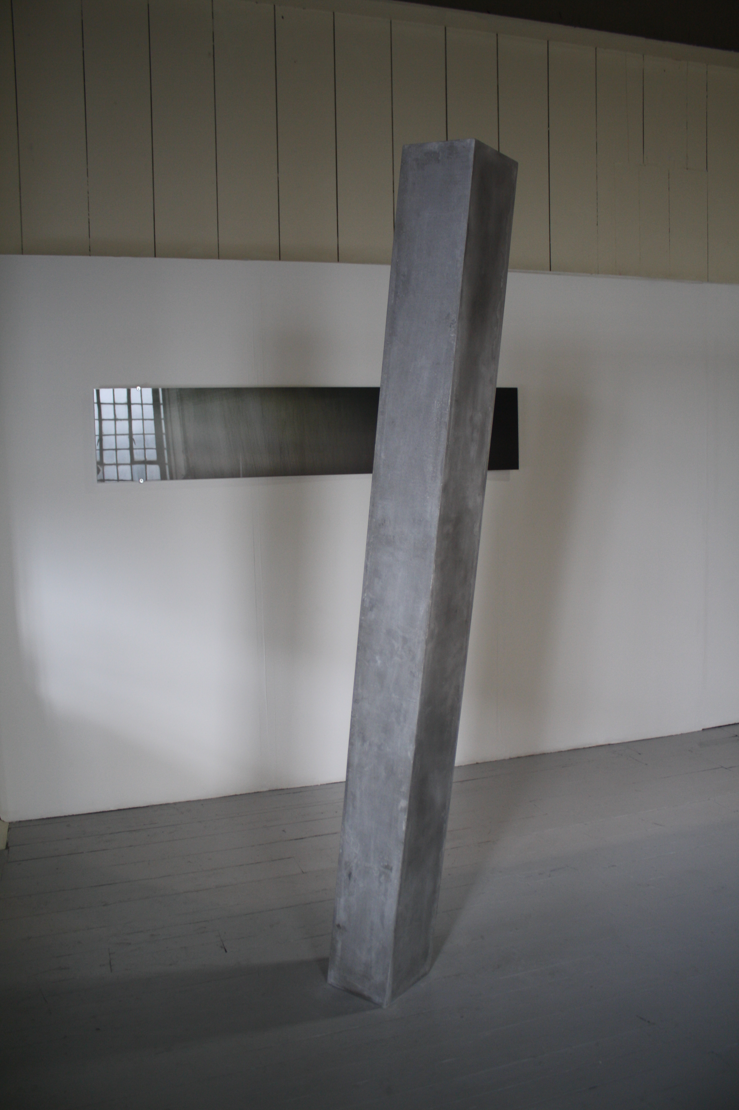
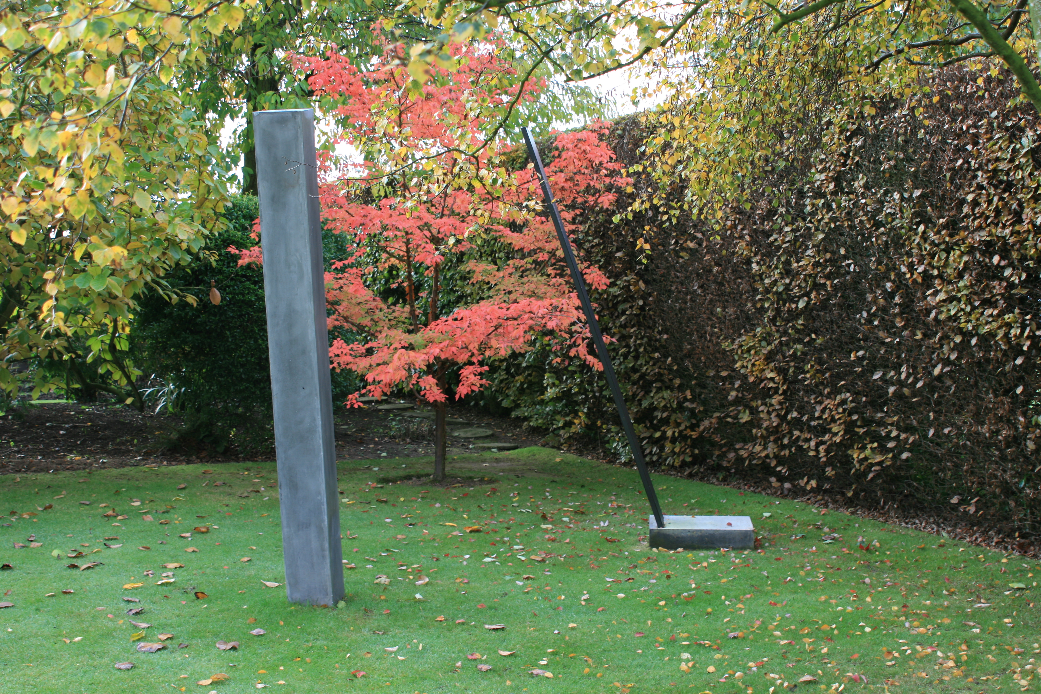
Notes:
MAKING THINGS THAT LAST

Slide 3
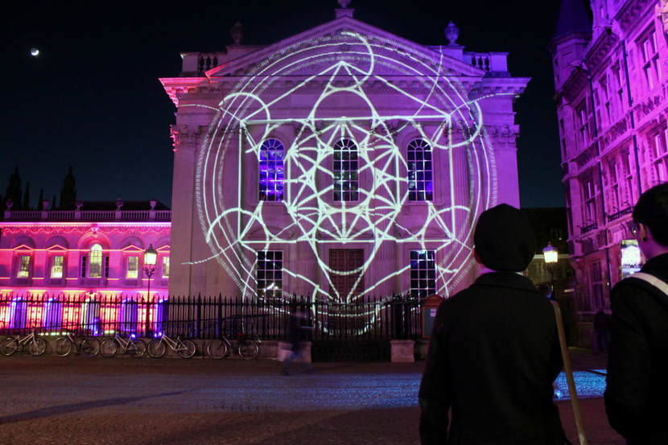
Notes:
PROJECTION MAPPING- low energy. COLLABORATION. PUBLIC ENGAGEMENT – John Venn- collab with Ross Ashton

Slide 4
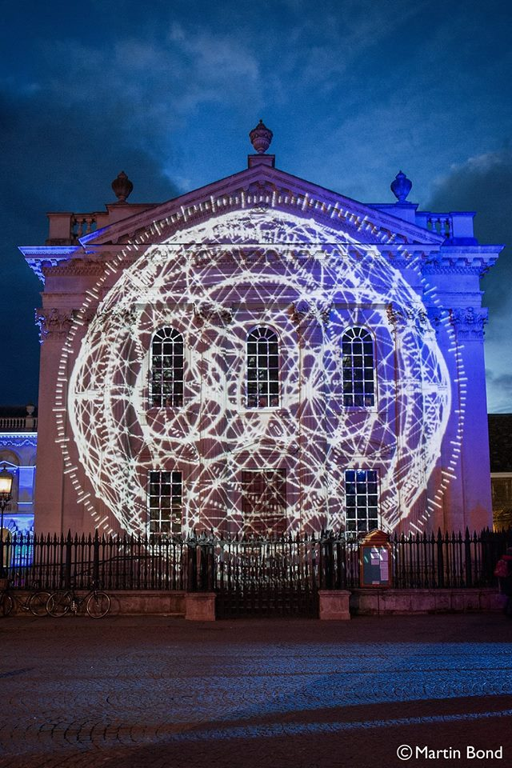
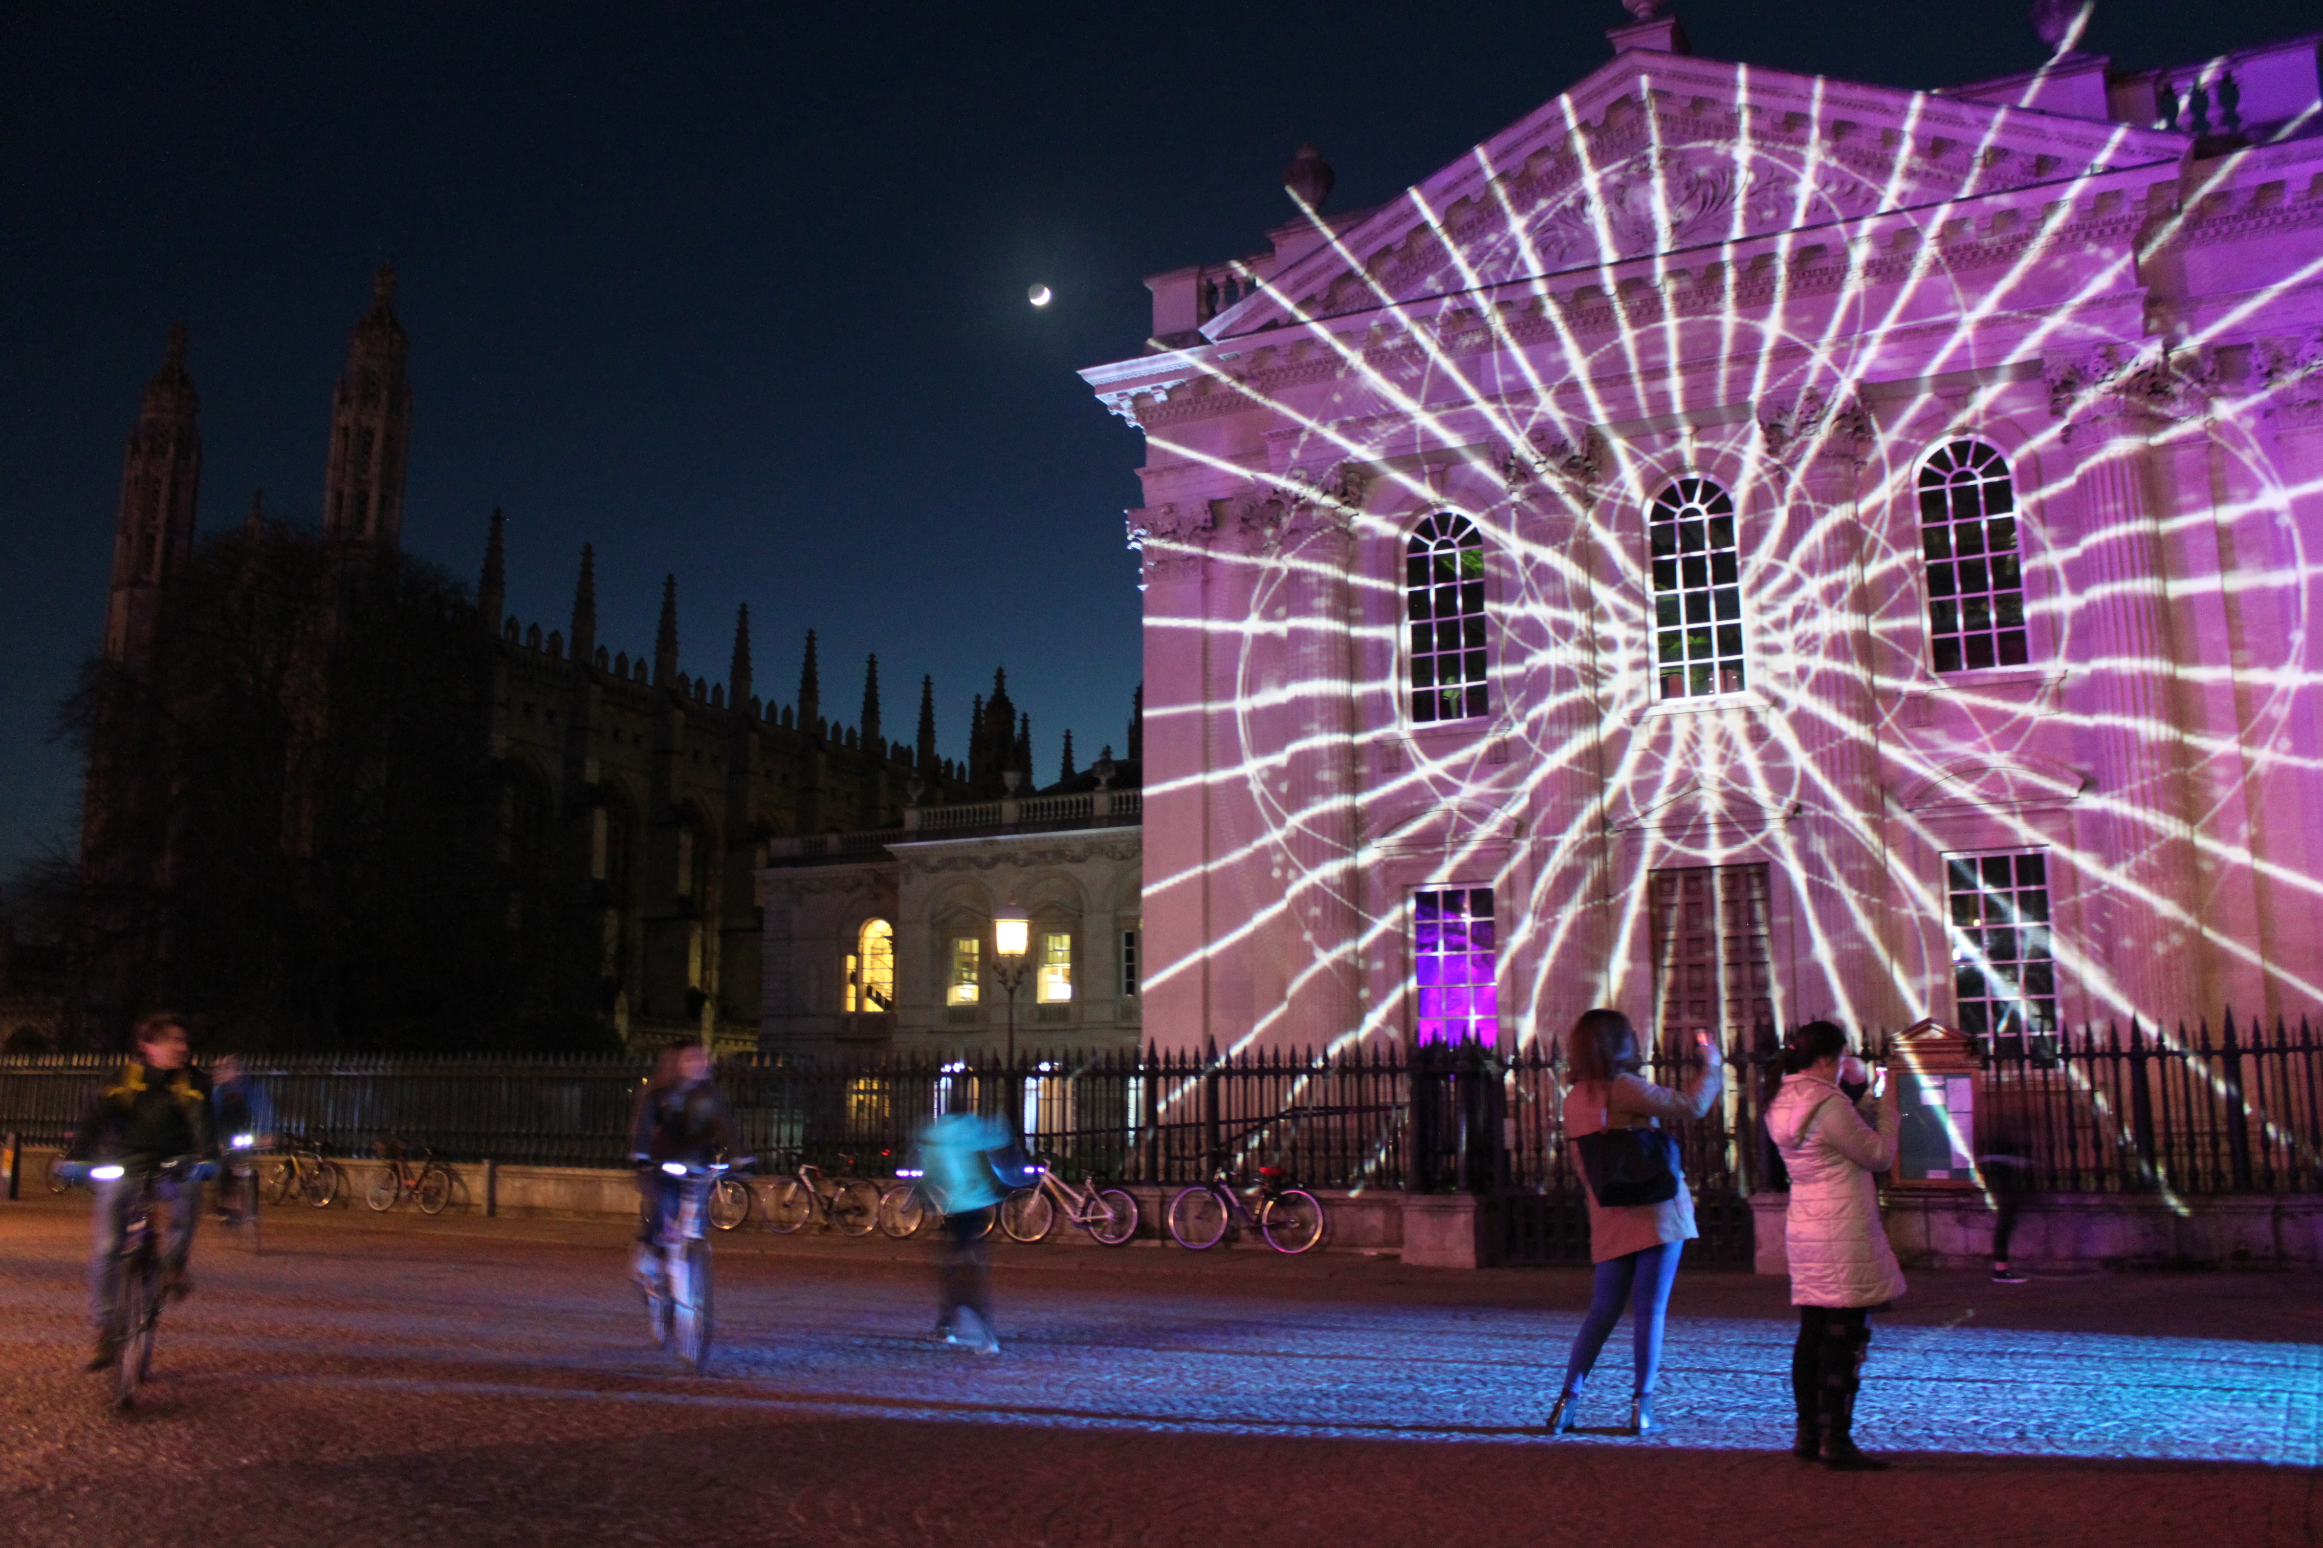

Slide 5
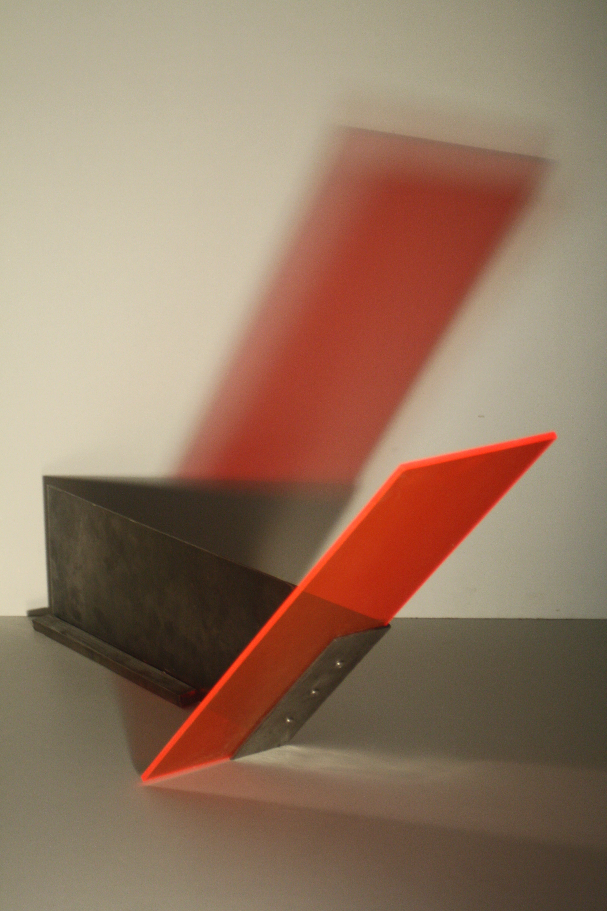
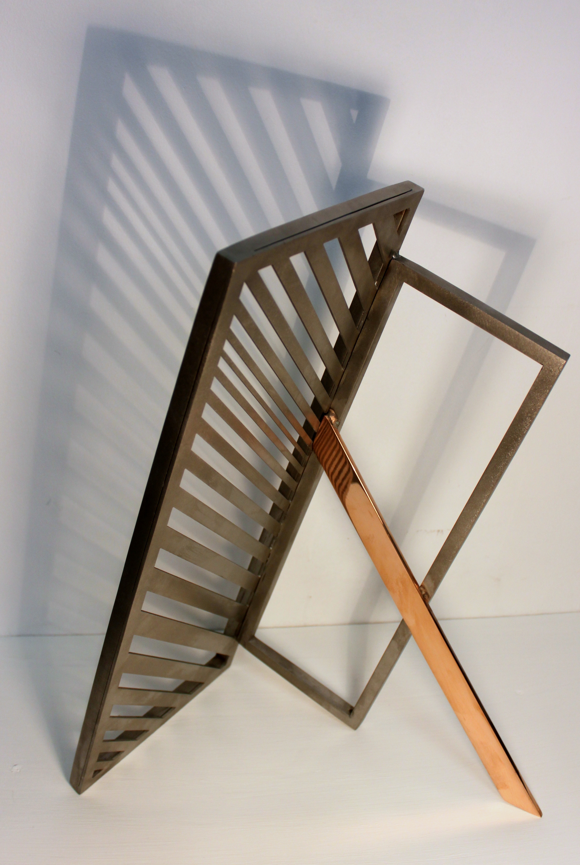
Notes:
Using scrap material

Slide 6
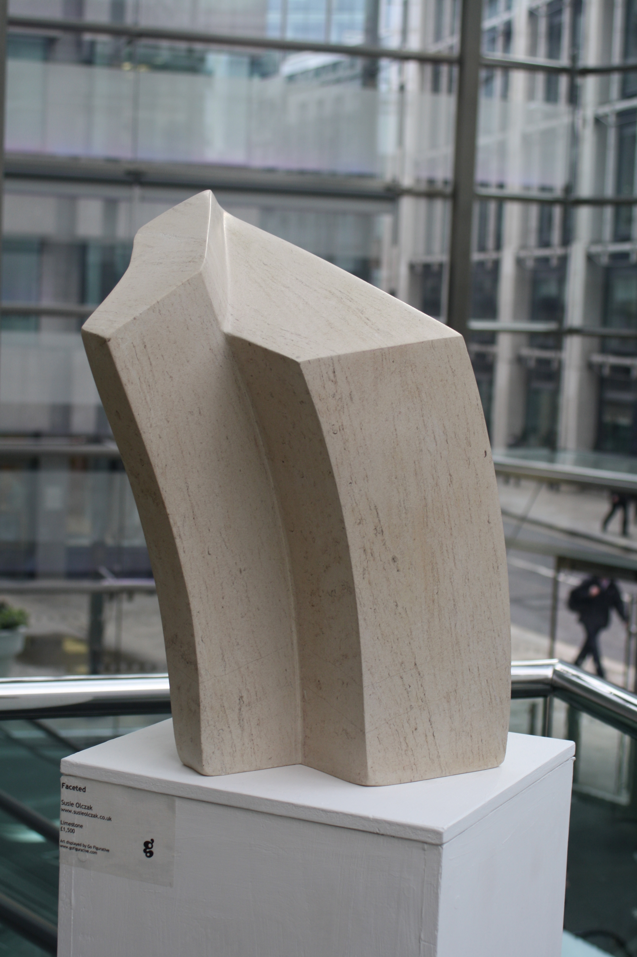

Slide 7
Notes:
INTERACTION + LIGHT - Minimal for maximal effect- CONSIDERATIONS WITH SPACE- TRANSPORT AND STORAGE

Slide 8
Notes:
LIGHT INTSTALLATION ASKING PEOPLE TO RETHINK

Slide 9
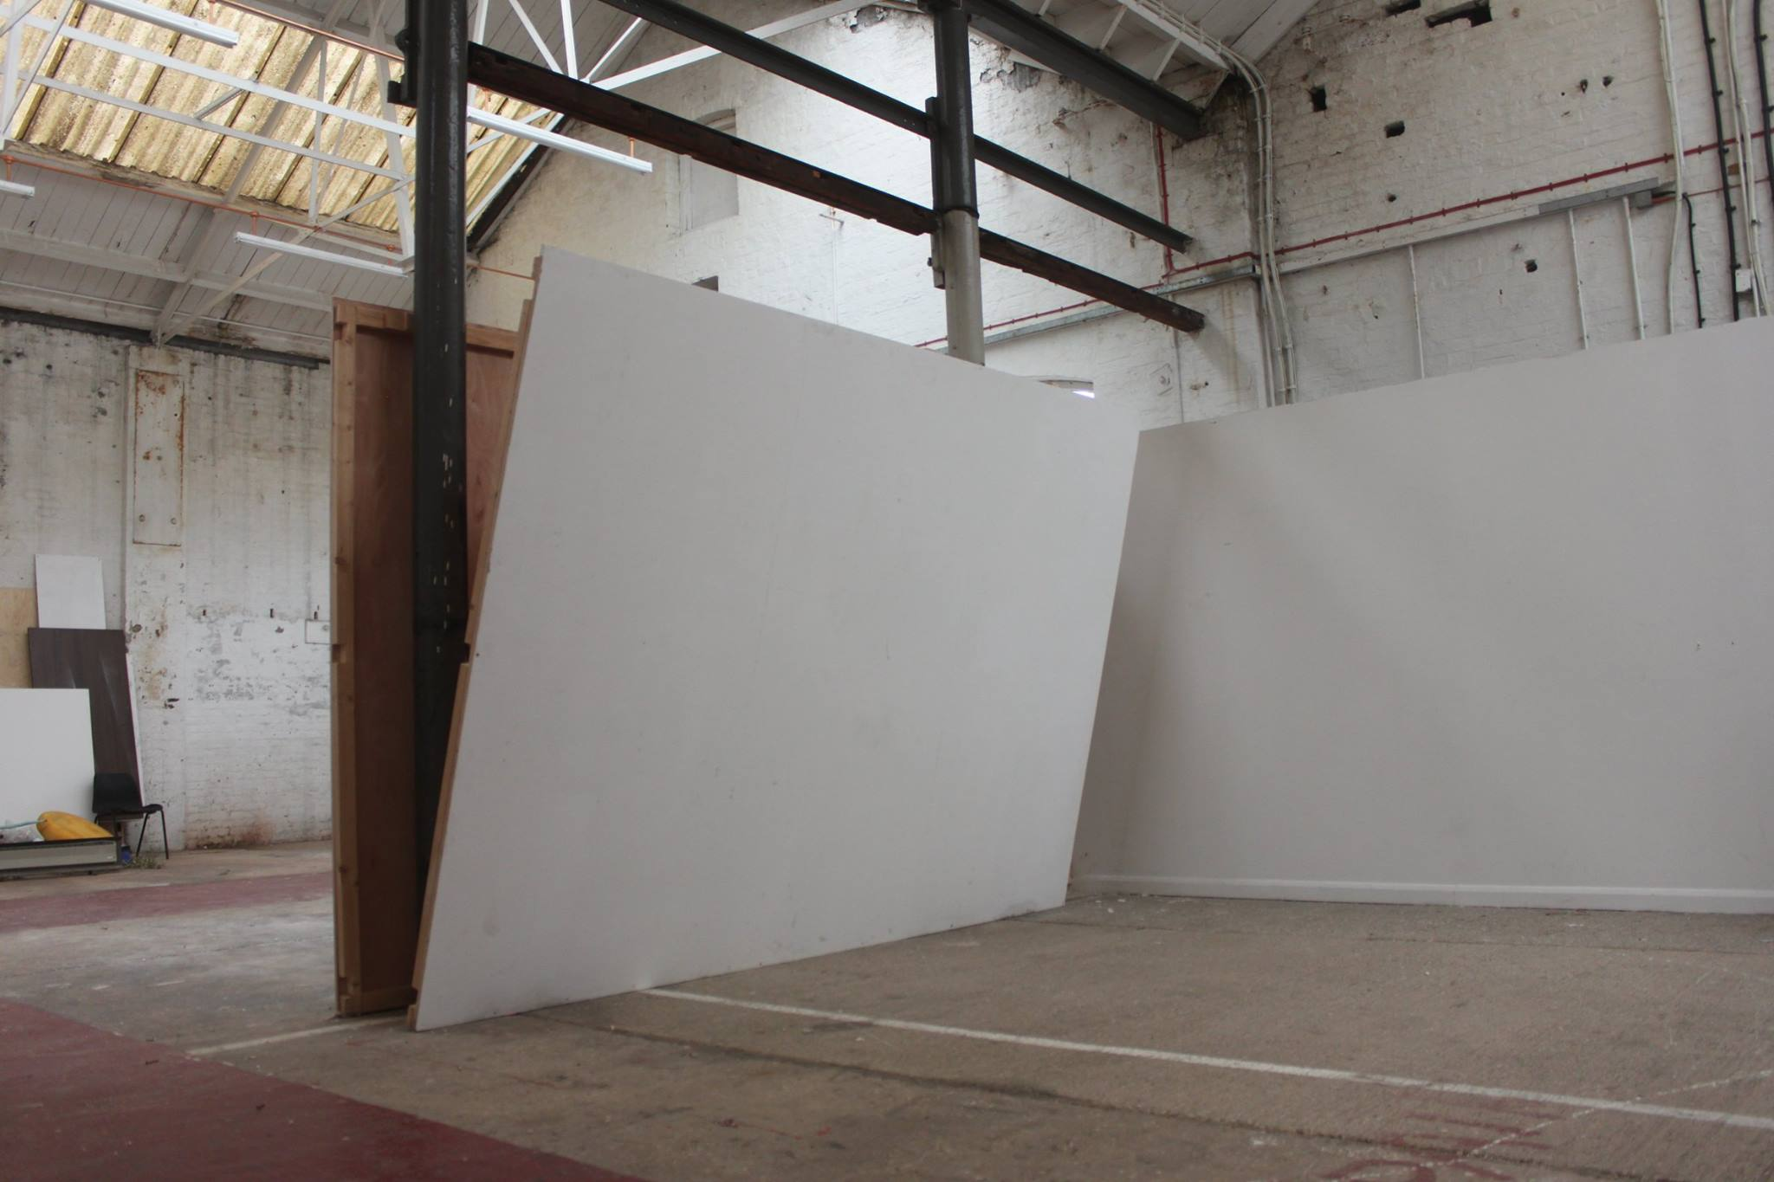
Notes:
Reconfiguring existing structures

Slide 10
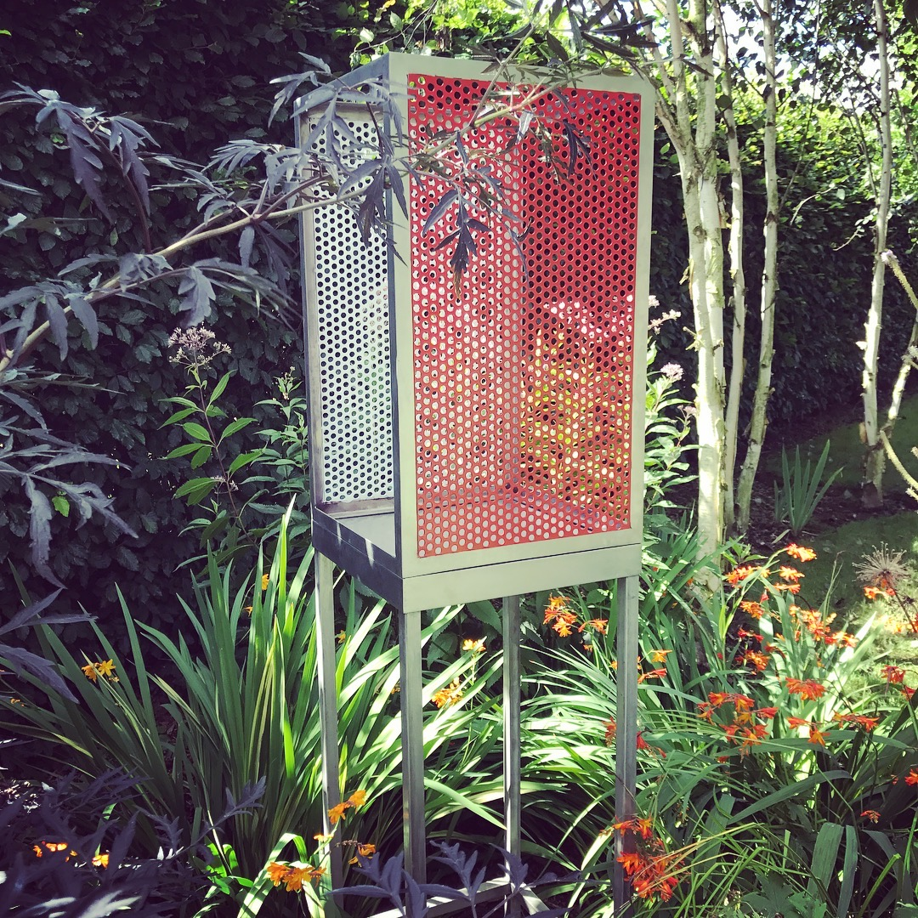
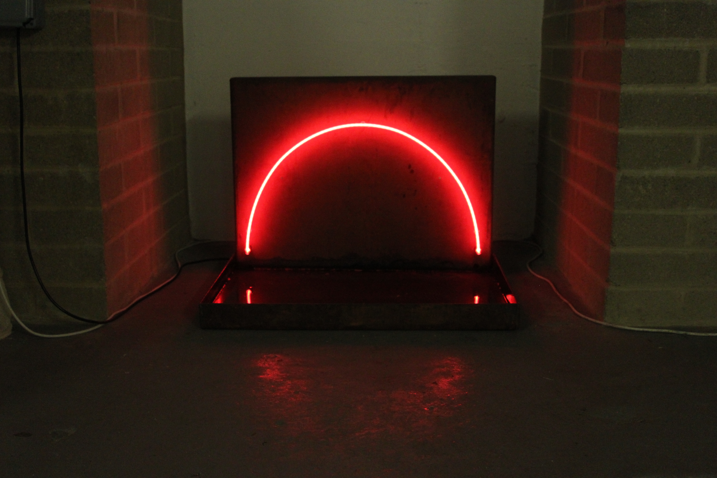

Slide 11
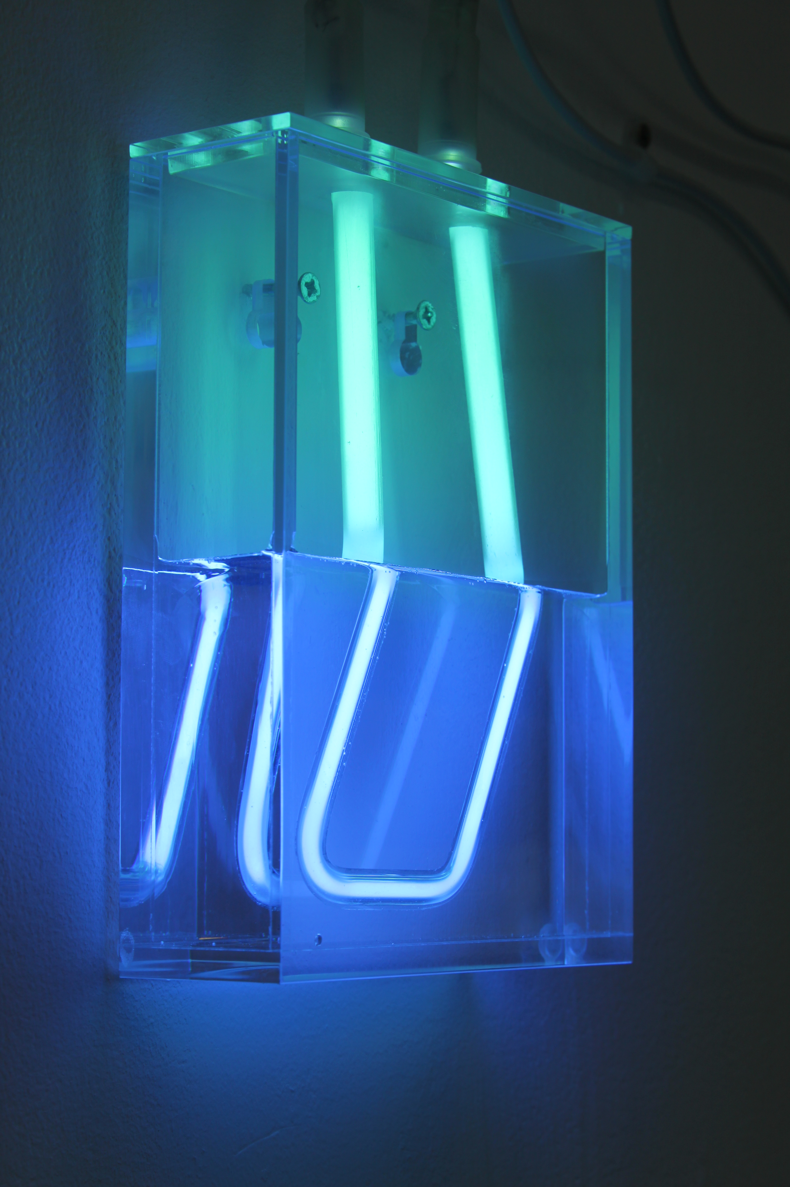

Slide 12
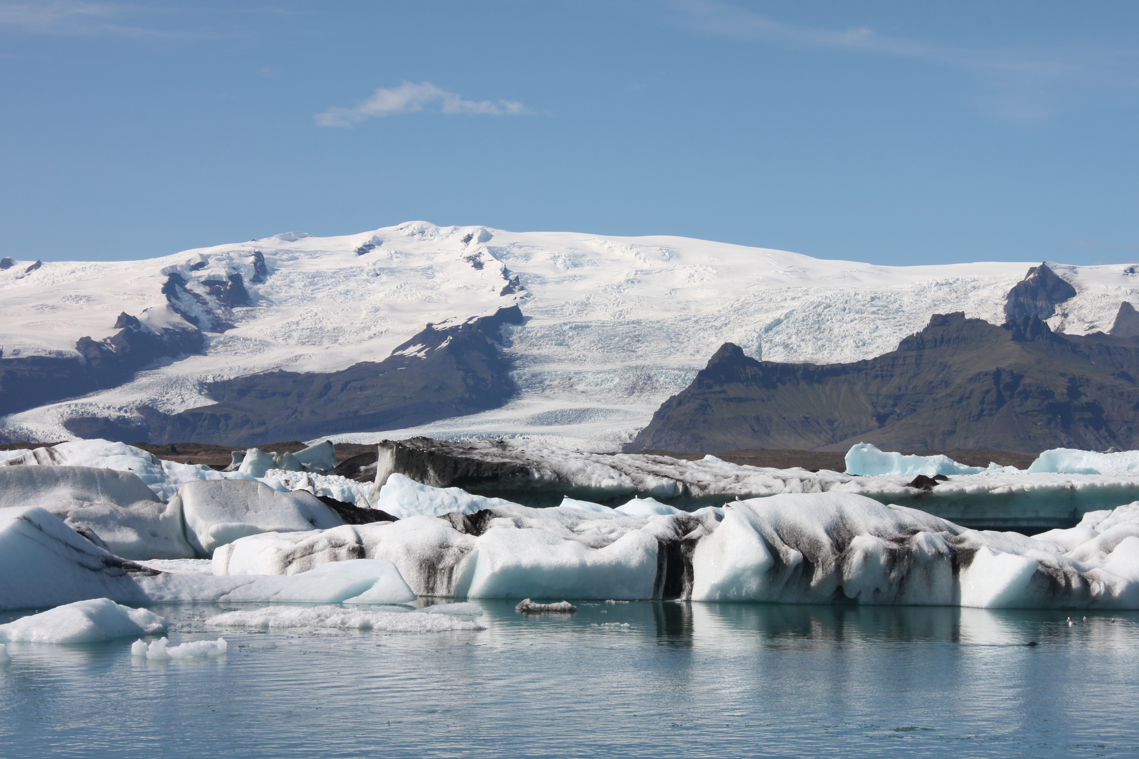

Slide 13
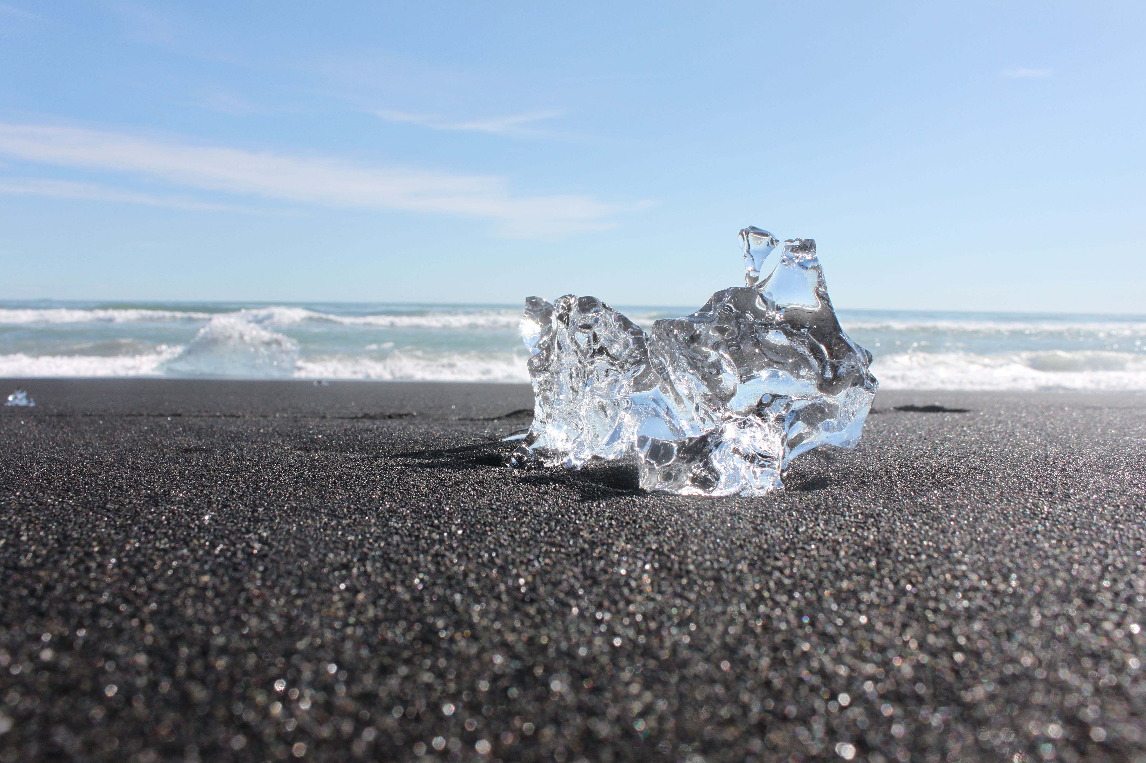
Notes:
REFLECT ON REAL WORLD SITUATIONS- ISSUE WITH SEDUCTIVE NATURE OF IT - Light and water are key aspects of the photograph. It is an image created during my time at the RCA from my recent research trip to Iceland, which was made possible through being awarded a travel grant from Villiers David at the RCA. It is of the Diamond Beach in the south of Iceland which is an incredibly beautiful but sad place as the ice melts from the glacier, breaks away into a lagoon, where it sits majestically. It continues to fragment, floats down to the sea and is then washed up onto the black volcanic shoreline. There it sits, glistening in the sun that is to be its own demise, never to be reformed again. I hope that this image highlights the fragmenting and shifting ice form and gives a sense of the magnitude of this climatic problem.

Slide 14
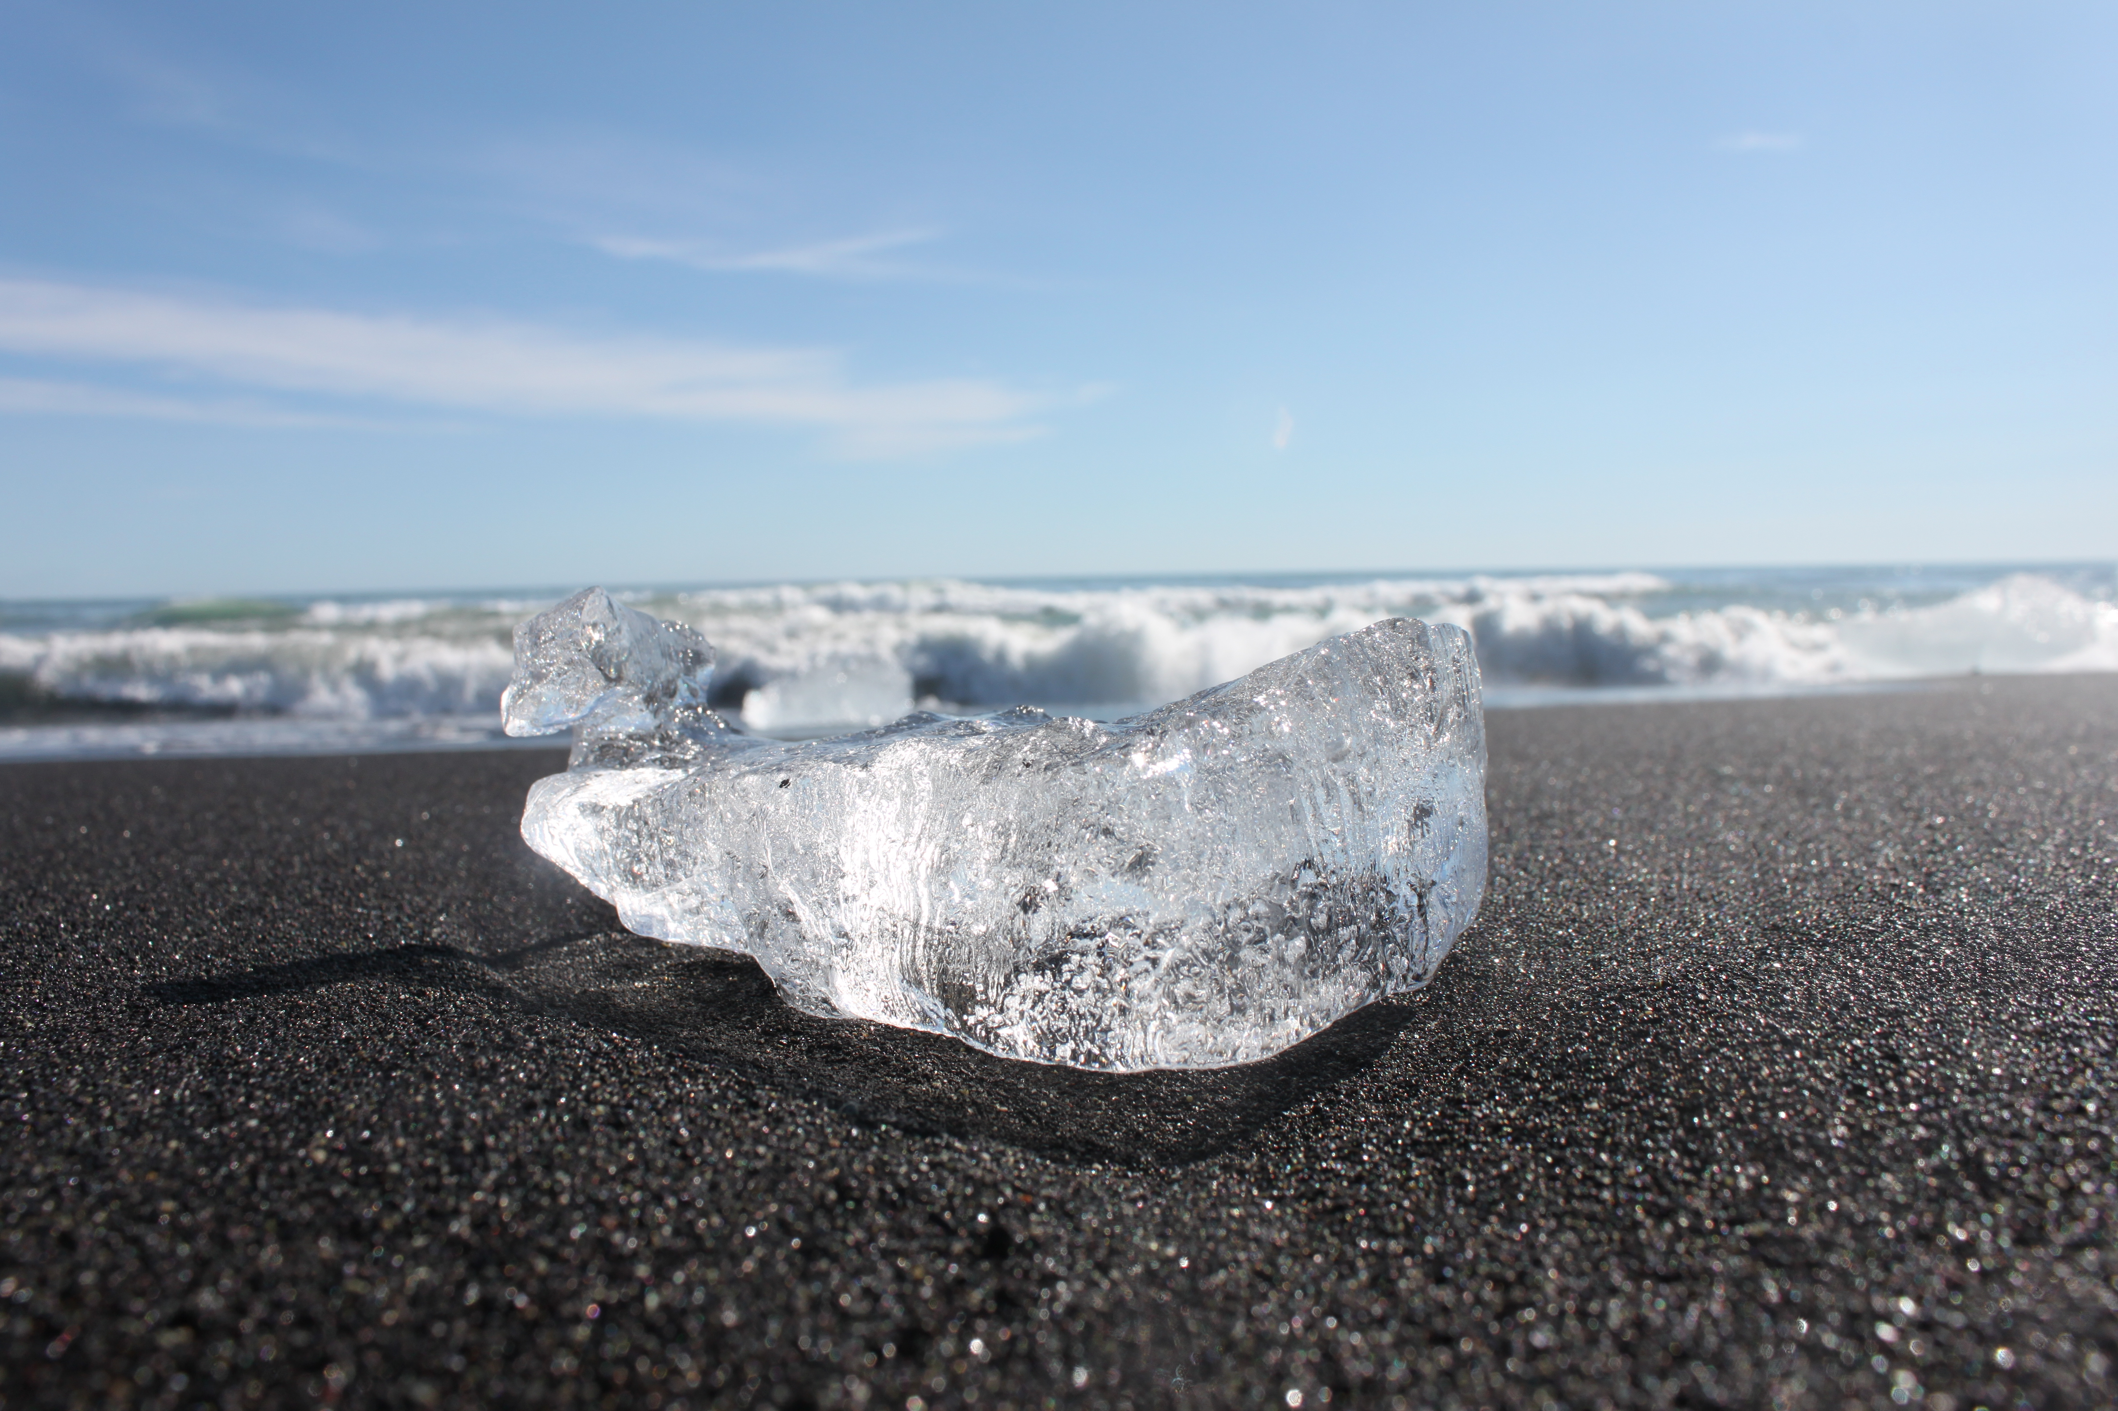

Slide 15
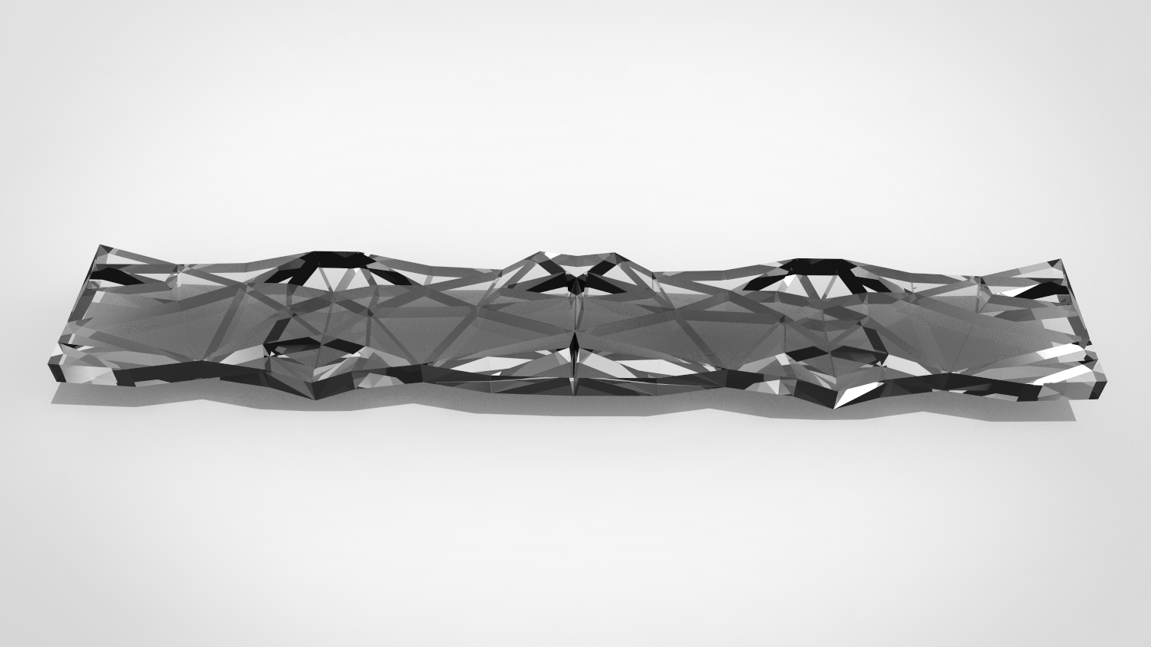

Slide 16
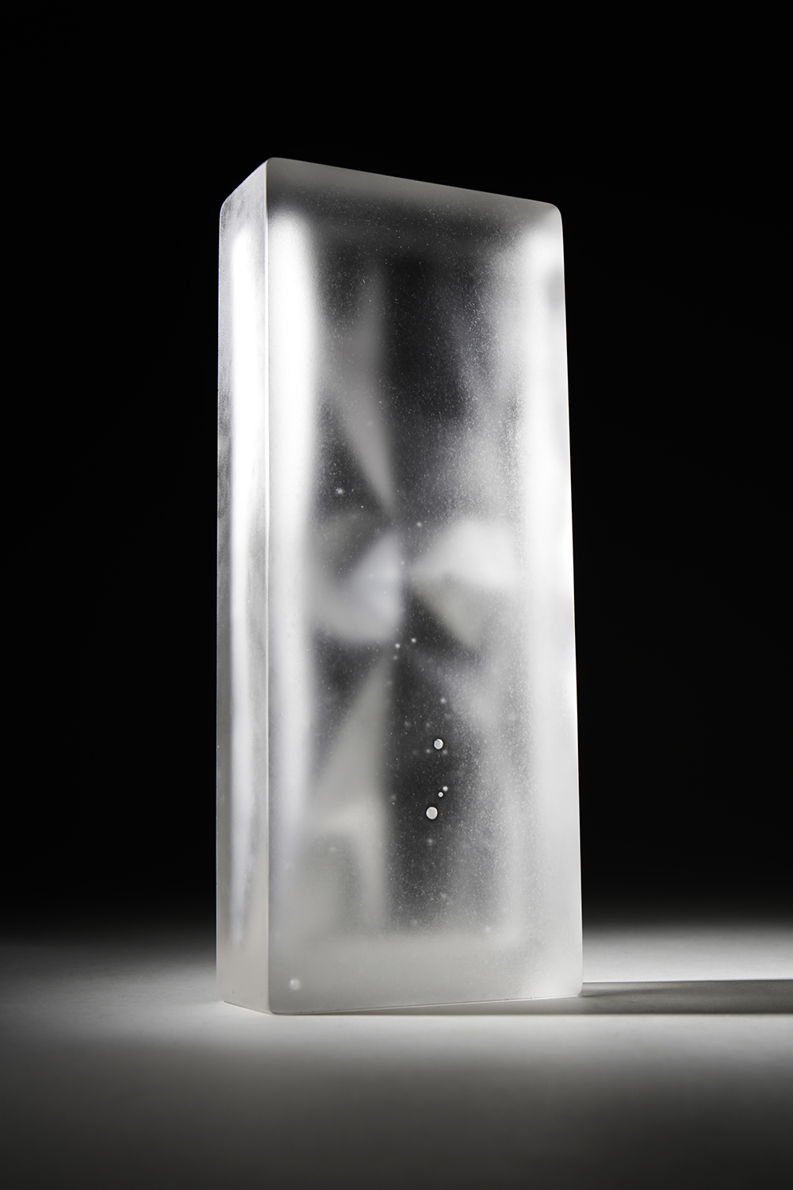

Slide 17
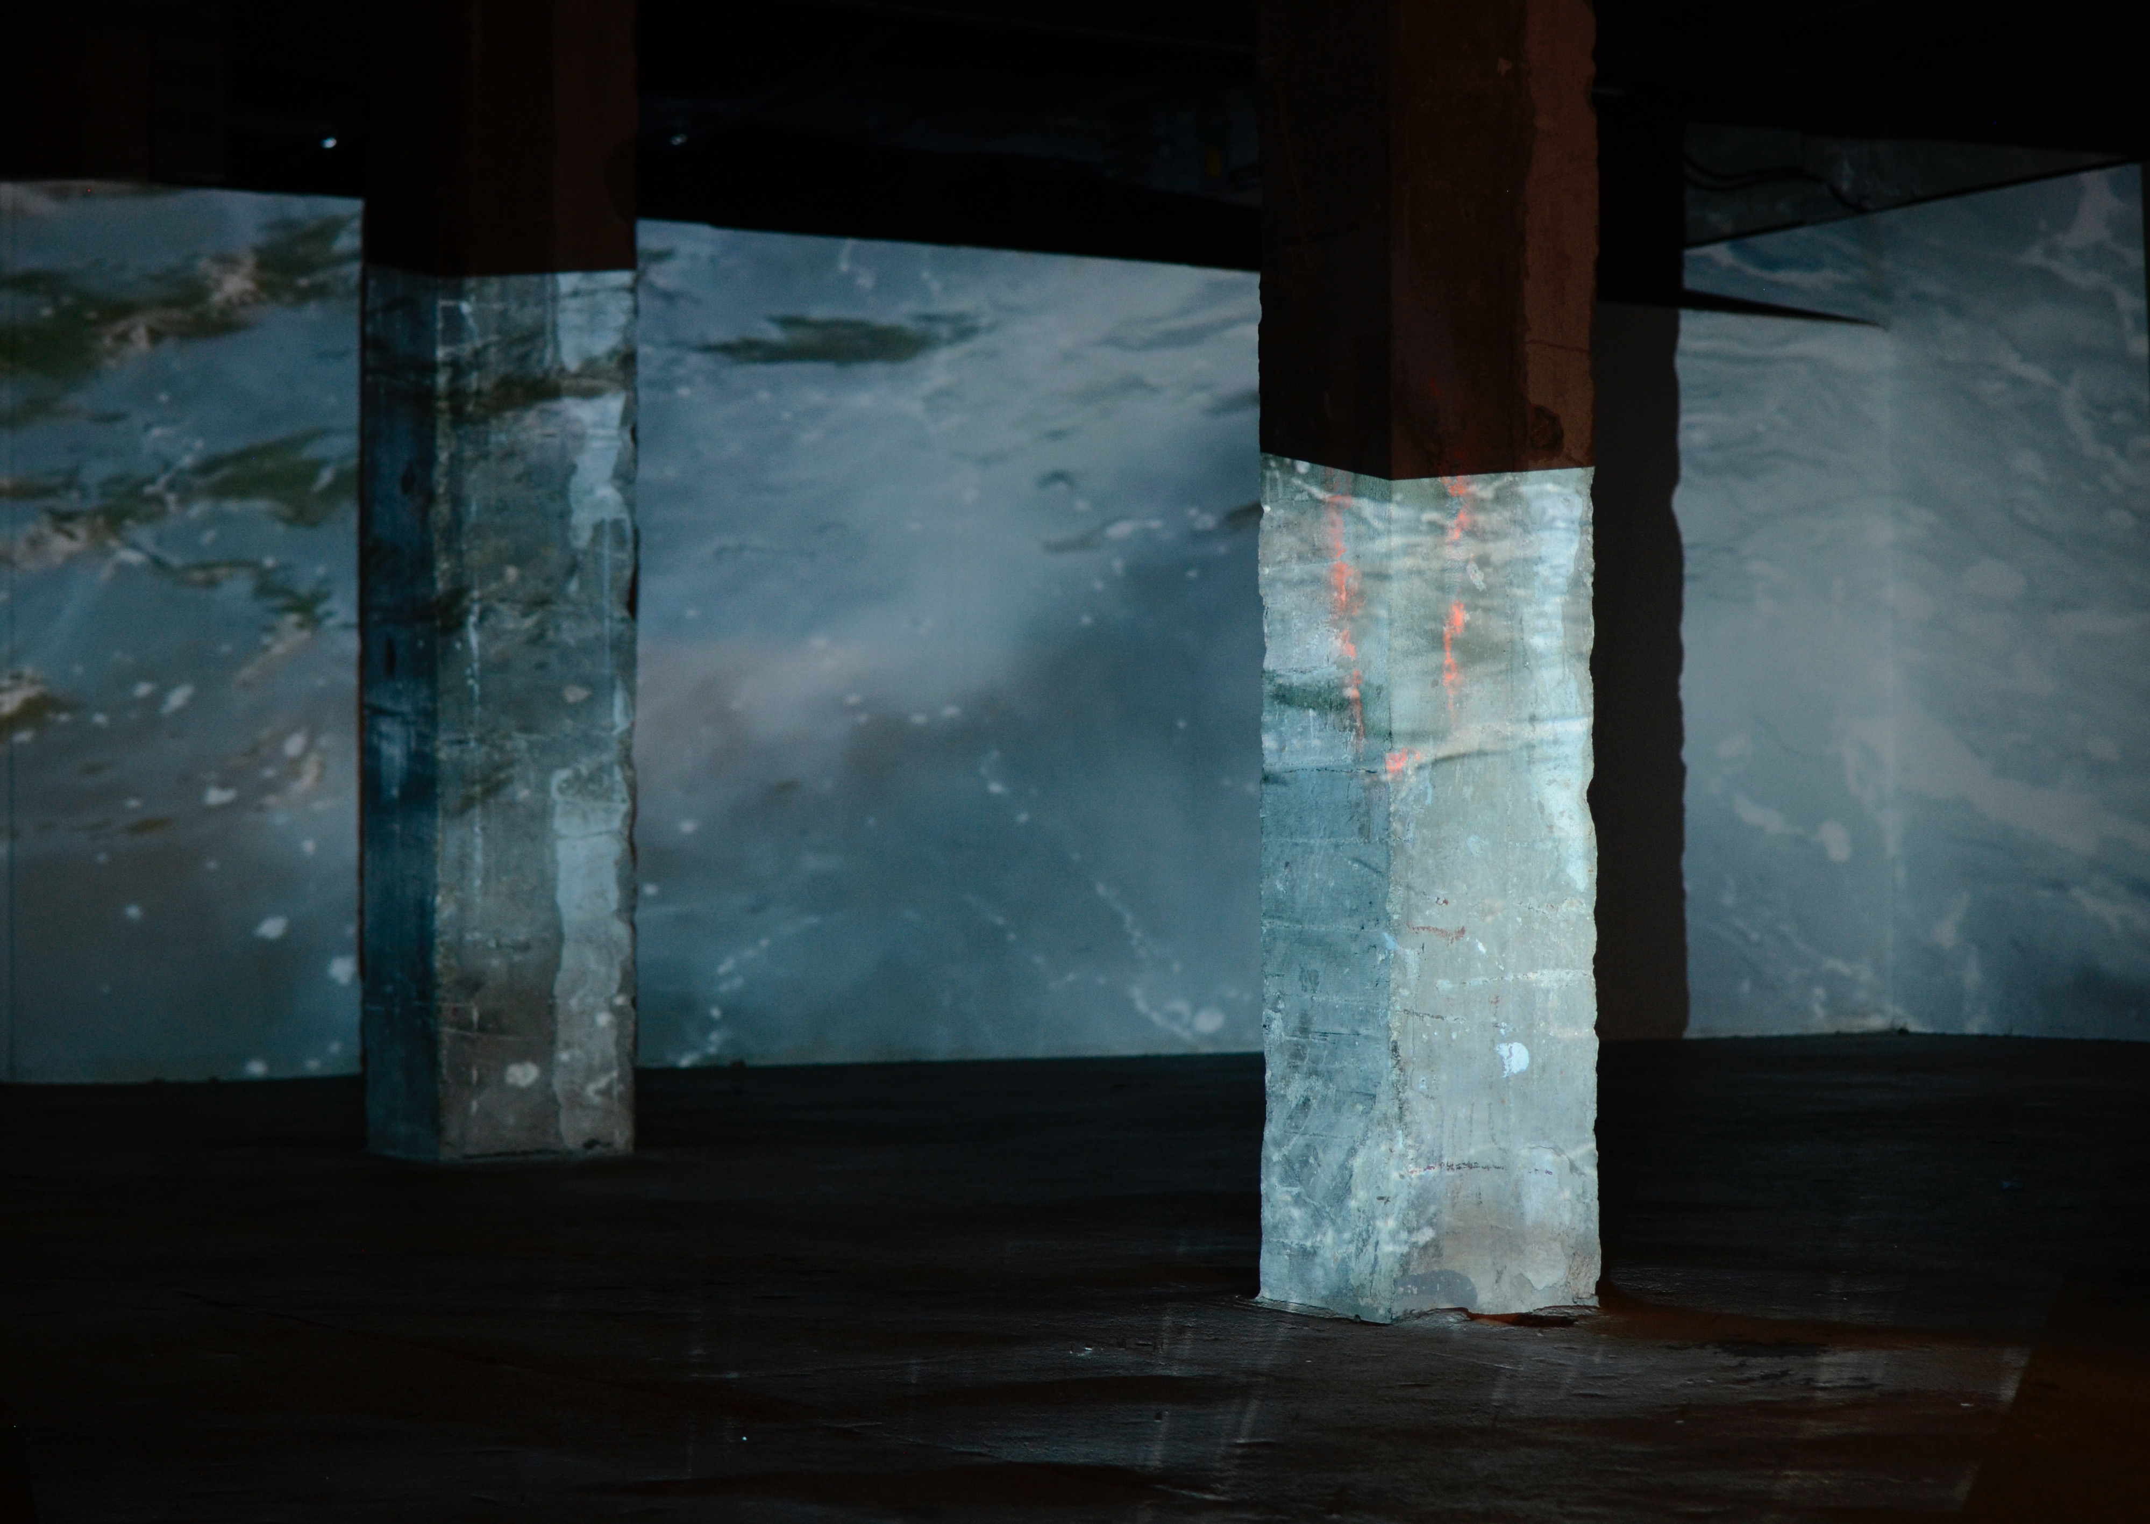
Notes:
LARGE SCALE PROJECTION OF ELEMENTS - including a large-scale projection work. (See Link 1) It was comprised of footage filmed during significant moments in my time at the Royal College of Art. The journey I have begun with my practice began with the consideration of light and the effects it can have in our urban spaces. In particular considering it whilst moving through cities, calling for us to stop and reflect on the details we see and to take notice of the world around us. This is represented with footage taken from details of materials in my studio and from documentation of the RCA buildings. Like in Saraceno’s work geometry and repetition is important, as are transparency and layers of light that moves around the space. The next elemental aspect of footage was water. I used shots taken in Venice during the summer. This section begins with water flooding into the room, it is turbulent and hard to control. This reflects my current view on climate change and the dangers that we face in relation to water, in particular within urban spaces, where a large percentage of the population lives. The abstract narrative ends with calmer waters, suggesting that there is hope in controlling the climate. It leads on to influences from the Palais de Tokyo using air, the footage is calm and more settled. I hope that as with the light this creates a full circle that we can go back to a more hopeful future.

Slide 18
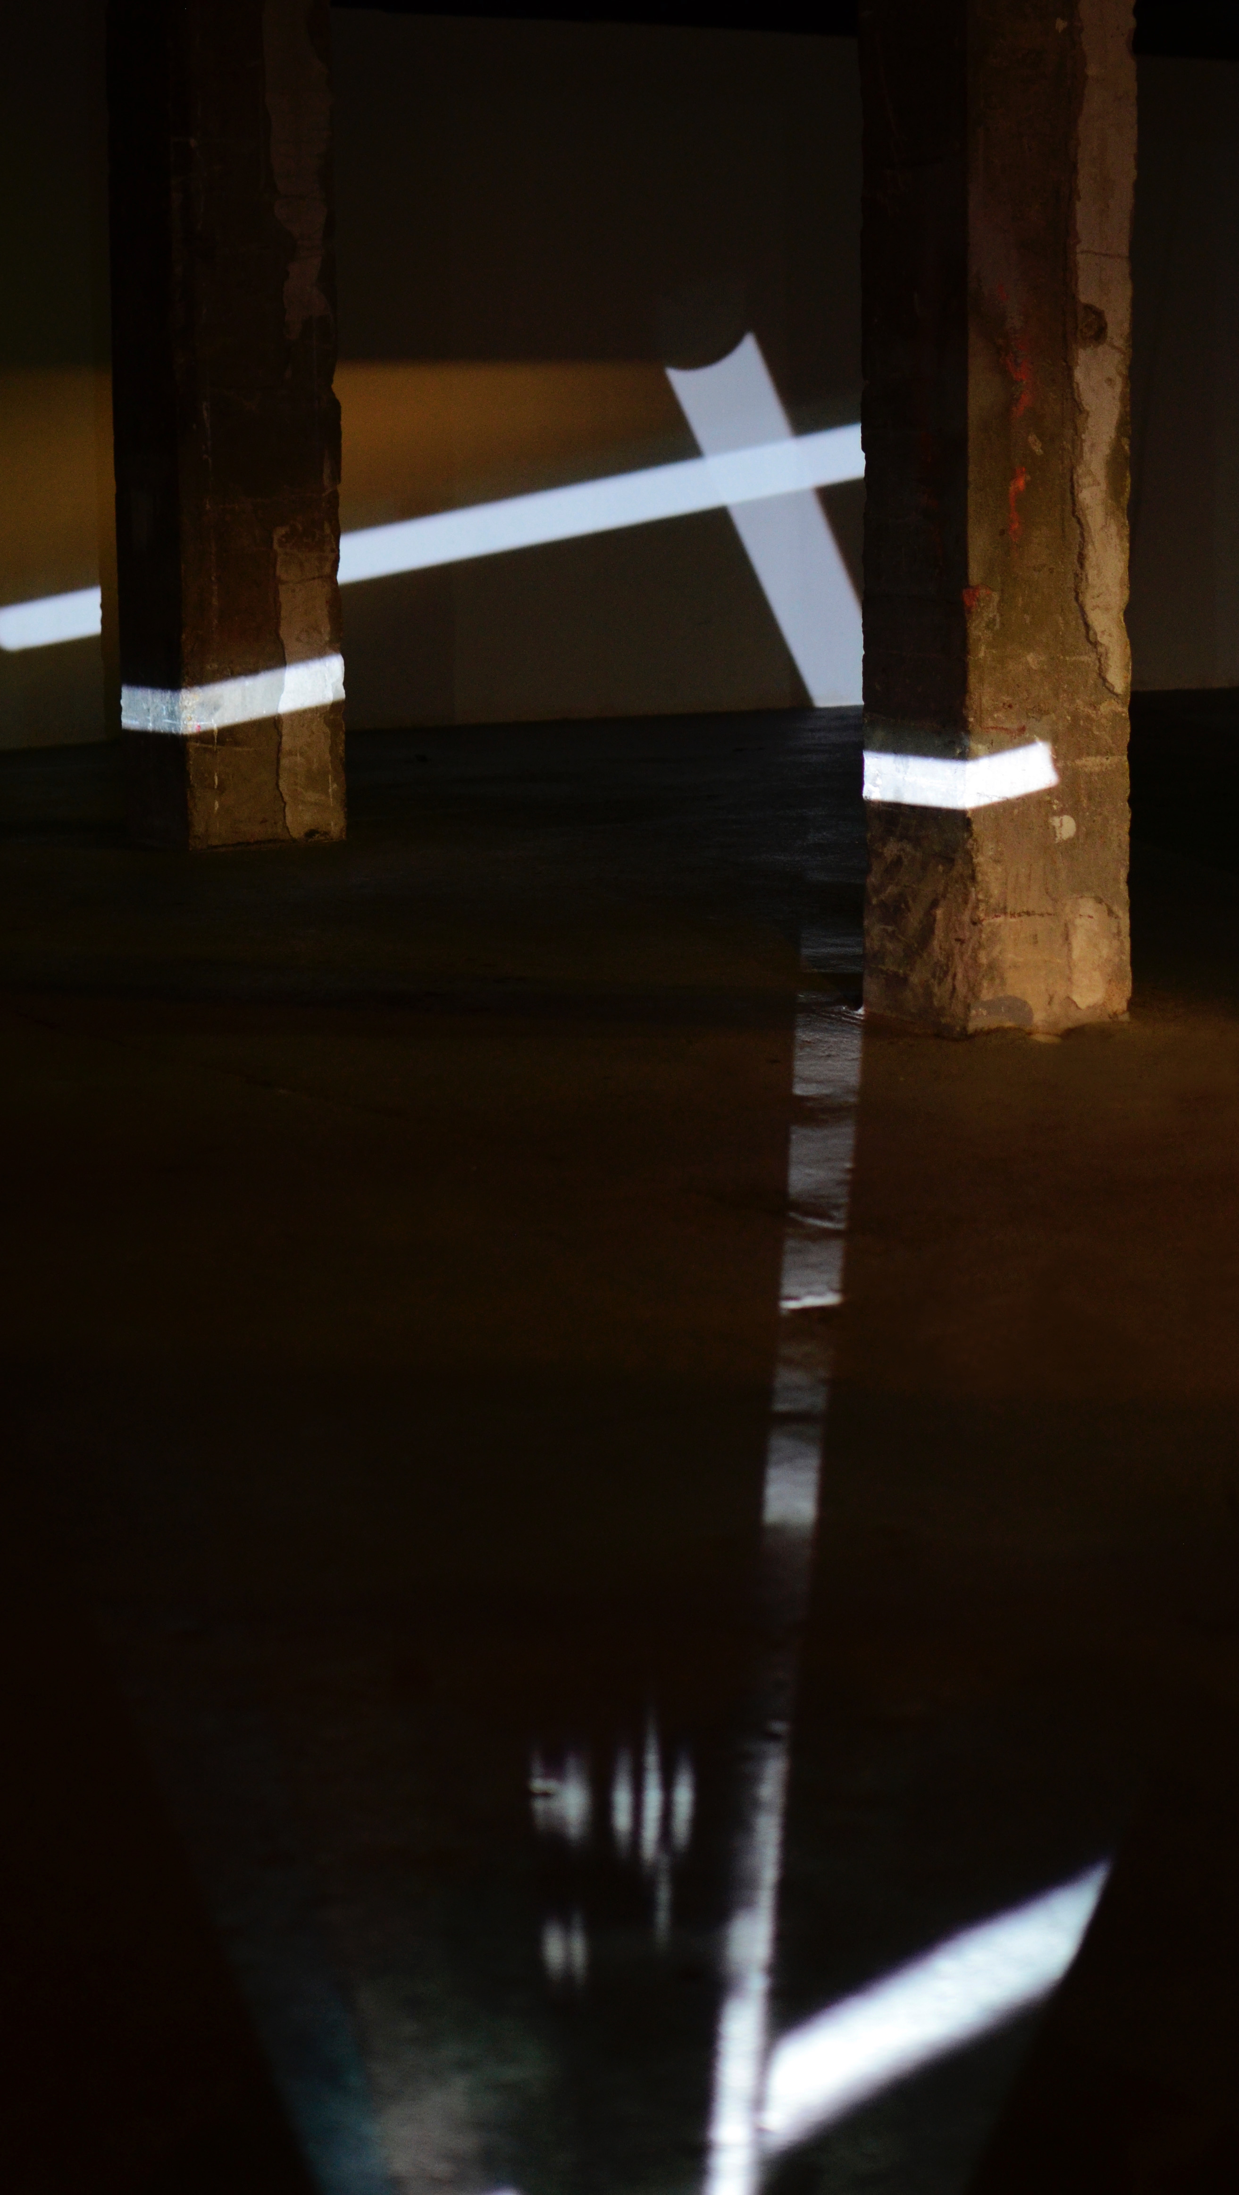
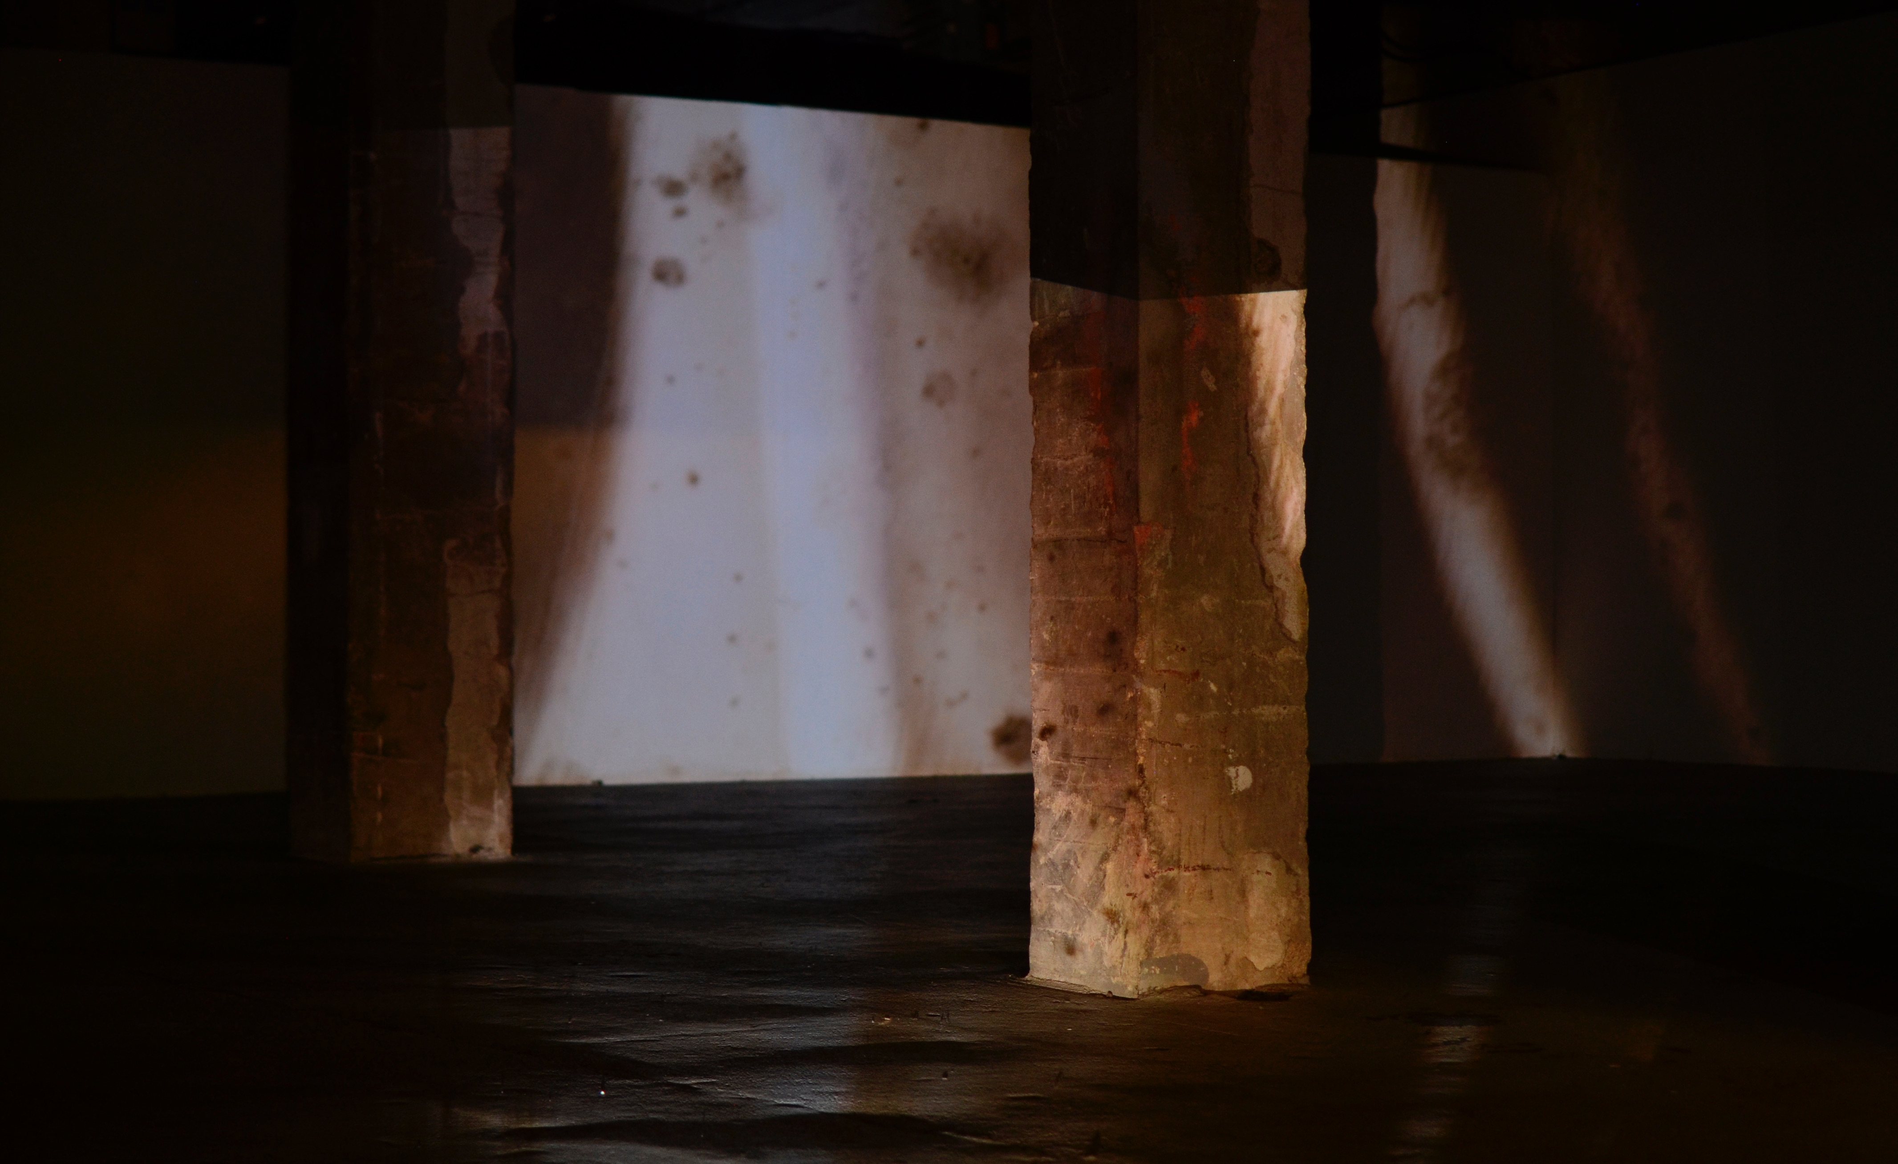

Slide 19
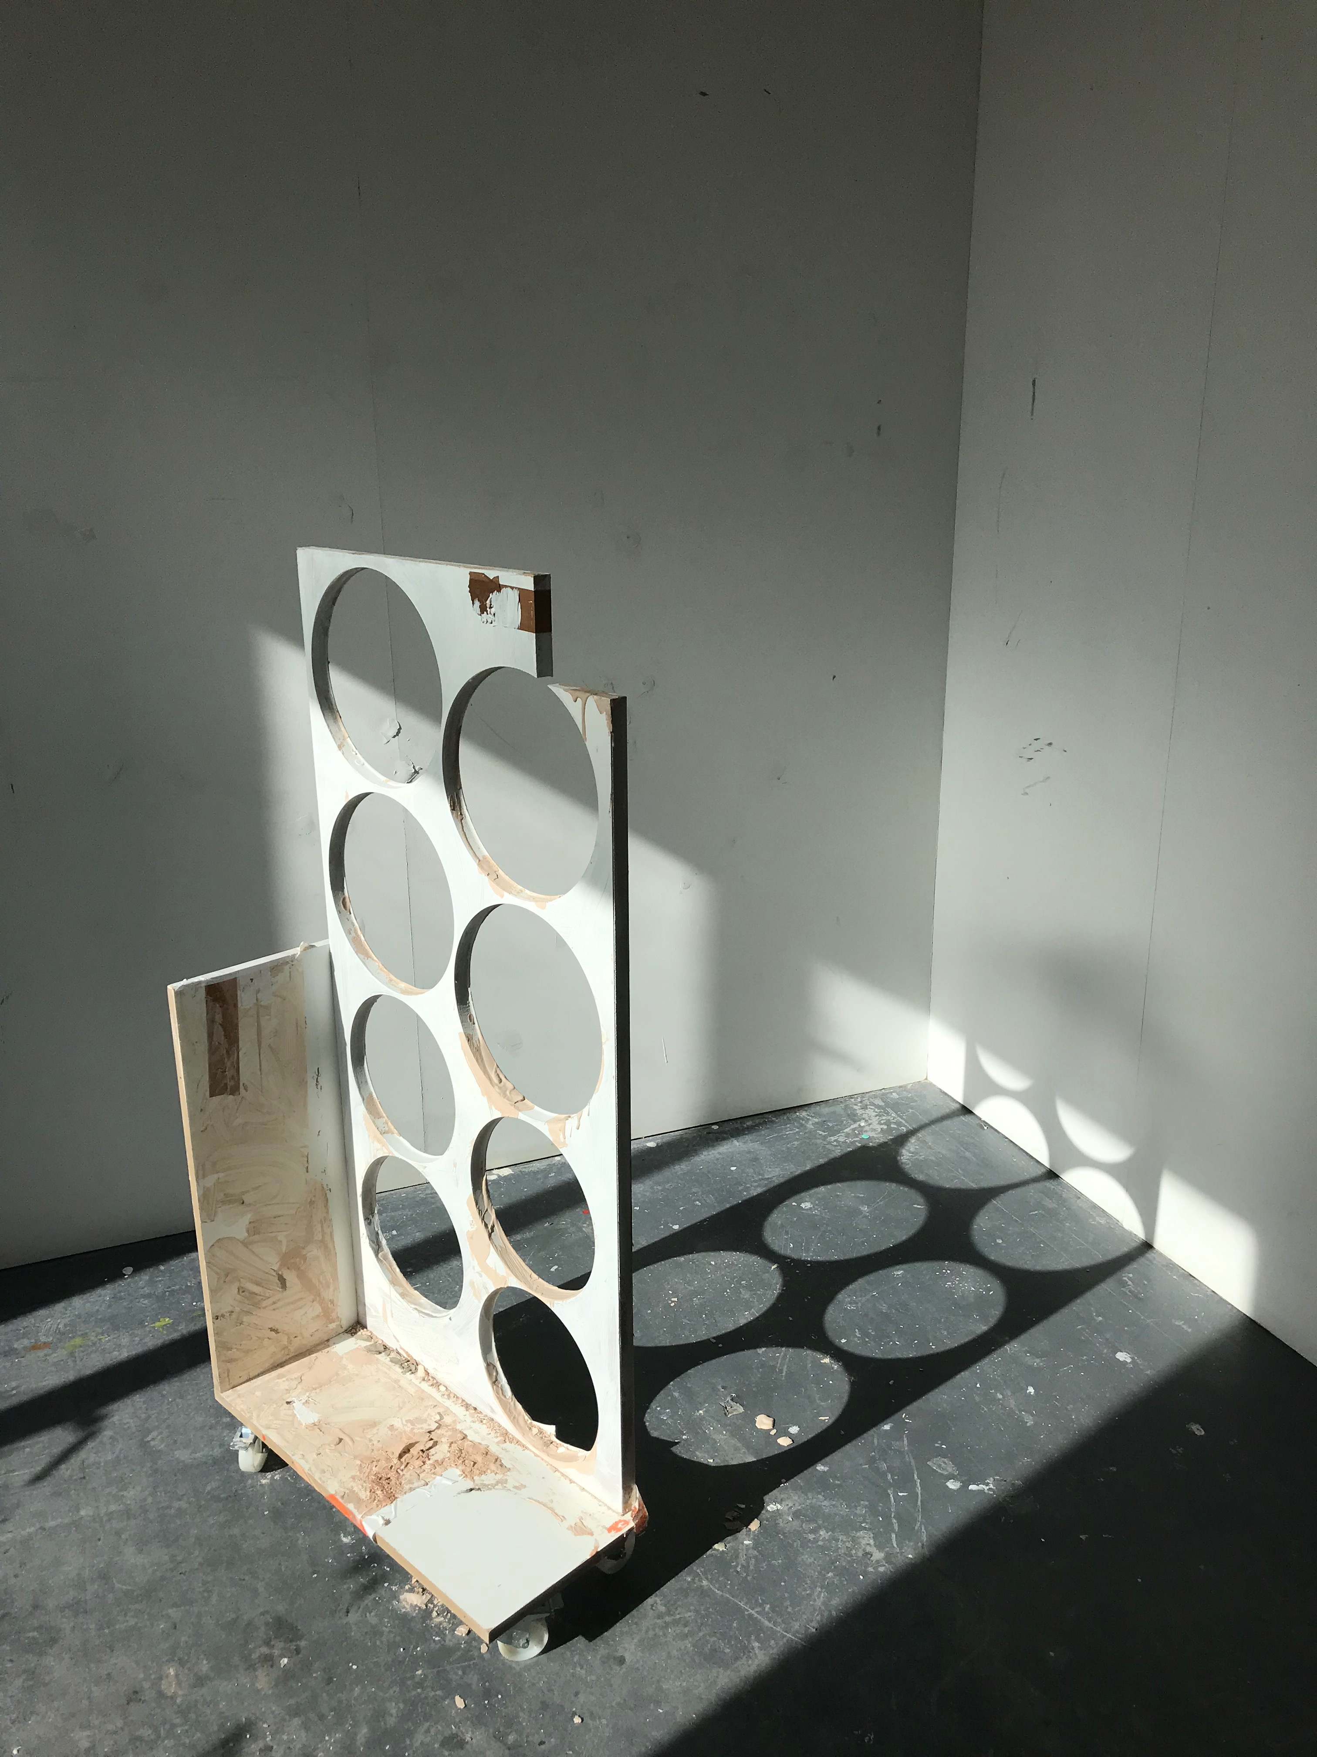
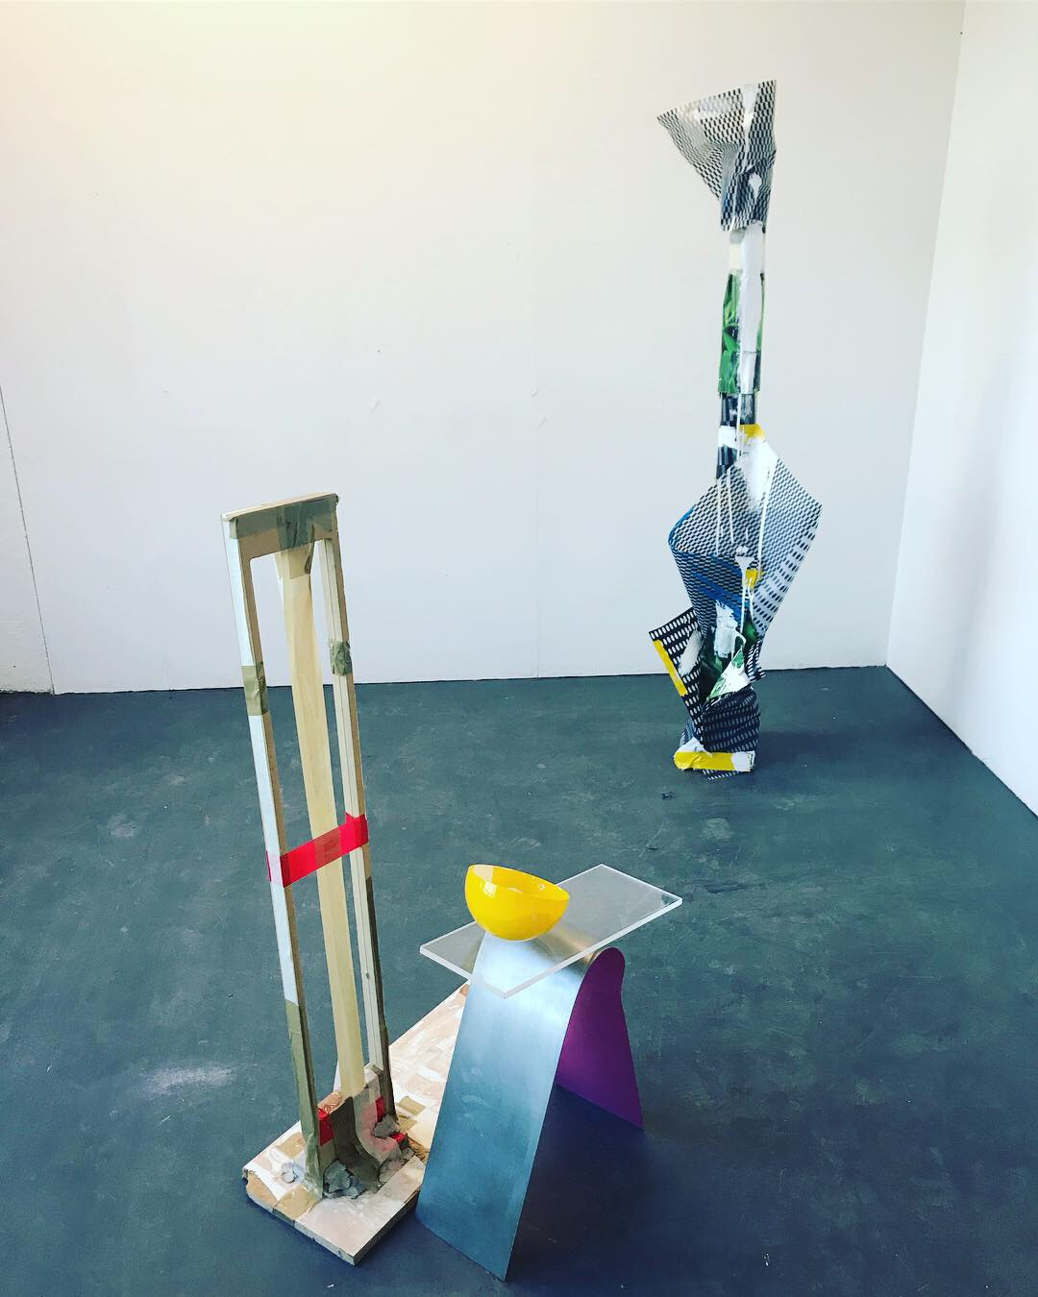
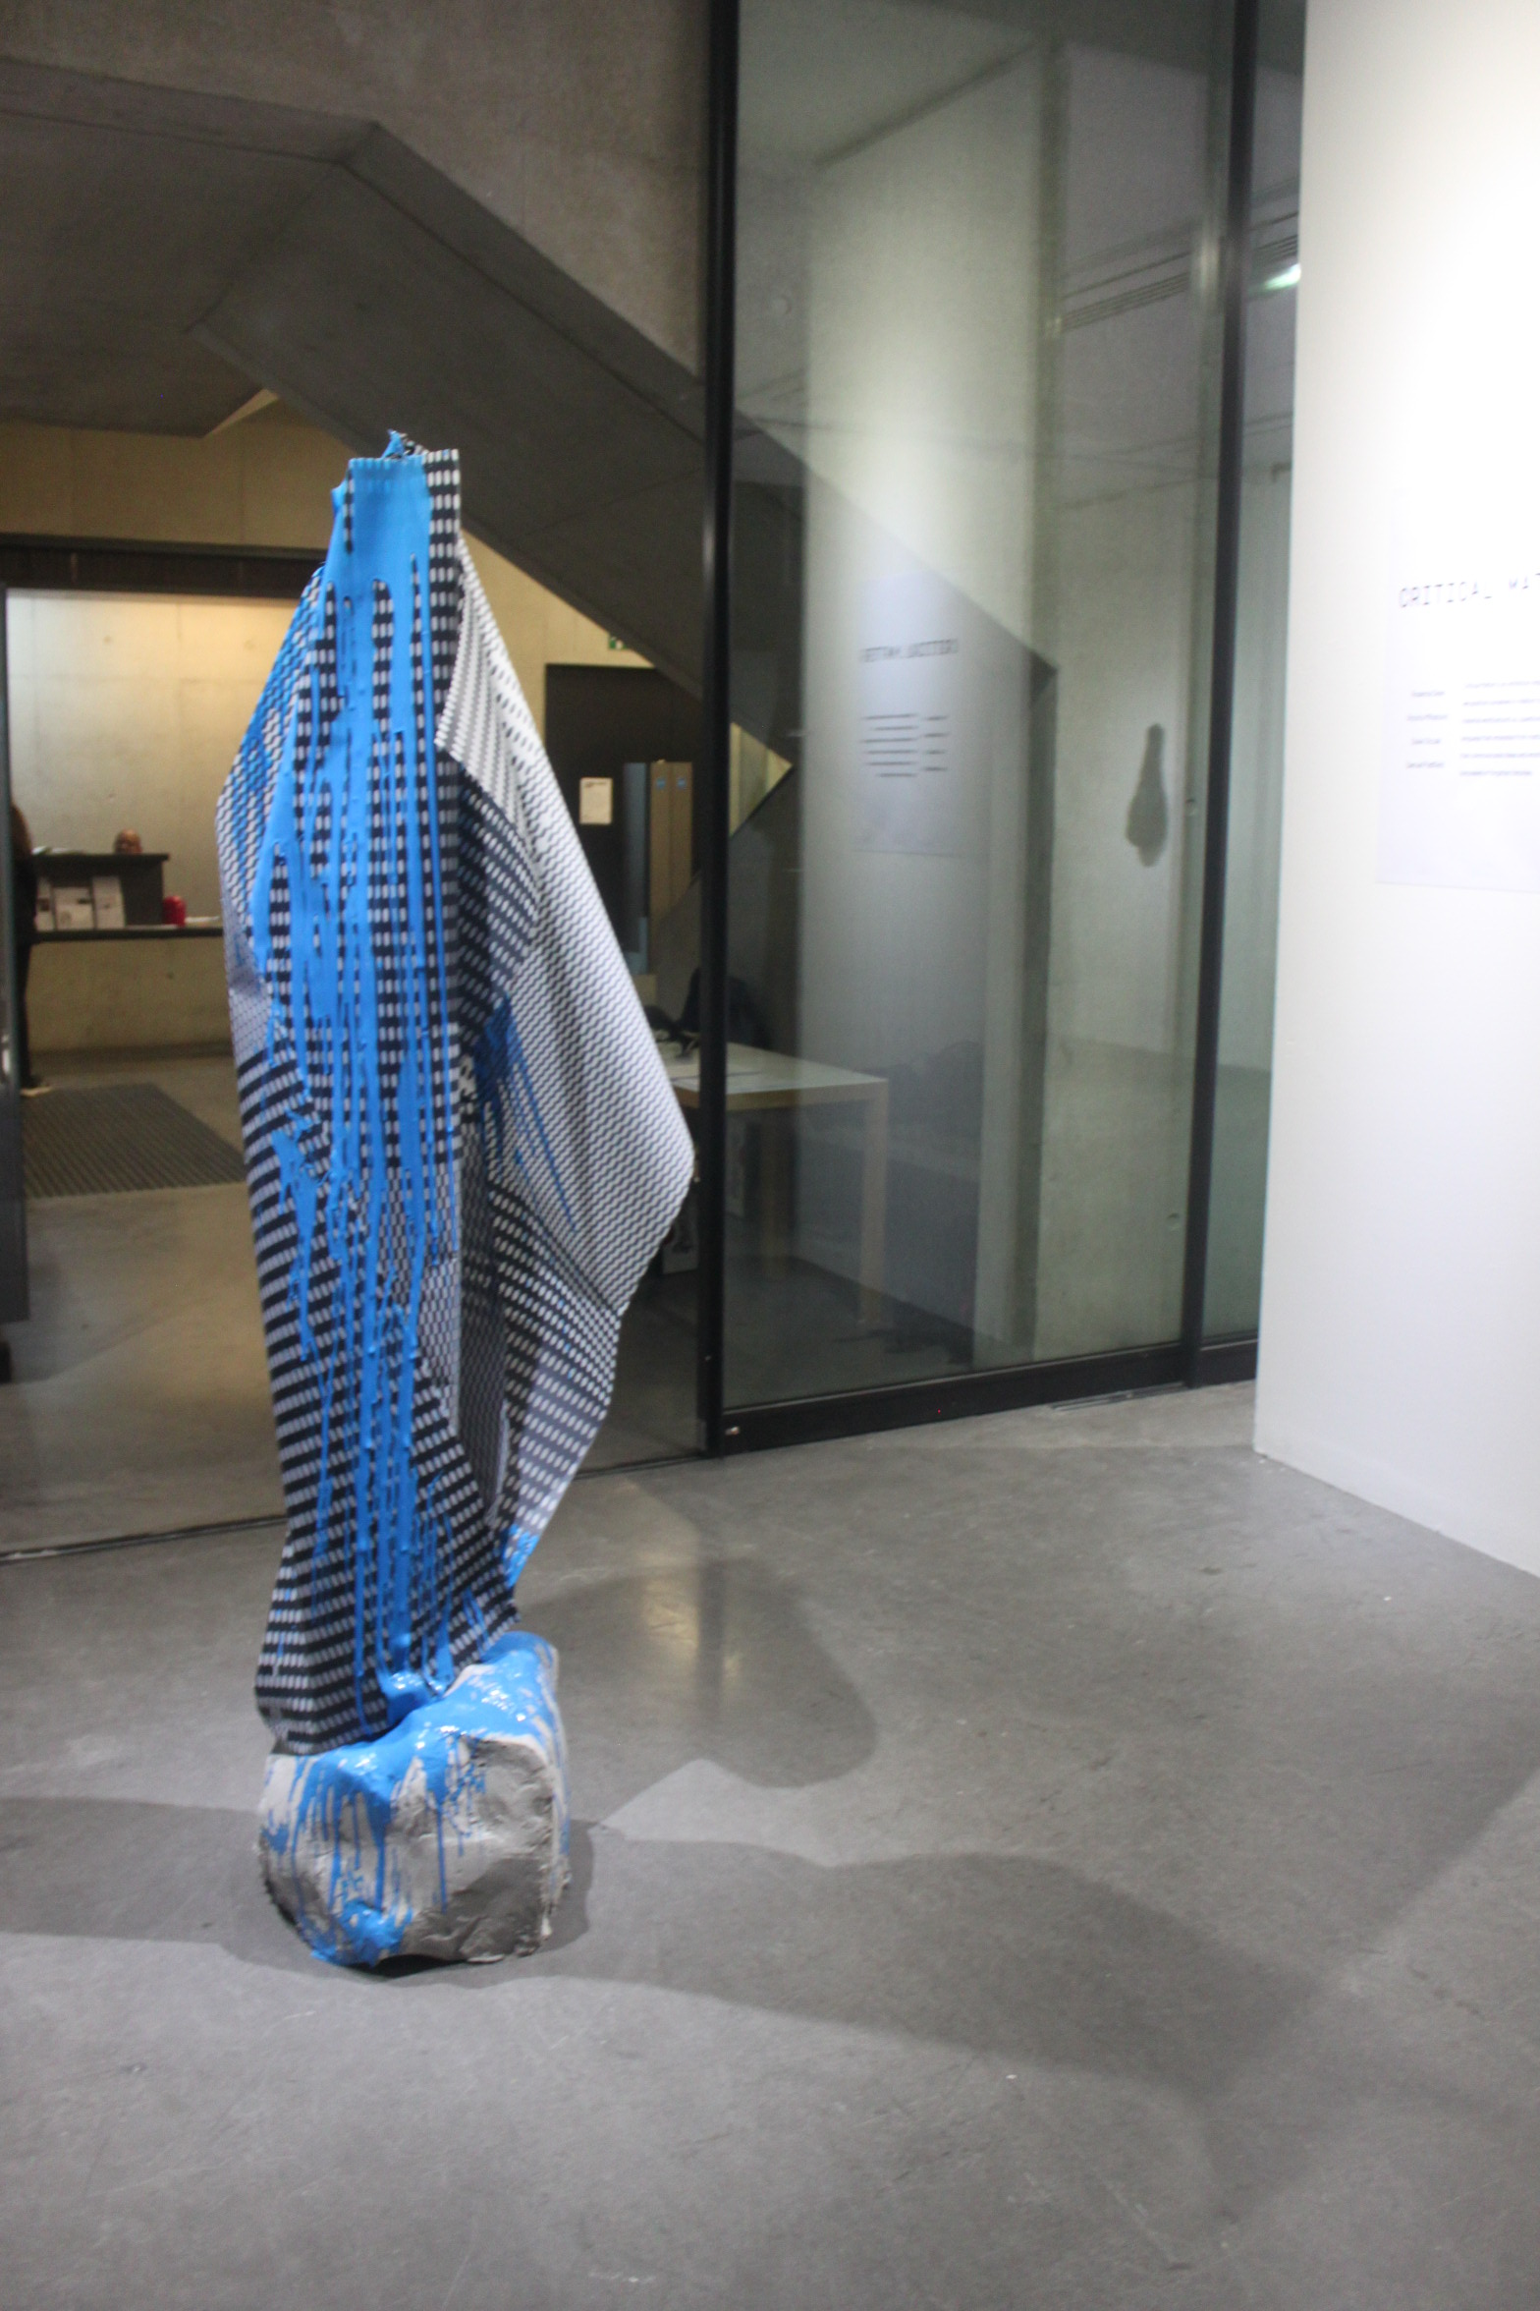
Notes:
RECONFIGURING WORKS WHILST IN AN ART SCHOOL CONTEXT – ALL WORK IS ABOUT FRAMING, AWARENESS, CHANGING PERCEPTION, BALANCE, ECOLOGY- DISORIENTATION, FLUIDITY, DRIPPING.

Slide 20
