Slide 1

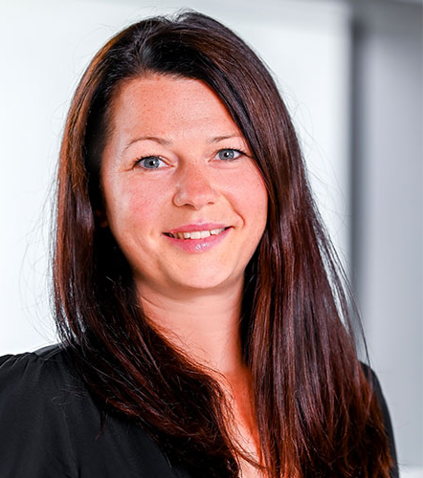
CIMEC’26 WATER CONFERENCE 02/04/2026 SUSTAINABILITY, THE CIRCULAR ECONOMY AND DIGITALISATION IN THE EUROPEAN TEXTILE & CLOTHING INDUSTRY - An Applied Maturity Framework-
Martin Wynn
University of Gloucestershire
Tina Wiegand
Hof University of Applied Sciences

Slide 2
Agenda
The European Textile and Clothing (T&C) industry
Key Sustainability/Circular Economy (CE) Issues
Research Findings
Towards a Model for Assessing Company Maturity

Slide 3
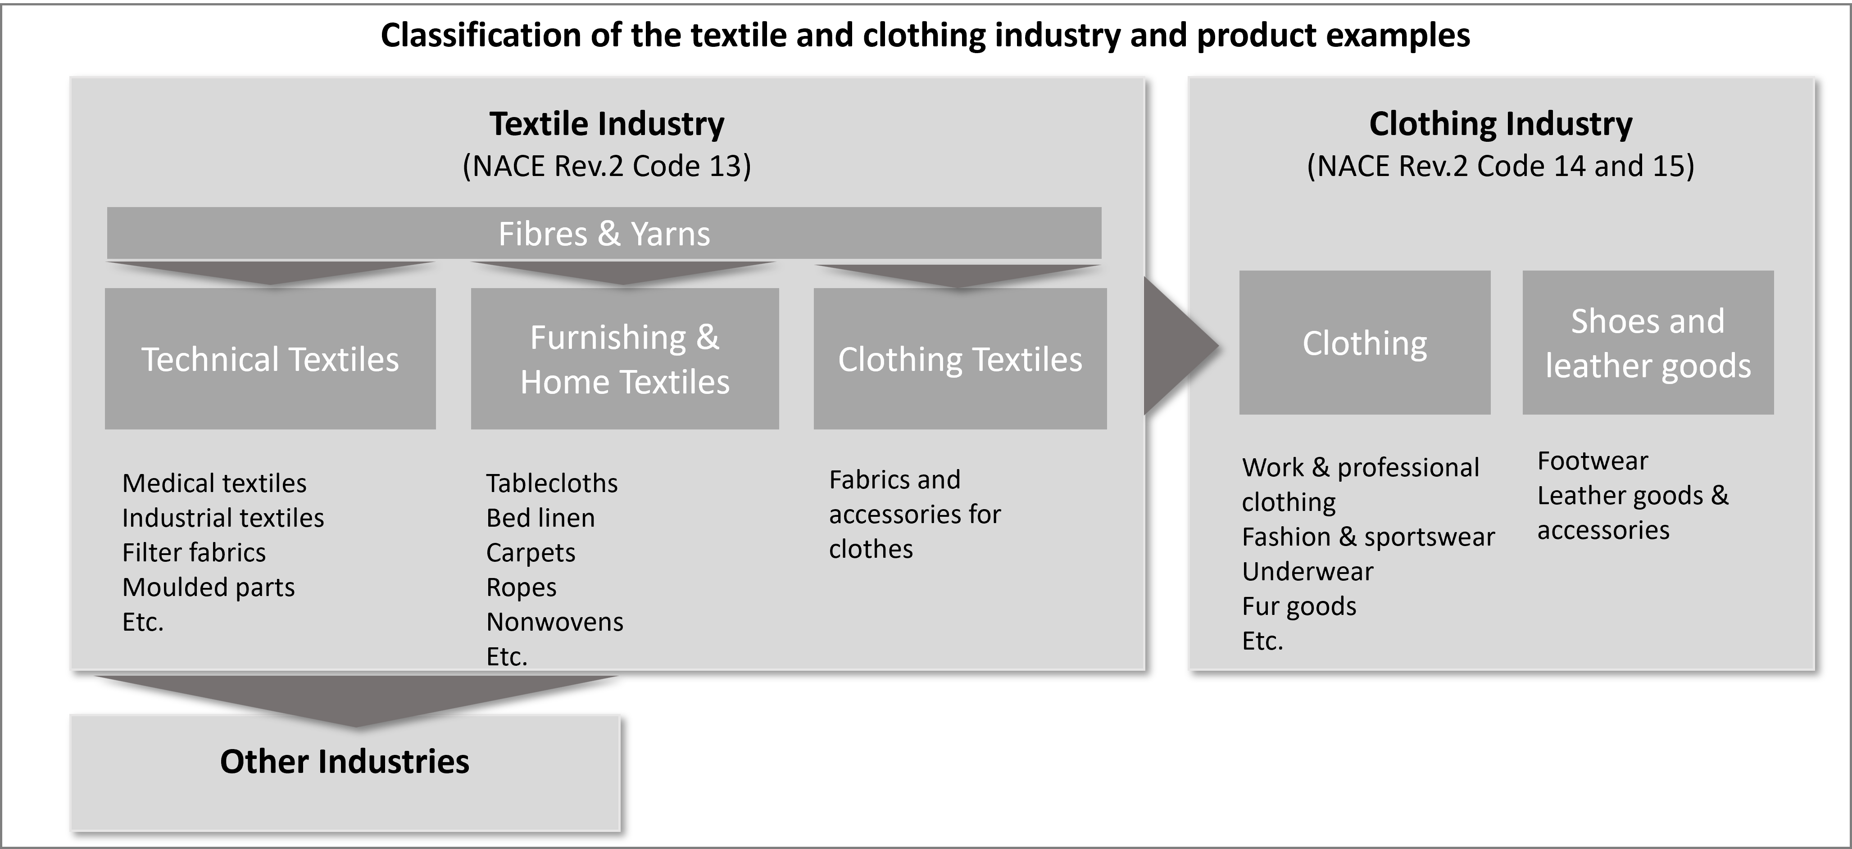
The textile and clothing (T&C) industry covers distinct but interconnected stages from fibre production to finished textiles and garments
The European Textile and Clothing (T&C) industry
Source: Wynn & Wiegand, 2025

Slide 4
Italy dominates the European T&C industry while SMEs shape its overall structure
The European Textile and Clothing (T&C) industry
Key figures on the European T&C industry
The European T&C industry comprises ~197,000 companies, 1.3 million workers, and €170 billion turnover (2023)
Italy leads the EU, with more than 40% of the total turnover of the EU’s T&C industry, followed by Germany, France, and Spain
More than 90% of companies are SMEs
Source: Wynn & Wiegand, 2025

Slide 5
The T&C industry faces major environmental impacts and increasing pressure for the transition to sustainability, circularity and digitalisation
Key Sustainability/Circular Economy Issues
The T&C industry is the 4th largest contributor to environmental impacts in the EU (after food, housing, transport)
High resource consumption and low recycling rates highlight the industry's linear value chain structure
The T&C sector is a key focus of the EU Circular Economy Action Plan
Digital technologies (e.g., AI, IoT, Blockchain) are seen as key enablers but remain underexplored in practice and research
Source: Wynn & Wiegand, 2025

Slide 6
Circular Economy and digital technologies are key enablers for sustainable transformation in the T&C Industry
Key Sustainability/Circular Economy Issues
Research Objective 1:
To examine the current status of sustainability strategies, circular economy (CE) practices, and digital technology deployment
Research Objective 2:
To develop and apply a framework to assess the maturity of European T&C companies regarding sustainability, CE and digitalisation

Slide 7
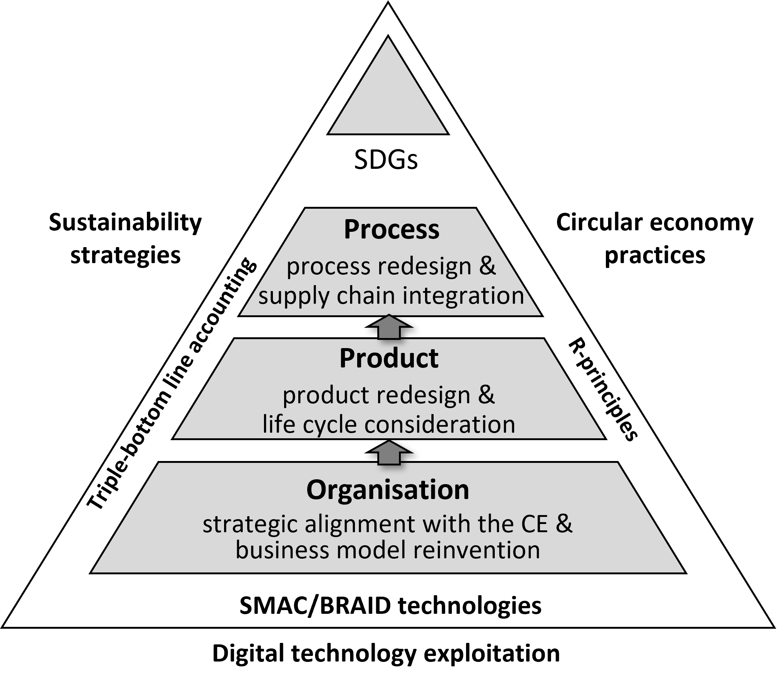
Companies progress incrementally towards integrated sustainability, CE, and digitalisation across products, processes, and organisation
Research Findings – change dimensions and influencing factors
Source: Wiegand and Wynn, 2023

Slide 8
Sustainability efforts focus on resource efficiency and waste reduction, while Scope 3 emissions lag behind
Research Findings – Key themes based on case study analysis
Sustainability strategies:
Reducing resource consumption is a key priority, particularly through water-saving production processes and the use of recycled or alternative materials
Waste reduction is widely pursued, including on-demand production, reusable packaging, and recycling initiatives
Emission reduction focuses on Scope 1 and 2, while Scope 3 remains largely unaddressed

Slide 9
Circular Economy practices focus on mainly on product design, business model innovation, recycling, and cross-company collaboration
Research Findings – Key themes based on case study analysis
Circular Economy Practices:
Circular product design and materials are increasingly adopted, though implementation remains uneven
Circular business models are emerging, but adoption remains limited and profitability uncertain
Collaboration is critical for circularity, including industrial clusters, partnerships, and cross-sector innovation initiatives

Slide 10
Digital technologies are widely adopted but only indirectly support sustainability strategies and CE-practices
Research Findings – Key themes based on case study analysis
Digital Technology Deployment:
Digital technologies support environmental performance assessment and reporting
Digital tools enhance supply chain transparency and traceability
Digital technologies enable resource-efficient and more circular production processes

Slide 11
A four-stage maturity framework captures the transition towards integrated sustainability, CE, and digitalisation
Research Findings – Initial Maturity Framework
Maturity Level / Change Dimensions | Organisation | Product | Process | Digitalisation
Static
Basic
Intermediate
Advanced
Source: Wiegand and Wynn, 2023

Slide 12
The case study companies follow different transition paths rather than linear maturity development
Research Findings – Maturity Framework Application and Evaluation
Dimension/case | Organisation | Product | Process | Digitalisation | Next Steps
C1 (Italy) | Advanced: fully institutionalised principles and policies; alignment with international standards; organisational integration. | Advanced: deliberate design strategies; extensive transparency and traceability; structured repair and take-back programmes. | Advanced: Capacity planning reduces waste; process discipline. | Advanced: Ecommerce platform for environmental information; capability intensification, ecosystem integration, and data-driven collaboration. | Stronger overall integration; leverage digitalisation benefits; extend DPP infrastructure.
C2 (Germany) | Basic: No systematic embedding into corporate strategy. | Intermediate: Some sustainability characteristics, but evidence of circularity principles is limited; Digital printing is a positive. | Intermediate: Strong water management, plus a range of benefits from digital printing; but systemic inter-organisational loop-closing mechanisms are lacking. | Advanced: Value chain integration via standard IS plus digital technology benefits (paperless accounting, a reduction in physical sampling, fully on-demand manufacturing, and substantial cost savings. | Exploit potential of digitalisation for material traceability, digital waste sorting, preparation for Digital Product Passport, data management, and supplier transparency; closer cooperation with main customers.
C3 (Portugal) | Intermediate: Limited embedding of sustainability and CE principles in overall strategy, but evidenced in areas of production; sustainability permeates governance, purchasing, and marketing. | Intermediate: Overall strong certification and quality control, but not for Portuguese wool; client data sharing is a positive and textile waste is treated and recycled; | Intermediate: Material, energy, water and chemical reduction measures; CE and innovation projects, both internally and with various partners in scientific and technological fields; certified internal quality control. | Basic/Intermediate: Functional approach for efficiency gains and process improvements, but active support and enablement of sustainability and CE practices is limited. | Full embedding of sustainability and CE principles into strategy and operations; stronger upstream coordination of policy measures; adopt eco-design strategies in product development; increase transparency via digital data sharing with clients.
C4 (Bulgaria) | Intermediate: Key principles largely integrated into strategy and operations; waste reduction and recycling initiatives, but more embedding in culture and awareness needed. | Intermediate/Advanced: Eco-design principles in evidence; textile waste is recycled and reused in company products; waste-free production technology implemented. | Advanced: Textile production volumes are tightly controlled to avoid waste; optimised production planning based on customer orders; advanced process integration with external partners. | Intermediate: Government funded project for automated seeing equipment with digitalised functions; robotics now used for cutting; social media and website for communications. | Greater focus on emissions and waste reduction; more embedding in organisational strategy and operations; training to improve awareness and progress culture change. Introduce DPP; exploit social media more.
C5 (Türkiye) | Advanced: sustainability embedded in strategic decision-making; adheres to internationally recognised standards; integration across production, design and resource management systems. | Advanced: materials selection integrates sustainability and CE principles; proactive corrective and reprocessing repair practices; pre-consumer textile wastes are collected and recycled. | Advanced: finishing process technologies aim to reduce chemical and water dependency; digital pattern making reduces water and chemicals consumption. | Intermediate/Advanced: ERP used to digitally manage all production processes and operational steps; digital reporting tools monitor environmental performance of the pro-duction processes; AI being trialled across supply chain; DPP being piloted. | Explore higher-value applications for pre-consumer waste valorisation; greater collaboration with recycling and upcycling partners; modular design approaches, innovative materials and finishing techniques; post-consumer take-back, repair, or refurbishment schemes; progress DPP and AI initiatives.

Slide 13
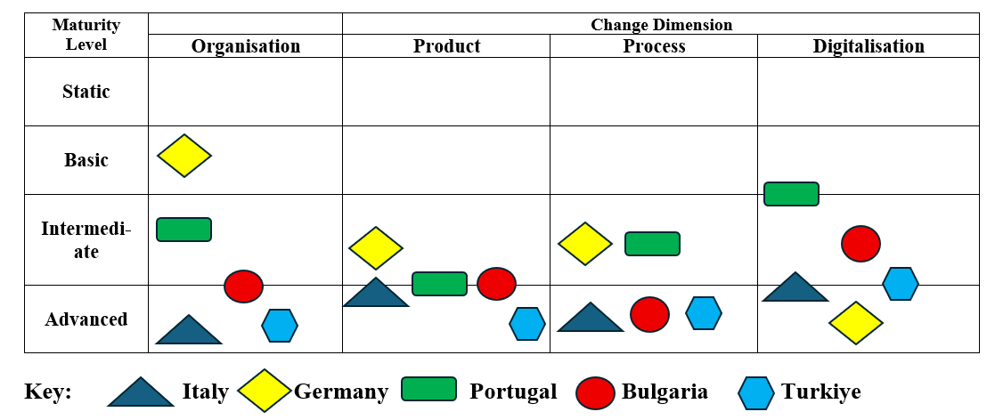
The case study companies follow different transition paths rather than linear maturity development
Research Findings – Maturity Framework Application and Evaluation

Slide 14
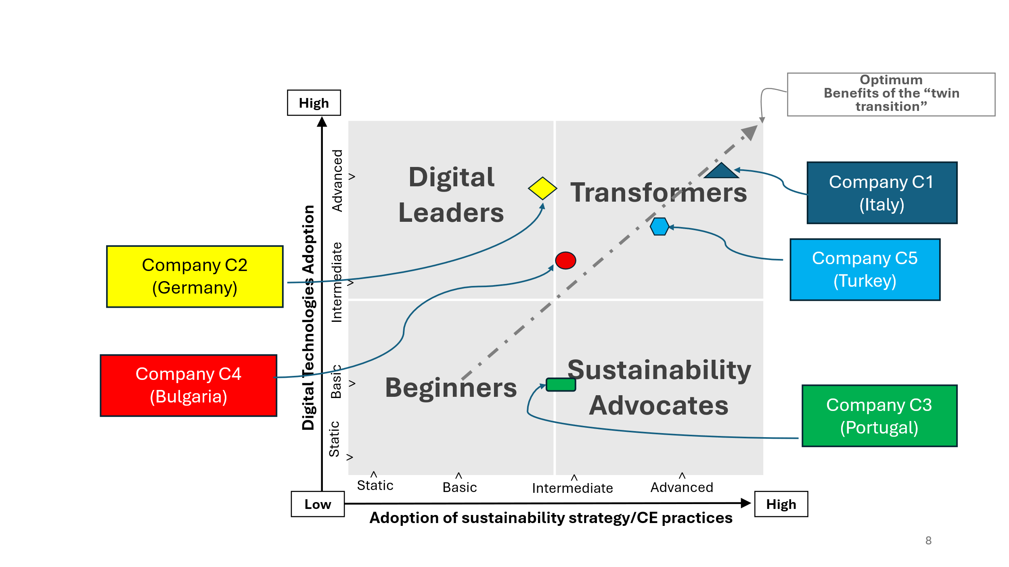
Four company profiles capture distinct maturity patterns in integrated sustainability strategy / circular economy practices, and digitalisation
Research Findings – Maturity Framework Application and Evaluation
Company Profiles Identified
Beginners — limited sustainability and digitalisation progress
Transformers — integrated sustainability, CE, and stakeholder collaboration
Digital Leaders — strong digitalisation but fragmented sustainability strategies
Sustainability Advocates — strong sustainability focus but limited digitalisation

Slide 15
Water-related sustainability, circularity, and digitalisation practices are most visible in process innovation, resource monitoring, and wastewater management
Research Findings – Water-related sustainability, circularity, and digitalisation practices
Water-related sustainability, circularity, and digitalisation practices differ across the case companies and are most advanced in three companies:
C2 (Germany): Closed-loop water recycling, reuse of rinsing and cooling water, and reduced consumption through digital printing; supported by ERP-driven process optimisation.
C3 (Portugal): Water reduction and ~60% recovery initiatives, including wastewater treatment; digital tools enable real-time water monitoring.
C5 (Türkiye): Dry processing, ozone and laser technologies reduce water use; systematic monitoring (EIM) and advanced wastewater treatment.

Slide 16
Fragmented progress calls for integrated strategies and further research on the twin transition in the European T&C Industry
Conclusion
Conclusion
Findings reveal uneven maturity levels across companies and regions
Digitalisation remains fragmented and often not aligned with sustain-ability and CE strategies
Integrated, cross-functional approaches are required to realise full sustainability potential
Inter-organisational collaboration is critical and can be strengthened through digital technologies

Slide 17


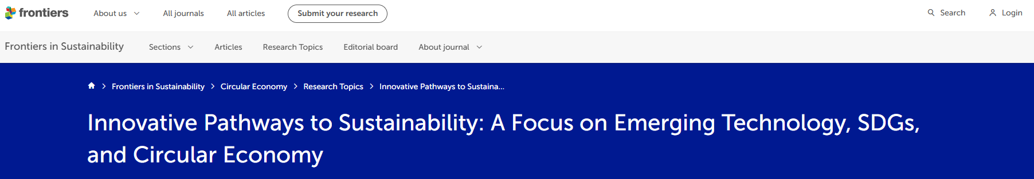
Thank you
Martin Wynn
University of Gloucestershire (UK)
mwynn@glos.ac.uk
Tina Wiegand
Hof University of Applied Sciences (DE)
tina.wiegand@hof-university.de
Research Topic: Frontiers | Innovative Pathways to Sustainability: A Focus on Emerging Technology, SDGs, and Circular Economy

Slide 18
Sources
European Environment Agency. 2022. Textiles and the Environment: The Role of Design in Europe’s Circular Economy. LU: Publications Office.
Wiegand, Tina, and Martin Wynn. 2023. ‘Sustainability, the Circular Economy and Digitalisation in the German Textile and Clothing Industry’. Sustainability 15(11):9111. doi:10.3390/su15119111.
Wynn, M., and Wiegand, T. (Eds.). (2025). Sustainability, the circular economy and digitalisation in the European textile and clothing industry: How digital technologies are enabling the circular economy. Springer Nature Singapore. https://doi.org/10.1007/978-981-97-9116-3

