Slide 1
Somali Maritime Predation
Traditional Piracy or
a New Form of Terrorism?
Anamika Twyman-Ghoshal, PhD.
Stonehill College, MA
Notes:
This research looks at the context for piracy in Somalia.

Slide 2
Problem Statement
Is Somali Maritime Piracy a form of Maritime Terrorism?
Is coupling these threats a sound policy decision?
Notes:
Is Somali Maritime Piracy a form of Maritime Terrorism?
Will look at definitions and motivations to understand these two phenomena
Is coupling these threats a sound policy decision?
Will look at the motivations of Somali piracy and if existing measure have been successful.
But first – why Somalia?

Slide 3
Somali Maritime Predation is different...
Occurs in the high seas,
Targets vessels in motion,
During daytime,
Likely to be armed and threatening, but not most violent,
Less likely to board,
Hold the ship for ransom,
Unprecedented response.
Notes:
Somali piracy is different
Occurs in the high seas,
Targets vessels in motion,
During daytime,
Likely to be armed and threatening, but not most violent,
Attackers are less likely to board,
Also, they hold the ship for ransom,
AND it has solicited an unprecedented response
In many ways it has already been associated with terrorism.
Research looks at whether Somali maritime piracy should be labeled terrorism. Are these different phenomena, are the underlying motives the same. To do this we will talk about wat piracy is, what terrorism is, what the motivations are of Somali pirates, and why there has been a trend to define Somali piracy as terrorism.

Slide 4
International Legal Definition of Maritime Piracy
United Nations Convention on the Law of the Sea (UNCLOS), 1982, Art. 101
Piracy consists of:
Any illegal acts of violence, detention, or any act of depredation committed for private ends by the crew or the passengers of a private ship or a private aircraft, and directed:
On the high seas, against another ship or aircraft, or against persons or property on board such ship or aircraft;
Against a ship, aircraft, persons or property in a place outside the jurisdiction of any State;
Any act of voluntary participation in the operation of a ship or of an aircraft with knowledge of facts making it a pirate ship or aircraft;
Any act of inciting or of intentionally facilitating an act described in subparagraph (a) or (b) of this article.
Notes:
Piracy is one of the oldest international crimes, and holds a unique position with the concept of universal jurisdiction (jure gentium).
The limitations of the UNCLOS
ship-to-ship conflict;
occur in international waters, and; [From 2001-10, 23% of all the incidents recorded in the CMPD fell within the legal definition of piracy. Most incidents occurred in territorial waters - 50.8 per cent.
for private ends.
Joseph Bingham, who prepared the Comment to the Harvard Draft Convention on Piracy (which formed the basis for the Geneva Convention and, therefore, UNCLOS), the private ends requirement excluded ‘all cases of wrongful attacks on persons or property for political ends, whether they are made on behalf of states or of recognized belligerent organizations, or of unorganized revolutionary bands’. In 1955, the International Law Commission (part of the UN General Assembly that is mandated with the development of international law) reiterated this stating that ‘the draft convention excludes from its definition of piracy all cases of wrongful attacks on persons or property for political ends, whether they are made on behalf of states, or of recognized belligerent organizations, or of unrecognized revolutionary bands’.

Slide 5
International Legal Definition of Maritime Piracy
Convention for the Suppression of Unlawful Acts against the Safety of Maritime Navigation (SUA), 1988, Art. 3
Any person commits an offence if that person unlawfully and intentionally:
(a) seizes or exercises control over a ship by force or threat thereof or any other form of intimidation; or
(b) performs an act of violence against a person on board a ship if that act is likely to endanger the safe navigation of that ship; or
(c) destroys a ship or causes damage to a ship or to its cargo which is likely to endanger the safe navigation of that ship; or
(d) places or causes to be placed on a ship, by any means whatsoever, a device or substance which is likely to destroy that ship, or cause damage to that ship or its cargo which endangers or is likely to endanger the safe navigation of that ship; or
(e) destroys or seriously damages maritime navigational facilities or seriously interferes with their operation, if any such act is likely to endanger the safe navigation of a ship; or
(f) communicates information which he knows to be false, thereby endangering the safe navigation of a ship; or
(g) injures or kills any person, in connection with the commission or the attempted commission of any of the offences set forth in subparagraphs (a) to (f).
Notes:
In 1985, four Palestinian Liberation Front members took a passenger cruise ship Achille Lauro hostage in exchange of release of 50 Palestinian prisoner in Israel. When demands were not met, they killed an elderly wheelchair bound American man. There were not two ships, no mutiny, and it was not for private ends – UNCLOS did not apply. It was not considered piracy.
New law was drafted that would be broad enough to include piracy and terrorism.
1988 Convention for the Suppression of Unlawful Acts against the Safety of Maritime Navigation. Much broader, LARGER SCOPE AND APPLICABILITY, no two ship requirement, no high seas requirement, motivation irrelevant...
BUT it did not have universal jurisdiction. Had to go through signing and ratification like any other international law. Added consensual boarding with the SUA Protocol in 2005 but still very rare use of SUA. Because it has to “ENDANGER THE SAEFTY OF MARITIME NAVIGATION”.

Slide 6
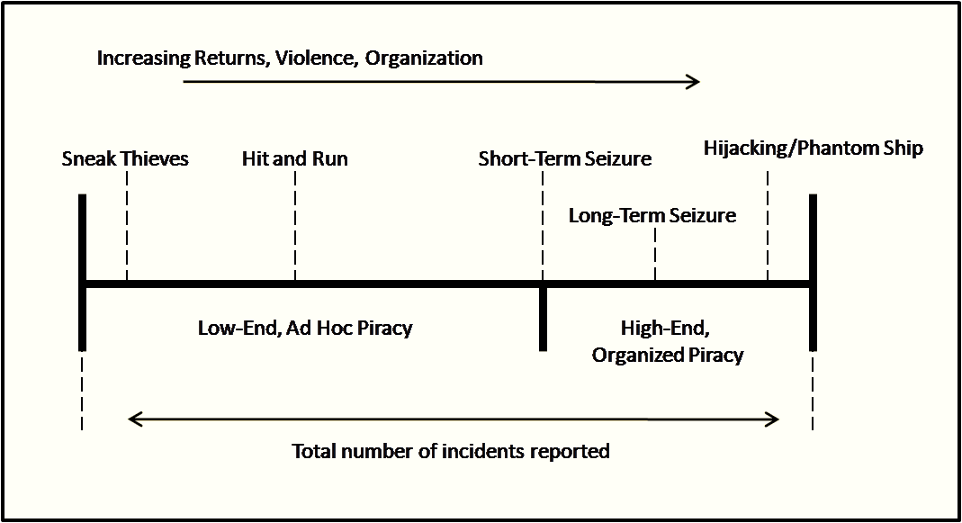
So what is Maritime Piracy?
Range of behaviors (Young, 2007; Murphy, 2009)
Common criminal piracy Highly organized criminal piracy
IMO Classification of Attacks and Assault (1993)
Low-level armed robbery
Medium-level armed assault and robbery
Major criminal hijack
SOURCE: A. Young, 2007
Notes:
Need to look beyond the legal definition since this is not helpful as we saw from two main instruments. What is piracy? It involves a variety of behaviors, from sneak thieves with no interpersonal violence, to hit and run incidents where individuals attack crew and steal equipment and personal belongings or partial cargo, to seizures to obtain cargo or ship, to ransoming which requires less sophistication. This range in levels of violence and organization and number of incidents. Phantom ships were stolen vessels which were used for stealing cargoes from ports through fake vessel IDs. Highly sophisticated crimes that occurred in the 90s.
The International Maritime Organization categorizes piracy into three broad categories.
There are several typologies, a select few include terrorism, but the majority suggest that maritime terrorism has a different motive, it is for private gain.

Slide 7
Defining Terrorism
No agreement, over 200 definitions
Common factors include:
Political motivation
Use or threat of violence
Generate fear
Innocent targets
Form of communication
Audience broader than the direct victims
Notes:
So what is terrorism. Even harder to define! Over 200 definitions. There are various types of terrorisms – domestic, international, state, sub-national... Political nature means it is based on societal perceptions and is a form of stigmatization. UN has been trying to come up with a definition but has largely been unsuccessful. The US has 20 different definitions depending on the organ of state (FBI, State Department, Department of Defense...) Problem with state definition is that it is PROPAGANDISTIC – it is biased towards the political and ideological interests. Need objective definition → literal definition.
From an anaysis of the various legal, national, international, and academic definitions can identify various common factors.
One of the key elements that differentiates terrorism is the political motivation. Need to look at motivation of piracy and terrorism and see if these are aligned.

Slide 8
Motivation
Robert K. Merton’s Anomie Theory
Mean-Ends Discrepancies create strains
Key Deviant Adaptations:
Rebellion (social crime)
Innovation (anti-social crime)
Notes:
Motivation can be divided into expressive and instrumental.
Expressive crimes are affective emotional outlets such as venting rage, anger or frustration, Instrumental crimes are aimed at acquiring form financial gain or social status it is usually planned, premeditated and reasoned. Terrorism is a RELATED to expressive crime however it is also a purposeful and planned form of communication.
Merton’s Anomie Theory
It is therefore more useful to use a different lens to understand the motivations of piracy and terrorism.
In one of the most well-known articles in sociology, Merton explores how structural contradictions caused by the incongruence of the goals set by society and the means to achieve these goals create strains and frustrations experienced by individuals. Merton theorized that these conditions produced various types of adaptations, thereby explaining the variance in human behavior in the face of anomic conditions. The various adaptations are contingent on the internalization of the existing cultural goals and institutionalized means of achieving these.
Innovation describes individual behavior which strives to attain the goals of monetary gain and success set by society but rejects the institutionalized means of attaining these goals. (anti-social crime embraces existing social and political order and take advantage if it)
Rebellion, on the other hand, is a rejection of both the goals espoused by society as well as the legitimate means of achieving such goals, instead those who rebel advocate for new goals using unorthodox means to achieve these. (social crime challenging prevailing social and political order and its values. It is a campaign for change.

Slide 9
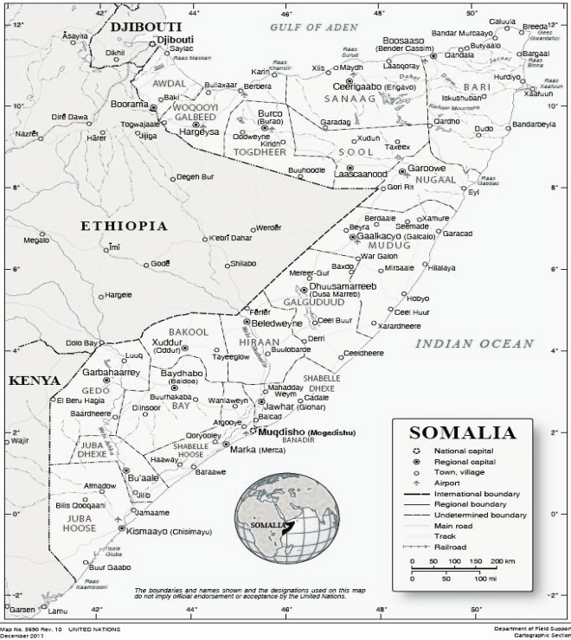
Motivation of Somali Piracy
No notable history of piracy
12th January, 1991 MV Naviluck
26th January, 1991 Siad Barre ousted
Notes:
12th January, 1991 MV Naviluck
Official first piracy incident – but not capturing trawlers (fishing vessels) in official data. However, this is the first merchant ship an remains a key marker
26th January, 1991 Siad Barre ousted
Coincides with Barre regime collapse, provides context but more than just social upheaval, it is about policies of the Barre regime and the strategies of international community

Slide 10
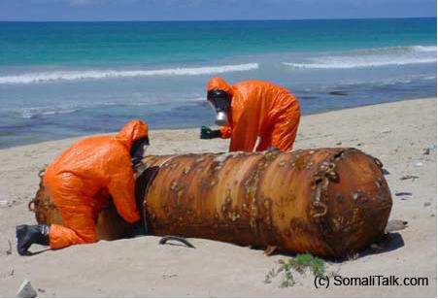
A brief history of Somalia
1960
1969
1974
1977
1991
1998
2000
2004
2006
2008
2012
Somali Independence
Siad Barre assumes power
Coastal Development Project (relocation)
Invasion of Ethiopia (Ogaden)
MV Naviluck
Siad Barre is ousted, civil war
Somaliland declares independence
Puntland declared autonomy
Transitional National Government
Transitional Federal Government
Tsunami
Galmudug declares autonomy
Islamic Courts Union
UN Security Council Res. 1851
US Airstrikes begin
EUNAVFOR authorizes land strikes
Illegal Unregulated Unreported Fishing (IUU) / Toxic Waste Dumping
Notes:
Somalia gained independence in 1960, previously being split between the colonial territories of the Britain and Italy.
British East African Protectorate (currently Somaliland) and Africa Orientale Italiana (currently divided between Somalia, Djibouti, northern Kenya and eastern Ethiopia).
After Siad Barre took power in a bloodless coup d’etat in 1969, the country was restructured ideologically aimed at creating a modern Islamic state that used socialism (through an allegiance with the Soviet Union) as a framework for social justice and unification across clan lines. This was coupled with ambitions to reintegrate Somalis into one nation.
This resulted in a failed war to capture eastern Ethiopia (the Ogaden region in the east) primarily due to military support by the Soviet Union for the Ethiopian Mengistu regime, which was perceived as a perfidious gesture by the Barre regime.
These events prompted Barre to restructure the country a second time, this time to a free market economy (allied with the US) with an emphasis on extensive militarization.
By the time the Barre regime collapsed in 1991, the Somali population had been through repeated restructuring and gross human rights violation under an authoritarian regime, with contradictory messages that served to disembed social relations and cultural identities of Somalis. It is within this historical context that Somali piracy emerged.
1974 to modernize and nationalize the country, to stimulate the Somali fishing industry, capitalizing on the country’s long coastline (3,300 km) and high levels of biodiversity in the northern parts of the country, especially off the Puntland coast. The Coastal Development Project, a large-scale relocation program moved over 14,000 pastoralists to the northeast coast of Somalia (present day Puntland) into fishing cooperatives.
By 1984 one million Somalis lived on the coast, ten per cent of whom were involved in artisanal fishing.
By 2000, Somalia was exporting US$ 2.5 million worth of fish, a 464 per cent increase in 20 years.
1991, the coastline of Somalia was left unprotected. This attracted fishing fleets from around the world to engage in illegal, unregulated, and unreported fishing (IUU).
In 2005, it was estimated that around 700 foreign owned ships engaged in IUU fishing in Somali waters. The scale of the problem was so large that fishing trawlers were visible in satellite pictures off the coast of Somalia. It is estimated that the extent of IUU fishing in Somalia removed US$300 million from the national economy each year. In addition to over exploitation, the foreign trawlers would use prohibited methods such as drift nets and dynamite, which destroyed entire habitats, affecting not only current fish stocks but also future marine resources.
Decrease in the catches of the main local fish types (tuna, shark, lobsters, and shrimp) and in some cases the complete disappearance of certain species.
Sharks per boat trip fell from over 600 kg in 1995 to just over 200 kg in 2005;
Lobster dropped from 450 kg to less than 100 kg; and
Other fish catch dropped from 200kg to around 40 kg.
Toxic waste dumping was another major concern.
UN Environmental Programme (UNEP) and Greenpeace investigated cases of illegal toxic waste dumping in Somalia finding that the practice was rampant. The economic reasoning for dumping off the coast of Somalia was underscored by the lack of an effective central government, which meant that that disposal costs in Somali waters was US$2.50 per ton compared to US$250 per ton in Europe.
The 2004 Boxing Day Tsunami washed sealed containers of waste onto Somali beaches laying bare the extent of the dumping in Somalia.

Slide 11
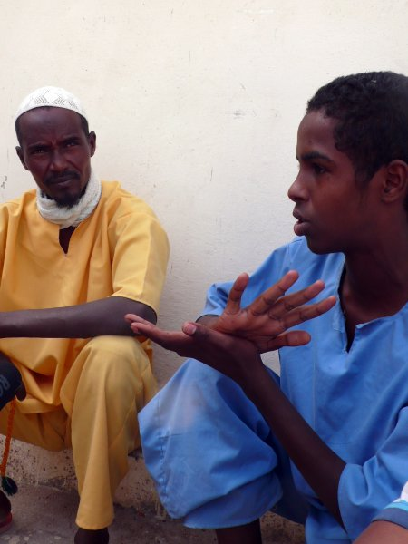
Defensive piracy – Piracy business
Farah Ismael Idle
Rationalizations of piracy – defensive piracy
If you hold hostage innocent people, that’s a crime. If you hold hostage people who are doing illegal activities, like waste dumping or fishing, that is not a crime.
(Interview with Sugule Ali, in Gettleman, 2008)
Sporadic piracies of the early 1990s evolved into business
There is no country in the world that does not take taxes. In a small country with no government, a small militia catches a ship and takes some taxes from them, and then releases them without harming or killing them, there is nothing wrong with that.
The first decision was to defend our waters. After that a lot of money was made and more and more people got involved. Because of that it’s turned into a business. There is no problem taking a ship. It will only be taxed and released safely. (Interview with Farah Ismael Idle, in Reeve, 2012)
Primitive Taxation
Pioneer pirates to Novice pirates
Notes:
Rationalizations are SUBJECTIVE justification for deviance. Pirates explain that their behavior is a result of exploitation by foreign fleets. A need to defend coast line due to the inaction by local authorities. This is a recurring theme in the interviews consulted (35 interviews, 25 separate individuals). Therefore Somali piracy is called defensive piracy. Quote.
Of CMPD data, only 1% involved theft, rest captures foreign vessels for ransom. The form of Somali piracy is a reflection of this rationalization. QUOTE.
BUT there is a discrepancy between the rationalization and reality – most ships captured in the 2000s are not fishing or carrying toxic waste but trade ships (as we saw in the CMPD). (6.3% fishing vessels, 56.7% merchant ships)
Some pirates are aware of this and their rationalizations reflect this, Idle explain QUOTE –
The younger generation of poor men who have grown up in stateless Somalia have a low level of education and a lack of legitimate opportunities, they observe the respect garnered by pioneer pirates which makes piracy an attractive form of employment. Although the new generation uses the same rationalizations, the original impetus is no longer necessary, new recruits come because it is an attractive career option.

Slide 12
Stateless Somalia? Puntland
Stateless and globalized
The process of globalization in Somalia was enhanced by the collapse of the State.
(Marchal et al., 2000, p.1)
Somalia’s telecommunications are known to be the cheapest and having the most extensive coverage in the continent.
(UNDP, 2001, p.107; see also The Economist, 2005; Winter, 2004; Southwood, 2007)
Uneven Development, Inequitable Structures
Regional Development Variations
Awareness of Inequalities & Injustice
Notes:
After the overthrow of the Barre regime in 1991, Somalia experienced the full effects of neoliberalization.
Contrary to popular beliefs globalization intensified and growth of the commercial economy surpassed pre 1991 figures - 14/18 development indicators show improvement under anarchy. Increasingly goods from other parts of the world are locally available.
Somalia’s telecommunications are known to be the cheapest and having the most extensive coverage in the continent. Internet connectivity in 2007 was at 53%.
Means Ends discrepancies are made palpable by perceptions of injustice and deprivation.
Despite the increases in development mentioned earlier, the lack of an effective central state in Somalia has meant uneven development in education, social and health services.
Even though there are more schools now than during the Barre regime (1172 in 2003-4) only 20% of children go to school. Private services are provided for a fee, therefore are accessible only to those who can afford them.
Another noticeable asymmetry is in the role of Somali women. The role of women was enhanced under early policies of Barre but were then limited by strict Islamist policies. Over the past 20 years women have increasingly become breadwinners of the family, threatening traditional male roles.
In addition there are regional disparities in development, LOOKING AT A MAP OF SOMALIA while in Muqdisho there was fighting for control of central state, in 1991 the former British colony in the north of the country declared independence, this is Somaliland. In 1998 Puntland became a autonomous Puntland state of Somalia and then Galmudug in central Somalia followed suit in 2006. The regions in Somalia vary in stability, security and wealth, Somaliland is considered comparatively rich, Puntland is stable and commercialized, Galmudug is below average but better off than southern Somalia.
Increased interconnections have meant increased awareness of inequalities, asymmetries, and injustices. Asymmetries were apparent in opportunities, in regional development, in education availability, in access to services, but with an increased exposure to the influences of globalization and the commercial economy.
Of particular importance to piracy is that the 15,000 pastoralists that were relocated by the Barre regime to the Puntland coast saw their livelihood increasingly threatened by illegal unregulated unreported IUU fishing and toxic waste dumping after the collapse of the central state.

Slide 13
Escalation of Piracy
Stateless and globalized
The process of globalization in Somalia was enhanced by the collapse of the State.
(Marchal et al., 2000, p.1)
Somalia’s telecommunications are known to be the cheapest and having the most extensive coverage in the continent.
(UNDP, 2001, p.107; see also The Economist, 2005; Winter, 2004; Southwood, 2007)
Press Freedom
Somali Diaspora : Distant, membership reference group
Remittances are the glue that holds many families together. They are a means by which individuals living in exile, away from their extended families, actively fulfill their social obligations and play a meaningful role in their communities despite the physical distance that separates them.
(Hammond, 2007, p.126)
Notes:
After the overthrow of the Barre regime in 1991, Somalia experienced the full effects of neoliberalization.
Contrary to popular beliefs globalization intensified and growth of the commercial economy surpassed pre 1991 figures - 14/18 development indicators show improvement under anarchy. Increasingly goods from other parts of the world are locally available.
Somalia’s telecommunications are known to be the cheapest and having the most extensive coverage in the continent. Internet connectivity in 2007 was at 53%.
Although there are regional variations in the press freedom, overall the situation has improved dramatically. In 1991 the only non-state source of information was the BBC Somali service. By 2005 there were 20 private newspapers, 12 radio and television stations and several internet sites. Although local faction control local print media, there is no censorship or regulation of electronic media.
Due to tight authoritarian control over the population, censorship and curbing individual and group freedoms, the full impact of neoliberal globalization was delayed in the lack of the introduction of socially distant comparative and normative reference groups.
Reference groups were rapidly created after the 1991 war, with a large exodus from the country. It is estimated that 1-2 million Somalis live abroad. Ties between the Somali Diaspora and local Somalis are very strong, creating a strong reference group.

Slide 14
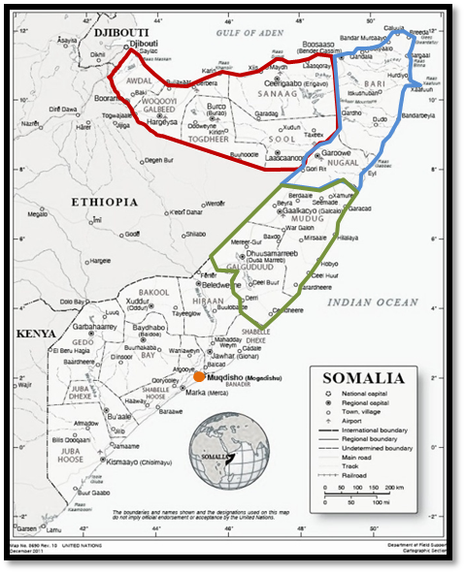
Component 5 Impact on Governability
Dysnomie from above
Lack of global norm making mechanisms
Inconsistent enforcement of international rules & regulatory patchwork of legal traditions and practices
Dysnomie from within
Insufficiency of national norm making mechanisms
Regulatory patchwork of legal traditions and practices & inconsistent enforcement of rules
Ineffective civic governance
Normative Deviance
Notes:
The case study showed that in Somalia the impact on governability was from above and from within.
ABOVE: Foreign infringement of Somali sovereignty has often not been for the benefit of Somalia.
UN Security Council Resolutions have allowed international forces access to sovereign territorial waters and the land of Somalia to eliminate piracy – not for IUU fishing or toxic waste prosecutions.
Counter piracy efforts by the international naval forces have been inconsistent – the various naval forces who are part of the international effort deal with captured pirates differently.
The policies of the international community, particularly the US and Ethiopia towards Somalia are perceived by locals as aggressive and guided by self-interest.
WITHIN: In addition in Somalia we saw the absence of national norm making mechanisms due to the absence of a functioning central state. Therefore with the development of smaller state formations we saw a regulatory patchwork of legal traditions and practices & their inconsistent enforcement . Much of this reflects the effectiveness of civic governance.
Comparing the different regions of Somalia, I found that
Somaliland has relatively effective laws and enforcement –particularly for piracy. Somaliland was successful in providing effective control mechanisms because the foundations of democracy were laid in grassroots efforts based on political consensus. No ports in Somaliland have been used for piracies.
Puntland – struggles in controlling piracy and piracy continues to come mainly from Puntland. The key problem with piracy enforcement here was that coast guard duties were subcontracted to foreign security companies (illustrating another form of globalization). They financed themselves by selling fishing licenses to foreign fleets with no oversight by local administration. Locals felt they were being further exploited.
Also, the foreign firms trained Somalis who conducted coast guard duties until 2008 when Puntland had a serious budget deficit and the trained Somali coast guard were at first left unpaid and then made redundant → adding to the pool of potential pirates (on top of those displaced from Galmudug during the rule of the Islamic Courts Union which actively prosecuted pirates in the South). In Puntland the pool of potential pirates came together, and piracy became a business and like any business it thrived because the environment was secure and stable and regulation and law enforcement was existent but weak.
The development of deviant subcultures which are normative on society (as discussed in component four) undermines conventional norms and the governance structure. In addition weak governance can sustain deviance, this is illustrated with the case of Puntland where errors made by local authorities aggravated the perceptions of being exploited. This actually elevated the social role of pirates who were seen by many as heroes protecting Somalia’s natural resources.

Slide 15
Findings: Somalia case study
What spurred on piracy in Somalia?
Why is piracy in Somalia different?
Why the dramatic increase at the end of the 2000s?
Notes:
The case study was able to provide some preliminary answers to the questions raised earlier.
The study found that piracy begun in Somalia as a self-protection mechanism which was necessary due to the absence of a governmental control mechanism to guard against foreign exploitation – the first Somali piracy attack occurred the same month that Barre was ousted from government.
From the initial impetus it developed into a form of taxation rather than theft, making it unlike most other piracies we see around the world. The business model that evolved continued to use the same modus operandi and rationalizations.
The reason for its escalation in the latter part of the 2000s was due to a conflation of multiple factors including governance failures from within, unwise international intervention efforts, and a sudden increase in the large pool of young unemployed, men with limited legal opportunities and resources which came together in the relatively stable and secure environment of Puntland. This created the unusually large spike we observed in 2008-2010.

Slide 16
Policy Implications
Somaliland
Somalis need to be stakeholder in any counter piracy actions
Bottom up approach needed, not top down
International efforts need to be consistent and just, have to apply to
Piracy
IUU
Toxic Waste Dumping
Notes:
In order to combat it effectively any counter piracy measures need to be from within, have to be implemented by Somalis. We see that Somaliland in the north has effectively been able to guard itself against piracy occuring. Therefore rather than a top down approach, governance needs to be built from bottom up, support needs to be given to local Somali efforts.
In addition foreign naval efforts need to be seen as fair and just, not just focusing on piracy but also on illegal fishing and toxic waste dumping.

Slide 17
Why define piracy as terrorism?
Policy implications
Integrated enforcement strategy
Efficient

Slide 18
Problem of labeling Somali piracy terrorism

Slide 19
Thank you Anamika Twyman-Ghoshal, Ph.D. a@twymanghoshal.com
Notes:
Scheduled to be published October 30th 2017!

