Slide 1
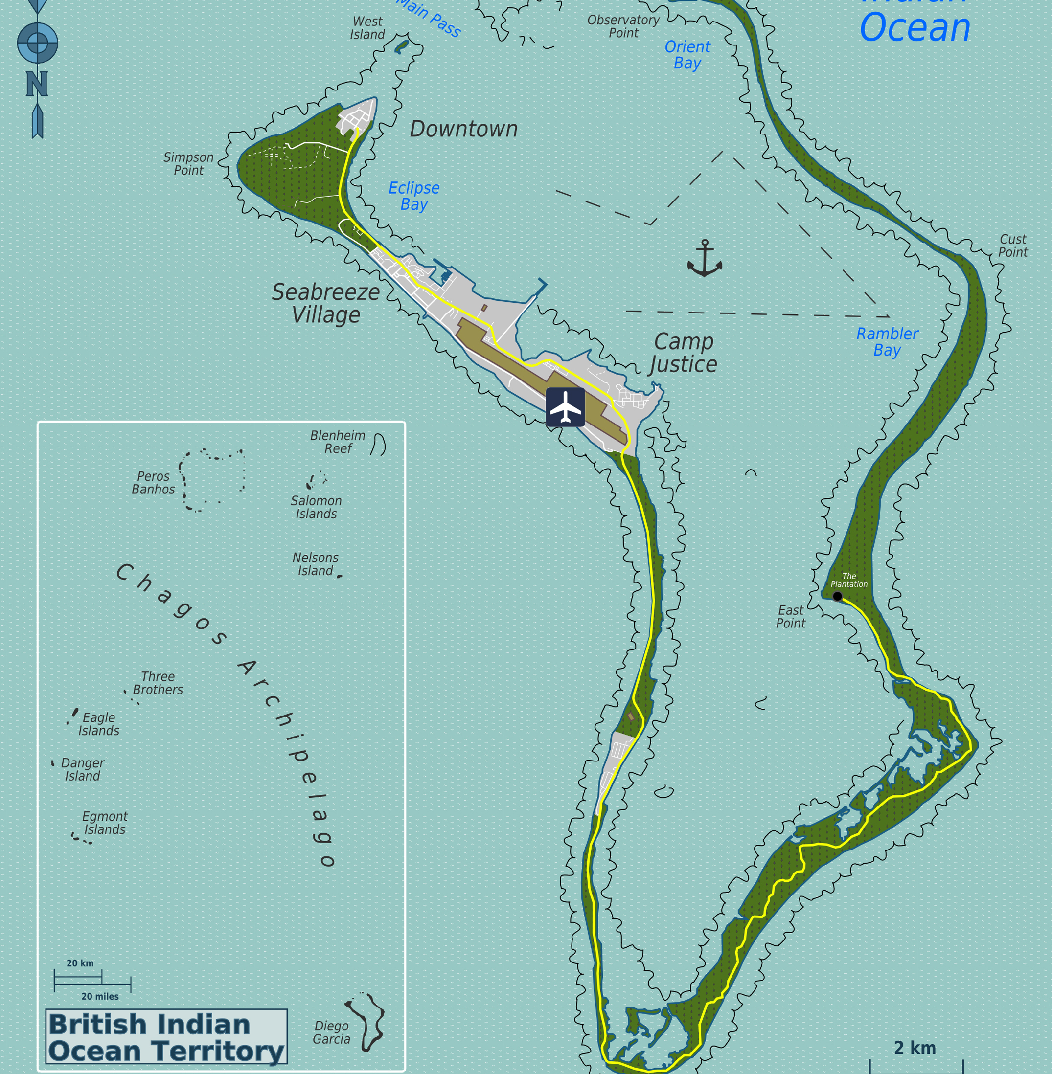
Globalization and Forced Eviction
An exploration of an obscured
crime of the powerful
in
Diego Garcia
Anamika Twyman-Ghoshal
atwymanghoshal@stonehill.edu

Slide 2
State Crime
“acts/actions or inaction/omissions committed by government agencies or caused by public policies whose victims suffer harm as a result of social, political, and economic injustice, racial, sexual, and cultural discrimination and abuse of political and/or economic crime”
Barak, 2011, p.36.

Slide 3
Forced Eviction & Displacement
“The removal of people from their homes or lands against their will, directly or indirectly, attributable to the state.”
Advisory Group on Forced Eviction to the Executive Director of UN Habitat Report, 2007
Domestic, International
Coerced, Violent

Slide 4
International Legal Definition of Forced Eviction
“[T]he permanent or temporary removal against their will of individuals, families and/or communities from the homes and/or land which they occupy, without the provision of, and access to, appropriate forms of legal or other protection”
Art.11(1), General Comment No. 7, International Covenant on Economic, Social, and Cultural Rights, 1976.
USA: 1977
UK: 1968/1976

Slide 5
International Legal Protection against Forced Eviction/Displacement
Universal Declaration of Human Rights 1948, Article 25
International Convention on the Elimination of All Forms of Racial Discrimination 1965, Article 5 (e)
International Covenant on Economic, Social and Cultural Rights 1966, Article 11 (1)
Convention on the Elimination of All Forms of Discrimination against Women 1979, Article 14(2)(h)
Convention on the Rights of the Child 1989, Article 27(3)
Rome Statute of the International Criminal Court 2002, Article 7
UN Basic Principles and Guidelines on Development-based Evictions and Displacement 2007

Slide 6
Forced Eviction & Displacement Types
Conflict/Crisis
Syria (UNHCR, 2017)
Environmental Disaster/Climate Change
Hurricane Katrina, New Orleans, United States (Klein, 2007)
Direct State Action & Development-Based
Papua New Guinea & Burma (Green, Lasslett & Sherwood, 2018)
Israel/Palestine (Green, 2014)
Japan (Okada, 2012)

Slide 7
Direct State Action & Development-Based Forced Eviction/Displacement
International Sporting Events
Urban Renewal/Beautification & Infrastructure Projects
Acquisition of Land for National/Global Industries
Military Bases

Slide 8
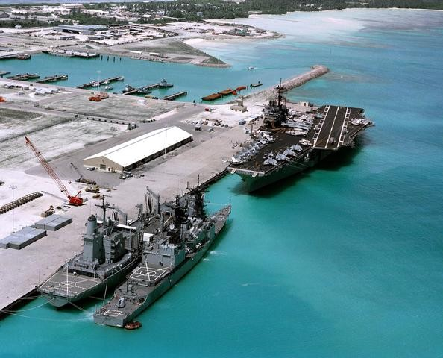
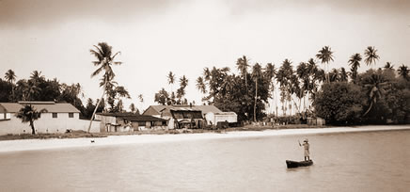
Case Study: Chagos Archipelago
Forced Eviction
Coerced
Change in Global Order
Displacement: Full International
Multiple Nations Collaborating

Slide 9
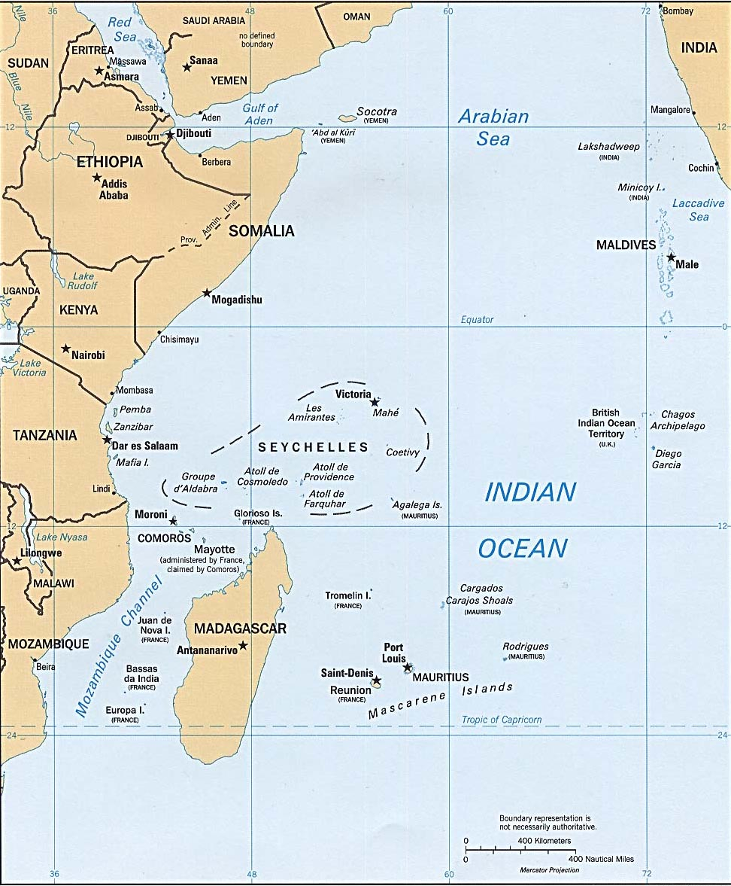
Chagos Archipelago
Diego Garcia Peros Banhos Salomon Island
British Indian Ocean Territory

Slide 10
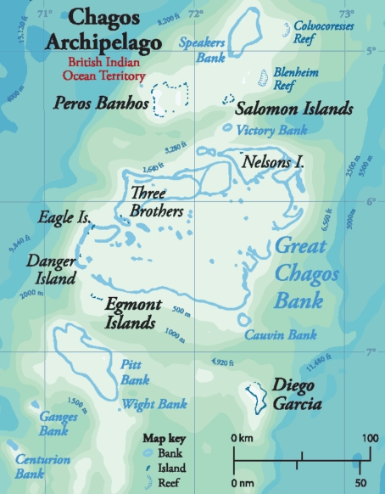
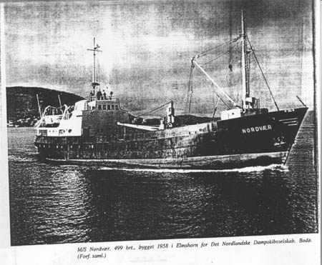
1956 – Diego Garcia identified as a strategic location for United States (US) Navy base.
1962 – Formal agreement between US & UK British to detach Chagos from Mauritius and to lease Diego Garcia
for to the US for Navy base. All inhabitants to be removed.
1965 – UK separates Chagos from Mauritius during independence negotiations, creates British Indian Ocean
Territory (using Order in Council).
1966 – Exchange of Notes between UK and US to use Diego Garcia for Naval Base.
1967 – British Indian Ocean Territory (BIOT) Ordinance No. 1 – compulsory acquisition of land from private
owners.
1968 – Islanders off-island refused permit to return. Imports restricted. Deteriorating conditions.
1971 – Immigration Ordinance mandates forced eviction and displacement of entire population to Mauritius and
Seychelles. Construction of US base begins.
1972 – UK pays Mauritius UKP 650,000 to assist in resettlement. Small payments of UKP 1225 per adult & UKP
165-245 per child made six years later, in 1978.
1973 – All pet dogs are exterminated. Last 133 Chagossians are deported to Mauritius on the MV Nordvoer.
1983 – As settlement of a lawsuit UK pays a further UKP 4 million to Mauritius for Chagossian claims
1344 Chagossians receive $2976 in exchange for renunciation (document in English).
2000 – UK feasibility report suggests resettlement possible on Peros Banhos and Solomon, not Diego Garcia.
2000 – Bancoult bring cases against UK for forced eviction and related crimes, initial success in High Court.
2001 – Bancoult bring cases against US for forced eviction and related crimes. Case rejected on procedural
grounds.
2002 – Second part of feasibility report suggests resettlement will be precarious and expensive.
2004 – Order in Council issued prohibiting repatriation of Chagossians.
2004 – European Court of Human Rights case decided against Chagossian, on procedural grounds.
2008 – UK appeal rejected on procedural ground in House of Lords.
2010 – UK establishes Marine Protection Areas around BIOT prohibiting commercial fishing, with the exception
of Diego Garcia.
2016 – US & UK Diego Garcia agreement expires and is extended to 2036.
2017 – General Assembly adopts resolution to seek International Court of Justice Advisory Opinion on separation
of Chagos Archipelago from Mauritius.

Slide 11
Effect on Chagossian Population
Deprivation of possessions and homeland
No meaningful relocation assistance
Trauma
Dislocation / Hopelessness / Insecurity
Abject Poverty
Deplorable Living Conditions
High Rates of Unemployment

Slide 12
Global Anomie Theory Analytical Framework
*
Globalization: Neo-colonialism, Neo-liberalization
Means-Ends Discrepancies & Asymmetries
Deviance Adaptation
Impunity & Normalization
Governance & Resistance
*Passas & Twyman-Ghoshal, 2015

Slide 13
Globalization
Change in Global Order
Reimagining Globalization: Transition from Colonialism to Post-Colonial World & Neocolonialism
Military Bases
Diego Garcia
Foundation for Neoliberalization
US Superpower Status
US Corporate Interests
Human Rights Norms & Narrative

Slide 14
Means-Ends Discrepancies & Asymmetries
Ends:
Continuing Political / Economic Power & Domination
Support Commercial Needs
Means:
Blocked due to
New Global Order
Human Rights Norms & Narratives

Slide 15
Deviance Adaptation
Chagos Forced Eviction: Deviance without Strain
Secret Agreement between US & UK
Recolonizing Chagos Archipelago into BIOT
Exchange of Notes vs. Treaty
Concealed from US Congress, UK Parliament, and the United Nations
Forced Eviction & Displacement of Chagossians
Fiction of ‘No Permanent Residents’
Organized, Willful Social Harm

Slide 16
Impunity and Normalization
Selective Applicability of National and International Laws & Norms
UN General Assembly Declaration 1514 (1960) – disrupting national unity of a country
UN General Assembly Resolution 2066 (1965) – “take no action which would dismember the territory of Mauritius and violate its territorial integrity”
Normalization among Direct Participants and Subsequent Governments
Normalization by Domestic Supreme Courts and International Courts
Rationalizations
Security Concerns
Compensations & Renunciation Document
Repatriation Harmful
Environmental Concerns

Slide 17
Governance & Resistance
Highlights Contradictions between Executive, Courts, and Special Interest Groups
Crippled Civil Society in Preventing & Repairing State Harm
Creates Impunity & Precedent
Domestic and International Laws Optional for Powerful Actors
Civil Society Helpless in Cases of Government Misconduct
Ineffective Democracy
Undermines Legitimacy of Domestic and International Governance Bodies

Slide 18
Conclusions
Awareness Raising and Analysis of State Crime - Crimes of the Powerful
Identification of the Negative Externalities of Neocolonialism and Neoliberalization
Trend towards Anomie – guiding force of international norms diminished
Impact on Democracy
Impact on Governability
Impact on Civil Society Movements
Development and Promotion of Consistent/Fair Domestic and International Laws & Norms
Consistent Application of Domestic and international Laws to Reduce Anomie and Enhance Governability.

