Slide 1
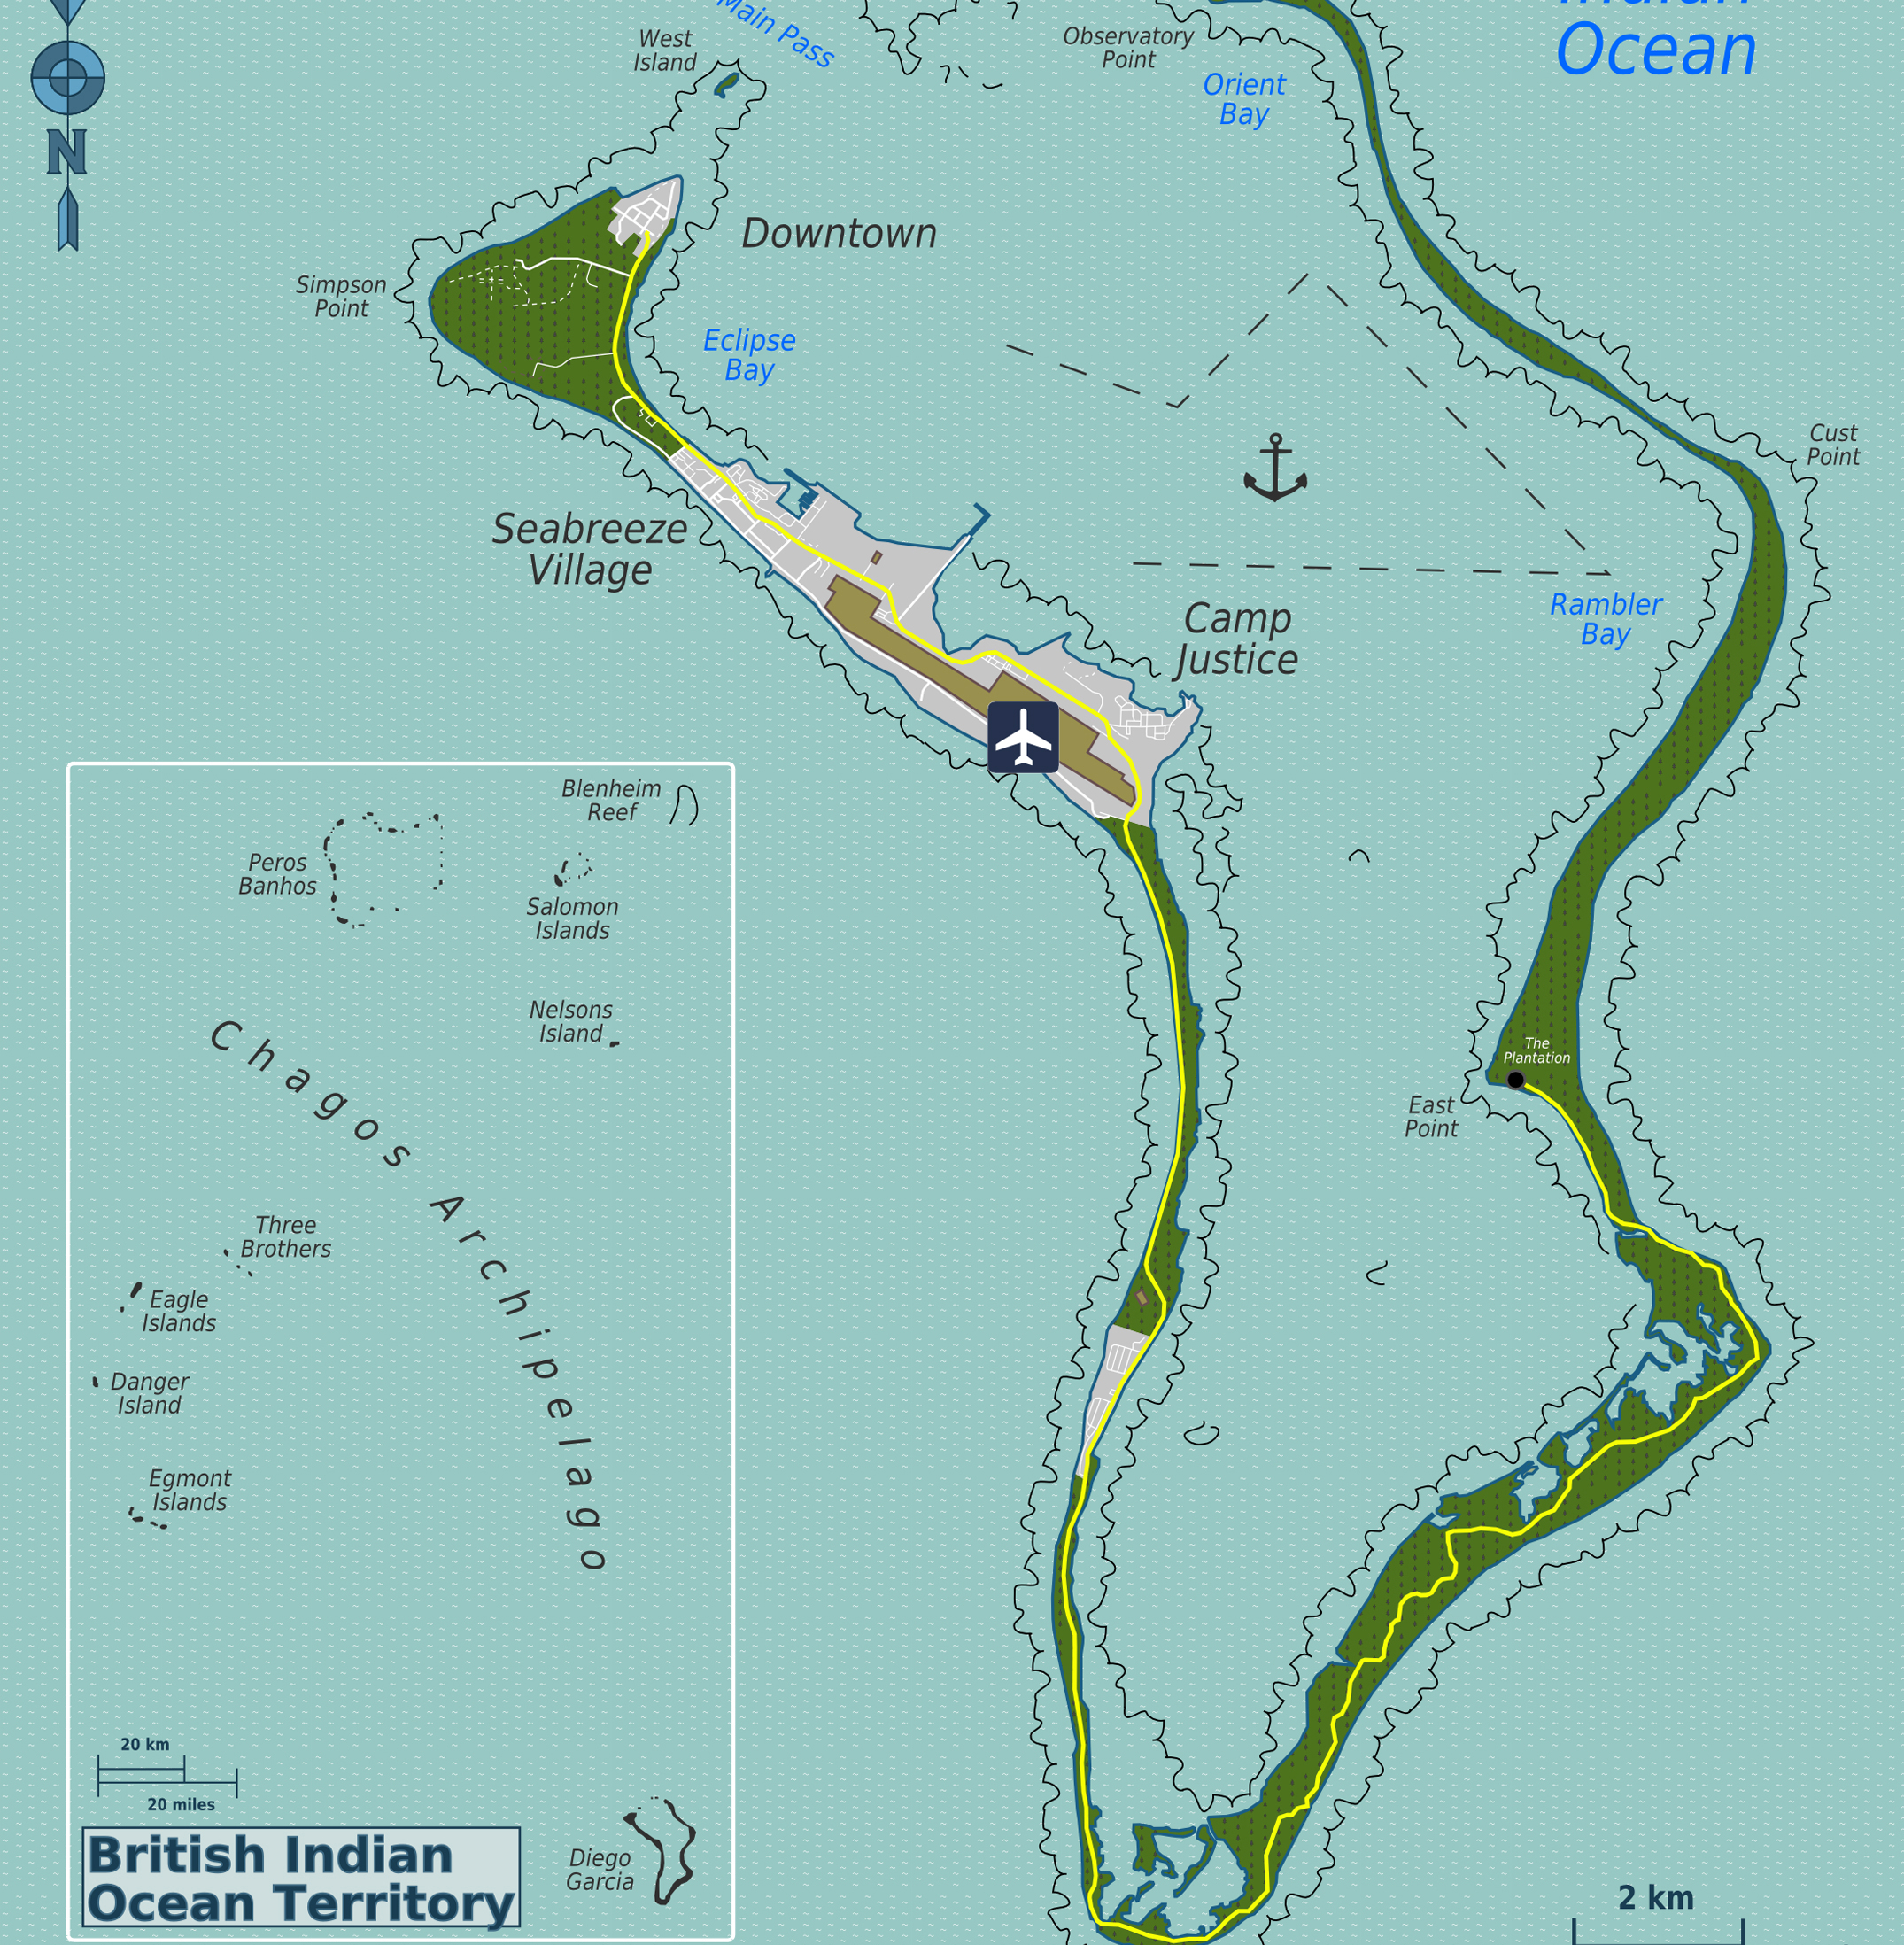
Power & Collusion
The Case of Forced Eviction
of the
Chagossians (Ilois)
Anamika Twyman-Ghoshal
atwymanghoshal@stonehill.edu

Slide 2
State Crime
“state organizational deviance involving the violation of human rights” Green & Ward, 2004, p.2.
“acts/actions or inaction/omissions committed by government agencies or caused by public policies whose victims suffer harm as a result of social, political, and economic injustice, racial, sexual, and cultural discrimination and abuse of political and/or economic crime” Barak, 2011, p.36.

Slide 3
State Crime & Power
Related concepts:
- Authority
Control
Influence
“delegated or implied trust” Sutherland, 1940, p.3
“power exists only through social relationships and is historically and culturally specific... It is produced and reproduced within social structures...
Power is exercised, obtained, legitimated, and maintained through capital accumulation.” Rothe & Kauzlarich, 2016, p.4.

Slide 4
Development of ‘State Crime’ concept
Origins:
DuBois (1899), Bonger (1916), Sutherland (1940), Chambliss (1989)
Elaborations:
State-Corporate Crime (Michalowski & Kramer, 2006)
Crimes of Globalization (Rothe & Friedrichs, 2016)
Crimes of the Powerful (Pearce, 1976)
Suggested addition:
Multi-State Collusion Crimes

Slide 5
Collusion
Related concepts:
- Co-offending
Conspiracy
Collaboration
“secret agreement for an illegal purpose, especially to defeat the course of law... [often] a network offence” Van Den Heuvel, 2005, p.133.
Collusion often requires networks, trust, and homophily. Nielsen, 2002; Reiss & Farrington, 1991

Slide 6
Multi-State Collusion Crimes
Defined here as:
organizational deviance that uses secret agreements between two or more sovereign states to circumvent established legal and human rights standards or is similar to other forms of criminalized behaviors that cause willful social harm.

Slide 7
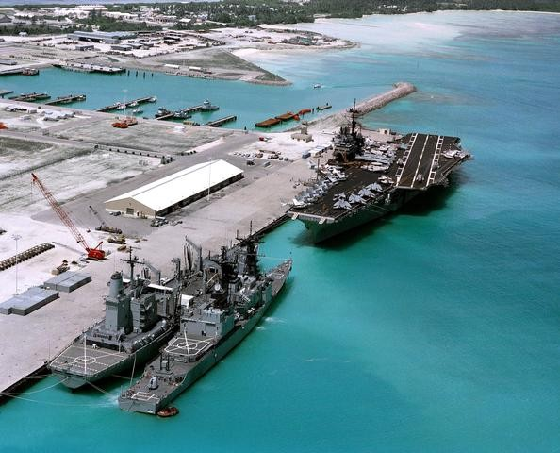
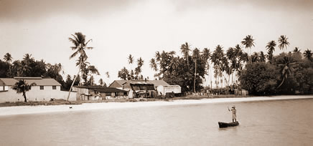
Case Study: Chagos Archipelago
Methods:
Qualitative research using historical/policy analysis
Includes published government document, statutes, legal cases, historical data, journalistic and academic analysis, and self-reports.

Slide 8
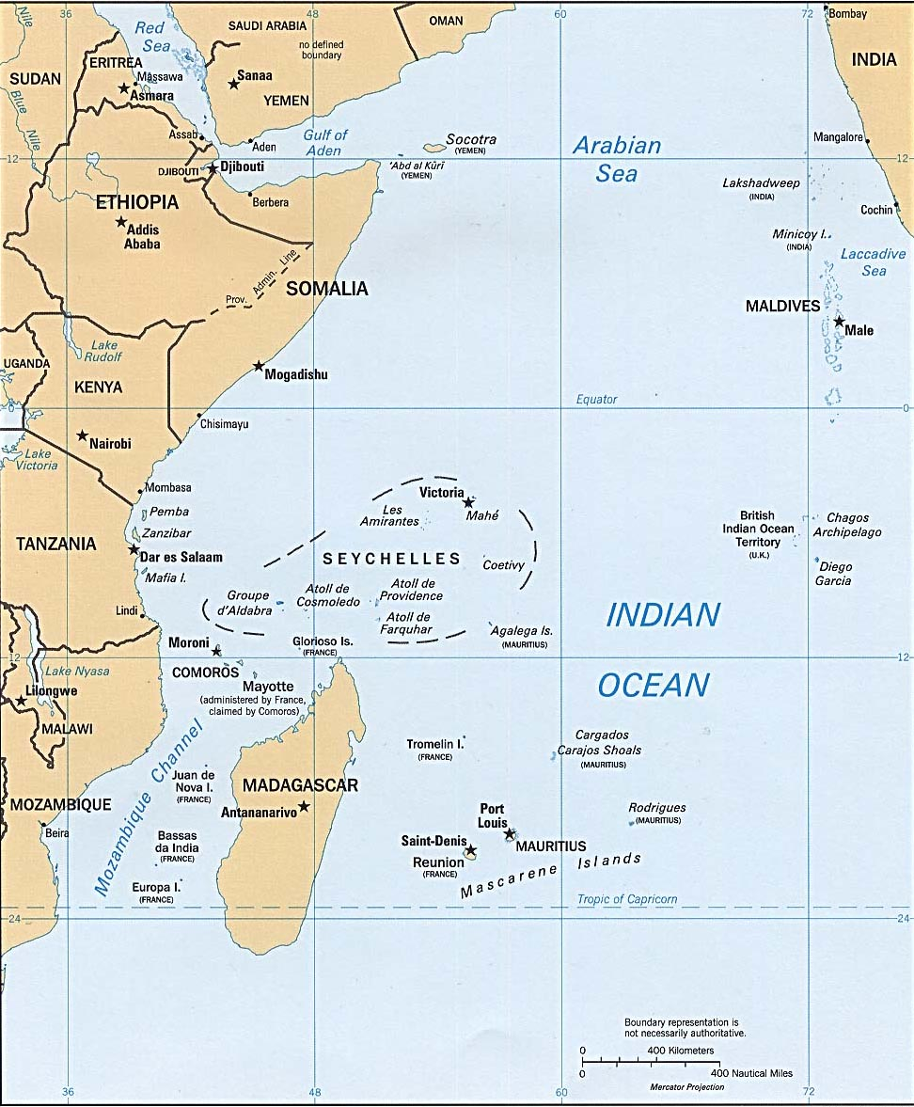
Chagos Archipelago
Diego Garcia Peros Banhos Salomon Island
Relabeled: British Indian Ocean Territory (BIOT)

Slide 9
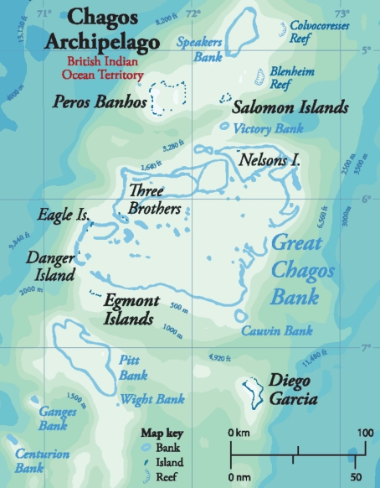
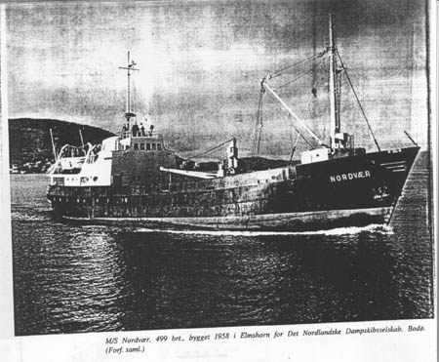
1956 – Diego Garcia identified as a strategic location for United States (US) Navy base.
1962 – Formal agreement between US & UK British to detach Chagos from Mauritius and to lease Diego Garcia
for to the US for Navy base. All inhabitants to be removed.
1965 – UK separates Chagos from Mauritius during independence negotiations, creates British Indian Ocean
Territory (using Order in Council).
1966 – Exchange of Notes between UK and US to use Diego Garcia for Naval Base.
1967 – British Indian Ocean Territory (BIOT) Ordinance No. 1 – compulsory acquisition of land from private
owners.
1968 – Islanders off-island refused permit to return. Imports restricted. Deteriorating conditions.
1971 – Immigration Ordinance mandates forced eviction and displacement of entire population to Mauritius and
Seychelles. Construction of US base begins.
1972 – UK pays Mauritius UKP 650,000 to assist in resettlement. Small payments of UKP 1225 per adult & UKP
165-245 per child made six years later, in 1978.
1973 – All pet dogs are exterminated. Last 133 Ilois are deported to Mauritius on the MV Nordvoer.
1983 – As settlement of a lawsuit UK pays a further UKP 4 million to Mauritius for Ilois claims
1344 Ilois receive $2976 in exchange for renunciation (document in English).
2000 – UK feasibility report suggests resettlement possible on Peros Banhos and Solomon, not Diego Garcia.
2000 – Bancoult bring cases against UK for forced eviction and related crimes, initial success in High Court.
2001 – Bancoult bring cases against US for forced eviction and related crimes. Case rejected on procedural
grounds.
2002 – Second part of feasibility report suggests resettlement will be precarious and expensive.
2004 – Order in Council issued prohibiting repatriation of Ilois.
2004 – European Court of Human Rights case decided against the Ilois, on procedural grounds.
2008 – UK appeal rejected on procedural ground in House of Lords.
2010 – UK establishes Marine Protection Areas around BIOT prohibiting commercial fishing, with the exception
of Diego Garcia.
2016 – US & UK Diego Garcia agreement expires and is extended to 2036.
2017 – General Assembly adopts resolution to seek International Court of Justice Advisory Opinion on separation
of Chagos Archipelago from Mauritius.
2019 – International Court of Justice judgment to decolonize BIOT, General Assembly ask the UK to decolonize within 6 month

Slide 10
Effect on the Ilois :
Deprivation of possessions and homeland
No meaningful relocation assistance
Deplorable Living Conditions
Abject Poverty
High Rates of Unemployment
Dislocation / Hopelessness / Insecurity
Trauma

Slide 11
Case Study Findings:
Criminal Behavior:
Incomplete Decolonization
Forced Eviction of the Ilois
Coercion
International Displacement
Collusion: Two Nations
Context: Changing Global Order
Impunity & Normalization

Slide 12
Criminal Behavior: Incomplete Decolonization
UN General Assembly Declaration 1514 (XV) of 1960 ‘Declaration on the Granting of Independence to Colonial Countries and Peoples’
disruption of national unity of a country and preventing the right to self- determination
UN General Assembly Resolution 2066(XX) of 1965 (directing the UK prior to creating of BIOT):
“take no action which would dismember the territory of Mauritius and violate its territorial integrity”

Slide 13
Criminal Behavior: Forced Eviction
Universal Declaration of Human Rights 1948, Article 25
International Convention on the Elimination of All Forms of Racial Discrimination 1965, Article 5 (e)
International Covenant on Economic, Social and Cultural Rights 1966, Article 11 (1)
“[T]he permanent or temporary removal against their will of individuals, families and/or communities from the homes and/or land which they occupy, without the provision of, and access to, appropriate forms of legal or other protection”
Convention on the Elimination of All Forms of Discrimination against Women 1979, Article 14(2)(h)
Convention on the Rights of the Child 1989, Article 27(3)
Rome Statute of the International Criminal Court 2002, Article 7
UN Basic Principles and Guidelines on Development-based Evictions and Displacement 2007

Slide 14
Collusion & Deviance
Forced Eviction & Displacement of Ilois through
Recolonizing & relabeling Chagos Archipelago into BIOT
Secret Agreement between US & UK
Deviance
Exchange of Notes vs. Treaty
Order in Council, no parliamentary oversight
Concealed from US Congress, UK Parliament, and the United Nations
Fiction of ‘No Permanent Residents’ in the Chagos Archipelago
...a Multi-State Collusion Crime

Slide 15
Context: Changing Global Order
New Normative Order: Development of Human Rights Norms & Narratives
Transition from Colonialism to Post-Colonial World & Neocolonialism
Collusion through trusted, homophilic network (US & UK)
Military Bases as means to an end (military and geo-strategic interests; capital accumulation)
Building Foundation for Neoliberalization
US Superpower Status (military and geo-strategic interests)
US Corporate Interests (capital accumulation)

Slide 16
Impunity & Normalization
Selective applicability of national and international laws & norms for powerful state actors (UK and USA)
Normalization among direct government participants and subsequent governments
Normalization for decades by domestic supreme courts and until recently by international courts
The lack of enforcement of international human rights norms undermines the legitimacy of domestic and international governance bodies

Slide 17
Conclusions
The need for consistent application of domestic and international laws to reduce impunity of those in power
Trend towards Anomie – guiding force of norms and laws diminished
Normalization of which has a direct impact on democracy, governability and the reduction of the power of civil society movements
More research and analysis of other Multi-State Collusion Crimes needed

Slide 18
Thank you

