Slide 1
International Criminal Justice and Extraordinary State Crimes:
The Case of the
British Indian Ocean Territory
Anamika Twyman-Ghoshal
atwymanghoshal@stonehill.edu

Slide 2
International Crime
... are crimes proscribed in international law and custom.
These are the gravest crimes of concern to the international community (Rome Statute on the International Criminal Court 1998)
The crime of genocide
Crimes against humanity
War crimes
The crime of aggression
International criminal law is a “discipline of crisis” (Charlesworth, 2002)

Slide 3
Extraordinary State Crimes
State crimes that do not strictly fall within the ICC categories of international crime
“state organizational deviance involving the violation of human rights” (Green & Ward, 2004, p.2)
Systematic and serious human rights violations not only during conflict but also during peacetime.
Case study: forced displacement, particularly forced eviction.

Slide 4
Displacement through Forced Eviction
Forced eviction is “the removal of people from their homes or lands against their will, directly or indirectly, attributable to the state.” Advisory Group on Forced Eviction to the Executive Director of UN Habitat Report, 2007
Criminalized when:
Dispossession without due compensation and support
Land theft
Involuntary
Permanent or temporary
Usually domestic but can be international
Examples:
Israeli Settlements in Palestine, 1968+
Olympic Games in Brazil, 2016
National Railway Project in Manila, Phillipeanes, 1992
Military Base in Vieques, Puerto Rico, 1941-1955

Slide 5
International Legal Definition of Forced Eviction
“[T]he permanent or temporary removal against the will of individuals, families and/or communities from the homes and/or land which they occupy, without the provision of, and access to, appropriate forms of legal or other protection” Art.11(1), General Comment No. 7, International Covenant on Economic, Social, and Cultural Rights, 1976.
USA: 1977
UK: 1968/1976
Mauritius: 1973

Slide 6
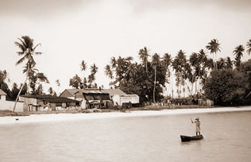
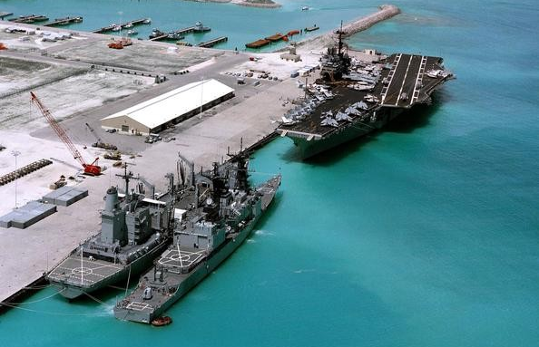
Case Study: Chagos Archipelago aka British Indian Ocean Territory
Methods:
Qualitative research using historical/policy analysis
Includes published government document, statutes, legal cases, historical data, journalistic and academic analysis, and self-reports.

Slide 7
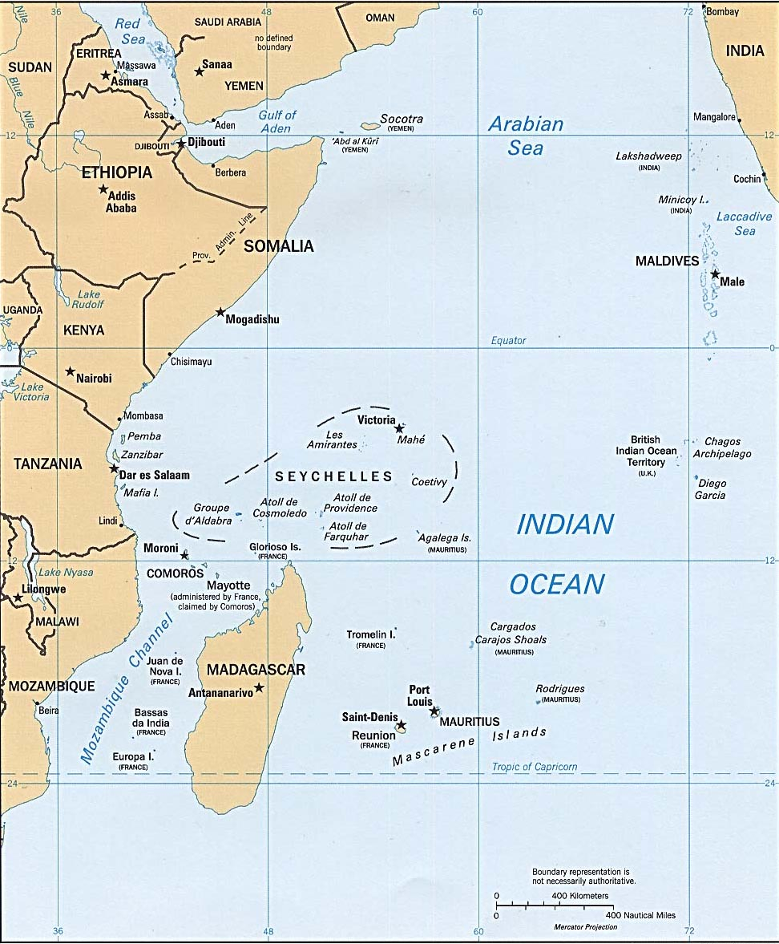
Chagos Archipelago
Diego Garcia, Peros Banhos, Salomon Island
Relabeled
British Indian Ocean territory
MAURITIUS

Slide 8
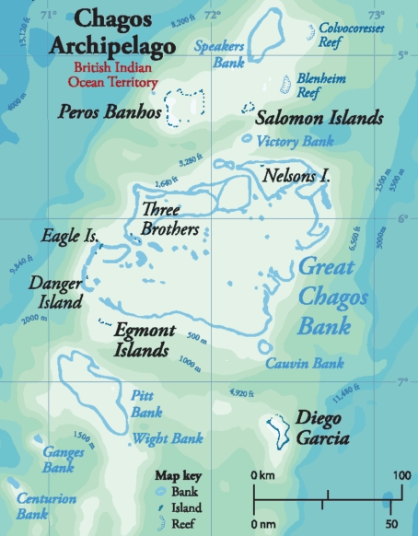
History of Recolonization and Forced Eviction of the Chagos Archipelago
1956 – Diego Garcia identified as a strategic location for United States (US) Navy base.
1962 – Formal agreement between US & UK British to detach Chagos from Mauritius and to lease Diego Garcia
for to the US for Navy base. All inhabitants to be removed.
1965 – UK separates Chagos from Mauritius during independence negotiations, creates British Indian Ocean
Territory (using Order in Council).
1966 – Exchange of Notes between UK and US to use Diego Garcia for Naval Base.
1967 – British Indian Ocean Territory (BIOT) Ordinance No. 1 – compulsory acquisition of land from private
owners.
1968 – Islanders off-island refused permit to return. Imports restricted. Deteriorating conditions.
1971 – Immigration Ordinance mandates forced eviction and displacement of entire population to Mauritius and
Seychelles. Construction of US base begins.
1972 – UK pays Mauritius UKP 650,000 to assist in resettlement. Small payments of UKP 1225 per adult & UKP
165-245 per child made six years later, in 1978.
1973 – All pet dogs are exterminated. Last 133 Ilois are deported to Mauritius on the MV Nordvoer.
1983 – As settlement of a lawsuit UK pays a further UKP 4 million to Mauritius for Ilois claims
1344 Ilois receive $2976 in exchange for renunciation (document in English).
2000 – UK feasibility report suggests resettlement possible on Peros Banhos and Solomon, not Diego Garcia.
2000 – Bancoult bring cases against UK for forced eviction and related crimes, initial success in High Court.
2001 – Bancoult bring cases against US for forced eviction and related crimes. Case rejected on procedural
grounds.
2002 – Second part of feasibility report suggests resettlement will be precarious and expensive.
2004 – Order in Council issued prohibiting repatriation of Ilois.
2004 – European Court of Human Rights case decided against the Ilois, on procedural grounds.
2008 – UK appeal rejected on procedural ground in House of Lords.
2010 – UK establishes Marine Protection Areas around BIOT prohibiting commercial fishing, with the exception
of Diego Garcia.
2016 – US & UK Diego Garcia agreement expires and is extended to 2036.
2017 – General Assembly adopts resolution to seek International Court of Justice Advisory Opinion on separation
of Chagos Archipelago from Mauritius.
2019 – International Court of Justice judgment to decolonize BIOT, General Assembly ask the UK to decolonize within 6 months

Slide 9
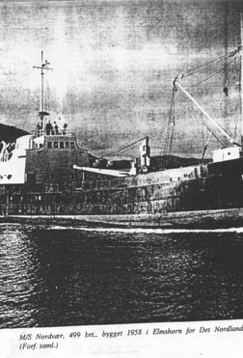
Case Study Findings:
Criminal Behavior:
Incomplete Decolonization
Forced Eviction of the Ilois
Impunity & Normalization
Effect of Global Dysnomie*
*Passas, 2000.

Slide 10
Criminal Behavior: Incomplete Decolonization
UN General Assembly Declaration 1514 (XV) of 1960 ‘Declaration on the Granting of Independence to Colonial Countries and Peoples’
- disruption of national unity of a country and preventing the right to self-determination
UN General Assembly Resolution 2066(XX) of 1965 (directing the UK prior to creating of BIOT):
- “take no action which would dismember the territory of Mauritius and violate its territorial integrity”
Recolonizing & relabeling Chagos Archipelago into BIOT

Slide 11
Criminal Behavior: Forced Eviction
Secret Agreement between US & UK
Concealed from US Congress, UK Parliament, and the United Nations
Exchange of Notes vs. Treaty
Order in Council, no parliamentary oversight
Fiction of ‘No Permanent Residents’

Slide 12
Impunity & Normalization
Impunity through selective application of laws which leads to precedent and normalization
Normalization among direct participants and subsequent governments
Rationalizations included
Security Concerns
Compensations & Renunciation Document
Repatriation Harmful
Environmental Conservation
Further normalization by domestic supreme courts and European Court of Human Rights

Slide 13
Global Dysnomie*
Regulatory patchwork of diverse and conflicting legal traditions and practices
Between & within nations
Lack of global norm making mechanisms
General reluctance due to sovereignty, especially for non crisis situations
Inconsistent enforcement of international rules
Domestic and international laws optional for powerful actors
Leading to impunity and normalization of extraordinary state crimes
Ineffective Civic Governance
Civil Society powerless in cases of government misconduct
*Passas, 2000.

Slide 14
Conclusions
Current situation undermines the legitimacy and effectiveness of domestic and international governance bodies
Therefore need:
Awareness raising and analysis of other extraordinary state crimes - crimes of the powerful in peacetime
Development and promotion of consistent/fair domestic and international laws & norms
Consistent application of domestic and international laws to reduce dysnomie
To enhance democracy through the rebalancing of the three pillars of society: state, private sector and civil society

Slide 15
Thank you
"Injustice anywhere is a threat to justice everywhere. We are caught in an inescapable network of mutuality, tied in a single garment of destiny. Whatever affects one directly, affects all indirectly."
Martin Luther King, Letter from Birmingham, Alabama Jail, April 16, 1963
ANAMIKA TWYMAN-GHOSHAL
atwymanghoshal@stonehill.edu

Slide 16
International Legal Protection against Forced Eviction
Universal Declaration of Human Rights 1948, Article 25
International Convention on the Elimination of All Forms of Racial Discrimination 1965, Article 5 (e)
International Covenant on Economic, Social and Cultural Rights 1966, Article 11 (1)
Convention on the Elimination of All Forms of Discrimination against Women 1979, Article 14(2)(h)
Convention on the Rights of the Child 1989, Article 27(3)
Rome Statute of the International Criminal Court 2002, Article 7
UN Basic Principles and Guidelines on Development-based Evictions and Displacement 2007

Slide 17
Not all Forced Evictions are illegal
Consultation and participation of affected people and communities
Adequate notification;
Effective administrative and legal recourse;
Provision of adequate relocation and/or adequate compensation before evictions are carried out
Prohibition of actions resulting in homelessness;
Prohibition of actions resulting in deterioration of housing and living conditions; and
(UN Office of the High Commissioner for Human Rights, 2011)

