Slide 1
Marriages of Convenience: Developing the state co-offending conceptual framework
Dr Anamika Twyman Ghoshal & Dr Omar El Masri
University of Gloucestershire

Slide 2
POSITIONALITy & Reflexive Statement
A zemiological/human rights approach
A commitment to empowerment, human rights, and social justice
Research that explores postcolonial & neoliberal legacies and relationships
Beyond legally defined 'crimes'
Social Harms
Sociology
Critical criminology
Human Rights foundation
Notes:
We begin with expressing our positionality and providing a reflexive statement. We are approaching this research from a zemiological perspective – where we see 'crime' as broadly defined to include wilful social harms and use human rights as a framework for understanding harm.
Our work is committed to empowerment, human rights, and social justice, we are a critical criminologist and an urban sociologist that make assumptions on these foundations.
Our past research has explored postcolonial and neoliberal legacies and relationships, which has led us to this work.

Slide 3
Definition of terms
State crime
State co-offending
“Two or more sovereign nations that seek to circumvent established legal and/or human rights standards and cause social harm” (Twyman-Ghoshal, 2021, p.313).
Crime
“State crime includes any action that violates public international law, international criminal law, or domestic law … committed by individuals acting in official or covert capacity as agents of the state … or resulting from state failure to exercise due diligence over the actions of its agents." (Kramer, Michalowski, & Rothe, 2005, p.52)
Using human rights and international standards as a benchmark for identifying wilful socially injurious actions (Schwendinger & Schwendinger, 1970; Barak, 1990)
“Acts/actions or inaction/omissions committed by government agencies or caused by public policies whose victims suffer…” (Barak, 2011, p.36). ​
Notes:
State crime is an important but understudied area within criminology (Rothe & Friedrichs, 2006; Rothe & Kauzlarich, 2016; Peoples & Sutton, 2017) that grows from a concern of social disadvantages and vulnerabilities created through asymmetrical power dynamics.
State crime includes action of individuals acting on behalf of the state, includes both commission and omission.
The concept of state co-offending is defined as a joint venture between “two or more sovereign nations that seek to circumvent established legal and/or human rights standards and cause social harm” (Twyman-Ghoshal, 2021) and emerged out of research on the Chagos Archipelago.
We are using a broad definition of crime that uses human rights and international standards as a benchmark for identifying wilful socially injurious actions .

Slide 4
Research Aims
Is there a pattern of state co-offending?
Understand the nature of state co-offending practices
Explore the legacy of colonialism on current/contemporary forms of state co-offending
Identify the effects and impacts of these activities using a zemiological perspective (victim-centered approach)

Slide 5
RESEARCH METHOD
Exploratory inductive research strategy (Reiter, 2017)
Identify the tendencies of the phenomenon
Study the occurrence & variability
Parameters for selecting cases
Two state (or more) involvement
Variance in Geographic Regions
Variance in Types of Harms/Crimes
Initial cases selected
Primary case:
Chagos (British Indian Ocean Territory)
Two test cases:
Yemen
Extraordinary Renditions
Research Phase 1: Basic Features
WHO are the co-offending state partners,
WHERE are the co-offending state partners located,
WHAT is the relationship,
WHAT is the nature of the harm,
WHERE is the harm located.
Research Phase 2:Theorising explanatory linkages between the phenomena; understanding the why and how
WHAT is the nature of the exchange/mutual benefits,
WHAT was the selection process,
WHAT brings collaborators together and WHEN do they come together,
WHAT are the pertinent historical contexts and alliances,
WHAT types of effects and repercussions emerge.
Notes:
Our research uses an inductive research strategy, where we want to identify the tendencies (the patterns) of a phenomenon that was observed in the primary case (Chagos), we want to understand the occurrence and variability of the phenomenon
We set certain parameters for selecting cases:
- Two state (or more) involvement
- Variance in Geographic Regions
- Variance in Types of Harms
We have three cases at the moment. The primary case was one that I researched for a project on the Chagos Archipelago (BIOT) where stat co-offending emerged as a reality.
We have since selected two very different cases to see if we recognise a similar co-offending pattern as in the primary case:
- Yemen
- Extraordinary Renditions
The research has two phases, an initial phase that provides some key descriptive data and a second deeper research phase that looks to theorise explanatory linkages between phenomena.
Today we will be able to provide some preliminary findings from phase 1 of the test cases.
Data used: Includes published databases, government document, legal statutes, legal cases, journalistic and academic analysis, and self-reports.

Slide 6
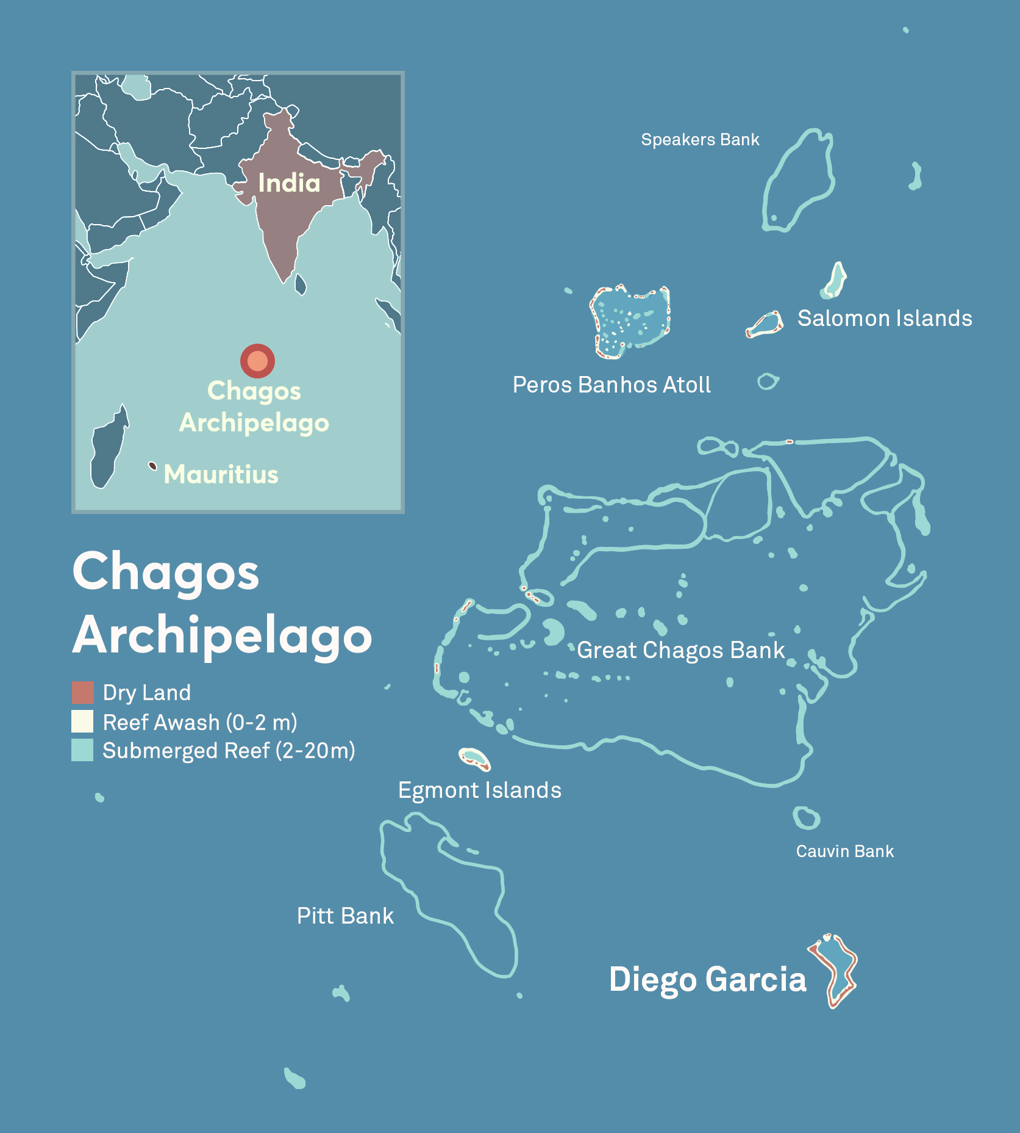
PRIMARY CASE: Chagos
Harmers:
United Kingdom – United States
Crime/Harm:
Forced Eviction
Universal Declaration of Human Rights 1948, Article 25
International Convention on the Elimination of All Forms of Racial Discrimination 1965, Article 5 (e)
International Covenant on Economic, Social and Cultural Rights 1966, Article 11 (1)
Incomplete Decolonisation & Recolonisation
UN General Assembly Declaration 1514 (XV) of 1960 ‘Declaration on the Granting of Independence to Colonial Countries and Peoples
UN General Assembly Resolution 2066(XX) of 1965 (directing the UK prior to creating of BIOT)
Harmed:
Chagossian Indigenous population
Mauritius
Credit: Griselda Gabriele; Kontinentalist
Notes:
Harmers:
United Kingdom – United States
Crime/Harm:
- Forced Eviction
Forced Eviction falls foul of the UDHR and the International Convention on the Elimination of All Forms of Racial Discrimination 1965, article 5 (e). At the time of the forced eviction of the Ilois which included coercion and complete displacement of the population internationally, the norms that were in force at the time were broken by the British in collusion with the Americans.
FE is defined in the General Comment No. 7, International Covenant on Economic, Social, and Cultural Rights, 1976 as
“the permanent or temporary removal against their will of individuals, families and/or communities from the homes and/or land which they occupy, without the provision of, and access to, appropriate forms of legal or other protection” Art 11(1)
150 countries have signed and ratified this:
USA: Signed 1977, not ratified.
UK: Signed 1968, ratified 1976 (Chagos eviction happened from 1968 to 1973)
Mauritius: State Party, Ratified in 1973
- Incomplete Decolonisation & Recolonisation
This deal occurred despite two UN General Assembly Declarations.
UN General Assembly Declaration 1514 (XV) of 1960 ‘Declaration on the Granting of Independence to Colonial Countries and Peoples’ was aimed at preventing colonial powers from disrupting the national unity and territorial integrity of a country, in an effort to maintain their presence and sovereignty and to ensure that former colonies go their right to self-determination.
When the creation of BIOT was announced, the UN General Assembly passed Resolution 2066(XX) of 1965 directing the UK to “take no action which would dismember the territory of Mauritius and violate its territorial integrity."
Agreements between the US and UK were secret – documents show knowledge of deviant nature of acts. Agreement between US & UK
Concealed from US Congress, UK Parliament, and the United Nations
Used an Exchange of Notes vs. Treaty to avoid international oversight.
Order in Council, no parliamentary oversight
Created a fiction of ‘No Permanent Residents’ - that Chagossians were temporary workers.
Harmed:
- Chagossian Indigenous population
The Effect on people of Chagos was that they were
deprived individually and collectively of their possession and homeland.
forced relocation was not supported with any meaningful efforts or financial assistance for resettlement
which means they ended up living in deplorable conditions - dilapidated shacks or slums (V&J, 2009, p.191)
in abject poverty (Vine, 2004; Lunn, 2012) (V&J, 2009, p.191) with high rates of unemployment
the population was traumatized, dislocated, hopeless, and insecure
- Mauritius
Detachment of Chagos from Mauritius,
Harmer – Harmed Relationship:
- Mauritius was a foreign-dependent territory, negotiations while Mauritius was seeking independence from the UK (Lancaster House Agreement, 1965). Created a new freesatnding colonyu, on indeterminate lease from mauritius to UK.

Slide 7
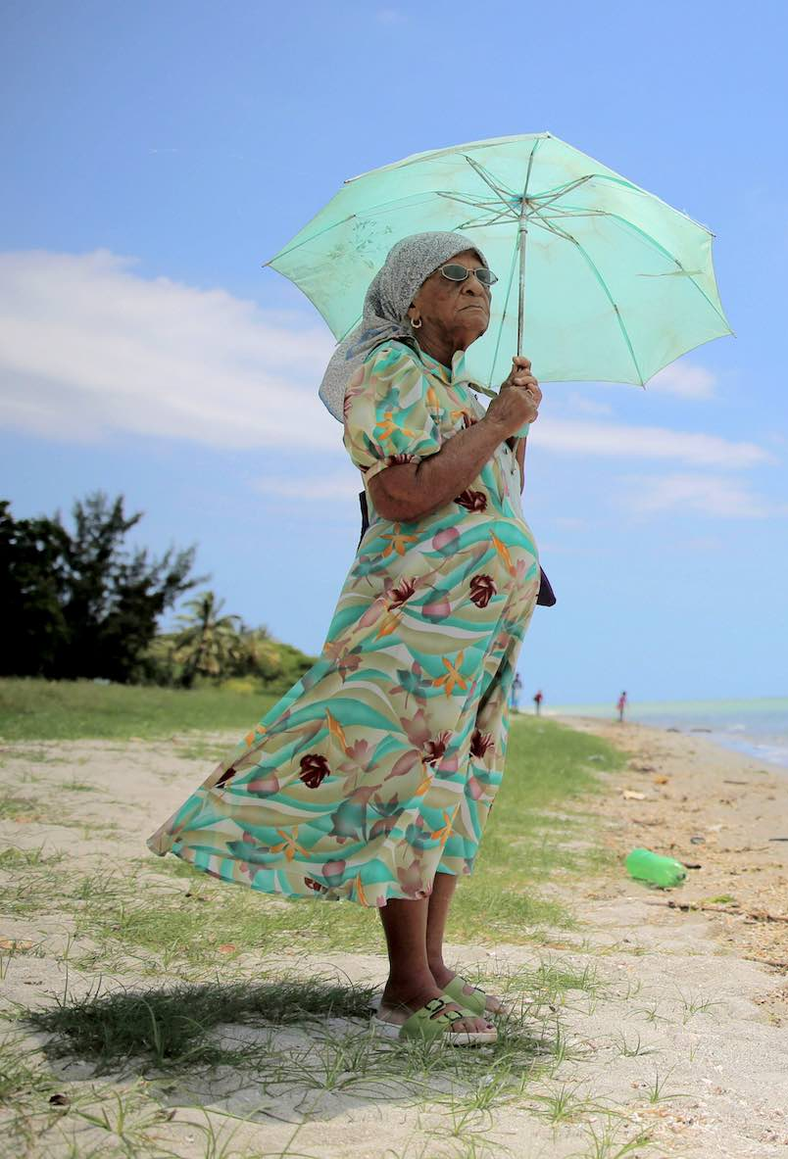
PRIMARY CASE: Chagos
Nature of the exchange:
Social Exchange that provided mutual material & immaterial rewards
Emergence of act:
Experiences of strain and mutually acceptable solution
Historical contexts and alliances:
Shared history and trusting 'special relationship'
Effects and repercussions:
Normalising oppression in the new world order
Credit: The Asahi Shimbun; Getty Images; Lowy Institute
Notes:
Nature of the exchange:
Social Exchange that provided mutual material & immaterial rewards
Selection process:
Shared social network, existing exchanges/relationship that spans decades (WW2)
Emergence of act:
Experiences of strain and identification of a mutually acceptable solution, legacy of a WW2 debt, where the UK was helped by the US.
US: expand sphere of influence, gain a strategic base location with no inhabitants as part of its vast base structure, which provides full freedom of manoeuvre.
UK: WW2 precedent, cash strapped so used colonial legacy as currency to buy military assets, plus passed its colonial legacy to trusted partner
Historical contexts and alliances:
Shared history and trusting 'special relationship', shared culture, kinship, supported shared vision of Anglo-American geopolitical interests
Effects and repercussions:
Normalised imperial behaviour which transitioned from overt colonial dominance to a more subtle form of neocolonial domination, act of transference. Lack of consequences for violation of international norms, no effect of the International Court of Justice ruling/UN General Assembly resolution that by November 22, 2019 the administration of the archipelago should end.

Slide 8
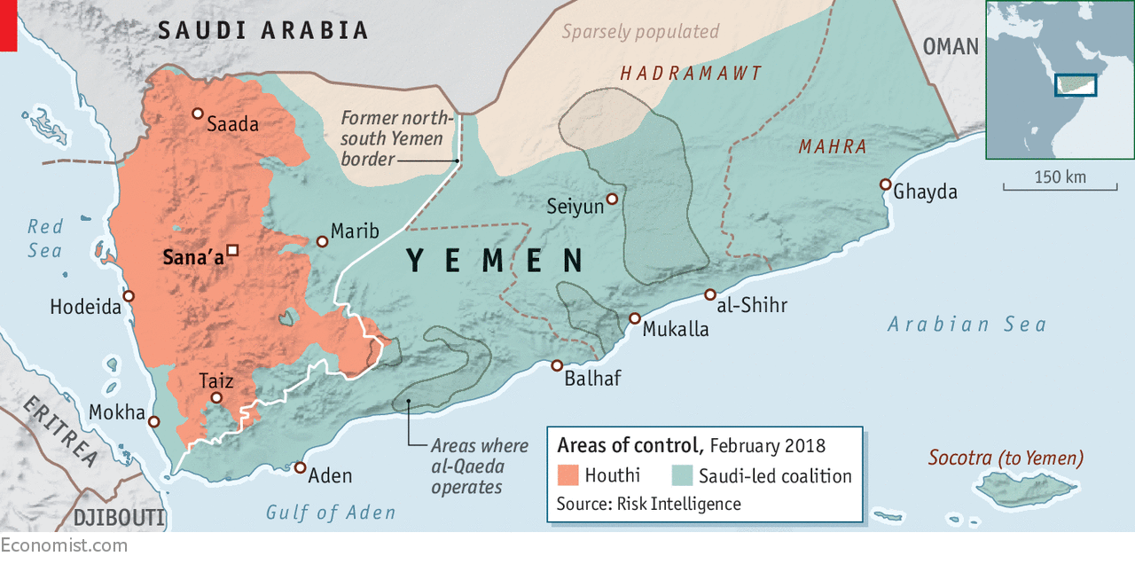
TEST CASE 1: YEMEN
Harmers:
Saudi Arabia, the United Arab Emirates (UAE), the Internationally Recognized Government of Yemen, the Ansar Allah (Houthi) armed group, and other warring parties (Non-international armed conflicts)
Crime/Harm:
The Fourth Universal Declaration of Human Rights, 12 August 1949, Additional Protocol II (non-international conflicts); Convention against Torture and Other Cruel, Inhuman or Degrading Treatment or Punishment 1984, Convention of Cluster Munitions 2008, ...
Harmed:
Yemeni civilian population
Notes:
While a Yemen truce hangs in the balance, little to no progress has been made by parties to the conflict to address ongoing and widespread violations and abuses of international human rights and humanitarian law or remedy the harms they have inflicted on civilians throughout the conflict. The humanitarian situation in Yemen remains desperate, and, in recent weeks, armed clashes have once again increased. Civilians continue to fall victim to shelling, drone strikes and other attacks. These factors attest to the urgent and critical need to reinvigorate international accountability efforts on Yemen through the establishment of an independent international investigation.
Classification: the longstanding non-international armed conflict between the government and the Houthis continues. During 2015, the Houthis assumed control over Yemen’s capital Sana’a. Upon invitation of Yemen’s President Hadi, an international coalition led by Saudi Arabia intervening since March 2015. The involvement of Saudi Arabia and its allies does not affect the classification as it takes place with the consent of Yemen.
- Yemen is a party to the four 1949 Geneva Conventions. All parties to the conflict are bound by Article 3 common to the 1949 Geneva Conventions that provides for the minimum standard to be respected and requires humane treatment without adverse distinction of all persons not or no longer taking active parts in hostilities. It prohibits murder, mutilation, torture, cruel, inhuman and degrading treatment, hostage taking and unfair trials.
- Yemen is also a party to the 1977 Additional Protocol II applicable to non-international armed conflicts. The ability of the Houthis and al-Qaeda of the Arabian Peninsula to exercise territorial control over large parts of Yemen suggests that they fulfil the required criterion for the applicability of Protocol II, namely the ability to carry out sustained and concerted military operations; impose discipline; and the ability to implement Protocol II. However, Protocol II does not apply between armed groups. All parties are bound by customary international humanitarian law applicable to non-international armed conflicts.
- In addition to international humanitarian law, international human rights law continues to apply during times of armed conflict. Under human rights law, the territorial state has an obligation to prevent and to investigate alleged violations, including by non-state actors.
As highlighted by the UN High Commissioner for Human Rights, “We know that lasting peace is interlinked with justice, development and respect for human rights.” Unfortunately, justice, truth and reparation for human rights abuses were overlooked by the international community after mass pro-democracy protests in Yemen toppled the government of the former President Ali Abdullah Saleh in 2011.
Between 2011-2014, the Gulf Cooperation Council’s (GCC) political initiative for Yemen, as endorsed by the UN Security Council, prioritized implementing a quick transition of power at the expense of ensuring accountability, establishing the rule of law and addressing the government’s long record of human rights violations. The immunity afforded to former President Saleh and others only entrenched a culture of impunity that likely played a key role in the renewal of armed conflict and the commission of widespread human rights abuses and war crimes within the country. Almost ten years later the international community is in danger of repeating the same mistake. For years Saudi Arabia, the United Arab Emirates (UAE), the Internationally Recognized Government of Yemen, the Ansar Allah (Houthi) armed group, and other warring parties have caused, and continue to cause, massive civilian harm and suffering in Yemen, carry out frequent and serious violations of international human rights and humanitarian law, [1] and have failed to conduct credible investigations, provide reparations, or ensure justice for victims. In the last month, attacks against civilians and other related violence have resulted in 232 civilian casualties including 57 children. The last week of July witnessed the highest increase of child casualties in one week since early 2020. Before its untimely dissolution in 2021, the UN Group of Eminent Experts (GEE), established by the UN Human Rights Council (HRC) in 2017, recommended that UN member states refer the situation in Yemen to the International Criminal Court (ICC), support the establishment of a criminal-accountability-focused investigative mechanism, and stressed the need to realize victims’ right to reparation. In late 2021, HRC members narrowly rejected the resolution that would have renewed the GEE’s mandate after Saudi Arabia, backed by the UAE, lobbied HRC members to vote against its renewal.

Slide 9
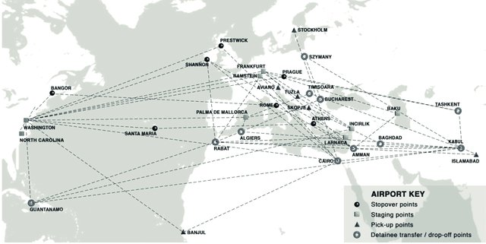
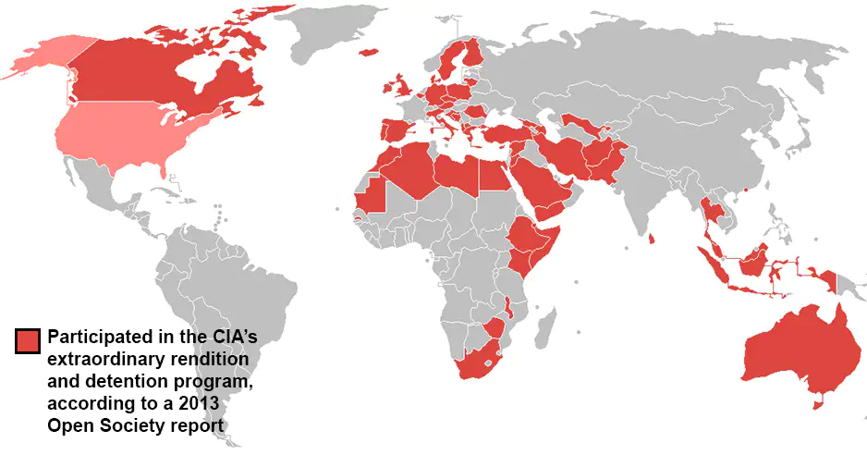
TEST CASE 2: Extraordinary Renditions
Harmers:
United States + 54 (Blakeley & Raphael, 2013) – 69 (Cordell, 2016) complicit countries
Crime/Harm:
Universal Declaration of Human Rights 1948, Art. 3, 5, 9, 10
Arbitrary Arrest & Detention
Enforced Disappearances
Declaration on the Protection of all Persons from Enforced Disappearance 1992
International Convention for the Protection of All Persons from Enforced Disappearance 2010
Fourth Geneva Convention, Article 49
Forcible Transfer
Convention on the Prohibition of Torture 1984, Article 3
Torture
Convention on the Prohibition of Torture 1984, Article 3
International Covenant on Civil and Political Rights 1966, Art. 7
Harmed:
Prisoners & other individuals from Global South or of minoritised identities in Global North
Notes:
In test case number two we are looking at extraordinary renditions. Renditions describe a process where you transfer a person from one jurisdiction to another, this process has been used in the US as form of recapturing fugitive slaves and therefore has a very problematic legacy. Rendition includes legal mechanisms such as deportation and extradition (Frankopan, 2008). These actions usually occur with court oversight and with some form of due process where there is a link between the person being rendered to and the country they are taken to (e.g citizenship or where a crime occurred for prosecution purposes). Extraordinary rendition describes this type of transfer but for the purpose of being subjected to interrogation, which included torture. There is no relationship to the location being rendered, and there is no judicial oversight.
The cases were all initiated by the United States as part of the war on terror, post 9/11. The hub for the rendition flights was Washinton Dulles Airport. The countries that were complicit in the renditions cases are estimated to range between 54 to 69 distinct countries. The renditions are known to have occurred from 2001-2012, but a process of rendition in the US existed as far back as the 1980s although in different forms.
The international crimes identified included various UDHR violations, including arbitrary arrest and detention, enforced disappearances, and forcible transfer and most importantly torture.
Not all individuates who were rendered have been identified, so far over 130+ individuals were identified by research conducted by Blakeley & Raphael (creators of the largest renditions database).
These individuals included prisoners captured as part of the war on terror, but also random individuals who had been taken on false allegations. Nearly all of these individuals were Arabs that were from Global South countries or of minoratised identities (usually Arab) from Global North countries.
The relationship between the harm and harmed is based on a clear power differential, both internationally (geopolitical relations) but also domestically (social status). It remains to be explored how these relationships were formed, what foundations they were built on, what the nature of exchange was for the countries co-offending, and in this particular case, how the "war on terror" narrative enabled so many countries to participate in harmful and deviant behaviours.

Slide 10
Emerging Patterns
Postcolonial legacies amongst the ‘core’ (Wallerstein, 1991) – continuing spheres of influence
Neocolonial trends that reproduce through neoliberalism
‘Normalisation’ (Vaughan, 1996) of oppressive structural systems
Colonial economic structures
Transfer from core to core (established)
Replicating core in the periphery/peripheries (emerging)
Notes:
State co-offending concept sits within a new geo-political environment. It seems to be a new form of colonialism - replicating old ways of domination. However in addition to the continuation of old forms of imperialism, in a new international context, which builds on postcolonial legacies amounts the core and maintaining spheres of influence that is relpicated in a neoliberal system, you also see normalisation of oppressive structural system, which is in opposition to international concerns for human rights and international law.
There seems to be evidence in the early analyses of the test cases, that there is a transfer of colonial economic structures, not only from core to core as in Chagos, but also from core to peripheries. Where the oppressive structural systems are being replicated.

Slide 11
Next Steps
Continue research on test cases
Theorise the explanatory linkages between the phenomena
Add cases to create a database of cases
Develop the theory of explanatory linkages

Slide 12
Thank you Dr Anamika Twyman Ghoshal & Dr Omar El Masri atwymanghoshal@glos.ac.uk oelmasri@glos.ac.uk
School of Natural & Social Sciences
University of Gloucestershire

