Slide 1
Reframing, reimagining and transforming education approaches in custodial and youth justice settings
Howard League for Penal Reform
University of Oxford, Keble College
13-14 September 2022
Dr Adeela ahmed Shafi MBE
Tristan Middleton
Jordan Wintle
Dan Clark

Slide 2

Some background
Number of children in custody at an all time low
Over 3,000 in 2008 down to just over 900 in 2020
However it means those in custody have some of the most complex needs and represent some of the most troubled young people in the UK
Educational attainment is low
School dropout is high with almost 9 out of 10 young offenders having dropped out of school for 6 months or more before being incarcerated (Little, 2015)
Complex family and socioeconomic backgrounds
High prevalence of special educational needs 23% compared with 2-3% in the general population of young people (Hughes, 2012)
Young offenders described as disengaged from education and learning

Slide 3

Today’s panel session
This panel session presents alternative ways of approaching education in custodial settings that present a better chance of enabling young people to recognise and therefore receive or engage in educational opportunities that can be transformative for them

Slide 4



Three key projects
The work of these three projects focus on the:
  principles of engagement and motivation;
  social and emotional competencies and;
  the importance of skills for life
as underpinning the development and piloting of materials and pedagogy
Demonstrable impact for almost 500 young people in custodial and other youth justice settings in ten countries across Europe.

Slide 5
The RENYO Project
Re-engaging young offenders with education and learning
This presents the research from a 3 year EU funded Erasmus project with 4 countries in Europe.
The aim was to develop tailored training and materials working with secure custodial settings within the partner countries in Italy, Spain, Germany and the UK, which would be usable beyond the life of the project.

Slide 6













Active Games 4 Change
A 3-year EU funded project designed to develop social, emotional and civic competencies in young offenders through active games and sport.
Notes:
10 European partners from the UK, Portugal, Spain, Italy, Turkey, Hungary and Romania
ActiveGames4Change supports young offenders (in custody and under community supervision) in the acquisition and usage of key competencies to facilitate inclusion, education and employability, by developing an innovative framework of learning environments and materials.
This project focuses the importance of incorporating sport and physical activity in correctional environments, in an effort to promote the physical, mental health and well-being of young offenders, as well as to strengthen their rehabilitation process.
Overall aim is to influence European policy to make sport and physical activity a fundamental part of youth rehabilitation.

Slide 7
What is Skills4Life?
Social Bonds and
Personal Relationships
Personal Empowerment
Life Skills
Planning for Life after Release
The Skills4Life (S4L) Project is a 26-month EU funded project with 4 countries in Europe (France, UK, Greece and Italy)
The aim of the project is to develop a comprehensive and bespoke curriculum to prepare young people for transition back in to the community.
The curriculum is split into four key areas:
These modules emerged from Phase 1 of the project which involved interviewing 80 young people

Slide 8
Adeela Shafi & Tristan Middleton
School of Education and Humanities: University of Gloucestershire
Howard League Conference 2022
Re-engaging incarcerated children and young people with education and learning using Authentic Inquiry in Italy, Spain, Germany and the UK

Slide 9
Aim: To re-engage young people in custodial settings with education and learning using the principles of authentic inquiry
University of Gloucestershire, CESIE (Palermo, Italy), FHD University (Dresden, Germany), Fundacion Diagrama (Spain), Jearni Professional Learning (UK)
We did this through developing ‘train the trainer’ materials with our partners for sustainable implementation in secure settings in the partner country settings.
By training the trainers we aimed to embed this approach in the custodial settings.

Slide 10
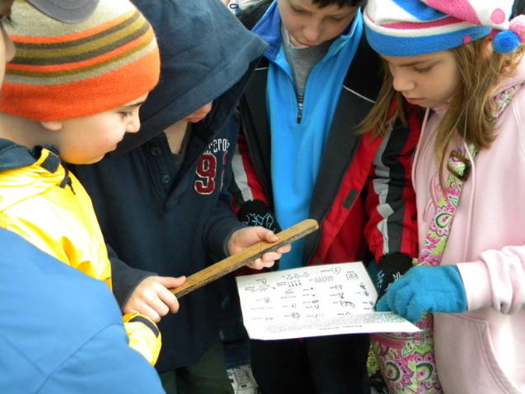
The Methodology: Authentic Inquiry
Authentic Inquiry –
‘personalised learning which is rooted in student experience and choice. It is shaped by the learner’s interest, driven by her curiosity and purpose, yet is capable of supporting the delivery of the valued outcomes of a publicly accountable curriculum ’
(Deakin Crick 2009 p. 73)

Slide 11

The Authentic Inquiry process:
8 stages in authentic inquiry. It starts with something that is authentic to the individual and moves through a range of stages to where the authentic also becomes something more public. Like a journey from the personal to the public

Slide 12
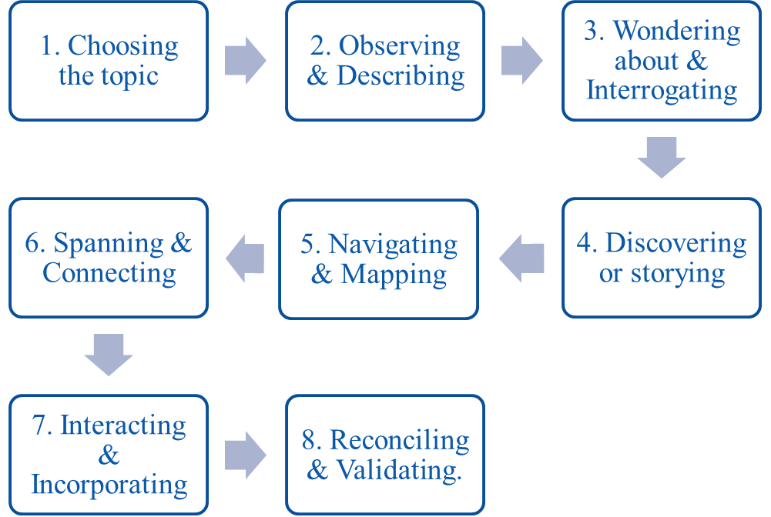
Authentic Inquiry –
8 steps
Click here to watch the video
or
https://youtu.be/7F3FUfGLXN0

Slide 13
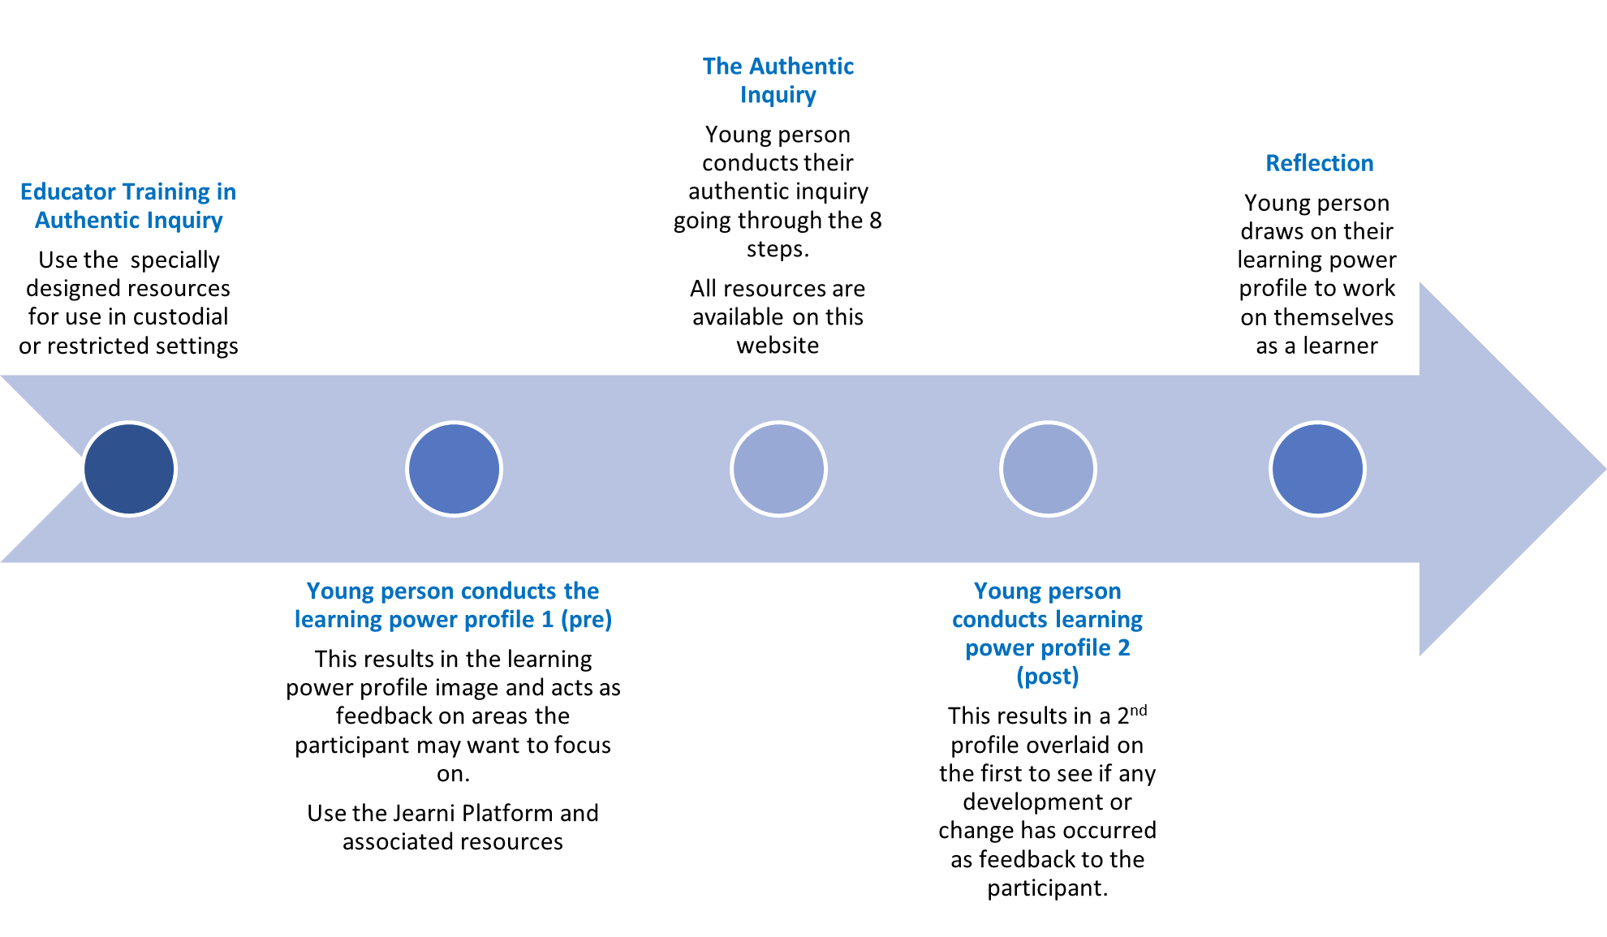
The Project

Slide 14
Research Questions
What were the behavioural, cognitive and affective impacts of using authentic inquiry on the young people in custodial settings?
Over the period of the project, did the young peoples’ learning skills and attributes change as reflected in the learning journey profile?
What are transnational educators’ perceptions of the effectiveness of AI as a pedagogical tool for ‘re-engaging’ and supporting young people in prison?
How have transnational educators’ understanding of pedagogical approaches changed as a result of using authentic inquiry?

Slide 15
Quantitative data collected from educators (n=100) and young people (n=60)
Qualitative data collected from educators (n=12) and young people (n=20) as well as the quantitative data from the 2nd survey

Slide 16
Findings
Positive re-engagement of young people in custodial settings with education resulted from the RENYo approach
Emotional impact of the RENYo approach was strongest
Authentic Inquiry as a hook for positive re-engagement and motivation
Transformative nature of Authentic Inquiry approach for educators – self-perception and own learning disposition (cultural differences)
Improved relationships with learners
More time and commitment from leadership from settings was needed to help embed this approach into the setting and enable the full opportunities to the young people that the approach afforded
This needed to be supported by appropriate time and consistency with the educator/mentor

Slide 17
Recommendations
Use of Authentic Inquiry to be further explored within the context of secure institutions
More time and commitment from leadership from settings was needed to help embed this approach into the setting and enable the full opportunities to the young people that the approach afforded
This needed to be supported by appropriate time and consistency with the educator/mentor

Slide 18
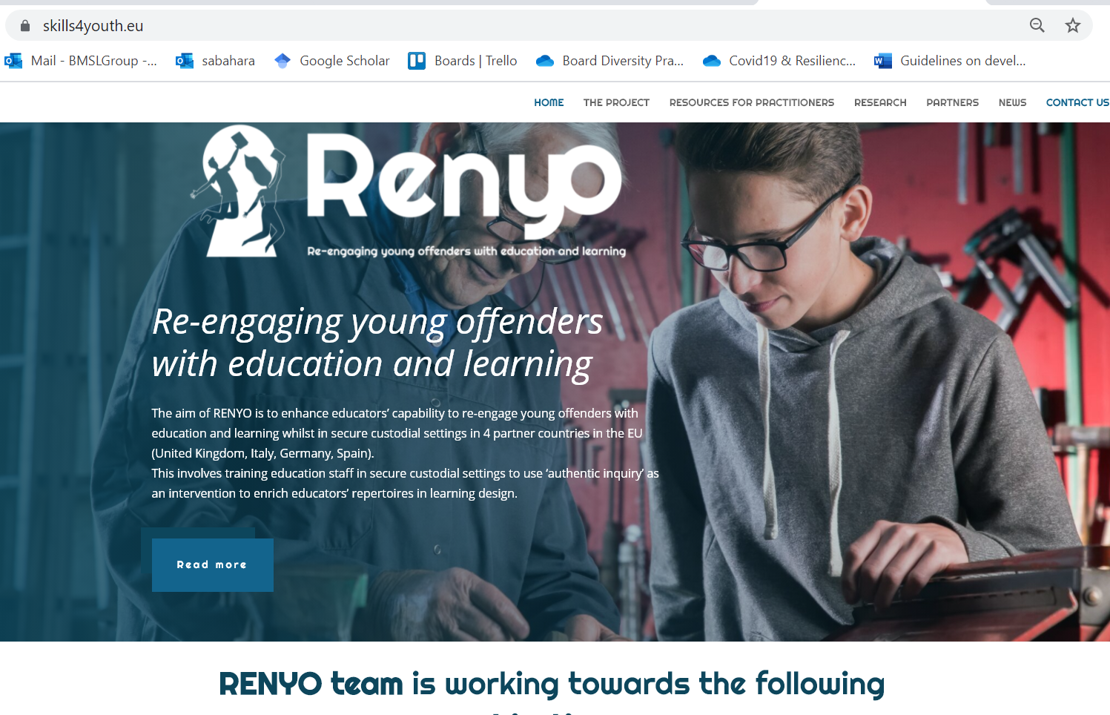
Renyo Website
You may download all resources and outputs from Renyo from this website as they become available.
All are freely available and free of charge.
www.skills4youth.eu/

Slide 19
References
Crick, R. D. (2009). Inquiry-based learning: reconciling the personal with the public in a democratic and archaeological pedagogy. Curriculum Journal, 20(1), 73–92. https://doi.org/10.1080/09585170902764021
Deakin Crick, R., Huang, S., Ahmed Shafi, A., & Goldspink, C. (2015). Developing resilient agency in learning: The internal structure of learning power. British Journal of Educational Studies, 63(2), 121-160
Lanskey, C. (2015). Up or down and out? A systemic analysis of young people's educational pathways in the youth justice system in England and
Wales. International Journal of Inclusive Education, 19(6), 568-582.

Slide 20




Further Reading
ahmed Shafi, A. (2018). Researching young offenders: navigating methodological challenges and reframing ethical responsibilities. International Journal of Research & Method in Education, 1-15.
ahmed Shafi, A. (2018). Re-engaging young offenders with Education in the Secure Custodial Setting. In Gallard, D. Children and Their Education in Secure Accommodation: Interdisciplinary Perspectives of Education, Health and Youth Justice, p.266-297.
ahmed Shafi, A. (2019). The complexity of disengagement with education and learning: A case study of young offenders in a secure custodial setting in England. Journal of Education for Students Placed At Risk.
Middleton, T. & Kay, L. (2019) Using an Inclusive Approach to Reduce School Exclusion: A Practitioner’s Handbook. Abingdon, Oxon: nasen Spotlight / Routledge
Notes:
AS

Slide 21
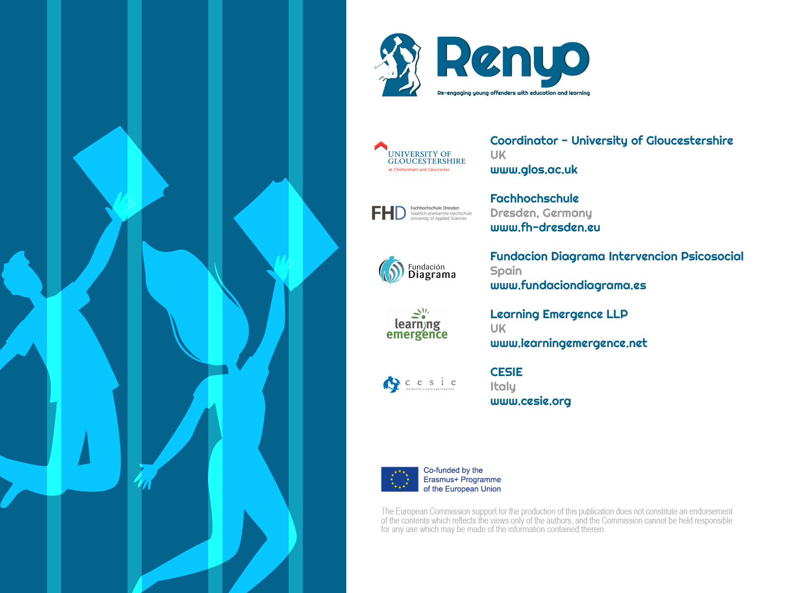

Slide 22


A Pedagogy of Personal Development
Howard League for Penal Reform
University of Oxford, Keble College
13-14th September 2022
Jordan Wintle
Senior Lecturer in Sport & Exercise
University of Gloucestershire

Slide 23
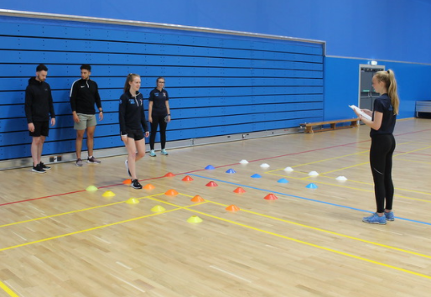


The potential of active games and sport
Sport plays a crucial role in the acquisition of values of young people because it provides a unique context, where there is a great social interaction between students.
(Côté, et al., 2016; Jacobs, et al., 2013; Morgan, et al., 2020; Wintle, 2020)
Notes:
A fabulous vehicle for engagement and development of young people not just in the physical domain.
A good evidence base supports the potential for sport ad active games.
An have some negative outcomes and certainly may not work for all.

Slide 24
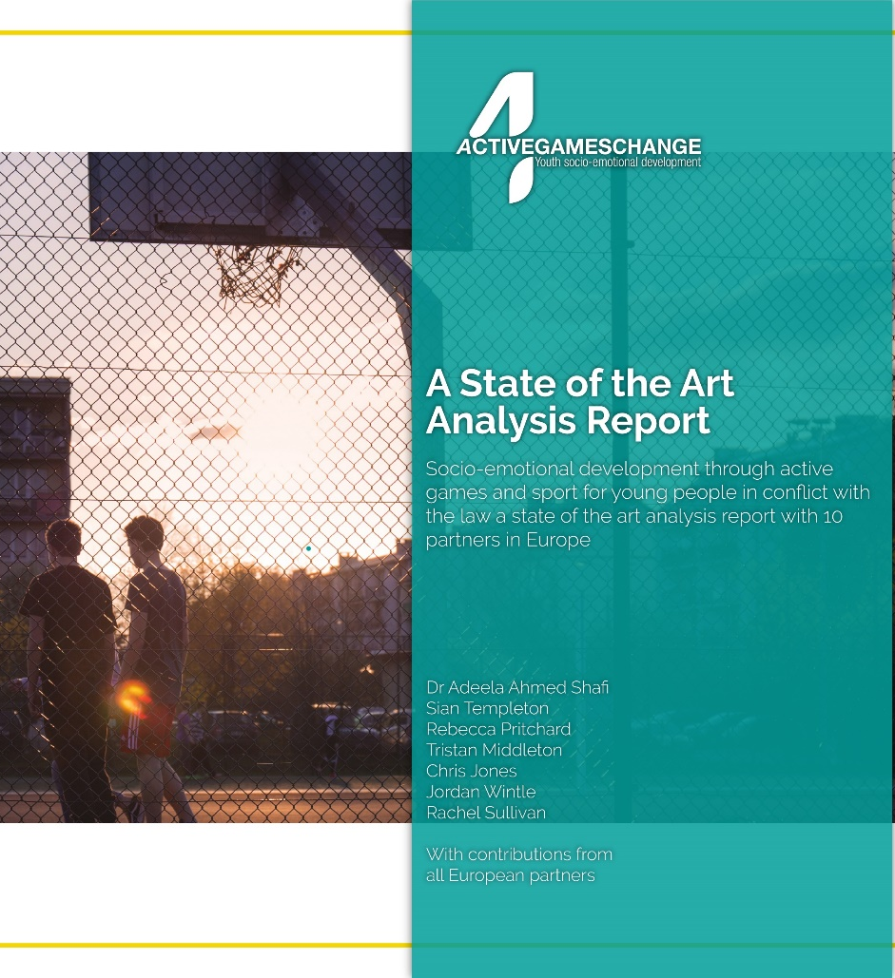
The State of the Art Analysis
Part I – an overview of the literature and policy status in the partner countries.
Part II - a theoretical and conceptual evidence base, which indicates the importance of these competencies for the target group
Part III - the methodology for the selection of tools to assess the development of the competencies alongside the contextual challenges of engaging young people within youth justice systems in restrictive environments.
You can view the full document at
www.activegames4change.org
Notes:
The first output and its purpose for the project

Slide 25


The Intervention Design Process
Contextual Information
Defining competencies
Theoretical underpinning
Pedagogy
Range and structure of activities
Notes:
Contextual information – On the ground logistics - Gathering of data from all partner countries on contextual information –facilities, skills of delivery team, time constraints, number of learners, equipment access etc. Games needed be deliverable across a wide range of contexts with variation both within and between countries.
Defining competencies – using the WE scale previously outlined but also considering what these will look like in practice – what kind of behaviours are we expecting to see from our young people exhibiting these competencies?
Theoretical underpinning – next slide for more detail but we wanted a tried and tested framework to underpin our designs – this led us to the TPSR model that we will look at in more detail shortly.
Pedagogy –closely linked to the TPSR model we need the games to be delivered in a particular way to maximise the potential for positive development in our young people – this means moving away from what we would define as a teacher centred approach and moving towards the role of the teacher being a facilitator allowing greater responsibility amongst the young people. We will look at this in further detail shortly.
Range and structure of activities – the activities needed to have broad appeal so have been designed to cover a wide range of physical activities, problem solving, teamwork tasks– some of these take on a sport based look whilst others link to recreational activities and teambuilding tasks. We recognise that sport will appeal to some but not all, so wanted to provide a range that offered something for everyone – challenge within the physical, cognitive, affective and social domains of learning.

Slide 26
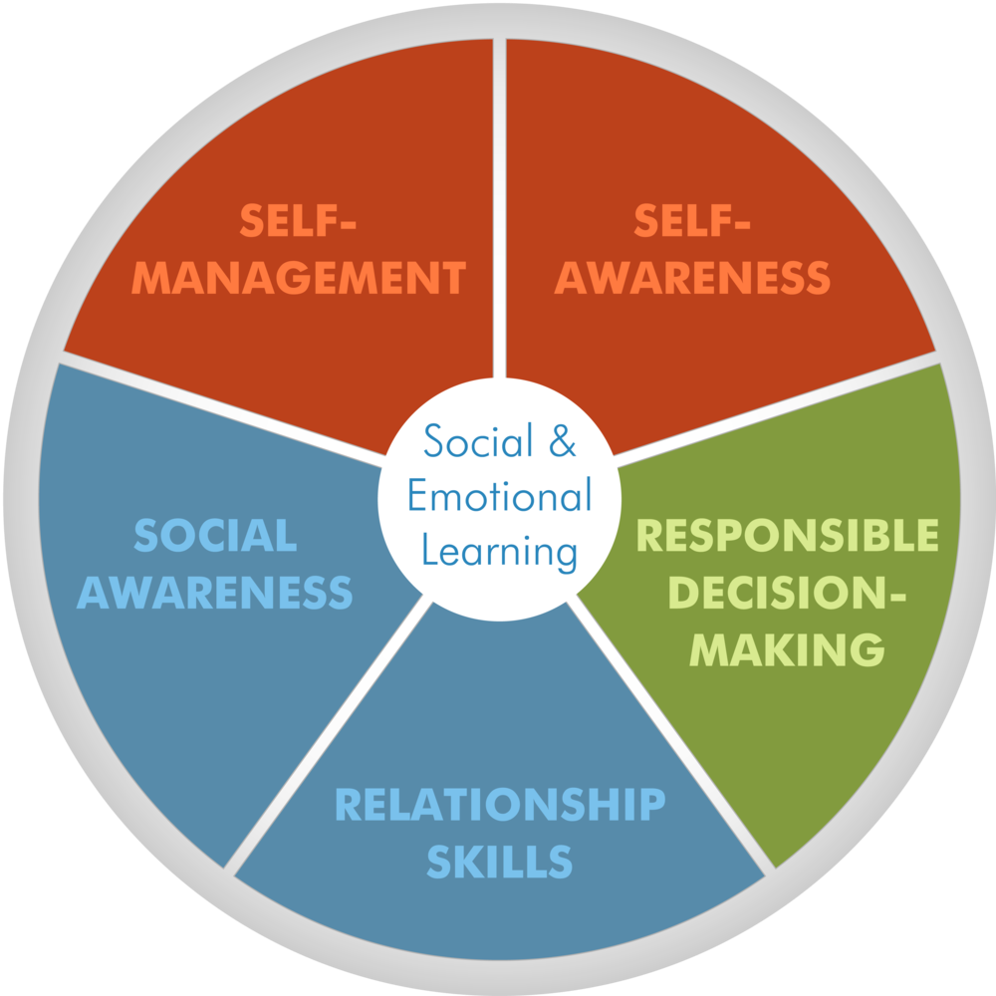
The social, emotional and civic competencies in AG4C
Young people in conflict with the law would benefit from the development of these competencies.
An absence or delay in development has a correlation with poorer academic outcomes, reduced financial stability in adulthood and an increase in the likelihood of engaging in criminal behaviours (Gutman & Schoon, 2013).
Notes:
Social and emotional competence in young children has clear links to positive outcomes in adult life and higher levels of wellbeing within the general population; these competencies also tend to result in higher academic achievement and a successful career trajectory
These competencies tend to include the ability to regulate emotions, manage social relationships and responsible decision-making, which can all serve as protective factors to dealing with change as well as being predictors of academic success. Conversely, according to a meta-analysis of the literature by Gutman & Schoon (2013) found that an absence or delay in this skill development has a correlation with poorer academic outcomes, reduced financial stability in adulthood and an increase in the likelihood of engaging in criminal behaviours.
‘Social and Emotional Competence’ which is widely agreed to describe the subdomains of self-management; self-awareness; social awareness; relationship skills; and responsible decision-making
The young people who end up in youth justice systems are less likely to have developed the social, emotional or civic competencies. This could explain why they have engaged in the risk taking behaviours they are more prone to in the absence of, for example, emotional literacy, self-awareness and regulation.
The CASEL framework was selected due to its clear links between research, policy and practice underpinned by a collaborative approach with a range of expertise including practitioners, academics and policy makers. This framework reflects the competencies identified in the literature pertaining to young people in conflict with the law and will be used to underpin the active games designed in this project.

Slide 27
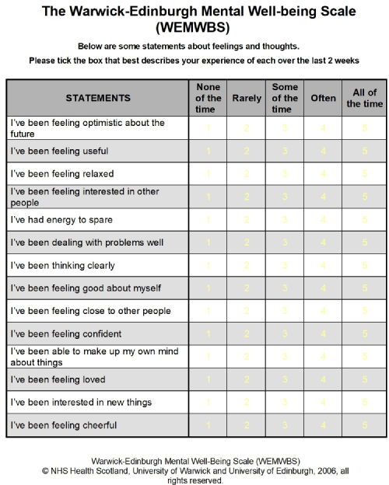
Assessment Tools (pre and post)
Quantitative:
Warwick-Edinburgh Mental Well-being Scale (WEMWBS)
Qualitative:
2 questions for the participants to answer
Notes:
In order to establish the assessment tool/s for the social and emotional competencies the SPECTRUM (Social, Psychological, Emotional, Concepts of self and Resilience: Understanding and Measurement) assessment tools from the Education Endowment Foundation (UK) were utilised as a basis for exploration
A total of 86 tools for measuring non-academic and essential skills were identified; each of these tools focused on measuring outcomes for children and adolescents
Each of the tools were evaluated for inclusion in the project using the following criteria: conceptual domain fidelity; target age range; opportunities and barriers to its inclusion for the AG4C project (i.e. accessibility; translations already available; cost; time taken to administer and score).
The Warwick-Edinburgh well-being scale (WEMWBS) was established as being a ‘best-fit’ to meeting the above criteria. This is a free tool which was initially designed to monitor the impact of programmes and interventions around well-being. In addition to this, this scale has already been validated for multi-cultural use and has been translated
To be administered by a key worker (ideally) but an adult rather than peers.

Slide 28
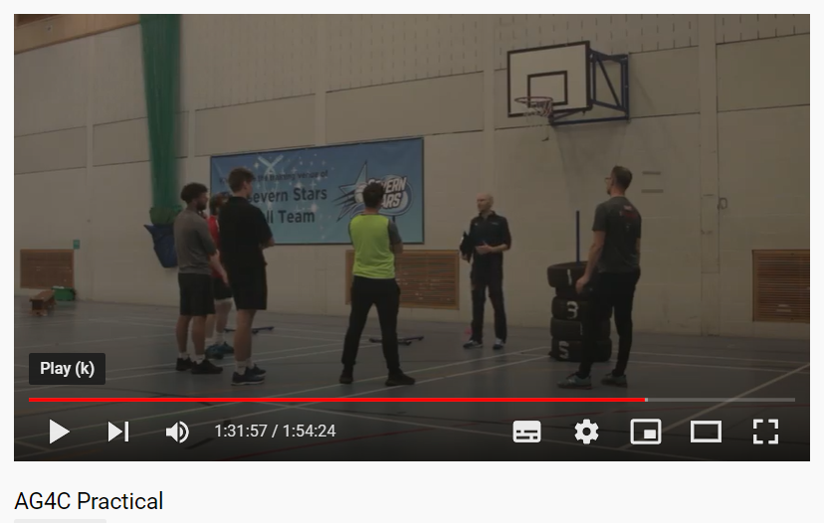
Training and Piloting
Masters trainers trained
2 master trainers in each country
Training of tutors in YOI
Up to 10 tutors trained in each country
Execute games programme
40 young people in each country minimum
Data collection
Pre, during and post programme
Notes:
Master training moved to online.

Slide 29
Pedagogy Overview
Teaching personal & social responsibility
Adventure
pedagogy
(Hellison, 2010)
(Sutherland, et al., 2016)
A Pedagogy of Personal Development
Notes:
Importance of facilitation and reflection are key.
Order of activities can be influential on success.
Generate awareness in the young people in of their performance in the games and how this can be transferred into other areas of their lives.
Provide opportunities to use and develop a range of social and emotional competencies.

Slide 30
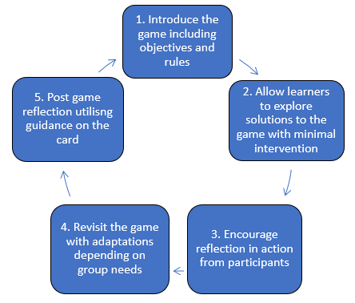
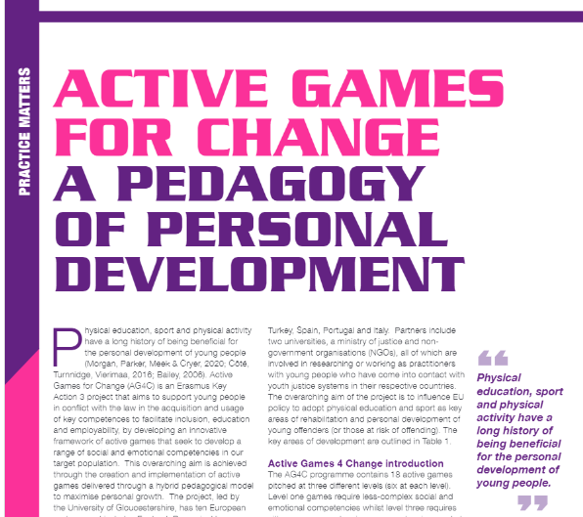
Pedagogy Overview
Full text at www.activegames4change.org
Notes:
Simple overview of pedagogy – step 1 to step 5.Fits in with what we have outlined so far. Combination of TPSR and Adventure pedagogy models taking the most relevant bits of each.
Talk through using an example.

Slide 31
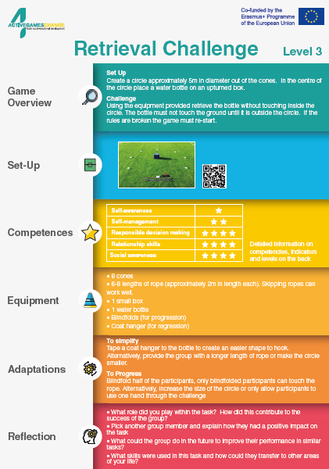
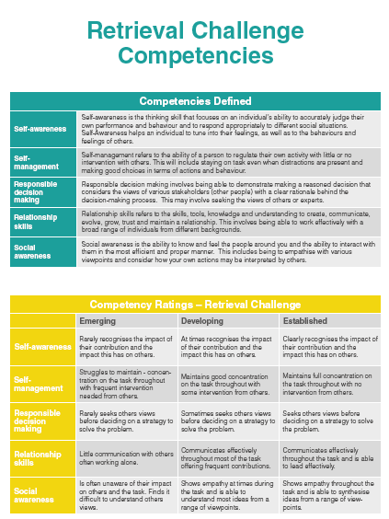
Notes:
Branded versions of game cards clear, user friendly etc

Slide 32


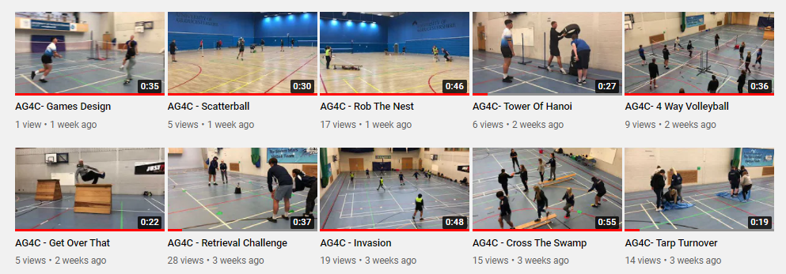
Notes:
Brief overview of video content and purpose. Short video of each game for the tutor to familiarise themselves with content – no commentary to allow use across all languages.
Also allowed us to pilot all the games internally and gain some initial feedback from students.

Slide 33

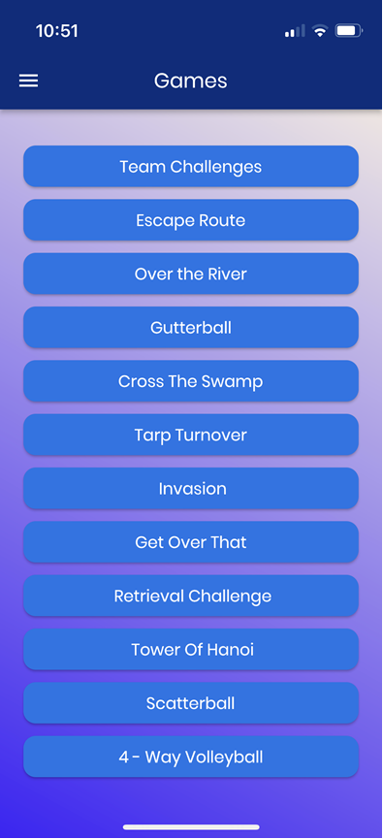
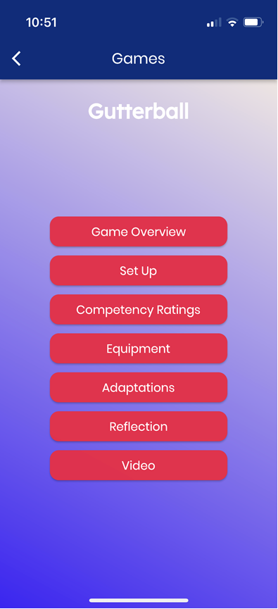
The
.
Notes:
Class lists
Assessment tools
Games
Videos
In development!!!

Slide 34

Results from the piloting
Who participated?
 | Educators Trained | Young people (aged 16-24)
UK | 11 | 60 (48 pre and post)
Portugal | 18 | 43 (Pending final results)
Italy | 20 | 48 (47 pre and post)
Spain | 5 | 39 (23 pre and post)
Hungary | 6 | 46
Romania | 2 | 40
Turkey | 10 | 50
Total | 72 | 326 (291 pre and post)
The training, materials and resources were piloted in the partner countries - Turkey, Romania, Portugal, Italy, Spain, Hungary and the UK across 17 settings.
Notes:
We exceeded the expected number of YP participants with a considerable number doing pre and post WEMBHS

Slide 35
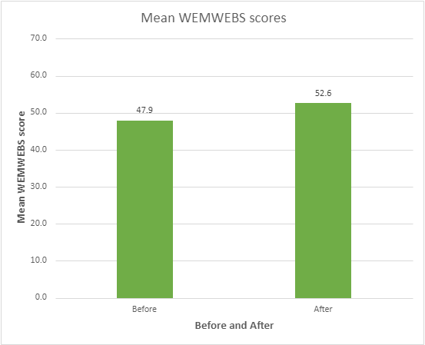
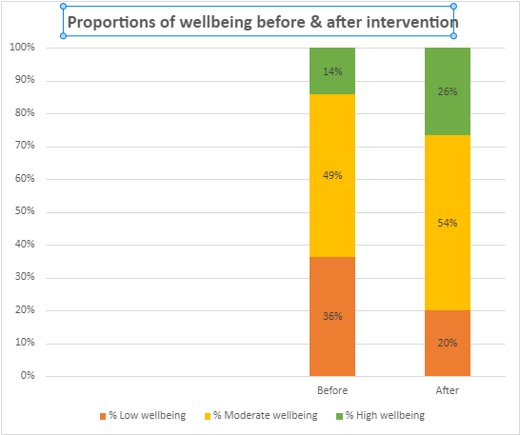
Data combined from across the partnership
As assessed by the WEMWBS
Notes:
These were statistically significant different both across the cohort and in each country.

Slide 36
Comparing the partner countries
Before and after WEMWBS for individual countries (non PT)

Slide 37
Comparing the competencies
Before and after across the countries
The five key competencies were mapped on to the WEMWBS scale. The questions from the WEMWBS relevant to each competency were extracted and the average changes in wellbeing in these areas were compared before and after participation in the games. The chart below shows the difference before and after for each competency across the partnership.
The findings show that after the games, young people show increased scores across all competencies

Slide 38
Themes from the qualitative data
Qualitative questions designed to assess the key competencies
Links to competencies
All competencies covered but especially relationship skills and social awareness
Enjoyment
Fun and enjoyment were key features that helped support programme engagement
Overcoming problems
Resilience, persistence and teamwork were evident in many settings
Transfer
Showed awareness of how the competencies helped them in normal life
Also linked to the delivery team/tutor and social environment created within the programme.
Often mentioned how self reflection and social awareness, and responsible decision making fed into this creating a sense of achievement – development in self-efficacy
A sense of purpose was often evident in these comments, they knew they had developed skills/competencies that had value beyond the gym/sports hall
Notes:
Links to competencies – also several mentions of the development of confidence both within and beyond the AG4C delivery.
Enjoyment – also linked to the delivery team/tutor and social environment created within the programme.
Overcoming problems – often mentioned how self reflection and social awareness, and responsible decision making fed into this creating a sense of achievement – development in self-efficacy?
Transfer – a sense of purpose was often evident in these comments, they knew they had developed skills/competencies that had value beyond the gym/sports hall (TPSR links)
A limited number (less than 3 comments) not so positive comments did emerge but these were rare – linked to gender make up of the groups – lack of females and one who perceived the games as “childish” and some groups who “didn’t get on”.
A number of participants had difficulty in identifying any specific difficulties when questioned as they enjoyed the games so much and they valued working with others.

Slide 39

Concluding thoughts
Sport and active games show potential in the development of social and emotional competencies in young offenders.
This is can be enhanced by using theoretically underpinned pedagogical models, alongside training of education staff in YOI and community settings.
More work is needed to assess the longevity and transfer of these competencies.

Slide 40


www.activegames4change.org jwintle1@glos.ac.uk
@jordanwintlePE
Jordan Wintle
Senior Lecturer in Sport & Exercise
University of Gloucestershire

Slide 41

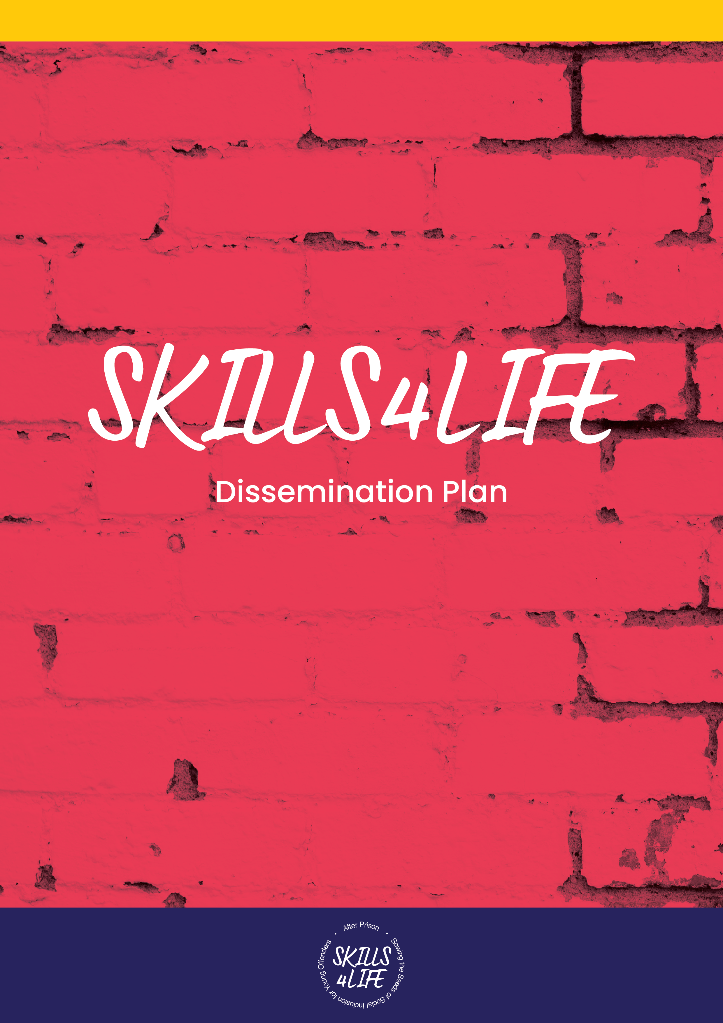

Skills for Life as education for young people in custodial settings: Developing the Innovative Curriculum
^{Howard League for Penal Reform}
University of Oxford, Keble College
^{13-14th September 2022}

Slide 42
What is Skills4Life?
Social Bonds and
Personal Relationships
Personal Empowerment
Life Skills
Planning for Life after Release
The Skills4Life (S4L) Project is a 26-month EU funded project with 4 countries in Europe (France, UK, Greece and Italy)
The aim of the project is to develop a comprehensive and bespoke curriculum to prepare young people for transition back in to the community.
The curriculum is split into four key areas:
These modules emerged from Phase 1 of the project which involved interviewing 80 young people

Slide 43
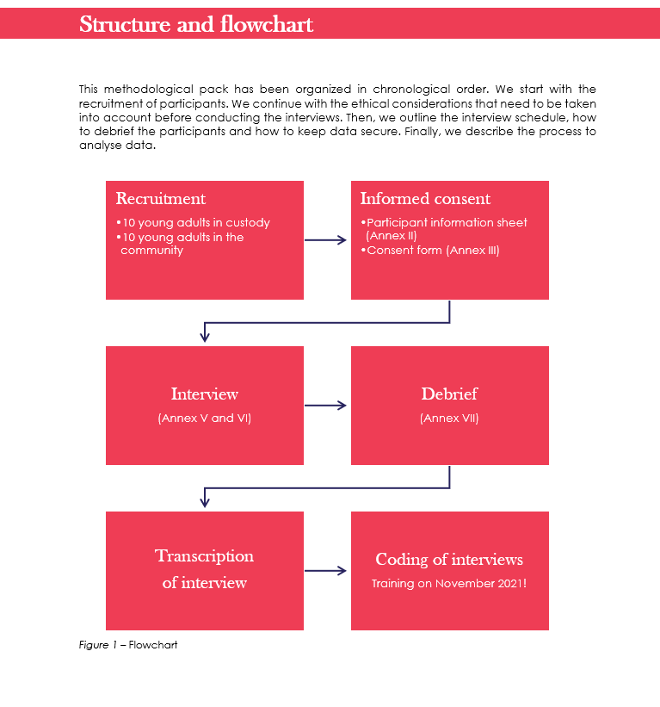
Phase 1 – data collection and analysis
The curriculum is informed by interview data from 80 young people from the UK, France, Italy and Greece.
Half were from custodial settings preparing for release and half who recently exited custodial settings.
We focused on previous educational experiences, as well as those inside settings to achieve a balanced view.
The curriculum content was designed using the results of that analysis
In doing so, the curriculum is informed by the experiences and needs of young people themselves.

Slide 44
Findings from Data sets 1 and 2 indicated…
Poor previous (mainstream) educational experiences (supporting previous research)
Self-Development skills are required
Decision-making skills support is needed
Employability (or future skills) needs a focus

Slide 45
Self Development skills
Self management
  anger management
  managing thinking
  Emotion regulation
Self-reflection
Relationship management skills
Help with motivation and mindset
Help with adapting to real life
Self-Development

Slide 46
Decision-making skills
The need for support in helping make decisions
Taking responsibility for decisions
Resisting peer pressure
Being able to recognise and then ask for help when needed
Help with having confidence to be yourself
Decision-making skills

Slide 47
Employability (future plan skills)
CV/Employability skills*
Vocational skills
Internet skills
Practical skills:
  Housing*
  Filling in forms*
  Finance*
Employability skills
Notes:
* Denotes specifically coming from those who recently left custodial settings

Slide 48
A key question: ‘If I was in charge…’
Ensure activities are purposeful and not random or aimless
Isolation does not work. Need skills to help manage being with others even if you do not get on. Its not real life to be separated
Sit down and plan futures with the young people
Serious courses/qualifications
Sports and physical activities
This all points to the request for a much more robust and rigorous education offer which we can emphasise in the final Output of S4L

Slide 49
Phase 2 Development of the Curriculum
Adeela at Werrington YOI
Transnational meeting in Saumur, France
Transnational meeting in Athens, Greece
Using the data from Phase 1, partners are currently designing the Curriculum.
The next phase is to train educators to deliver the curriculum followed by testing in settings across the partner countries. This begins in November 2022
We will be collating data from educators and young people on the effectiveness of the Curriculum during the pilot.

Slide 50
The Challenges
Educational Challenges
Transitory group
Wide variety of ability levels
Practical Challenges
Release dates
Institutional schedules
Age range
Educational experiences
Delivery structure
Continuity/buy-inn
Educator skills
How do we develop a curriculum that can be successful in a challenging secure environment with the diverse and transitionary nature of participants and educators?

Slide 51
Existing useful educational practice in custodial settings
This suggests that a custodial setting has an opportunity to engage young people with education and learning as the context of small class sizes and feeling more comfortable are areas necessary for learning to be possible (ahmed Shafi, 2020)
Smaller class sizes
Able to ask for help
Feeling more secure and comfortable to ask questions

Slide 52
Areas for improvement in education in custodial settings
No continuity
Need to be stretched and challenged
Need to get you to think about your future (career/job) and help you plan
Lots of different staff
Repetitive work
Staff duplicating work
Focussing on strengths
This is useful feedback for education departments of custodial settings – we can include in IO3

Slide 53
The main challenge
The key thing is going to be able develop an AGILE curriculum that:
Responds to the structures and routines of a secure setting
Has multiple entry points
Maintains a developmental approach
Maintains its integrity as a curriculum
The Pilot will help us in designing these practical aspects of the Curriculum.
The feedback from educators and young people will be essential in this.

Slide 54

Find Us:
For updates on the project, please follow our page at:
https://www.facebook.com/skills4lifeEU

Slide 55
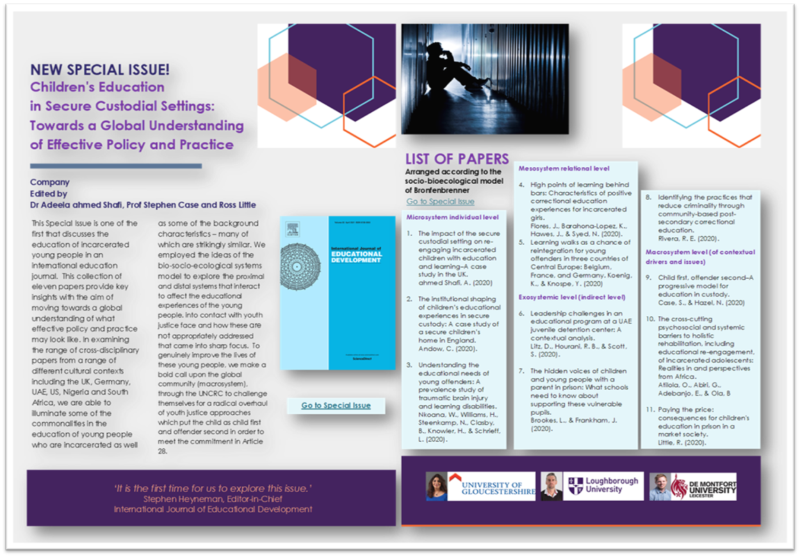

Slide 56
The contribution of this work to the education of children and young people in custodial settings
Combined, these works are aiming to mitigate against not only the impact of the youth justice system itself, but other inequalities and disadvantages so these young people have a better chance when re-entering society.
Collective knowledge and practice from diverse perspectives on youth justice from across Europe can contribute to a reframing and re-imagining of policy in this area, as shown by this international collection of works.

Slide 57

Some publications
ahmed Shafi, A. (2018). Researching young offenders: navigating methodological challenges and reframing ethical responsibilities. International Journal of Research & Method in Education, 1-15.
ahmed Shafi, A. (2018). Re-engaging young offenders with Education in the Secure Custodial Setting. In Gallard, D. Children and Their Education in Secure Accommodation: Interdisciplinary Perspectives of Education, Health and Youth Justice, p.266-297.
ahmed Shafi, A. (2019). The complexity of disengagement with education and learning: A case study of young offenders in a secure custodial setting in England. Journal of Education for Students Placed At Risk.
ahmed Shafi, A., 2020. The impact of the secure custodial setting on re-engaging incarcerated children with education and learning–A case study in the UK. International Journal of Educational Development, 76, p.102190.
ahmed Shafi, A., Little, R., & Case, S. (2021). Children’s education in secure custodial settings: Towards a global understanding of effective policy and practice. International Journal of Educational Development, 82, 102379.
Notes:
AS

Slide 58

Notes:
AS

