Slide 1
Reconceptualising Resilience: A Dynamic Interactive Model of Resilience for Educational Practice - in theory and in practice
ISPA Conference 7-10th July 2022
Leuven, Belgium
Rick Millican, Adeela ahmed Shafi, Sian Templeton, Tristan Middleton

Slide 2
Plan
Introduce the DIMoR and how it was developed
Illustrate how we have used the DIMoR as a lens for analysis within our own research linked to COVID-19
Invite expressions of interest in developing practical applications using the model
https://www.glos.ac.uk/content/reconsidering-resilience-in-education/
TrM

Slide 3
The Dynamic Interactive Model of Resilience (DIMoR)
Builds on existing models
Is dynamic, interactive and emergent
Recognises individual agency + interactions with other systems
TrM
Notes:
Resilience has recently been understood as dynamic; emerging as a result of reciprocal interactions between systems, whilst also being based on features within any given system be that human, institutional or organisational (ahmed Shafi et al. 2020). The importance of interpersonal relationships in helping students to manage change and adversity in a resilient way is well recognised (Conrad et al. 2021; Rodgers et al. 2020; Sun, Lin and Chung 2020; Ye et al. 2020; Zhang et al. 2021). These aspects of resilience have been conceptualised within the Dynamic and Interactive Model of Resilience (DIMoR) (ahmed Shafi et al. 2020a, 2020b) (see Figure 1 below). Within this model, reciprocal interactions are indicated not only on an interpersonal level, but also within and between wider systems surrounding the individual, which is highlighted as key for developing resilience. Important within DIMoR is the concept of individual agency and its impact on interactions with other individuals and also within and between the systems in which these interactions take place; the reciprocity of all these interactions being fundamental. Need to check if journal uses capitals for Figure / Table etc

Slide 4
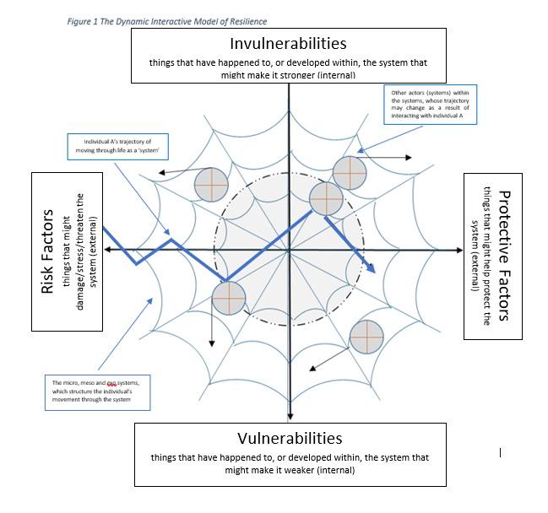
The DIMoR
TrM
Notes:
Building on the work of Ungar, we propose an adapted ecological model which retains Bronfenbrenner’s idea of nested systems but recognises the interaction or interconnectivity of these systems.
In the book we discuss Felix Guattari’s notion of different ecological registers (environment, social relations and human subjectivity) plus technology as proposed by Pringle. This leads to a socio-material understanding of how resilience is enhanced at society level, whether through laws, policies or physical aspects of different locations.
By superimposing this web-like structure on the two axes described above, the DIMoR takes account of both the systems around the individual as well as the individual’s own risk-protective/vulnerability-invulnerability matrix. An interaction of all these is what shapes the emergent property of resilience (represented by the dotted lines).

Slide 5
Theoretical underpinnings
Daniel, Wassell & Gilligan (1999)
Risk and protective factors alongside vulnerability/ resilience dimension
Bronfenbrenner (1979)
Bio-Ecological Model
Ungar (2013)
Downes (2017)
Social-Ecological Model
Spatial relations and individual agency
TrM
Notes:
Michael Ungar and colleagues (2013) made the connection between Bronfenbrenner’s (1979) seminal ecological model of human development and the parallel advances centred around a social-ecological interpretation of resilience. Equifinality referred to how in particular circumstances, one system or another can become more influential to the outcome. The differential impact notion suggests that protective factors can have a differential impact in different contexts and time. Cultural moderation….
Paul Downes (2017) proposed a further model of resilience, which attempted to reconceptualise foundational assumptions of resilience, by proposing a cross-cultural, spatial systems domain that took account of individual agency in resilience trajectories. Downes drew upon both Bronfenbrenner and Ungar’s models of resilience and, builds on a re-interpretation of Levi-Strauss’s (1973) ideas of cross- cultural observations of contrasts between concentric and diametric spatial systems.

Slide 6
Developing the Model
Resilience
Adversity
Protective factors
Vulnerability
Daniel, Wassell & Gilligan (1999)
AS
Notes:
Protective Factors: Factors which buffer the effects of adversity
Resilience: Normal development under difficult circumstances
Adversity: Life events or circumstances which pose a threat to healthy development.
Vulnerability: Characteristics of the child, their family circle and wider community which might threaten healthy development.
Brigid et al The resilience dimension is used to refer to intrinsic qualities of an individual; these are personal qualities of the individual or the ‘nature of the person’ such as their personal traits and behaviours; having a secure attachment; well-developed intrapersonal and interpersonal skills; being socially included and problem solving skills amongst others
The vulnerability dimension is defined by ‘susceptibility to negative developmental outcomes after exposure to risk factors such as perinatal stress, poverty, parental psychopathology, and disruptions of their family unit.’ (Werner, 1993, p 503). It therefore refers to the more immediate systems around the child which might threaten optimal development such as having an isolated parent, lack of community support and poor housing.
The final dimension identified for the understanding of individual differences is that of protective, (such as a positive school experience), and adverse (i.e. parental depression, domestic violence) environments. This dimension covers extrinsic factors and is therefore located at the outer ecological levels of family and wider community
The basic principles of Bronfenbrenner’s bio-ecological model emphasised the importance of context on human development. Its major feature included the concept of a range of nested systems centring around any individual or organism.

Slide 7
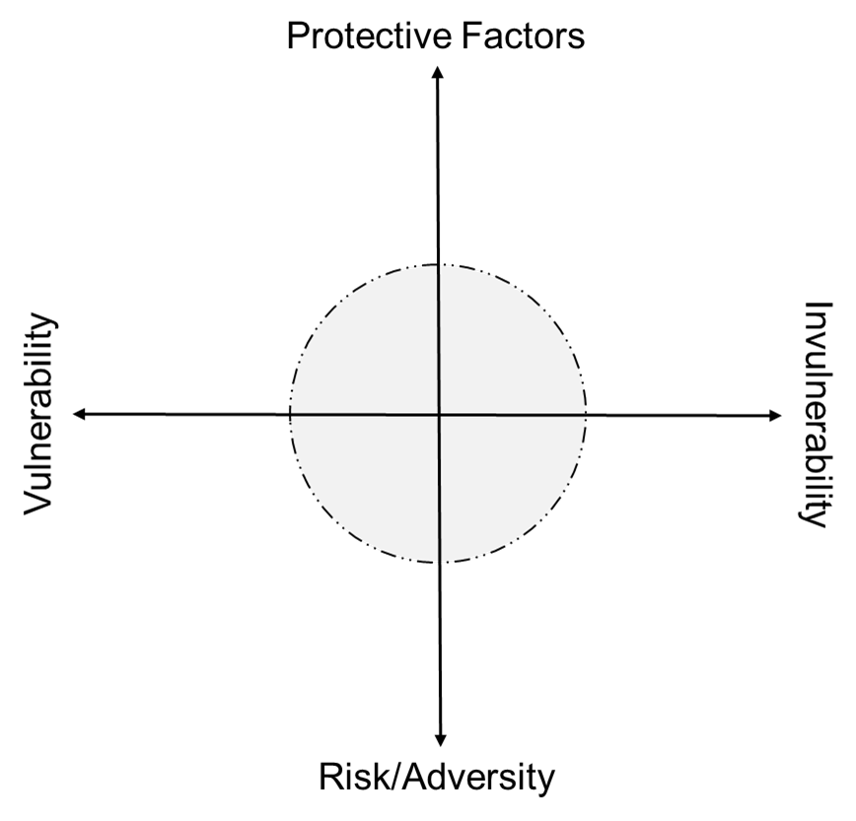
Developing the Model
Invulnerabilities
Risk factors
Protective factors
Vulnerabilities
AS
Notes:
Resilience is a domain and context specific emergent property which changes shape and structure within this risk-protective factors; vulnerability-invulnerability framework.
(If deemed necessary we could also add: This is based on the principles of equifinality, differential impact and cultural moderation – but hopefully somebody else has said all that.)

Slide 8
Developing the Model
Invulnerabilities
Risk factors
Protective factors
Vulnerabilities
AS
Notes:
Resilience is a domain and context specific emergent property which changes shape and structure within this risk-protective factors; vulnerability-invulnerability framework.
(If deemed necessary we could also add: This is based on the principles of equifinality, differential impact and cultural moderation – but hopefully somebody else has said all that.)

Slide 9
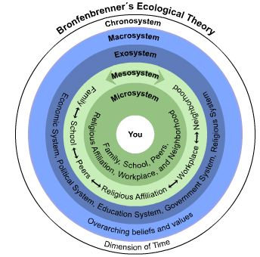
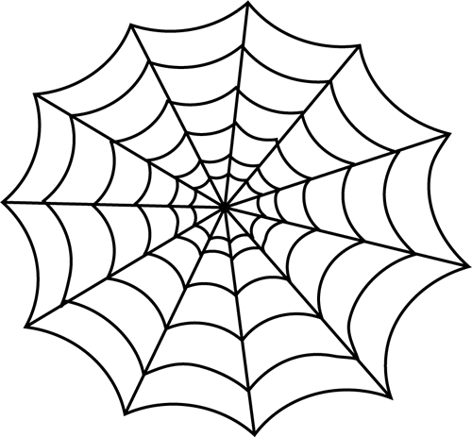
Bronfenbrenner (1979)
AS

Slide 10
Developing the Model
An individual as a system
AS
Notes:
Lastly, our illustration of the model includes examples of individuals moving through it. This is based on an idea of Hannah Arendt’s…
Firstly, here’s an individual with their own internal axes or matrix as described above.

Slide 11
Developing the Model
Individual on its life course
AS
Notes:
Our individual is in the world, developing or becoming who they are going to be – this process is denoted by the arrow.

Slide 12
Developing the Model
Interacting with other systems
AS
Notes:
As we act in the world, our process of becoming is confounded by the actions of others.
As social creatures, it’s inevitable that this will occur; we can’t expect to chart our own straight path of development without it being influenced by the trajectories of others.

Slide 13
Developing the Model
Being influenced by and influencing other systems
AS
Notes:
So individuals meet, not necessarily physically; their ideas may meet and change our own.

Slide 14
Developing the Model
Reflecting complexity theory (Morin, 2018)
Planned and incidental interactions with unpredictable outcomes
(Arendt, 2018)
AS
Notes:
And so the course of our development changes…

Slide 15
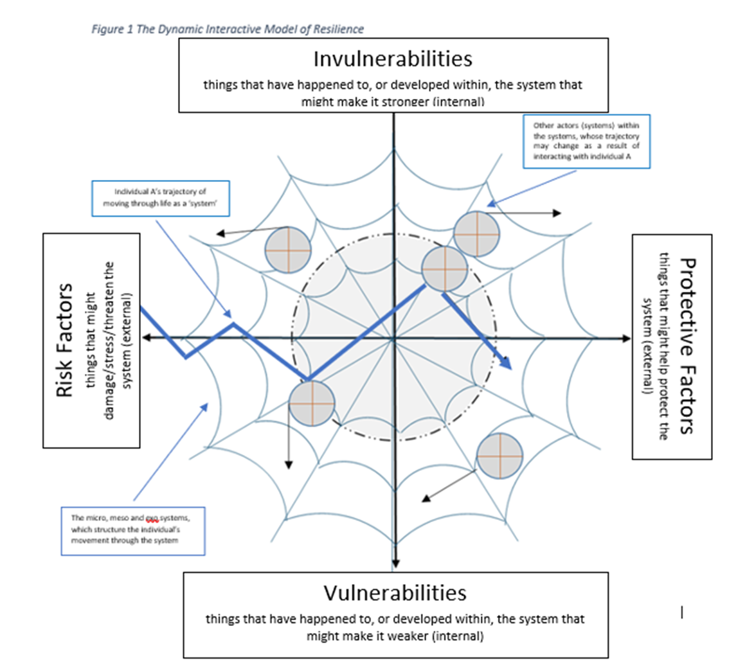
The dynamic interactive model
AS
Notes:
…all within a socio-material web of conditions that interact with and modify our own risks and vulnerabilities.
And here we see the full dynamic, interactive model of resilience.

Slide 16
The DIMoR in practice
Learning in a Disrupted Environment: Exploring Higher Education Student Resilience using the Dynamic Interactive Model of Resilience
The overarching purpose of this research was to explore how, and to what extent, student resilience was impacted during the disruptions caused by the pandemic; what helped them to cope and also to discover lessons for future practice.
(ahmed Shafi, A., Middleton, T., Millican, R., Templeton, S. and Hill, J.
(under review) Studies in Higher Education.)
ST

Slide 17
The study
N = 434 students (UG and PG) using an online survey.
N = 23 follow up interviews
Data analysis used the lens provided by the DIMoR
ST

Slide 18
How did we use the DIMoR?
Early theme development​​
Inter-coder reliability ​​
Broad themes and subthemes developed​​ across dataset
DIMoR used to analyse coded data, identifying resilience factors - including dynamic risk-protective factors and vulnerabilities-invulnerabilities
Used with qualitative data only from both surveys and interviews.
4 stages of analysis
ST

Slide 19
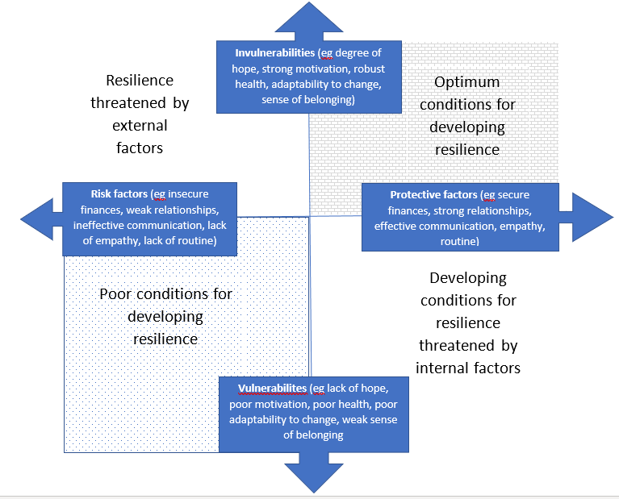
Value of DIMoR as a tool for analysis.
RM

Slide 20
What does the DIMoR offer?
A lens to:
Emphasise the complex and dynamic nature of resilience
Demonstrate how protective and risk factors can be different for individuals
Support the perspective that resilience is not solely held within the individual
Encourage a holistic analysis of the system, which gives due consideration to individual factors and their interaction with surrounding systems
Position resilience as an emergent quality relating to the proximal and distal factors within the environment
Illustrate how factors can be both risks and protectors
RM
Notes:
Demonstrate

Slide 21
Next steps
Develop a DIMoR tool for systematic analysis of system resilience in practice
Invite offers of partners to collaborate
RM

Slide 22
Thank you for listening
Questions?
Expressions of interest: please contact ashafi@glos.ac.uk, tmiddleton1@glos.ac.uk, rmillican@glos.ac.uk, stempleton@glos.ac.uk
RM

Slide 23
References
ahmed Shafi, A., Hatley, J., Middleton, T., Millican, R. and Templeton, S. (2018) 'The role of assessment feedback in developing academic buoyancy', Assessment & Evaluation in Higher Education, 43(3), pp.415-427.
Arendt, H. (2018) The human condition (2nd ed.). University of Chicago Press.
Bronfenbrenner, U. (1979) The ecology of human development. Harvard university press.
Daniel, B., Wassell, S. & Gilligan, R. (1999) Child Development for Child Care and Protection Workers. London: Jessica Kingsley Publishers
Downes, P. (2017) 'Extended Paper: Reconceptualising Foundational Assumptions of Resilience: A Cross-Cultural, Spatial Systems Domain of Relevance for Agency and Phenomenology in Resilience', International Journal of Emotional Education, 9(1), pp.99-120.
Morin, E (2008) Introduction to the Complete Thought, Gedisa: Barcelona
Ungar, M. (2013) 'Resilience, trauma, context, and culture', Trauma, violence, & abuse, 14(3), pp.255-266.

