Slide 1
Tristan Middleton
School of Education and Humanities: University of Gloucestershire, UK.
ENSEC 2022
Authentic Inquiry: How the RENYO Erasmus+ project identified the importance of relational aspects of education for learners in secure youth justice institutions

Slide 2
The RENYO Project
Re-engaging young offenders with education and learning
This paper presents the research from a 3 year EU funded Erasmus project with 4 countries in Europe.
The aim was to develop tailored training and materials working with secure custodial settings within the partner countries in Italy, Spain, Germany and the UK, which would be usable beyond the life of the project.

Slide 3

Background
School dropout is high with almost 9 out of 10 young offenders having dropped out of school for 6 months or more before being incarcerated (Little, 2015)
High prevalence of special educational needs 23% compared with 2-3% in the general population of young people (Hughes, 2012)
Young offenders described as disengaged from education and learning and educational attainment is low

Slide 4
Aim: To re-engage young people in custodial settings with education and learning using the principles of authentic inquiry
University of Gloucestershire, CESIE (Palermo, Italy), FHD University (Dresden, Germany), Fundacion Diagrama (Spain), Jearni Professional Learning (UK)
We did this through developing ‘train the trainer’ materials with our partners for sustainable implementation in secure settings in the partner country settings.
By training the trainers we aimed to embed this approach in the custodial settings.

Slide 5
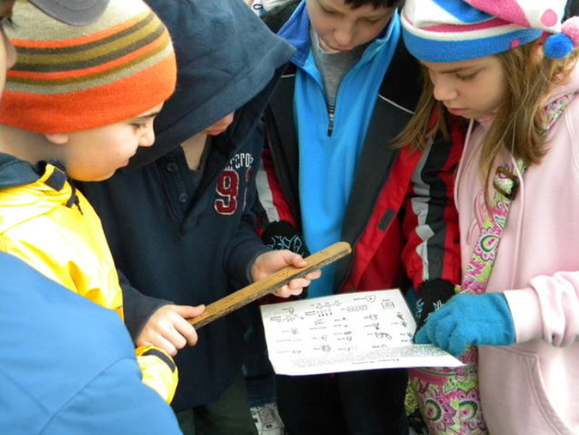
The Methodology: Authentic Inquiry
Authentic Inquiry –
‘personalised learning which is rooted in student experience and choice. It is shaped by the learner’s interest, driven by her curiosity and purpose, yet is capable of supporting the delivery of the valued outcomes of a publicly accountable curriculum ’
(Deakin Crick 2009 p. 73)

Slide 6
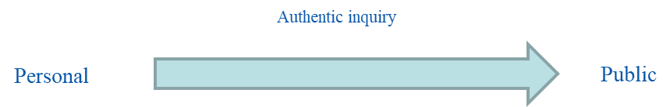
The Authentic Inquiry process:
8 stages in authentic inquiry. It starts with something that is authentic to the individual and moves through a range of stages to where the authentic also becomes something more public. Like a journey from the personal to the public
Notes:
TRM

Slide 7
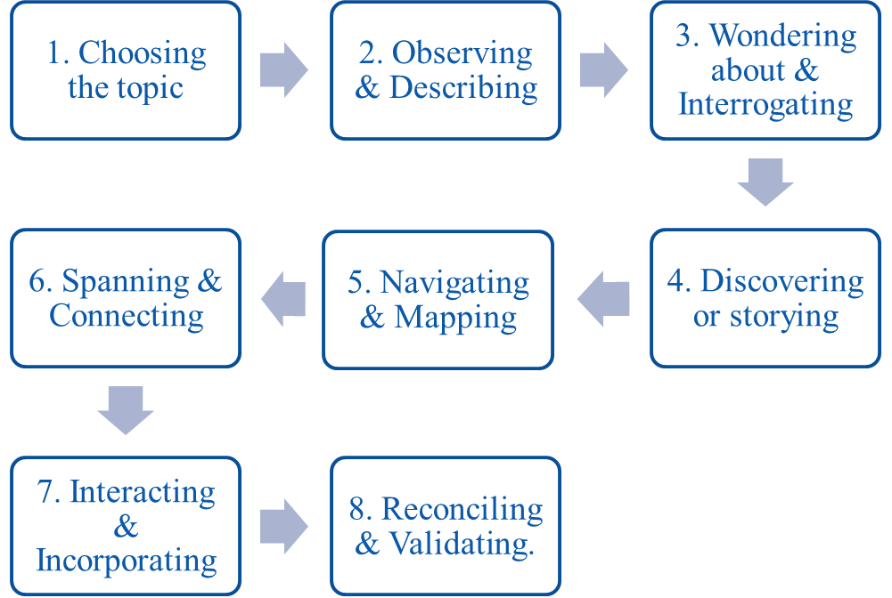
Authentic Inquiry –
8 steps
Click here to watch the video
or
https://youtu.be/7F3FUfGLXN0

Slide 8
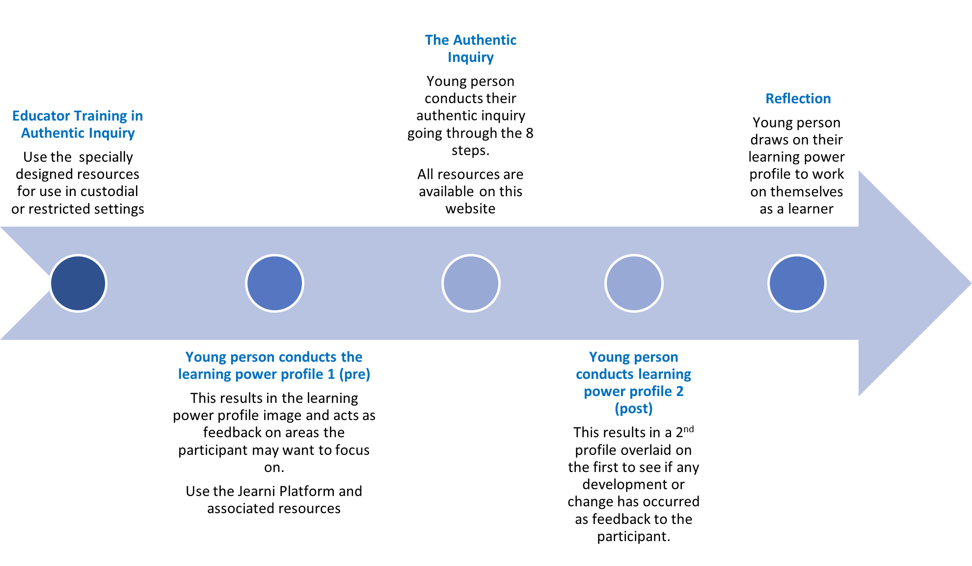
The Project

Slide 9
Research Questions
What were the behavioural, cognitive and affective impacts of using authentic inquiry on the young people in custodial settings?
Over the period of the project, did the young peoples’ learning skills and attributes change as reflected in the learning journey profile?
What are transnational educators’ perceptions of the effectiveness of AI as a pedagogical tool for ‘re-engaging’ and supporting young people in prison?
How have transnational educators’ understanding of pedagogical approaches changed as a result of using authentic inquiry?

Slide 10
Quantitative data collected from educators (n=100) and young people (n=60)
Qualitative data collected from educators (n=12) and young people (n=20) as well as the quantitative data from the 2nd survey

Slide 11
Early Findings
Early findings are showing that:
Educators felt that the authentic inquiry process was transformative for them as educators and that undergoing the process themselves was key in helping them to embed it into their practice
More time and commitment from leadership from settings was needed to help embed this approach into the setting and enable the full opportunities to the young people that the approach afforded
It was possible to re-engage young people with education and learning using the authentic inquiry process.
This needed to be supported by appropriate time and consistency with the educator/mentor
We are at the time of this presentation still analysing the quantitative data as well as still working on the qualitative data

Slide 12
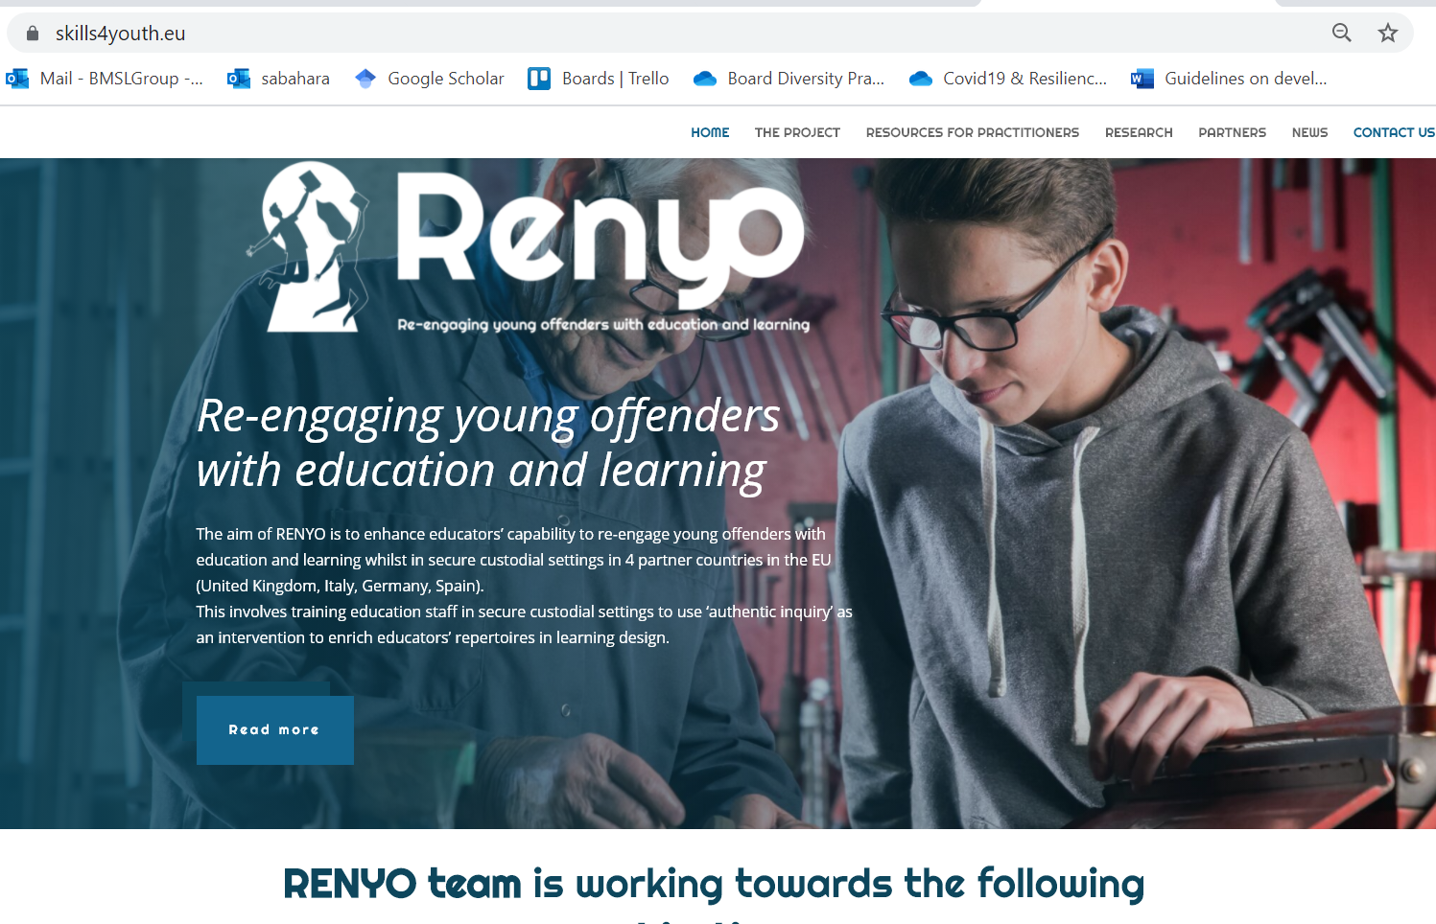
Renyo Website
You may download all resources and outputs from Renyo from this website as they become available.
All are freely available and free of charge.
www.skills4youth.eu/

Slide 13
References
Crick, R. D. (2009). Inquiry-based learning: reconciling the personal with the public in a democratic and archaeological pedagogy. Curriculum Journal, 20(1), 73–92. https://doi.org/10.1080/09585170902764021
Deakin Crick, R., Huang, S., Ahmed Shafi, A., & Goldspink, C. (2015). Developing resilient agency in learning: The internal structure of learning power. British Journal of Educational Studies, 63(2), 121-160
Lanskey, C. (2015). Up or down and out? A systemic analysis of young people's educational pathways in the youth justice system in England and
Wales. International Journal of Inclusive Education, 19(6), 568-582.

Slide 14
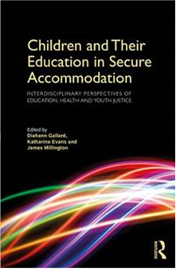
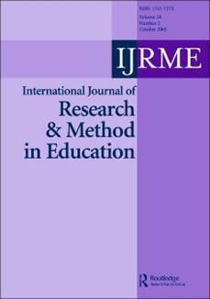
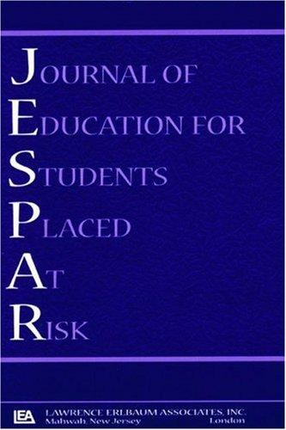

Further Reading
ahmed Shafi, A. (2018). Researching young offenders: navigating methodological challenges and reframing ethical responsibilities. International Journal of Research & Method in Education, 1-15.
ahmed Shafi, A. (2018). Re-engaging young offenders with Education in the Secure Custodial Setting. In Gallard, D. Children and Their Education in Secure Accommodation: Interdisciplinary Perspectives of Education, Health and Youth Justice, p.266-297.
ahmed Shafi, A. (2019). The complexity of disengagement with education and learning: A case study of young offenders in a secure custodial setting in England. Journal of Education for Students Placed At Risk.
Middleton, T. & Kay, L. (2019) Using an Inclusive Approach to Reduce School Exclusion: A Practitioner’s Handbook. Abingdon, Oxon: nasen Spotlight / Routledge
Notes:
AS

Slide 15
