Slide 1
Educating for a ‘Rounder Sense of Purpose’ Lessons learned from practice: assessing ESD competences
Paul Vare & Rick Millican
University of Gloucestershire

Slide 2
Plan
The Rounder Sense of Purpose (RSP) framework
Assessment: results of a review of student portfolios
New assessment tools
Tensions

Slide 3
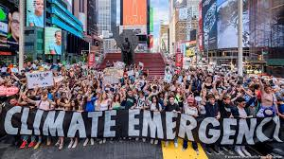

Slide 4
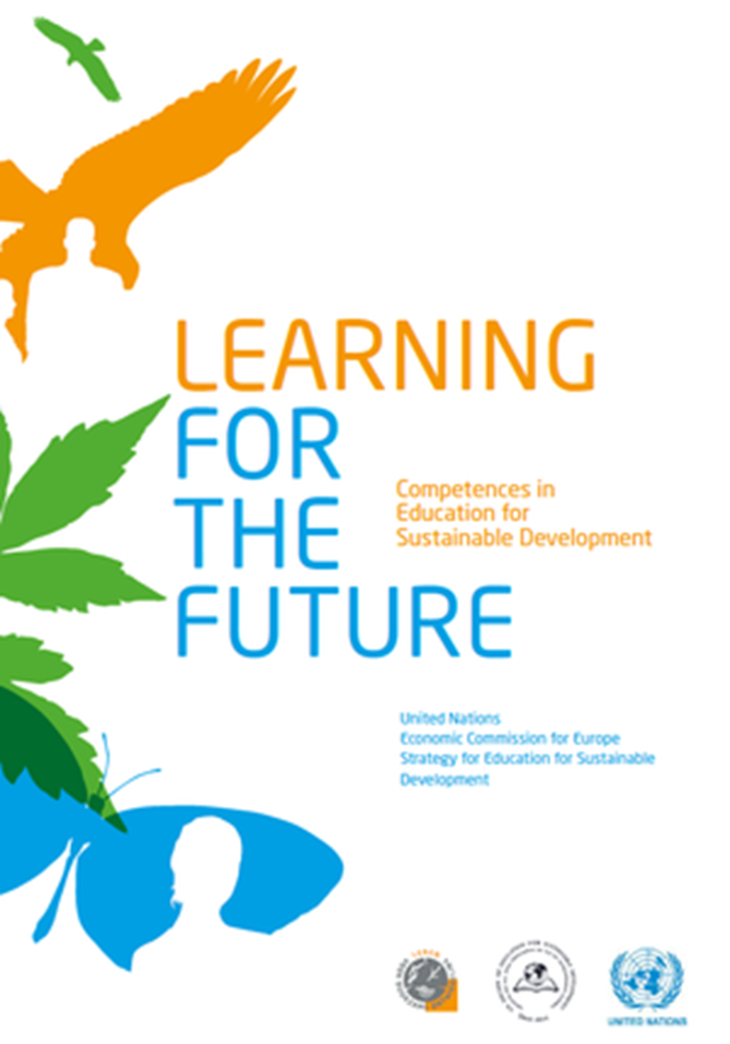
Competences in Education for Sustainable Development (ESD)
The United Nations Economic Commission for Europe (UNECE)

Slide 5
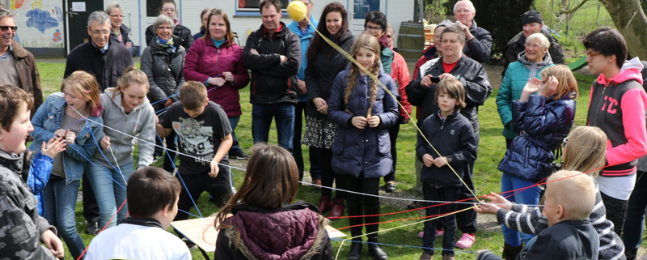
A Rounder Sense of Purpose
Funded by Erasmus+

Slide 6
Thinking Holistically | Envisioning Change | Achieving Transformation
Integration:
Systems The educator helps learners to develop an understanding of the world as an interconnected whole and to look for connections across our social and natural environment and consider the consequences of actions. | Futures The educator helps learners to explore alternative possibilities for the future and to use these to consider how behaviours might need to change. | Participation The educator helps learners to contribute to changes that will support sustainable development.
Involvement:
Attentiveness The educator helps learners to understand fundamentally unsustainable aspects of our society and the way it is developing and increases their awareness of the urgent need for change. | Empathy The educator helps learners to respond to their feelings and emotions and those of others as well as developing an emotional connection to the natural world. | Values The educator develops an awareness among learners of how beliefs and values underpin actions and how values need to be negotiated and reconciled.
Practice:
Transdisciplinarity The educator helps learners to act collaboratively both within and outside of their own discipline, role, perspectives and values. | Creativity The educator encourages creative thinking and flexibility within their learners. | Action The educator helps the learners to take action in a proactive and considered manner.
Reflexivity:
Criticality The educator helps learners to evaluate critically the relevance and reliability of assertions, sources, models and theories. | Responsibility The educator helps learners to reflect on their own actions, act transparently and to accept personal responsibility for their work. | Decisiveness The educator helps the learners to act in a cautious and timely manner even in situations of uncertainty.

Slide 7
Learning Outcomes: The educator helps learners to…
1.1 Understand the root causes of unsustainable development and that sustainable development is an evolving concept
1.2 Understand key characteristics of complex systems such as living environments, human communities and economic systems, including concepts such as interdependencies, non-linearity, self-organisation and emergence
1.3 Apply different viewpoints and frames when looking at systems, e.g. different scales, boundaries perspectives and connections

Slide 8
Underpinning Components for the educator In order to achieve the above Learning Outcomes the educator should be able to:
UC1 Identify the level of complexity and abstraction to be tackled with students and use techniques such as concept mapping, systems analysis, games, or structured research-based activities to make complexity accessible to them
UC1.1a Identify and discuss causes of unsustainability, be they environmental, social, cultural, political or economic
UC1.1b Understand and critique different models of sustainability
UC1.2a Explain the difference between systematic and systemic thinking
UC1.2b Understand and apply boundaries and frames to systems, look for interconnections and emergence and recognise feedback and unpredictability
UC1.2c Understand the difference between linear and circular economies
UC1.3a Analyse issues and contexts from different perspectives and from different levels of detail
UC1.3b Use different forms of thinking and logic to aid analysis, e.g. linear vs systemic approaches, scientific method and artistic interpretation

Slide 9
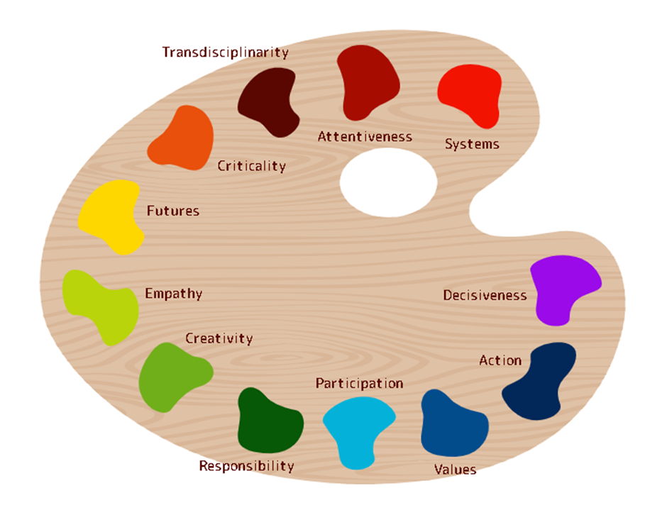

Slide 11
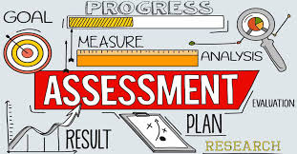

Slide 12
A review of students portfolios demonstrated evidence of:
Understanding of the competences and the issues they raise
Action taken on the basis of the competences and
Reflection on the competences themselves and on their own engagement with them

Slide 13
Understanding of:
the competence itself
the connections between the competence and existing knowledge and experience, other RSP competences, and existing professional priorities
the implications for change to professional and/or personal behaviours.

Slide 14
Action that:
communicates ideas contained in the competence to others
implements changes to personal and/or professional life
seeks evidence of the impact that their actions are having.

Slide 15
Reflection on:
the development of their own ideas
the concepts and issues involved and how these need to be questioned and problematised
any lessons learned as a consequence of their actions.

Slide 16
Portfolio of evidence – a checklist
(Example response from a ‘typical’ student)
Student name:
Aspect | Systems | Futures | Participation | Attentiveness | Empathy | Values | Transdisciplinarity | Creativity | Action | Criticality | Responsibility | Decisiveness
U1 | x | x |  | x | x | x |  | x | x | x | x | x
U2 | x |  | x | x |  |  | x |  |  |  | x | x
U3 |  | x |  | x |  | x |  | x | x |  |  | x
A1 | x |  | x | x | x |  |  |  |  | x | x | x
A2 |  |  | x | x | x | x | x | x |  |  | x
A3 |  | x |  |  | x |  |  |  | x | x
R1 |  | x |  |  |  | x | x | x | x |  | x | x
R2 |  |  | x | x |  | x |  |  |  | x
R3 | x |  |  |  |  |  | x |  | x | x |  | x

Slide 17
Portfolio Checklist
This record of evidence is a ‘gateway’ process…
…i.e. students should register at least four examples of evidence for each competence and for each evidence type in order to be considered for grading.
Beyond this it does NOT contribute to an individual student’s grade.
Using this data to grade students would encourage meaningless performativity; however, it can be used to evaluate the impact of the course itself.

Slide 18
RSP Marking Grid
 | <40 E | 40-49 D | 50-59 C | 60 – 69 B | > 70 A
Understanding of:
the competences | Gives inaccurate, mistaken or unclear explanations | Can describe competences and activities as presented | Can describe and present competences and activities in own way | Shows clear and deep understanding of the competences and activities | Shows nuanced and sophisticated understanding of the competences and activities
links between competences and existing knowledge and experience, other RSP competences and professional context | Shows no evidence of holistic thinking | Shows a little evidence of making connections between competences, experience, previous learning and/or professional context | Shows evidence of making connections between competences, experience, previous learning and/or professional context | Makes confident connections between competences, experience, learning from elsewhere and/or professional context | Makes interesting and insightful connections between competences, experience, learning from elsewhere and/or professional contexts
the implications for change (including of professional and personal behaviours) | Shows no evidence of envisioning opportunities for change | Shows some evidence of spotting opportunities to make a change | Shows evidence of spotting opportunities to make a change | Good at spotting opportunities to make a change | Creative and confident at spotting opportunities for change
Action taken:
communication with others | Shows no evidence of communicating with others about SD issues | Shows some evidence of communicating with others about SD issues | Shows evidence of communicating with others about SD issues | Shows evidence of effective communication with others about SD issues | Shows evidence of creative and confident communication with others about SD issues
implementation of changes in personal life (e.g. to lifestyle) and/or in professional life (e.g. to teaching) | Shows little or no evidence of change to personal and/or professional life | Shows some evidence of change to personal and/or professional life | Shows evidence of change to personal and/or professional life with some rationale | Shows evidence of much change to personal and/or professional life with solid rationale | Shows evidence of deep and meaningful change to personal and/or professional life with strong and convincing rationale
search for evidence of the impact of actions taken | Shows no evidence of assessing impact of actions taken | Shows some evidence of assessing impact of actions taken | Shows evidence of assessing impact of actions taken | Shows evidence of an active search for the impact of actions taken | Shows evidence of effective assessment and analysis of the impact of actions taken
Reflection on:
the development of own ideas | Shows little or no evidence of developing ideas | Shows some evidence of developing ideas | Shows evidence of developing ideas | Shows evidence of transformed thinking | Shows evidence of deep consideration of how ideas have developed
concepts and issues and the questions that need asking | Shows little or no evidence of questioning | Shows some evidence of questioning and analysis | Shows evidence of questioning and analysis | Shows evidence of deep questioning and analysis | Shows evidence of profound, probing and insightful questioning and analysis
learning from actions taken | Shows little or no learning from actions taken | Shows some evidence of learning from actions taken | Shows evidence of learning from actions taken | Shows evidence of deep learning from actions taken | Shows evidence of profound and insightful learning from actions taken

Slide 19
Tensions that emerged:
Breadth, depth & detail
Usability & accessibility
Embedding competences in existing programme
Creating a discrete course
Teaching & assessing competences separately
Teaching & assessing them as combined & overlapping
Direct assessment of competences in action
Indirect assessment using portfolios of evidence
Assessing actual change for sustainability
Assessing evidence of capability to make changes

Slide 20
These and other issues are form the basis of a forthcoming paper plus a book in the Springer series on the UN Sustainable Development Goals:
More detail of the project, materials and related research can be found on the project website: https://www.aroundersenseofpurpose.eu/uk/home

Slide 21
Any questions?
Contact:
Paul Vare: pvare@glos.ac.uk
Rick Millican: rmillican@glos.ac.uk
Thank you!

