Slide 1
A Rounder Sense of Purpose
Developing competences in Education for Sustainable Development (ESD)
Paul Vare & Rick Millican
School of Education, University of Gloucestershire

Slide 2
Plan
The context and a rationale for A Rounder Sense of Purpose (RSP)
Overview of the framework of competencies
Piloting the framework
Ways it might be used
Next steps…

Slide 3






The Six RSP Partners
University of Gloucestershire (UK)
Frederick University (Nicosia, Cyprus)
Hungarian Research Teachers’ Association (Budapest, Hungary)
Italian Association for Sustainability Science (Rome, Italy)
Duurzame PABO (Oostburg, The Netherlands)
Tallinn University (Tallinn, Estonia)

Slide 4
Purpose of education?
Education is the engine of our economy, it is the foundation of our culture, and it’s an essential preparation for adult life …
…But perhaps most important of all, we must ensure that more people have the knowledge and skills they need to succeed in a demanding economy.
Nick Gibb MP Schools Minister, 2015
https://www.gov.uk/government/speeches/the-purpose-of-education

Slide 5
"You take the top five PISA nations and say 'Here are the top five world problems' and ask whether those nations have anything to offer in solving those problems, and there is a desperate mismatch"
(Prof. Stephen Heppell, cited in T.H.E. 2011 )

Slide 6
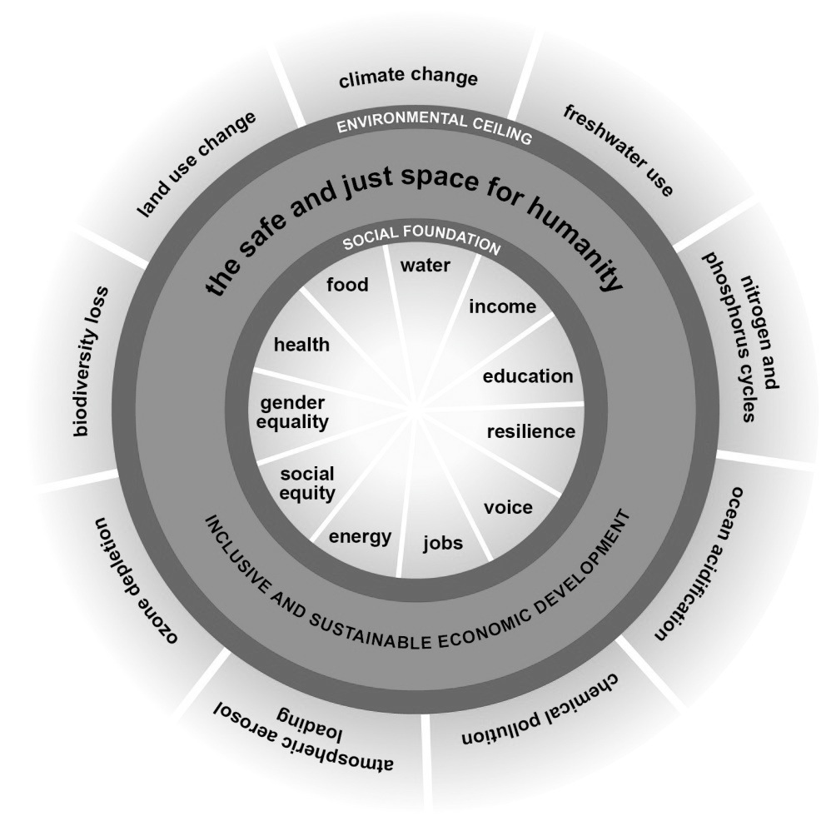
(Raworth (2013)
Notes:
We are overshooting the planet’s limits to sustain a safe, humanly habitable environment while still failing to address key social concerns adequately.
Sustainable development might be ‘covered’ by Geography teachers but it is tackled (or not) by everyone.
It’s our choice. We either choose to ignore these issues as irrelevant, and thus we remain part of the problem, or we engage in whatever capacity we find ourselves, seeing the connections between our own work and wider concerns.
For teacher educators this distinction is magnified immensely.

Slide 7
So?
“If still more education is to save us, it would have to be education of a different kind…”
(Schumacher in Sterling 2001)
“Moving towards sustainability may involve a fundamental reassessment of the purposes, content and processes of education…”
(Huckle 2006)

Slide 9
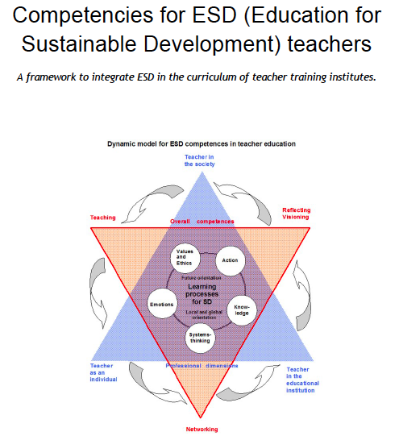

Slide 10
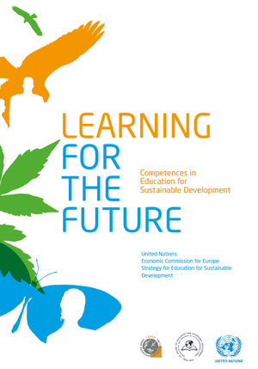

Slide 12
We ‘distilled’ the 39 UNECE competences
Refining, filtering, extracting the essential elements to define 12 competences
(Also using Wiek et al 2011 & Roorda 2012)

Slide 13
The resulting 12 competences
Systems thinking
Futures thinking
Participation
Attentiveness
Empathy
Engagement
Transdisciplinarity
Innovation
Action
Criticality
Responsibility
Decisiveness

Slide 14
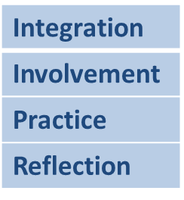
Arranged in a grid, with
3 columns
4 rows

Slide 15
Each with an explanatory descriptor

Slide 16
Thinking Holistically | Envisioning Change | Achieving Transformation
Integration:
Systems The educator helps learners to develop an understanding of the world as an interconnected whole and to look for connections across our social and natural worlds and consider the consequences of our actions. | Futures The educator helps learners to explore alternative possibilities for the future and to use these to consider how our behaviours might need to change. | Participation The educator contributes towards system level changes that will support sustainable development and develops their learners’ ability to do the same.
Involvement:
Attentiveness The educator alerts learners to fundamentally unsustainable aspects of our society and the way it is developing and conveys the urgent need for change. | Empathy The educator is considerate of the emotional impact of the learning process on their learners and develops their self-awareness and their awareness of others. | Engagement The educator works responsively and inclusively with others, remaining aware of their personal beliefs and values and develops their learners’ ability to do the same.
Practice:
Transdisciplinarity The educator acts collaboratively both within and outside of their own discipline, role, perspectives and values and develops their learners’ ability to do the same. | Innovation The educator takes a flexible and creative approach using real world contexts wherever possible and encourages creativity within their learners. | Action The educator takes action in a proactive, considered and systematic manner action and develops their learners’ ability to do the same.
Reflection:
Criticality The educator critically evaluates the relevance and reliability of assertions, sources, models and theories and develops their learners’ ability to do the same. | Responsibility The educator acts transparently and accepts personal responsibility for their work and develops their learners’ ability to do the same. | Decisiveness The educator acts in a cautious and timely manner even in situations of uncertainty and develops their learners’ ability to do the same.

Slide 17
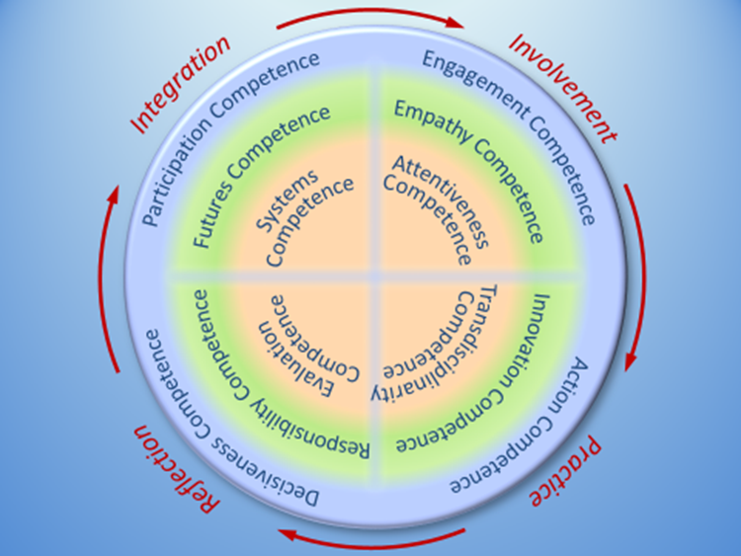

Slide 18
“As soon as you start to teach one of the competences, you inevitably touch on the other eleven.”
(Teacher in The Netherlands)

Slide 19
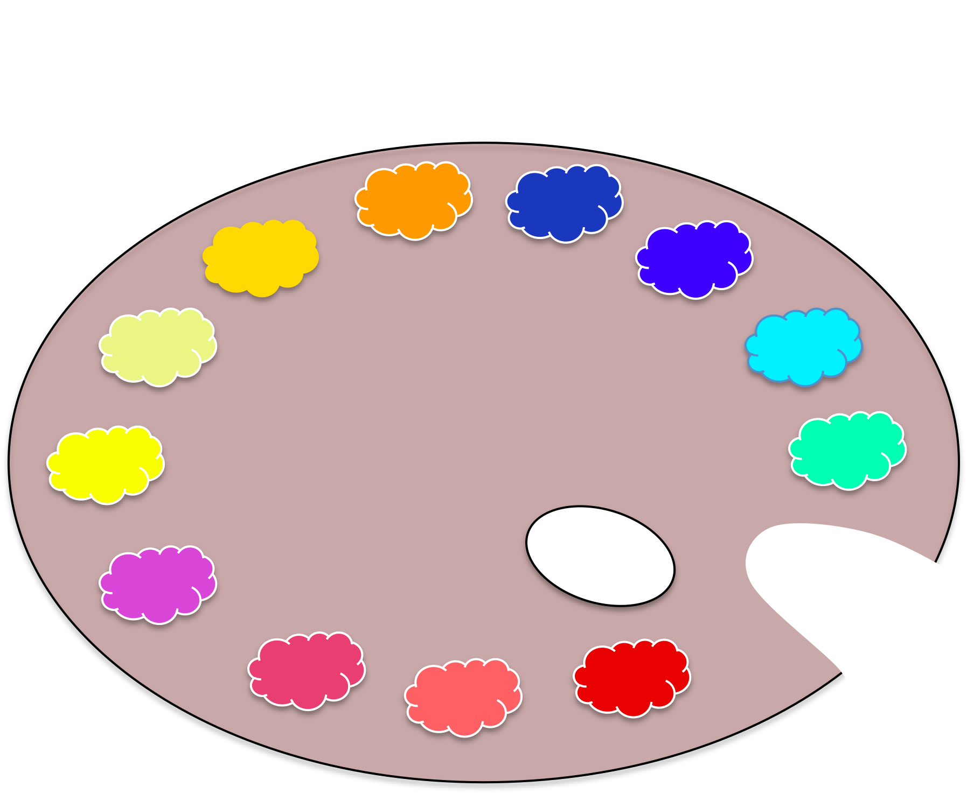
The RSP
Pallet

Slide 21
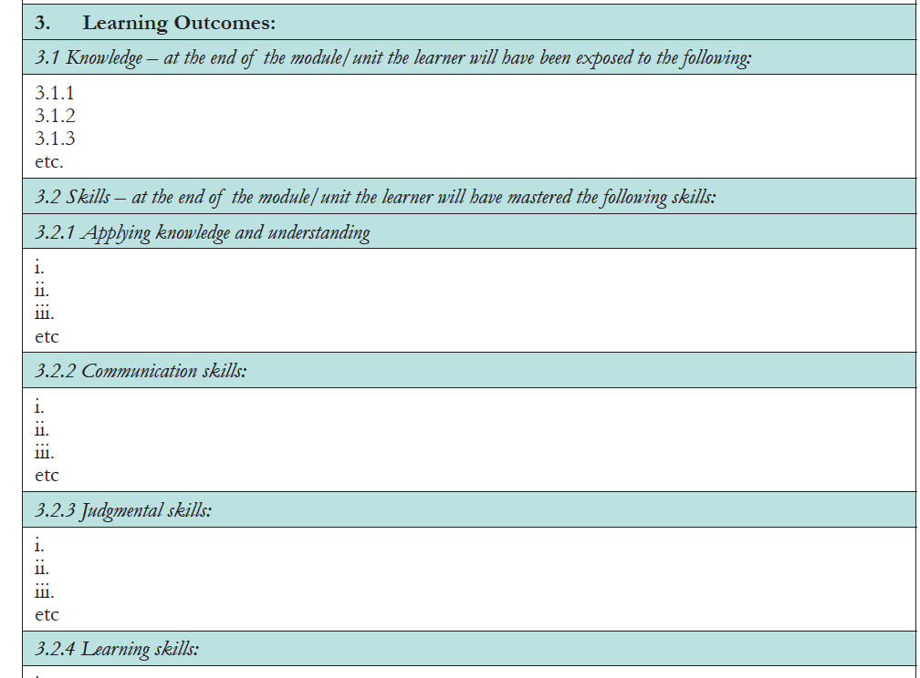
But how to assess the learning?
This is one approach
The atomisation of learning

Slide 22
An example:
From the Achieving Transformation set:
Action
The educator focuses on the development of learners’ critical thinking skills and helps them to take considered actions in their own context
Learning objectives The educator…
Places the learners and their development at the centre of the education process, supporting them to meet new challenges and building on their experience and feedback
Applies a learner focused approach to engage learners in democratic processes
Provides opportunities for learners to develop their agency

Slide 23
(e.g. from Futures)
Underpinning Components In order to achieve the above Learning Objectives the educator should be able to: | Connections with the Learning Objectives of this competence
UC 5.1a can imagine a number of different future scenarios and consider whether they are sustainable | 5.1
UC5.1b understand how the world might change as we project into the future and how these changes might be considered from different perspectives. | 5.1
UC5.2a can see how changes that take place are linked to past actions and evolve over time. | 5.2
UC5.2b can analyse and look for causes of change from different perspectives | 5.2
UC5.3a can think creatively about possibilities for the future and critique suggestions | 5.3
UC5.3b can share and debate ideas, suggestions and worldviews. | 5.3

Slide 24
Example Activities
Title | My vision of the future (Activity 2)
Technique used (e.g. research, simulation, debate) | Discussion
Aim of activity | To help students imagine positive alternative sustainable futures
Connection with underpinning components (from same competence) | UC 5.1a can imagine a number of different future scenarios and consider whether they are sustainable
 | UC5.1b understand how the world might change as we project into the future and how these changes might be considered from different perspectives.
Connection with underpinning components (from other competences) | (To be completed when all templates are filled)
Short description (10 lines max) | Close your eyes and sit in silence – relax. Now listen for 10-15 minutes while someone asks you to imagine yourself in 30 years time but imagine it is a positive future. Tell the class/group that they should think of themselves as the age that they are today but the year is 20xx. Now, with a series of pre-planned statements and questions, take them through the process of waking up, asking details about what their bed is like, what they have for breakfast, the clothes they wear (and where they bought them). Ask them to think about the work they might be doing or the school they might be attending; what job might they hope to do? How do they travel? How do they talk to friends and connect with family? What are they planning to do that evening? Allow plenty of long pauses between each question so people have time to imagine the details and think about how it feels, sounds, tastes, smells. After a final long pause ask the group to open their eyes and share with their neighbour or small group, the things they imagined or envisioned. Give each pair/small group a sheet of flip-chart paper and marker pens and ask them to illustrate their ideas so they can share with the wider group. After sharing and now back in pairs/groups, think about the first steps that you will need to take in order to start the journey towards that positive future. NB This can be a very emotional experience for some people. Be sensitive to the impact it can have and be sure that everyone has the support they need when they 'come back' to the present.

Slide 25
Piloting RSP in Gloucestershire
Offered to Level 5 undergraduates
  BEd
  BA Education
12 sessions (a 2-hour session on each competence)
For a University of Gloucestershire Certificate + added to Higher Education Achievement Record (HEAR)

Slide 26
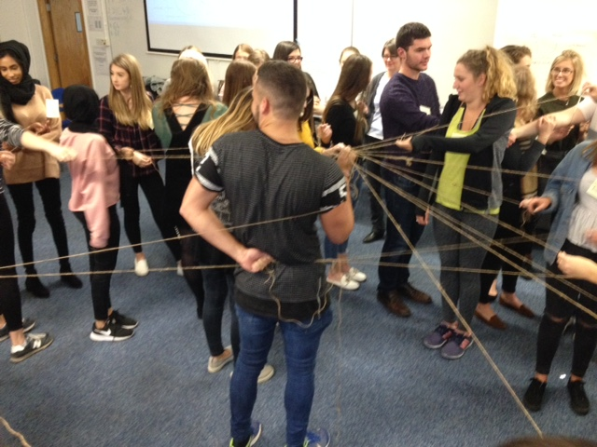
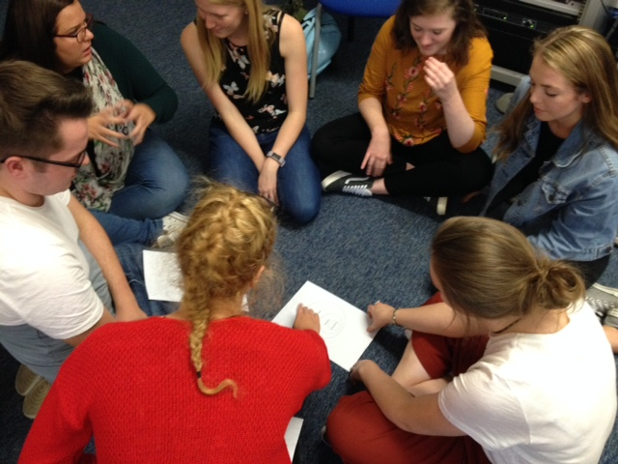

Slide 27
At any academic ‘Level’ we suggest three stages of achievement
Stage 1 | Participation in a given programme
Stage 2 | Demonstrate engagement with each of the competences in practice.
Stage 3 | Show either: How you have brought about change in others and/or in a place of work or A series of critical reflections on the ESD competence framework.

Slide 28
How could it be used?
A framework guide to embed into existing programmes
An off-the-shelf course with training materials for others to use
A bespoke course
A qualification

Slide 29
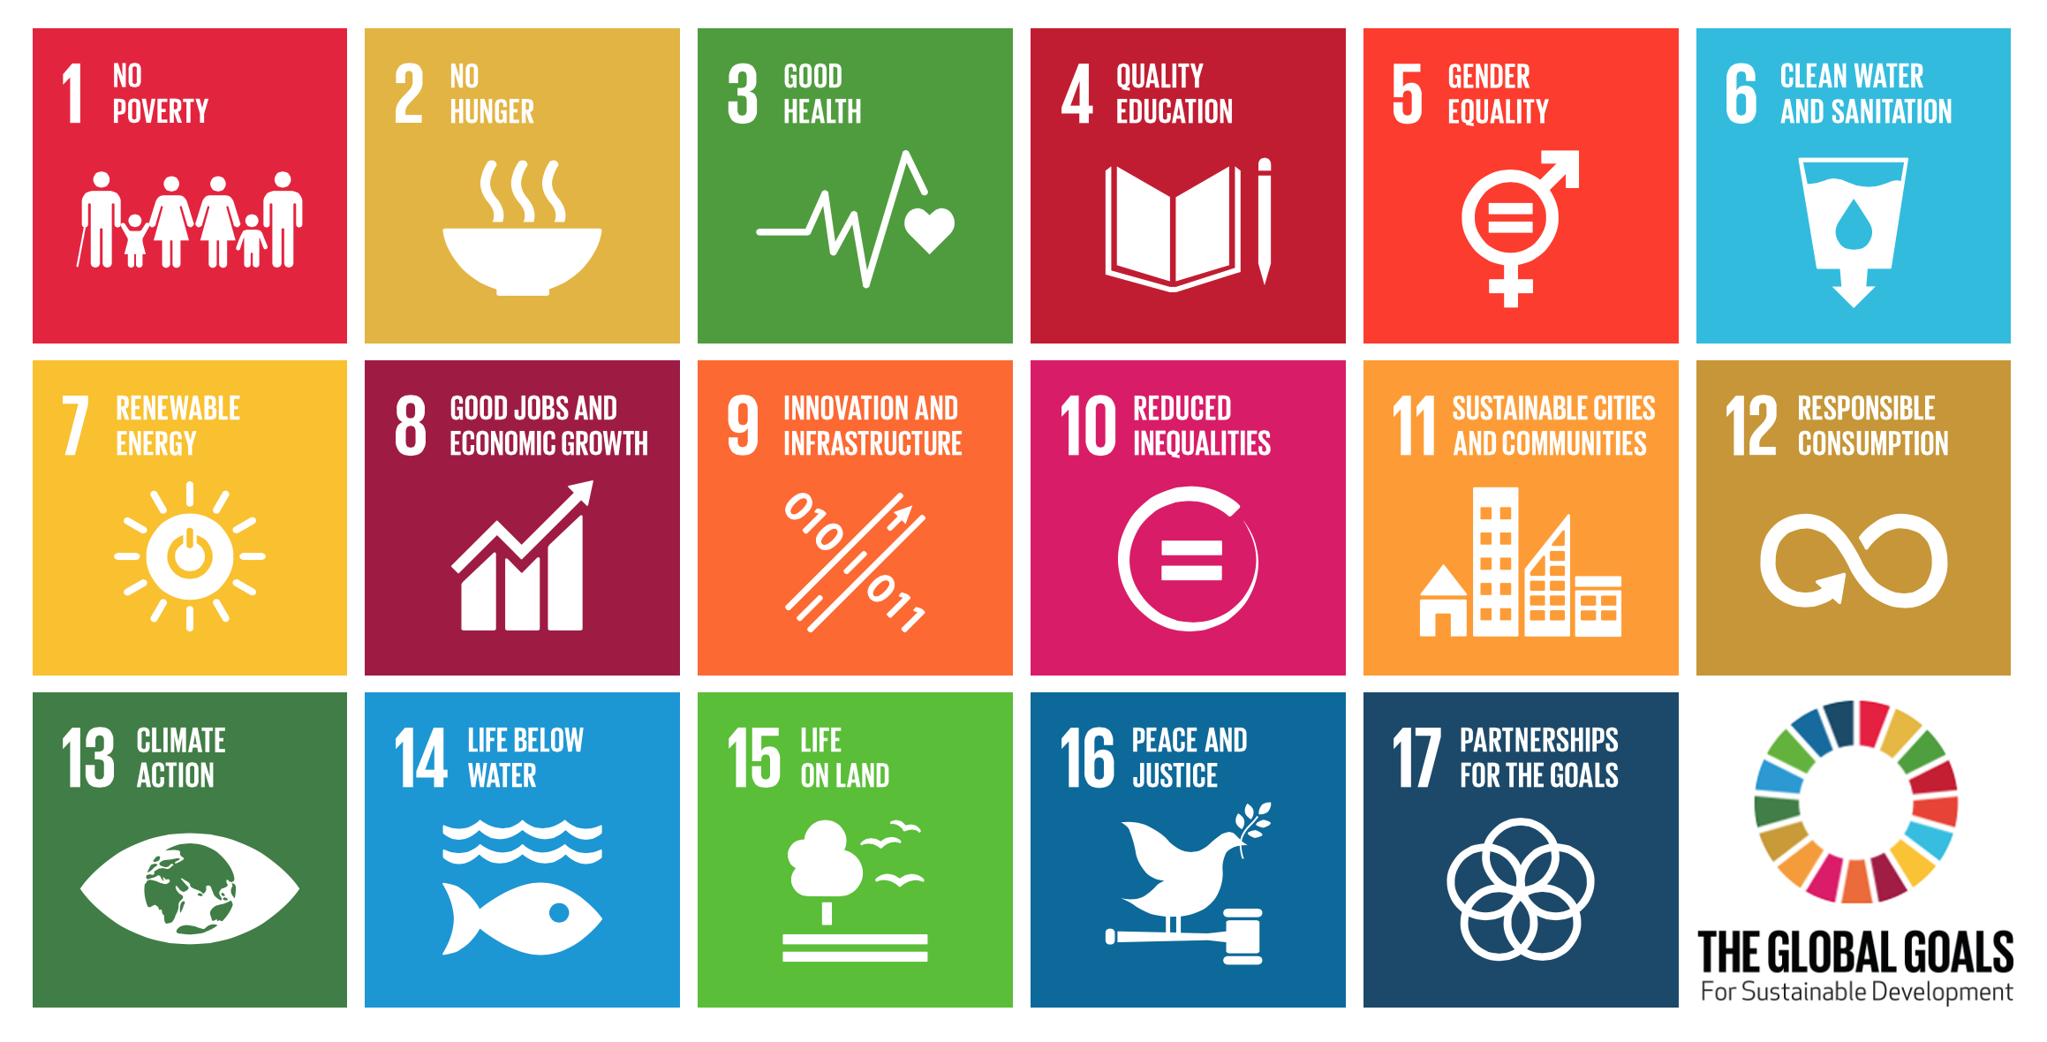
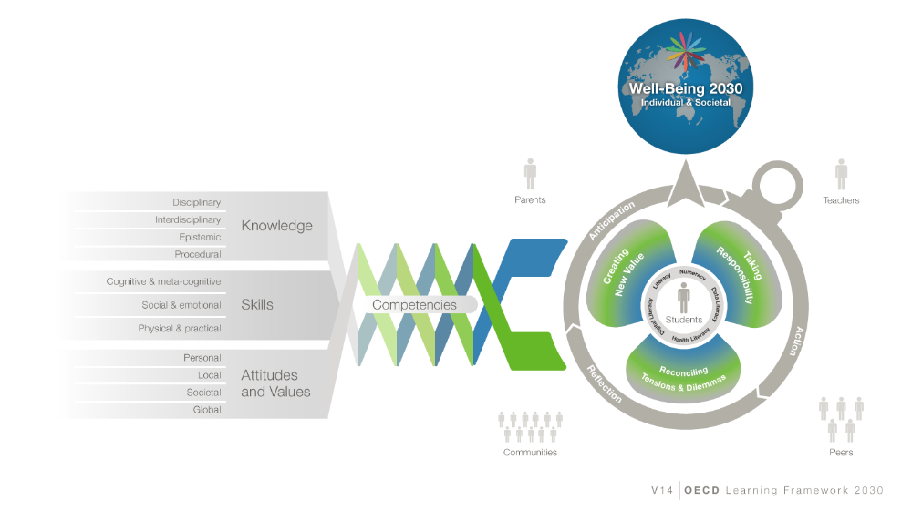
Next?
RSP2?
Alignment with OECD’s
E2030 framework?

Slide 30
Thank you!
Many thanks for listening and for your interest
If you have any ideas, comments or suggestions, please chat to us later or contact us at:
  pvare@glos.ac.uk
  rmillican@glos.ac.uk

