Slide 1
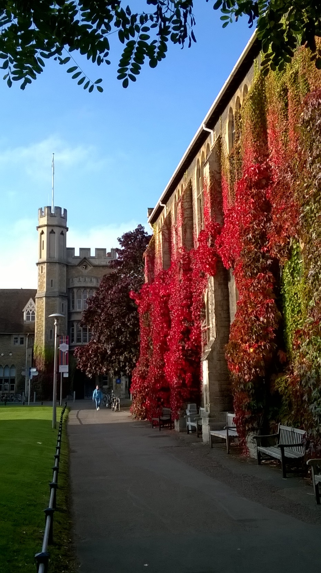

A Rounder Sense of Purpose: Developing a framework of educator competences in ESD
Dr Paul Vare
University of Gloucestershire
Carpathian Convention Seminar
on Education for Sustainable Development
16-18 April 2019, Budapest

Slide 2
Plan
- Introduction
A Rounder Sense of Purpose – project and framework
Examples of activities
A word on assessment
Some closing thoughts

Slide 3
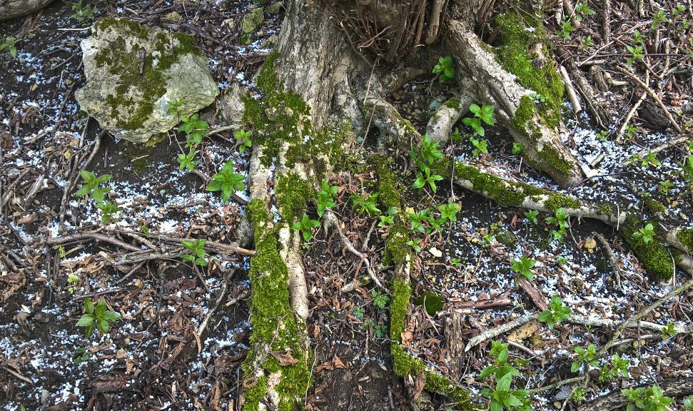
Notes:
We’re only here a short while – better make the most of it.

Slide 4
Introduction

Slide 5


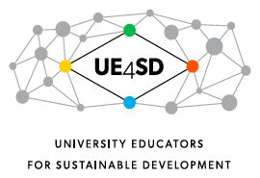





University of Gloucestershire
The Environmental Association for Universities and Colleges

Slide 6
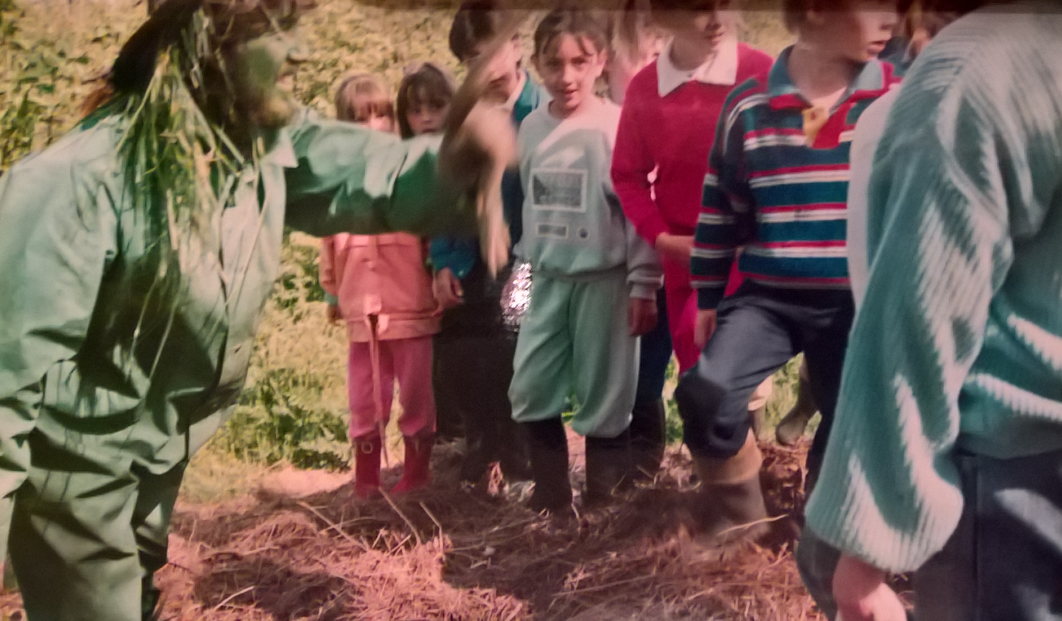
Leicester, 1987

Slide 7
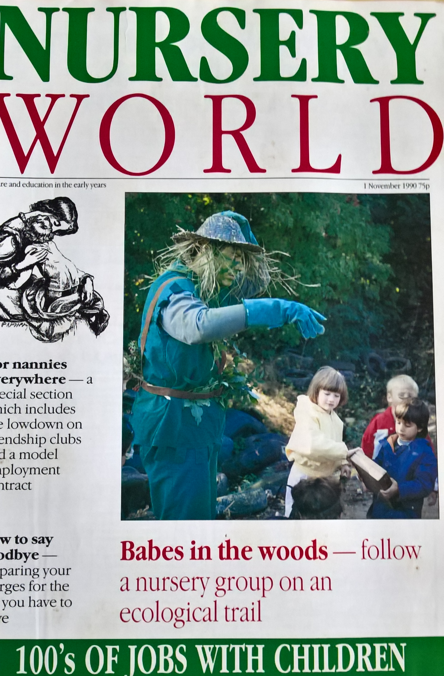
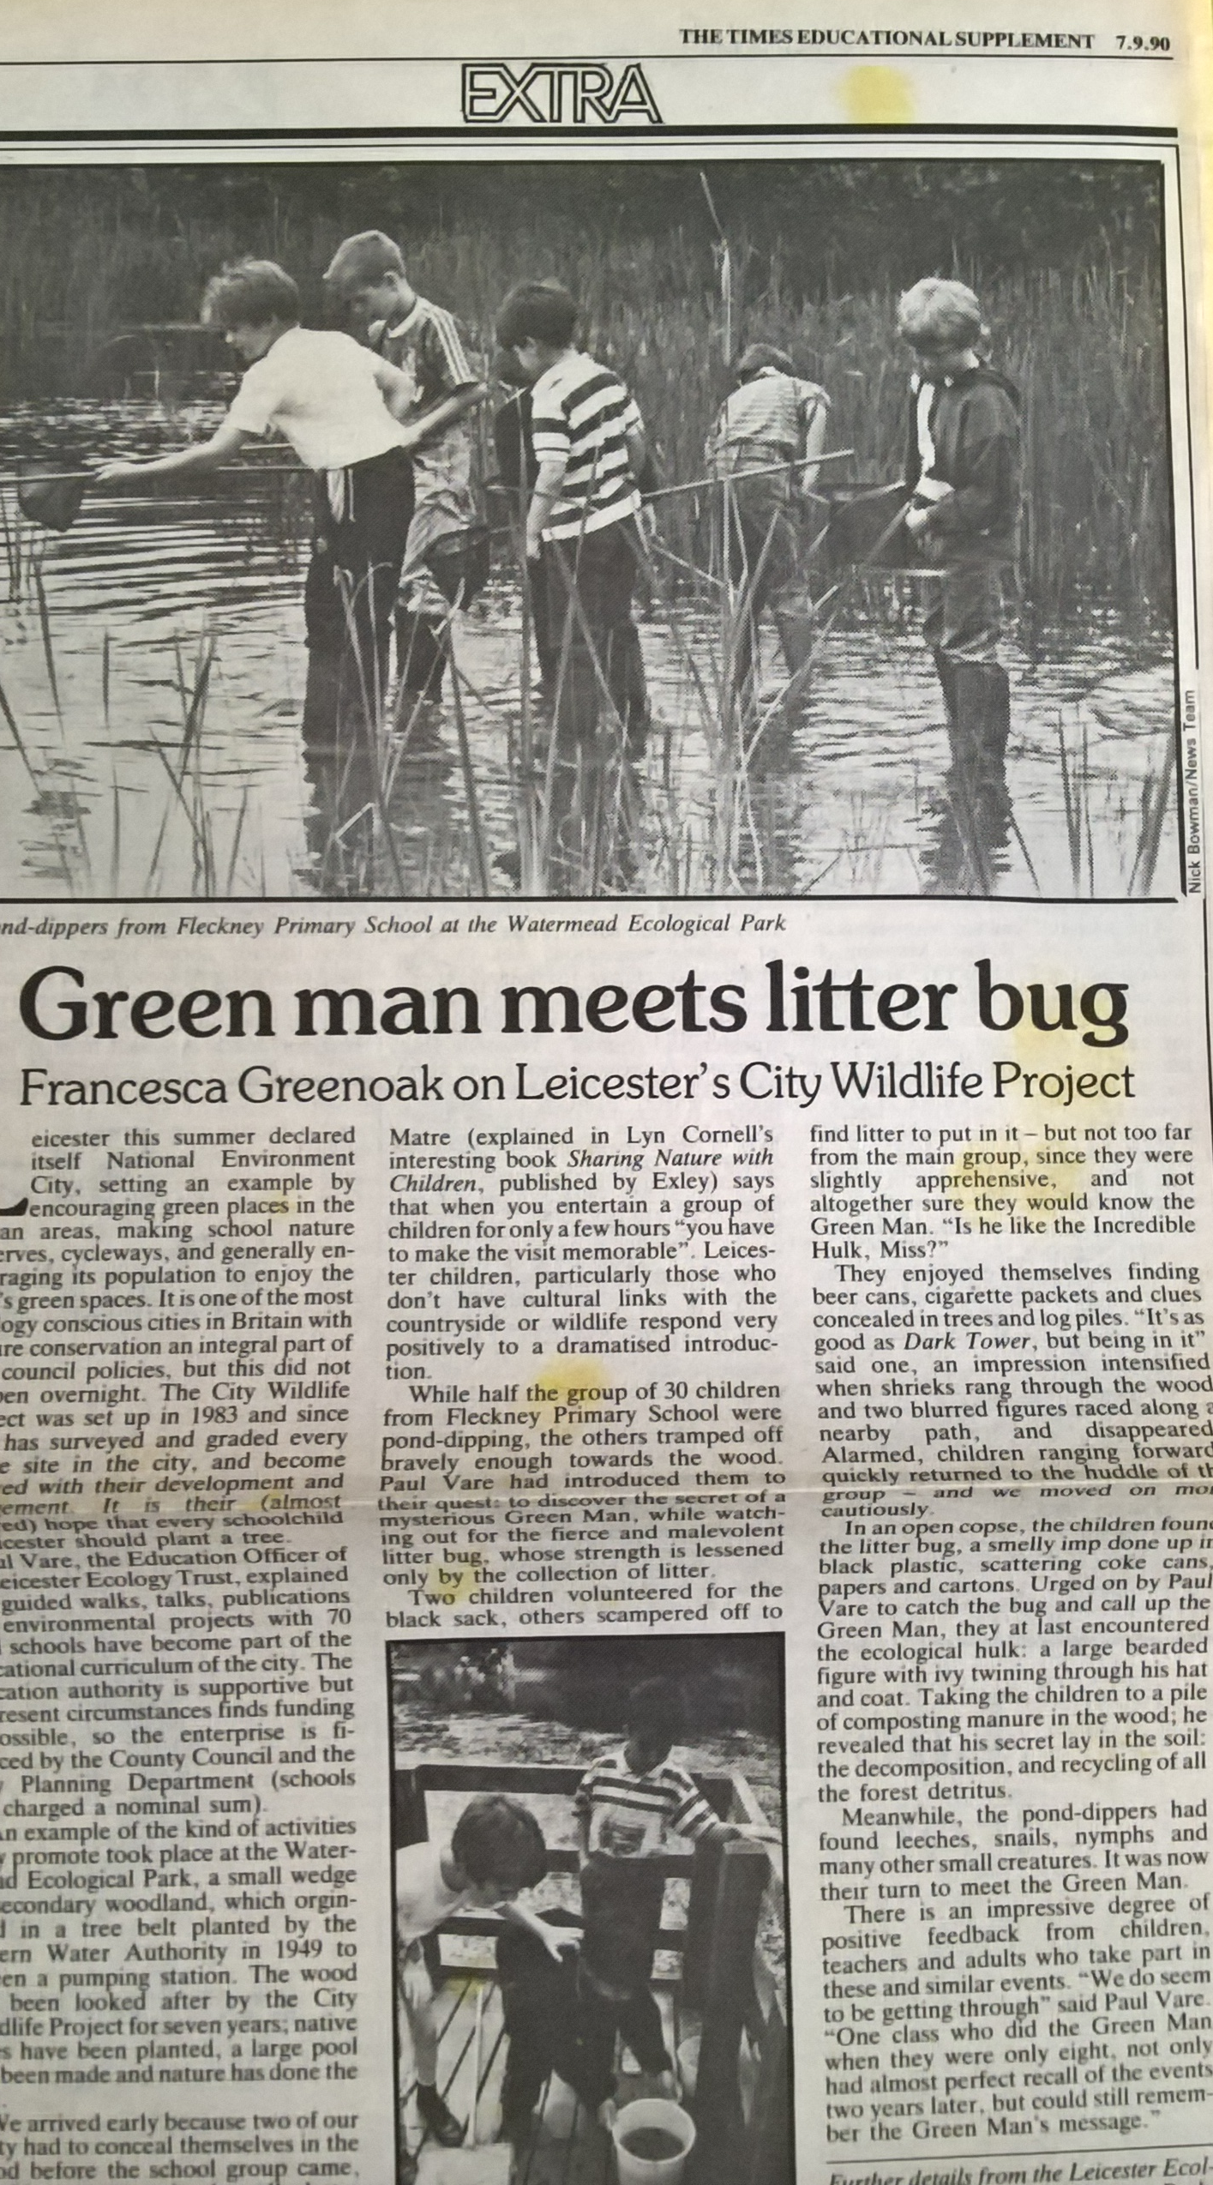

Slide 8
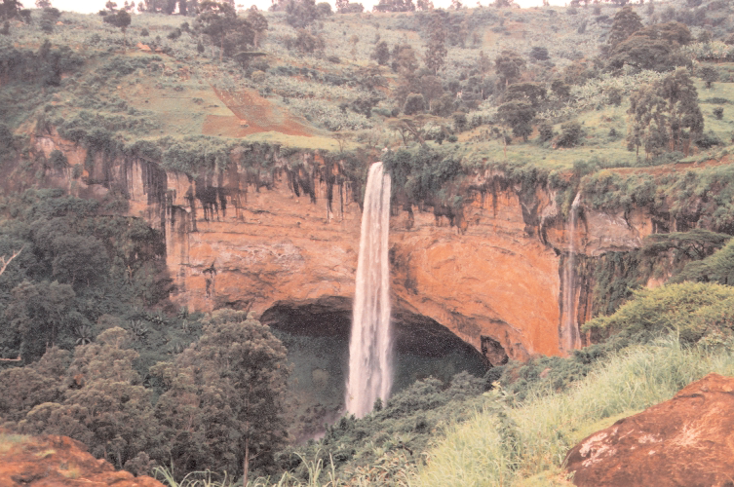

Slide 9
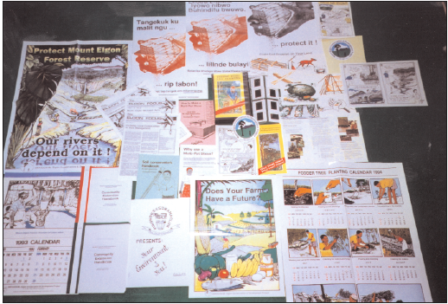
From this…

Slide 10
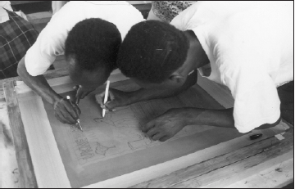
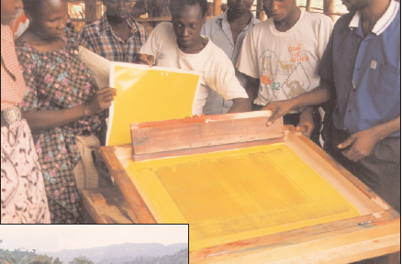
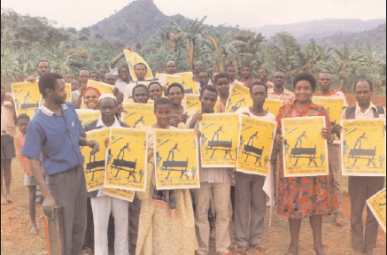
To this…

Slide 11
A Rounder Sense of Purpose
Educator competences for a sustainable world
The project and framework

Slide 12









RSP Phase I (2015-18)
RSP Phase II (2018-21)

Slide 13
RSP Phase I (2015-18)
RSP Phase II (2018-21)

Slide 14
RSP Phase I (2015-18)
RSP Phase II (2018-21)

Slide 15
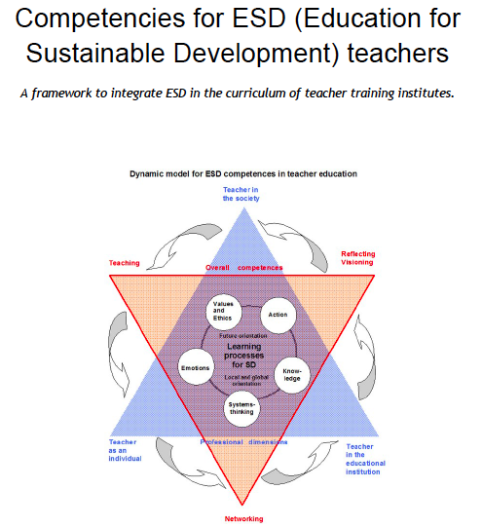
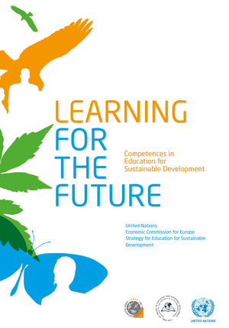
The United Nations Economic Commission for Europe (UNECE 2012)
Defined 39 ‘competences’.
(ENSI-CSCT 2008)

Slide 16
Holistic Approach
We ‘distilled’ the 39 UNECE competences
Refining, filtering, extracting the essential elements to define 12 competences
(Also using Wiek et al 2011 & Roorda 2012)
X
X
Envisioning Change
Achieve Transformation
X
X
Notes:
An unreadable slide. The UNECE framework – it’s unreadable in any language. It is not really workable in schools.

Slide 17
Thinking Holistically | Envisioning Change | Achieving Transformation
Integration:
Systems The educator helps learners to develop an understanding of the world as an interconnected whole and to look for connections across our social and natural worlds and consider the consequences of actions. | Futures The educator helps learners to explore alternative possibilities for the future and to use these to consider how behaviours might need to change.. | Participation The educator helps learners to contribute towards changes that will support sustainable development.
Involvement:
Attentiveness The educator helps learners to understand fundamentally unsustainable aspects of our society and the way it is developing and increases their awareness of the urgent need for change. | Empathy The educator helps learners to develop their self-awareness and their awareness of others. | Engagement The educator helps learners to work responsively and inclusively with others, remaining aware of their personal beliefs and values.
Practice:
Transdisciplinarity The educator helps learners to act collaboratively both within and outside of their own discipline, role, perspectives and values. | Innovation The educator encourages creativity and flexibility within their learners. | Action The educator helps the learners to take action in a proactive and considered manner.
Reflection:
Criticality The educator helps learners to critically evaluate the relevance and reliability of assertions, sources, models and theories. | Responsibility The educator helps the learners to act transparently and to accept personal responsibility for their work. | Decisiveness The educator helps the learners to act in a cautious and timely manner even in situations of uncertainty.

Slide 18
Example: Futures Competence
The educator helps learners to explore alternative possibilities for the future and to use these to consider how behaviours might need to change.
Learning Outcomes: The educator helps learners to…
5.1 Envision a range of futures, considering and evaluating likely impacts (potentials and risks) attached to different scenarios
5.2 Identify and analyse the steps that would need to be taken to reach desired and possible future scenarios
5.3 Recognise relations and possible evolutions between the past, present, near future and far future

Slide 19
Notes:
Instead, we opted for a capabilities approach that could either support the TVET approach or allow for more open-ended possibilities.

Slide 20
Notes:
Behind all this we also offer related literature for those who want to go into more depth.

Slide 21
“As soon as you start to teach one of the competences, you inevitably touch on the other eleven.”
(Teacher in The Netherlands)

Slide 23
www.aroundersenseofpurpose.eu
Updated version to be posted after Easter

Slide 24
Examples of activities

Slide 25
Thinking holistically
Systems – helping learners to see that everything is connected and how this impacts our lives
Attentiveness – researching issues to discover their importance, impact and possibilities for change
Transdisciplinarity – working together with people from different backgrounds
Criticality – asking why things are as they are, checking sources, recognising perspectives

Slide 26
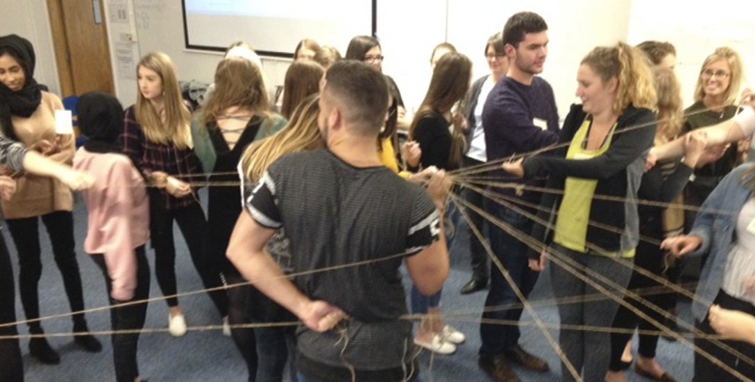

Slide 27
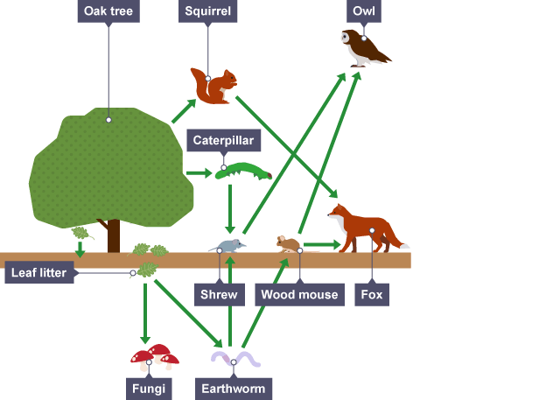
http://www.bbc.co.uk/education/guides/z2m39j6/revision/2

Slide 28
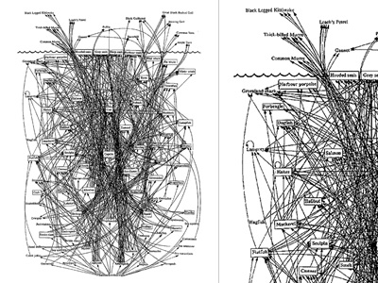
http://www.visualcomplexity.com/vc/project.cfm?id=47

Slide 29
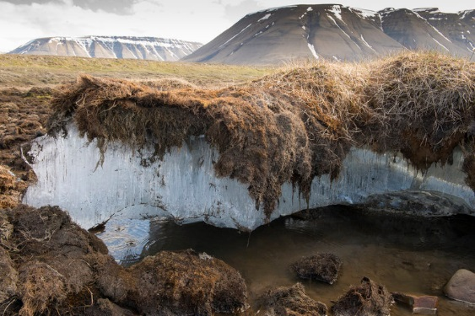
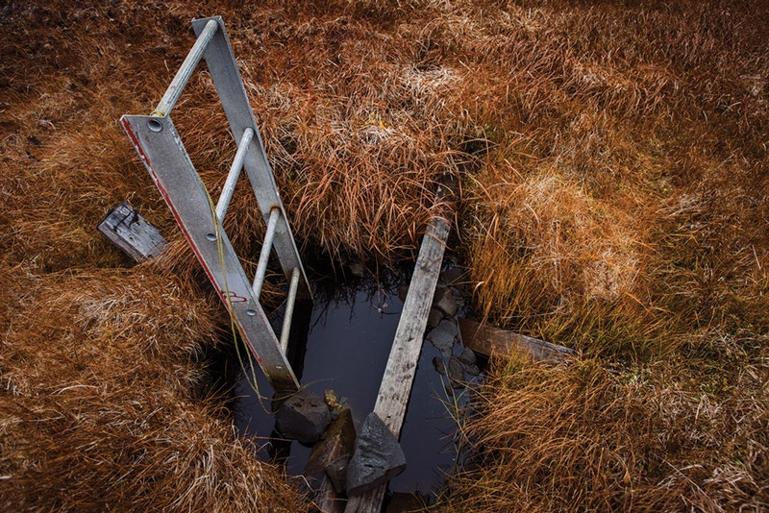
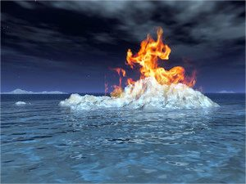

Slide 30
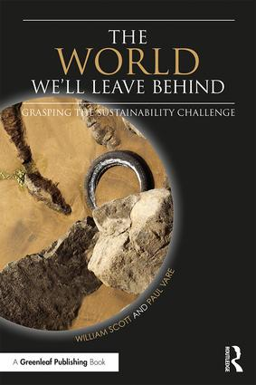

Slide 31
Transdisciplinarity
‘Wicked’ problems are multi-faceted…

Slide 32
There will always be a need for expertise from multiple disciplines

Slide 33
…which demands inter-disciplinary working…

Slide 34
This can still leave key people out of the picture…

Slide 35
…hence the need for trans-disciplinary thinking and working

Slide 36
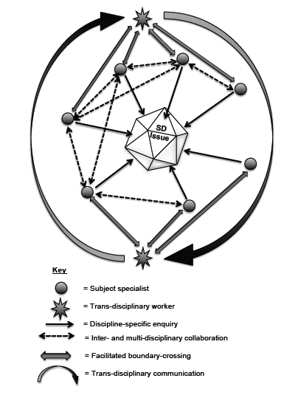
Vare (2014)

Slide 37
Envisioning change
Futures – imagining different possibilities for the future and describing their consequences
Empathy – understanding the centrality of emotions to learning; seeing situations as others do
Innovation – considering new ideas while learning from the past
Responsibility – being personally responsible and transparent in how we work

Slide 38
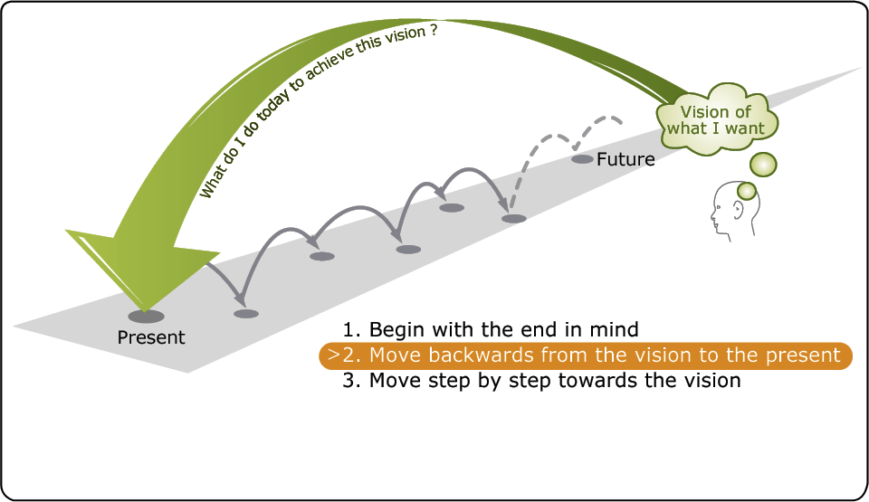
Futures

Slide 39
Hope…
…has multiple dimensions.
Blind hope could be a form of denial, whereas hope founded on evidence can help us act constructively on our fears and anxieties.
(Ojala, 2016)

Slide 40
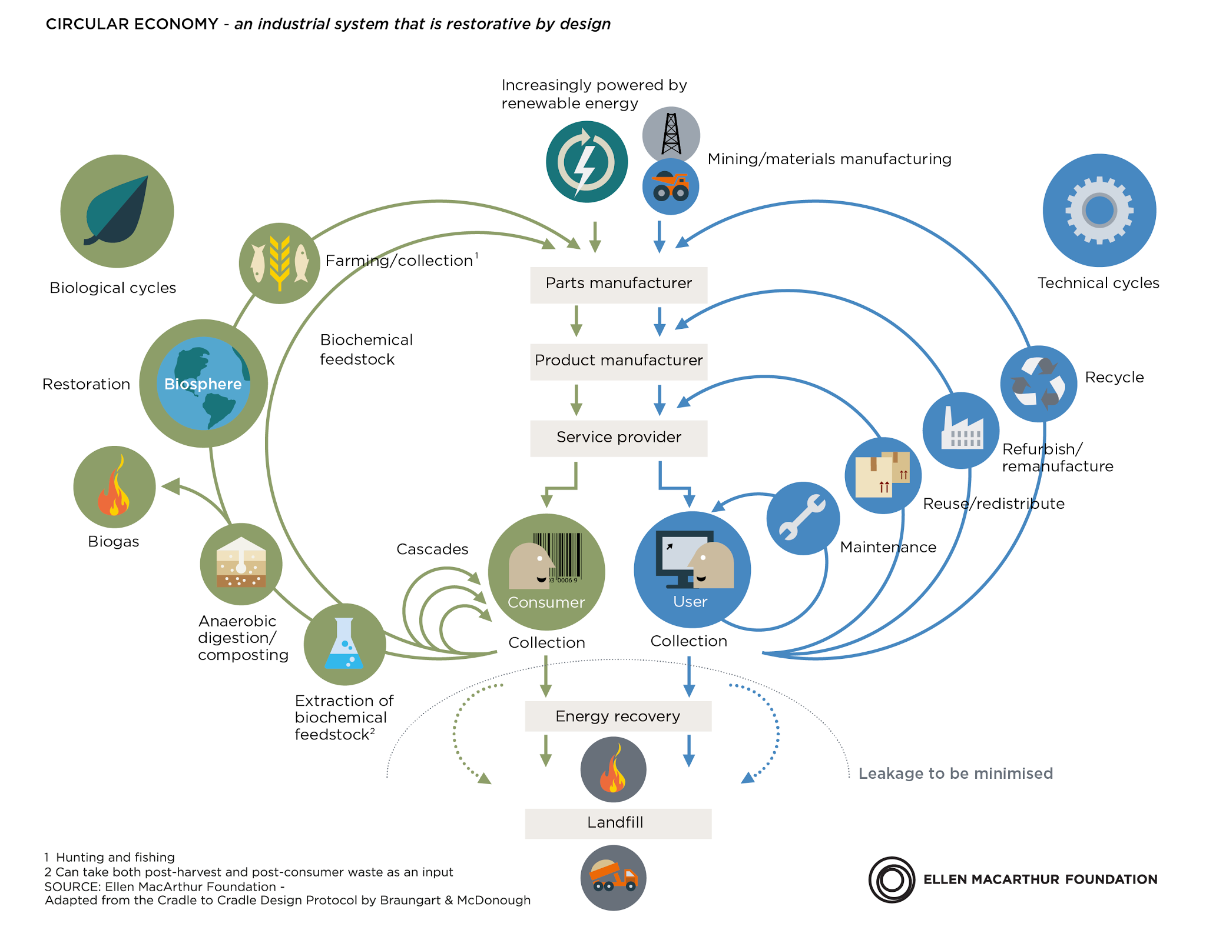
Innovation

Slide 41
Achieving transformation
Participation – collaborating with others to improve the places where we live and work
Engagement – working from ‘who I am’ recognising my values and those held by others
Action – developing agency through involvement in meaningful, community-based change projects
Decisiveness – acting in good time, even when faced with dilemmas or situations of uncertainty.

Slide 42

Human development rests on people
having…
“…the freedom to lead lives that
they have reason to value.”
(Armartya Sen 1999)

Slide 43
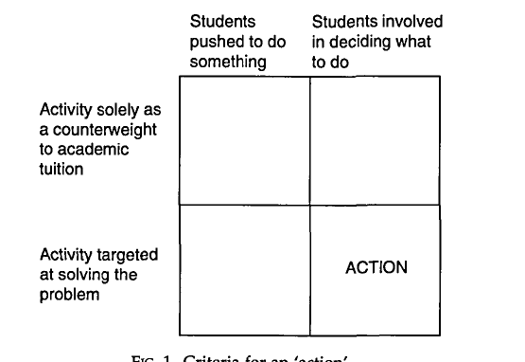
Criteria for ‘action’
’
Jensen & Schnack 1997

Slide 44
I CAP = Innovation capacity – ‘letting go of the learning’

Slide 45
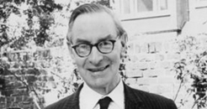

Can you empower another person?
Dr Chad Varah

Slide 46
A word on assessment

Slide 47
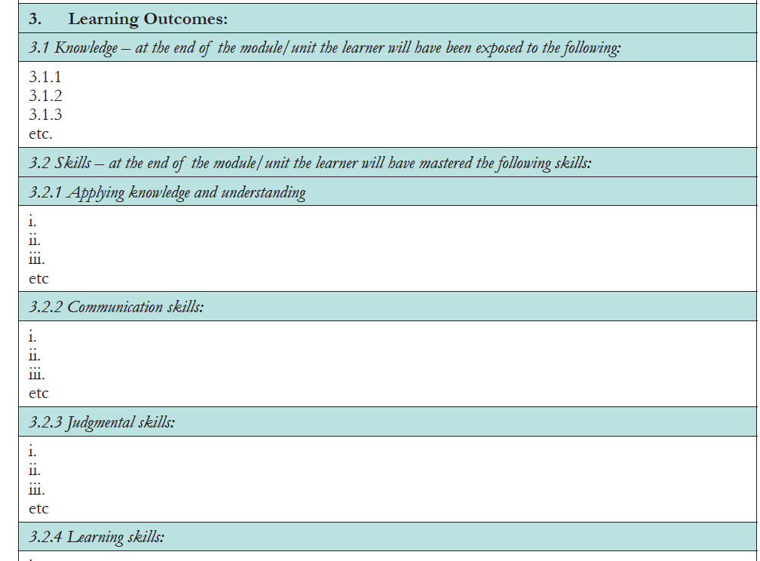
This is one approach to assessment
The atomisation of learning
Notes:
This one approach – the TVET-style template, which we rejected…

Slide 48
Levels of Assessment
Level 1 – The educator uses the competence effectively
Level 2 – The educator reflects on the competence and is able to use it in new contexts
Level 3 – The educator has mastery of the competence, improves it and promotes it among colleagues.

Slide 49
A word of warning: learn to think beyond the competences
Expert teachers act and think differently from novices
Novices require rules and guidelines
Experienced professionals need freedom to develop their own style
“Objectives limit learning…” (John Dewey 1916)

Slide 50
Some closing thoughts

Slide 51
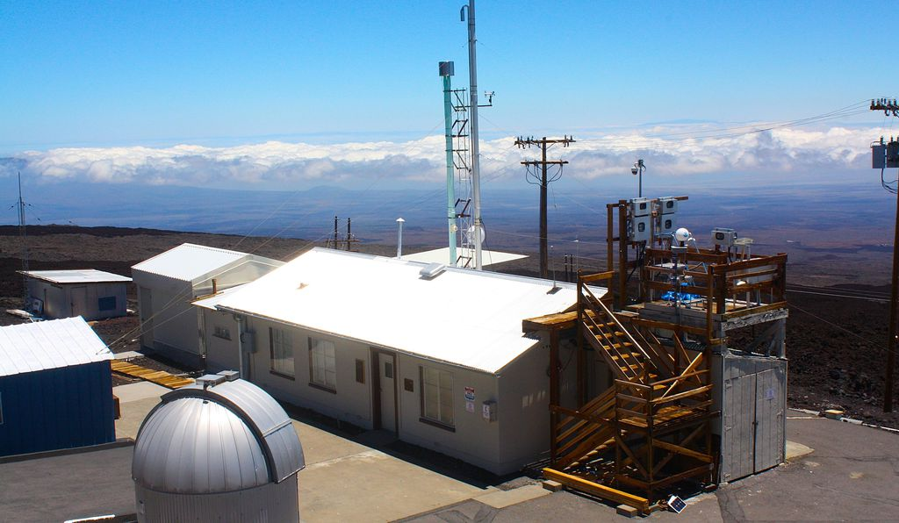

Slide 52
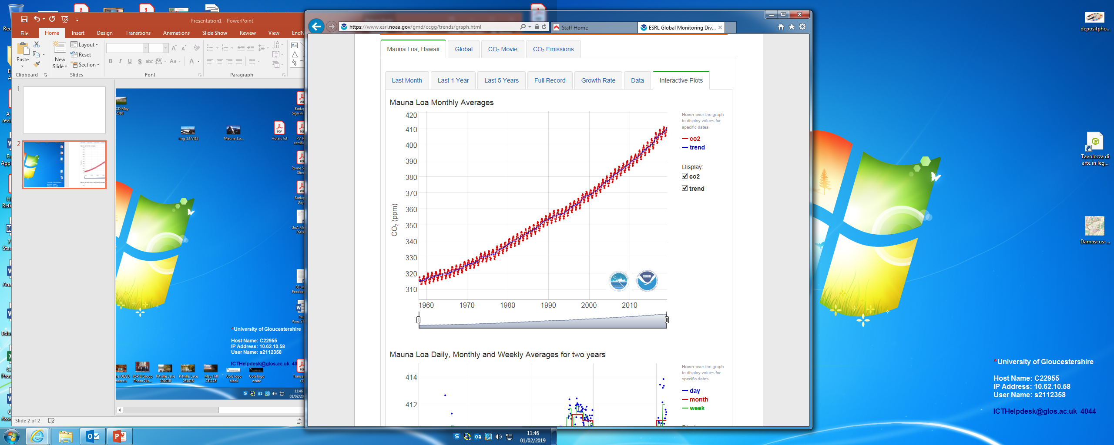
350 ppm – safe level

Slide 53
The four Rs of ‘Deep Adaptation’
Resilience – adapt to survive
Relinquishment – learn to let go
Restoration – rediscover what makes life worth living
Reconciliation between peoples and with our own mortality.
Jem Bendell 2018
Notes:
What this says to me is hold on to your love – for others, for the world – don’t loose sight of love.

Slide 54
There is only love, and then oblivion.
Notes:
“She said it (I love you) over and again before the line went dead. And that is what they were all saying down their phones, from the hijacked planes and the burning towers. There is only love, and then oblivion. Love was all they had to set against the hatred of their murderers.”
https://www.theguardian.com/world/2001/sep/15/september11.politicsphilosophyandsociety2
So… if we are going to survive what’s coming, we need to promote working examples of cooperation, adaptive technologies in food production, etc. for as long as we have the means to do so. Rather than look forward to the demise of others we had better embrace all the hope that the next living person represents. There’s certainly a lot of fear to be encountered, it’s incumbent on all of us as concerned alchemists to transform that fear into love. Whatever fate awaits us, I’d rather die in someone’s arms than at their hands.

Slide 55
Don’t lose sight of hope!
Martin Luther King did NOT say…
“I have a nightmare…”

Slide 56
At the core of the RSP framework:
a critical awareness of connections – and how to nurture them
the importance of relating to others
a positive vision of one’s future – and developing one’s sense of agency in achieving this
the importance of doing something – even if it seems futile!

Slide 58
Notes:
We’re only here a short while – better make the most of it.

Slide 59

Thank you
Questions?
pvare@glos.ac.uk

Slide 60
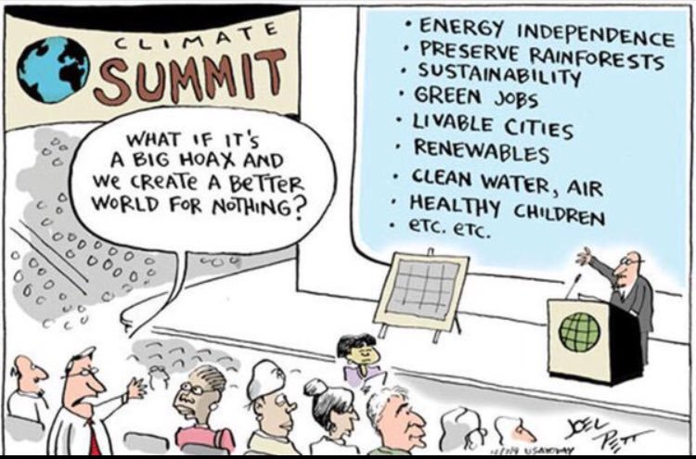

Slide 61
References
A Rounder Sense of Purpose website: www.aroundersenseofpurpose.eu
  Bendell J (2019) The 4th R of Deep Adaptation. Accessed at: https://jembendell.wordpress.com/2019/01/09/hope-and-vision-in-the-face-of-collapse-the-4th-r-of-deep-adaptation
  ENSI-CSCT (2008): Competencies for ESD (Education for Sustainable Development) teachers: A framework to integrate ESD in the curriculum of teacher training institutes. https://platform.ue4sd.eu/downloads/CSCT_Handbook_11_01_08.pdf
  Jensen B B & Schnack K (1997) The Action Competence Approach in Environmental Education, Environmental Education Research, 3:2, 163-178
  Roorda N (2012) Fundamentals of Sustainable Development. London: Earthscan
  Scott W & Vare P (2018) The world we'll leave behind: grasping the sustainability challenge. Abingdon:Routledge
Sen A (1999) Development as Freedom. Oxford: OUP
Wiek, Arnim, Lauren Withycombe, and Charles L. Redman. 2011. Key Competencies in Sustainability: A Reference Framework for Academic Program Development. Sustainability Science 6(2): 203–18
UNECE (2011) Learning for the future: Competences in Education for Sustainable Development. Geneva: UNECE

