Slide 1


Workshop on
Children & Young People's Participation
Dr Azora Hurd
Ph.D Doctoral Research
© (2012)

Slide 2
Young Citizens
“How effectively do public and third sector organisations encourage and engage with children and young people to participate in decision making processes affecting their lives?”

Slide 3

Emerging from the broader national policy agenda for greater citizen participation, which has in resent years seen a significant drive for more ‘listening, participation, empowerment, user involvement, consultation and inclusion’ (Willow, 2002, p. 31),

Slide 4
My research explored these basic questions through an investigation into how the ‘rights of the child’, as expressed in Article 12 of the United Nations Convention of the Rights of the Child (UNCRC 1989), have developed a growing realisation that young people are both a distinct and integral part of the policy initiative.

Slide 5

“I’m smart, you’re dumb, I’m big, you’re little,
I’m right, you’re wrong”
(Roald Dahl)
“I’m smart, you’re dumb”
LACKS RESPECT
“I’m big, you’re little”
INABILITY TO RELATE
“I’m right, you’re wrong”
FAILURE TO RESPOND APPROPRIATELY

Slide 6
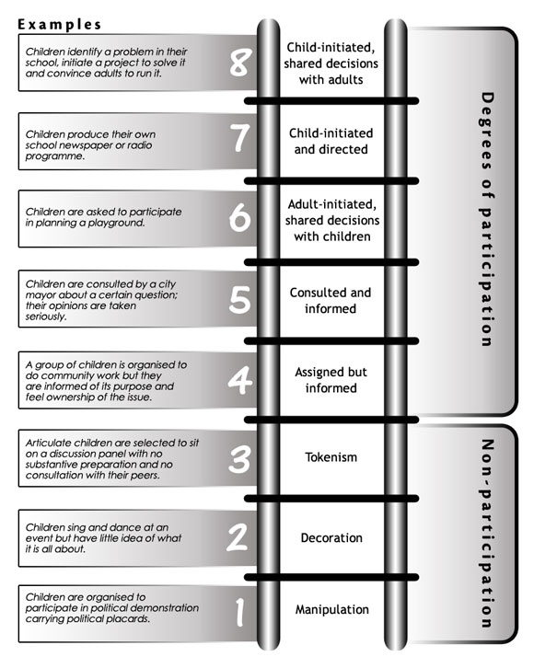
Hart’s ‘Tokenism to Citizenship’ (1992) maps the various degrees in which adults can foster either positive or negative participation levels.
Others Include:
The Mosaic Approach (Clark & Moss, 2008)
Constructing & Reconstructing Childhood (James & Prout, 1997)
Participation in Practice (Willow, 2002)
Childhood and Society—Becoming (Lee, 2005).

Slide 7



The promotion of local democratisation has been a central tenet of the Organisation for Economic Co-operation and Development’s (OECD) global strategy aimed at fostering greater social and political stability. The inclusion of children and young people has emerged as a fundamental building block in the promotion of citizen engagement.
Partnership of equals

Slide 8

“The 3 ‘Rs’ of Awkwardness”
Respect
Relate
Respond
It examines the factors that both inhibit and promote participation with young citizens, through the proposition of a new paradigm shift in the adultism discourse that identifies an awkwardness in the way adults engage with children and young people arising from a lack, or loss, of the skills necessary to respect, relate and respond appropriately to them, which I have coined the “Three R’s of Awkwardness”.

Slide 9
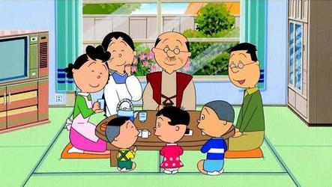
Expressive and Instructive Dialogue
An ‘expressive’ form of communication involve an interactive dialogue in which ideas, suggestions and opinions are exchanged
An ‘Instructive’ form of communication essentially concern a form of communication primarily directed at imparting information.

Slide 10


The Field Research
The research objectives explore, by means of a Participatory Action Research methodology in the form of an Interactive Group Work Programme within a number of case study public and third sector organisations.

Slide 11
